Slide 1
The Book of Titus
The Life of Christians in a Congregation:
“The Knowledge of the Truth
Which Accords With Godliness”
Trinity Lutheran Church Norman, OK. Pastor David Nehrenz
Date: 8-21-16 Study: 8

Slide 2
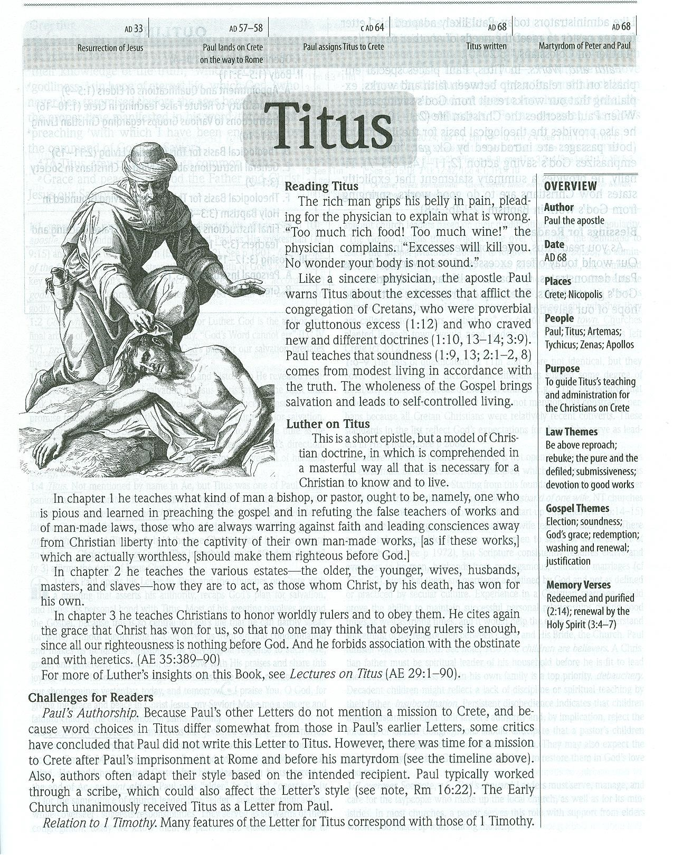

Slide 3
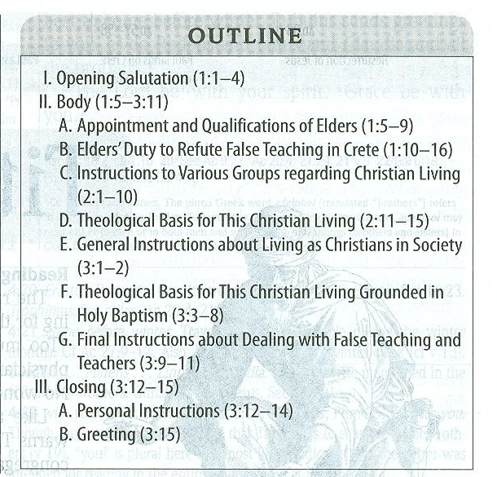

Slide 4
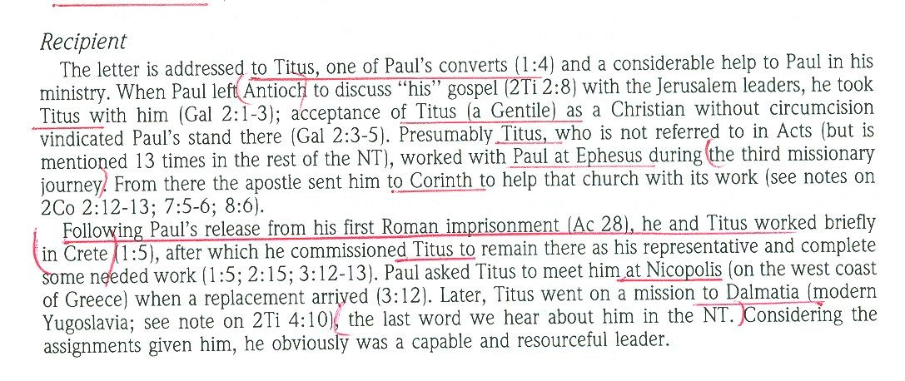

Slide 5
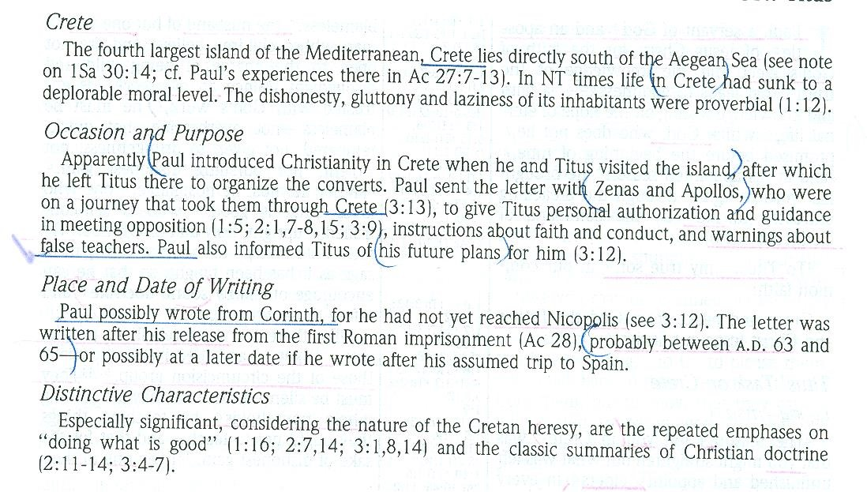

Slide 7
Titus in the New Testament:
(2 Corinthians 2:12-13) When I came to Troas to preach the gospel of Christ, even though a door was opened for me in the Lord, (13) my spirit was not at rest because I did not find my brother Titus there. So I took leave of them and went on to Macedonia.
(2 Corinthians 7:6-7) But God, who comforts the downcast, comforted us by the coming of Titus, (7) and not only by his coming but also by the comfort with which he was comforted by you, as he told us of your longing, your mourning, your zeal for me, so that I rejoiced still more.
(2 Corinthians 7:13-16) Therefore we are comforted. And besides our own comfort, we rejoiced still more at the joy of Titus, because his spirit has been refreshed by you all. (14) For whatever boasts I made to him about you, I was not put to shame. But just as everything we said to you was true, so also our boasting before Titus has proved true. (15) And his affection for you is even greater, as he remembers the obedience of you all, how you received him with fear and trembling. (16) I rejoice, because I have perfect confidence in you.

Slide 8
(2 Corinthians 8:6) Accordingly, we urged Titus that as he had started, so he should complete among you this act of grace.
(2 Corinthians 8:15-24) As it is written, "Whoever gathered much had nothing left over, and whoever gathered little had no lack." (16) But thanks be to God, who put into the heart of Titus the same earnest care I have for you. (17) For he not only accepted our appeal, but being himself very earnest he is going to you of his own accord. (18) With him we are sending the brother who is famous among all the churches for his preaching of the gospel. (19) And not only that, but he has been appointed by the churches to travel with us as we carry out this act of grace that is being ministered by us, for the glory of the Lord himself and to show our good will. (20) We take this course so that no one should blame us about this generous gift that is being administered by us, (21) for we aim at what is honorable not only in the Lord's sight but also in the sight of man. (22) And with them we are sending our brother whom we have often tested and found earnest in many matters, but who is now more earnest than ever because of his great confidence in you. (23) As for Titus, he is my partner and fellow worker for your benefit. And as for our brothers, they are messengers of the churches, the glory of Christ. (24) So give proof before the churches of your love and of our boasting about you to these men.

Slide 9
(2 Corinthians 12:18) I urged Titus to go, and sent the brother with him. Did Titus take advantage of you? Did we not act in the same spirit? Did we not take the same steps?
(Galatians 2:1-3) Then after fourteen years I went up again to Jerusalem with Barnabas, taking Titus along with me. (2) I went up because of a revelation and set before them (though privately before those who seemed influential) the gospel that I proclaim among the Gentiles, in order to make sure I was not running or had not run in vain. (3) But even Titus, who was with me, was not forced to be circumcised, though he was a Greek.
(2 Timothy 4:10-12) For Demas, in love with this present world, has deserted me and gone to Thessalonica. Crescens has gone to Galatia, Titus to Dalmatia. (11) Luke alone is with me. Get Mark and bring him with you, for he is very useful to me for ministry. (12) Tychicus I have sent to Ephesus.

Slide 10
C. THE PERSON OF TITUS
His relics, now consisting of only his skull, are venerated in the Church of St. Titus, Heraklion, Crete to which it was returned in 1966 after being removed to Venice during the Turkish occupation.
St. Titus is the patron saint of the United States Army Chaplain Corps. The Corps has established the Order of Titus Award. According to the Department of Defense, the "Order of Titus award is the only award presented by the Chief of Chaplains to recognize outstanding performance of ministry by chaplains and chaplain assistants. The Order of Titus is awarded for meritorious contributions to the unique and highly visible Unit Ministry Team Observer Controller Program. The award recognizes the great importance of realistic, doctrinally guided combat ministry training in ensuring the delivery of prevailing religious support to the American Soldier."

Slide 11
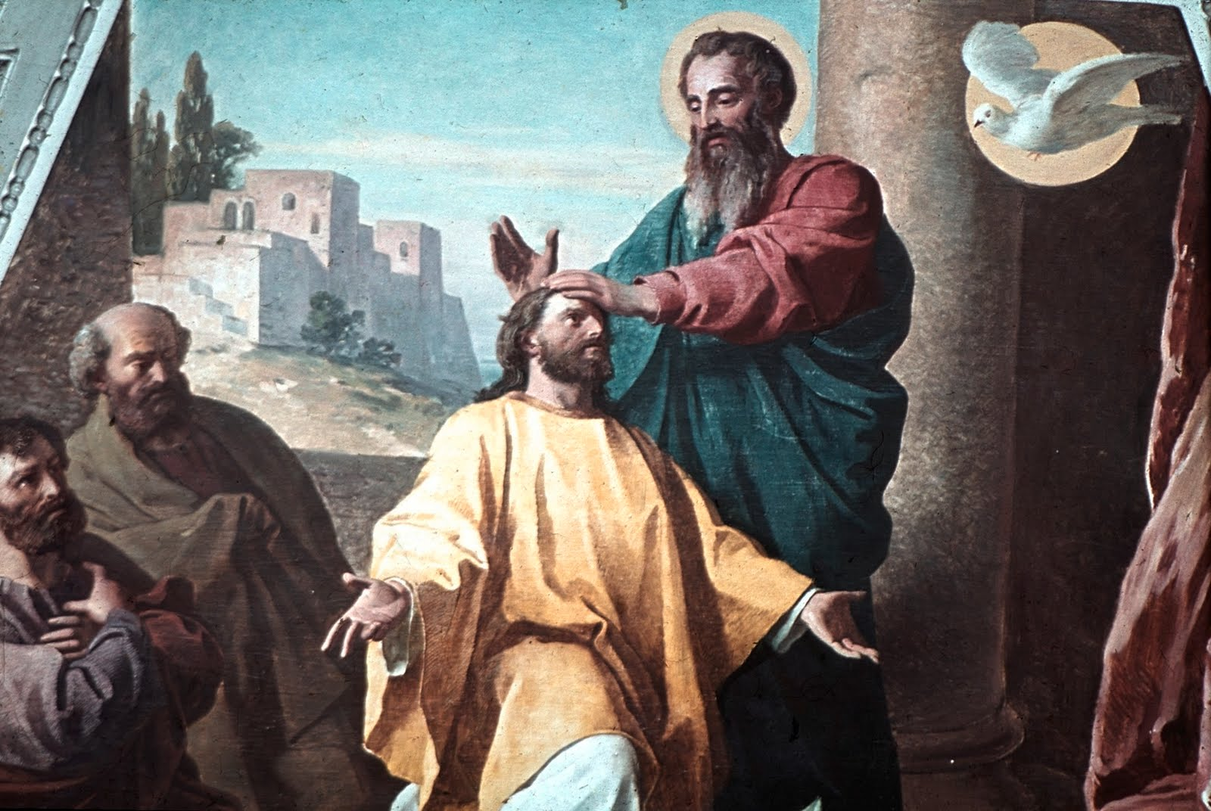

Slide 12
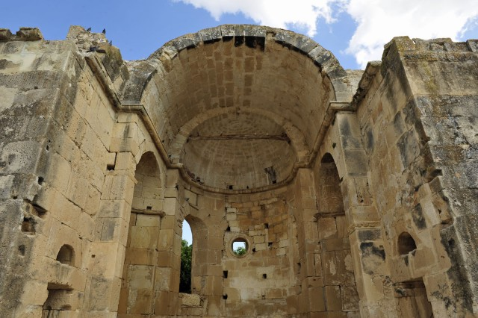

Slide 13
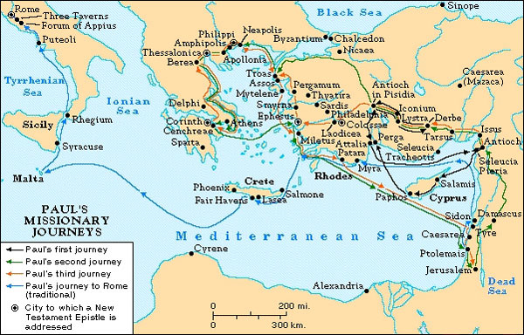

Slide 14
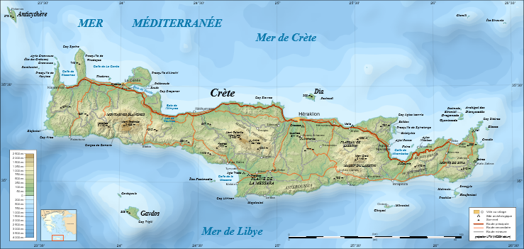

Slide 15
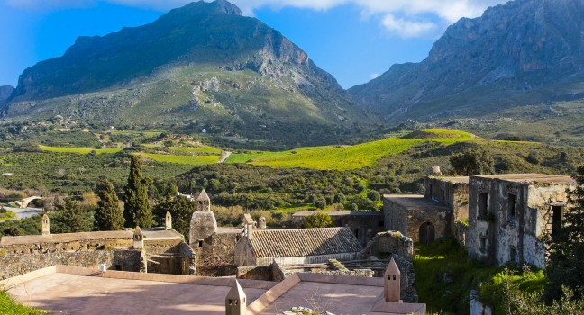

Slide 16
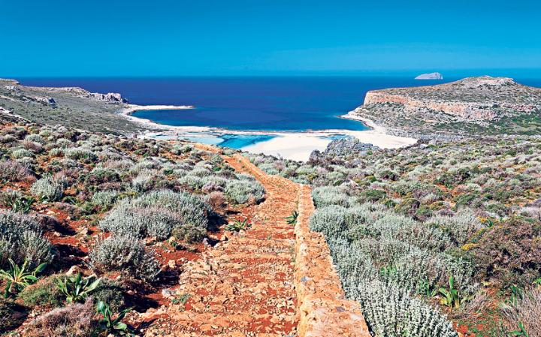

Slide 17
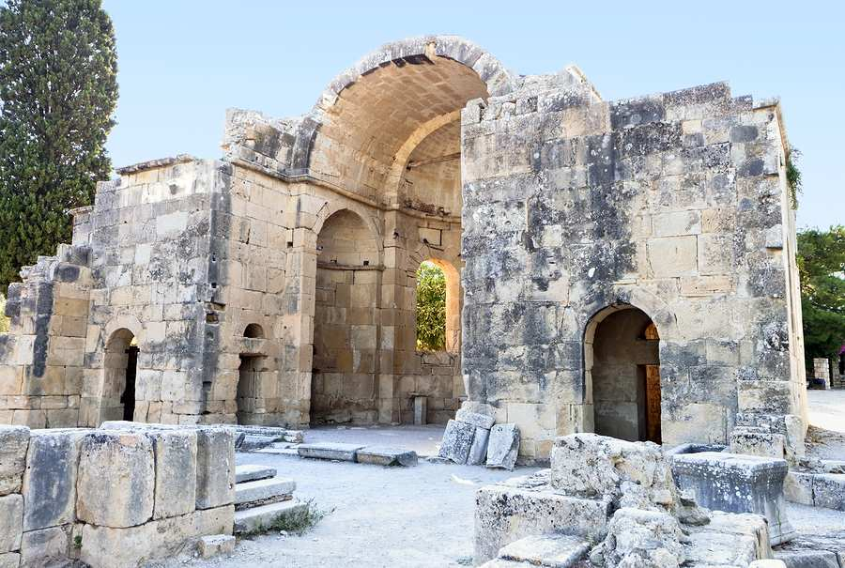

Slide 18
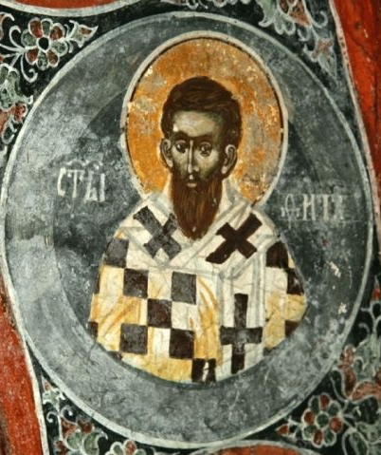

Slide 19
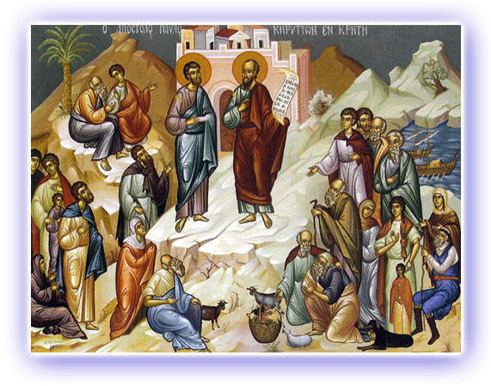

Slide 20
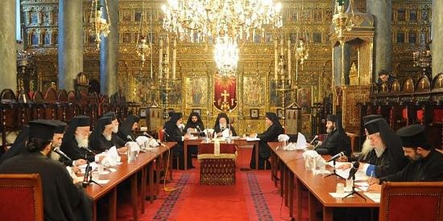

Slide 21
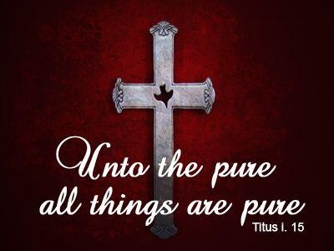

Slide 22
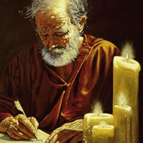

Slide 23
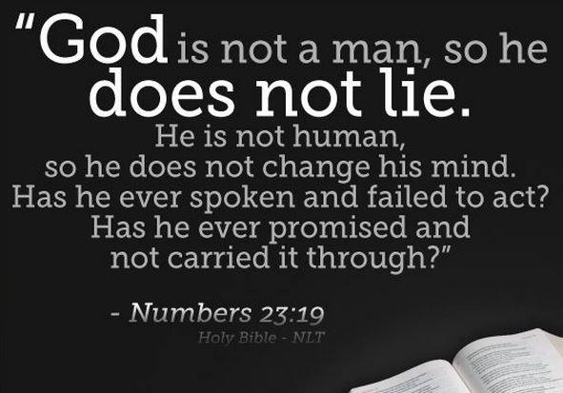

Slide 24
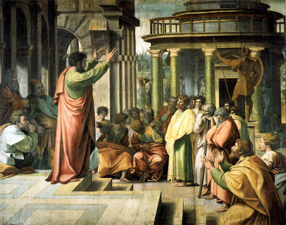

Slide 25
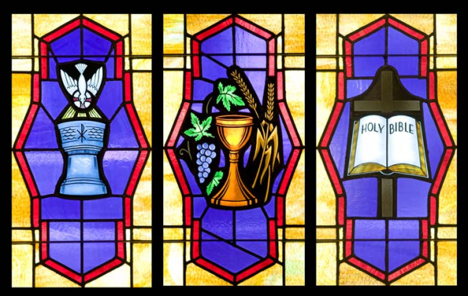

Slide 26


Slide 27
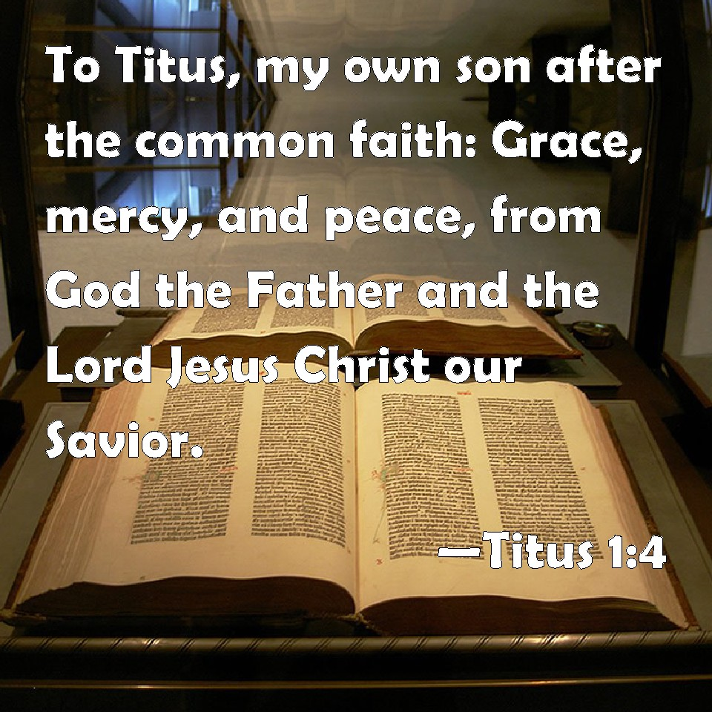

Slide 28
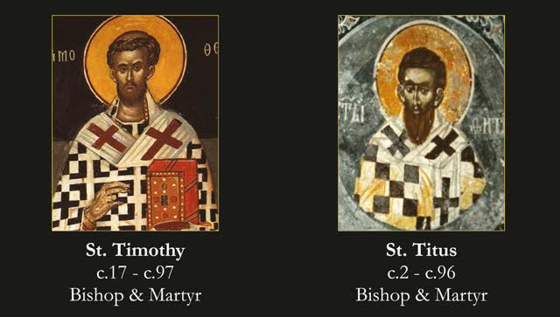

Slide 29
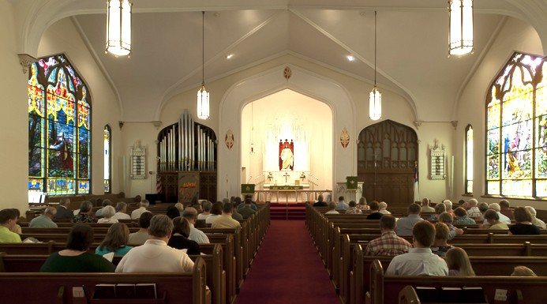

Slide 30
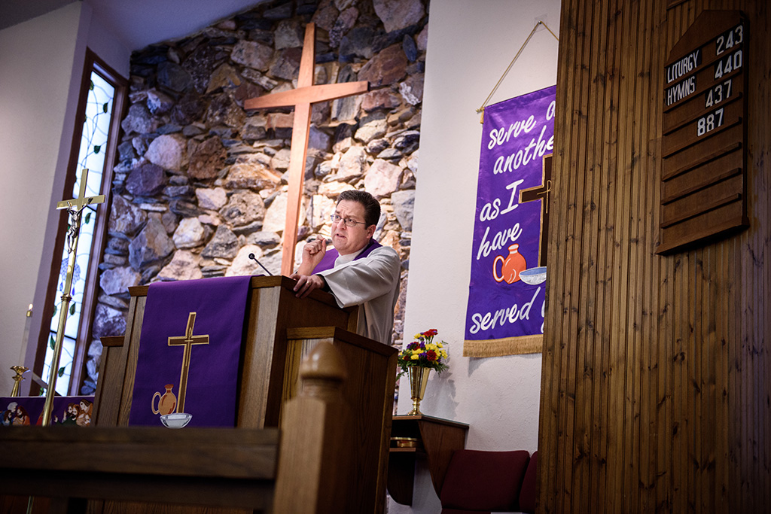

Slide 31
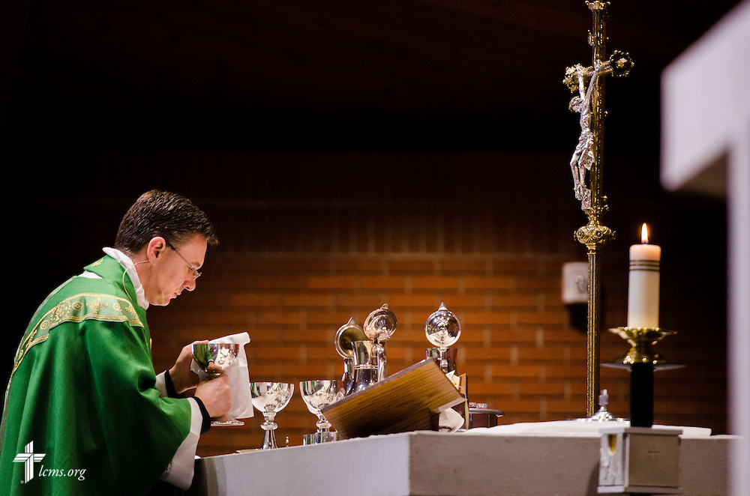

Slide 32
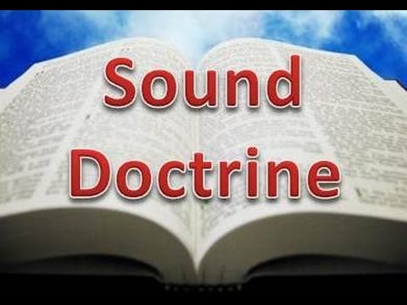

Slide 33
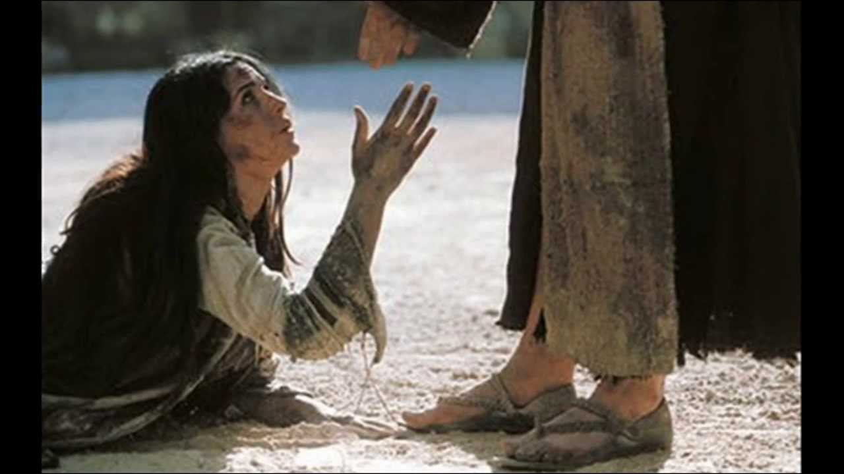

Slide 34


Slide 35
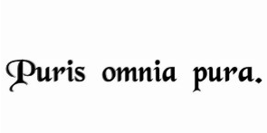

Slide 36
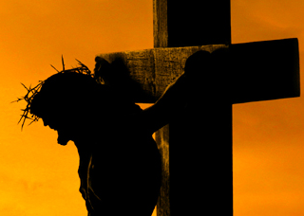

Slide 37
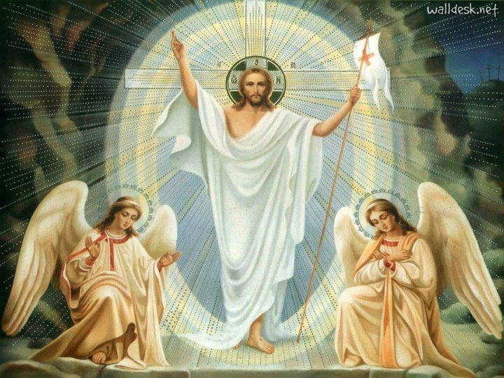

Slide 38
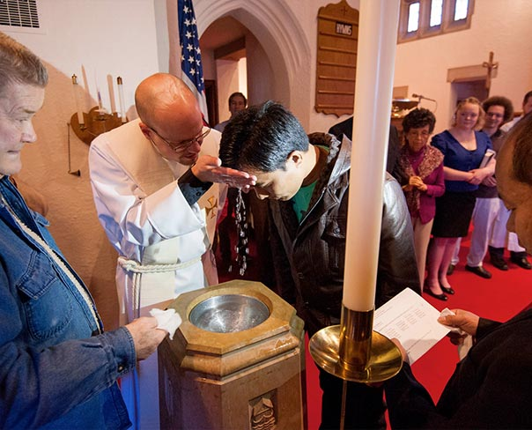

Slide 39
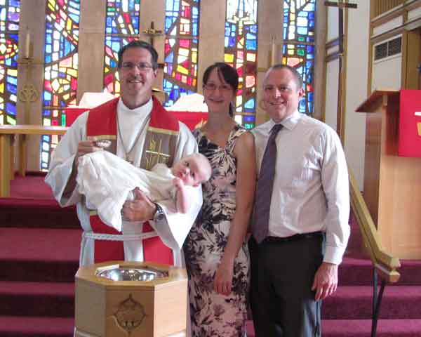

Slide 40
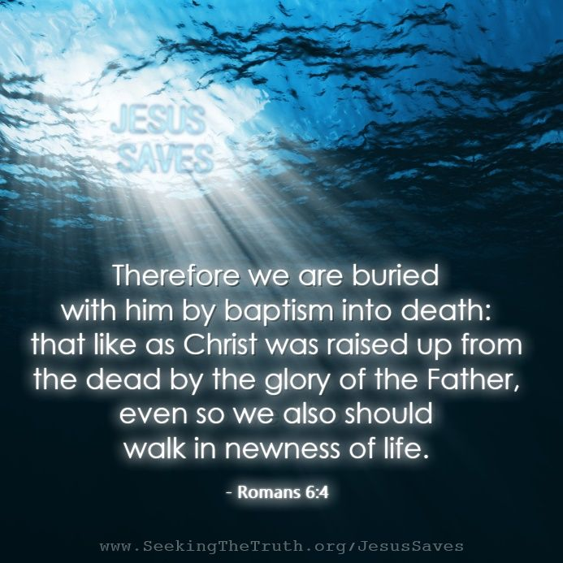

Slide 41
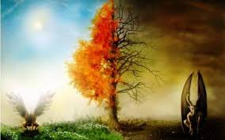

Slide 42
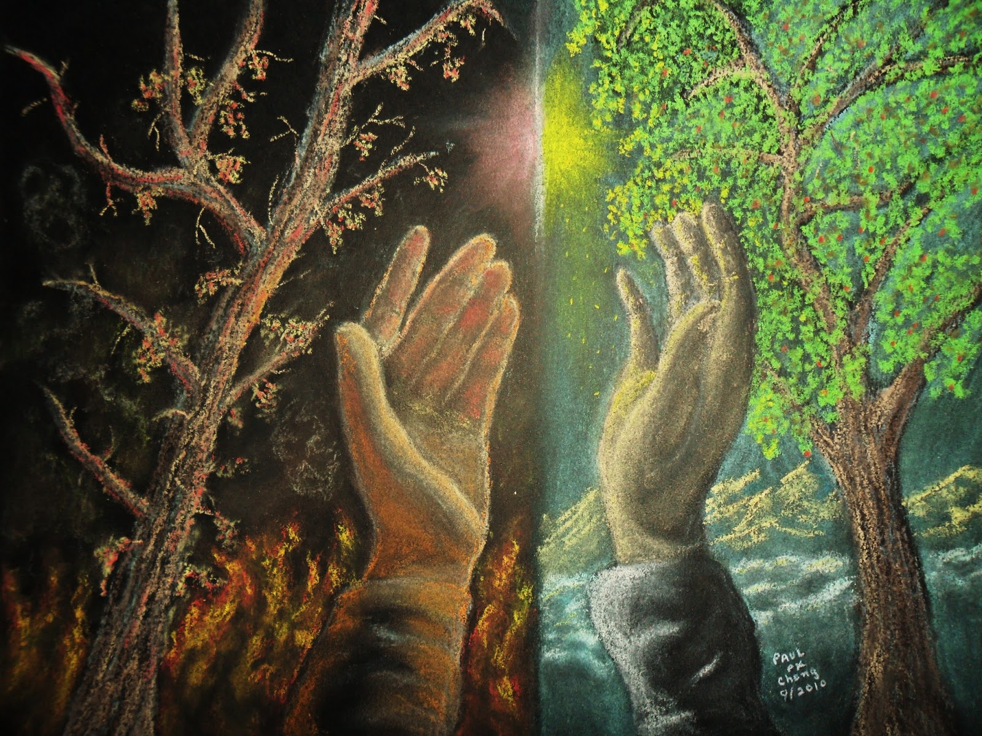

Slide 43
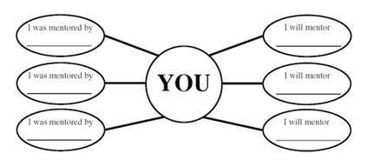

Slide 44
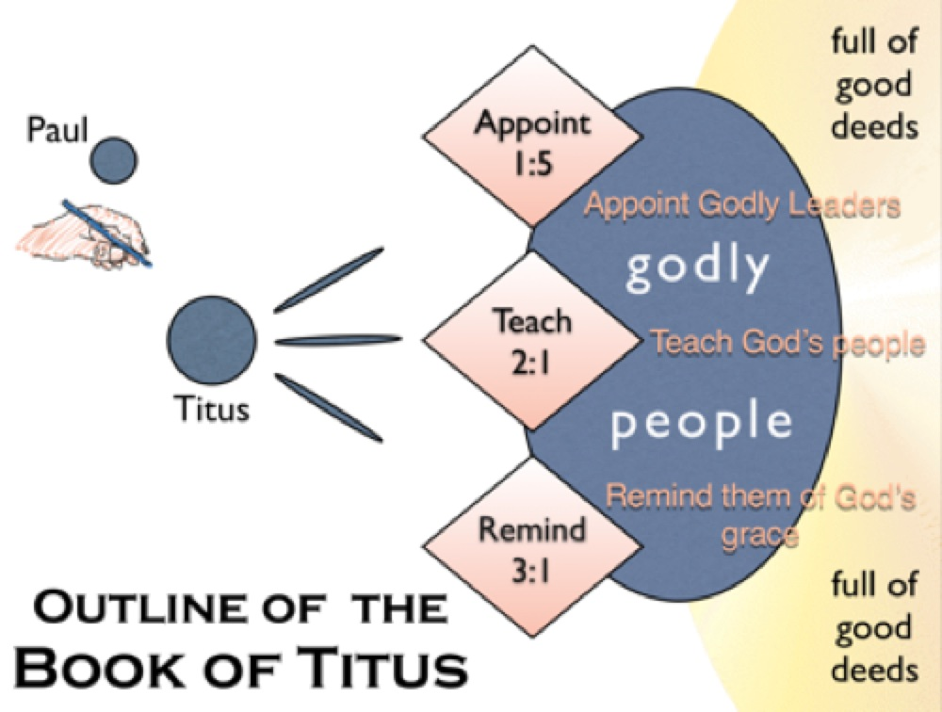

Slide 45


Slide 46
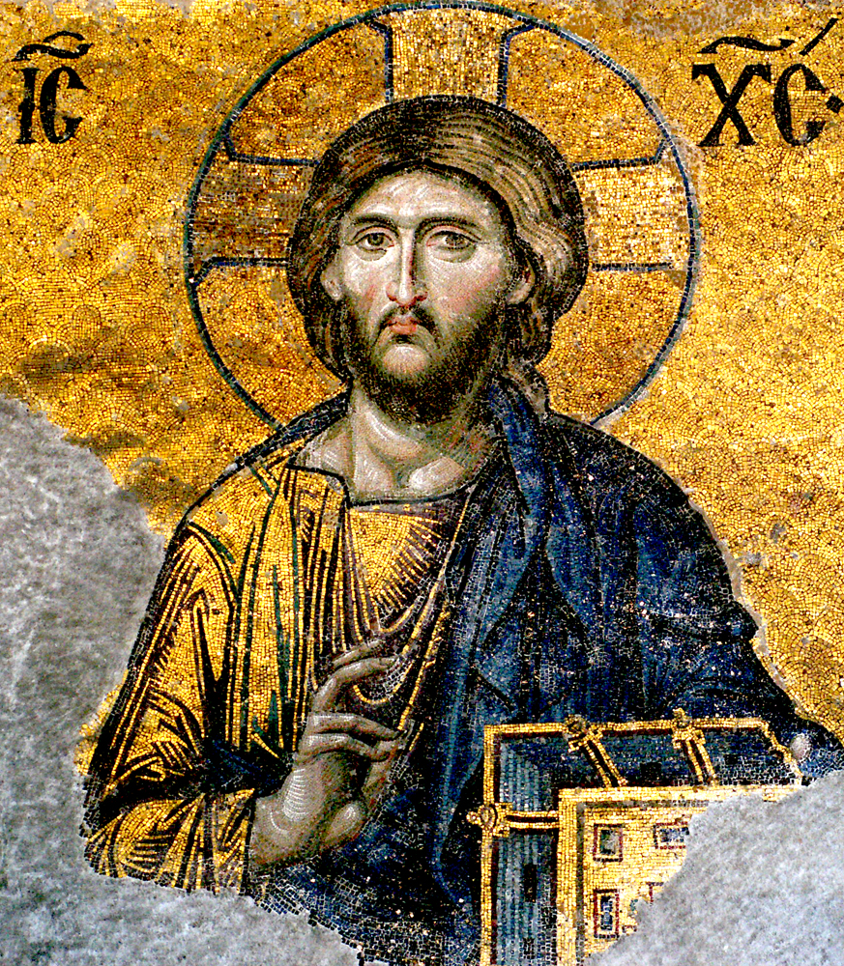

Slide 47
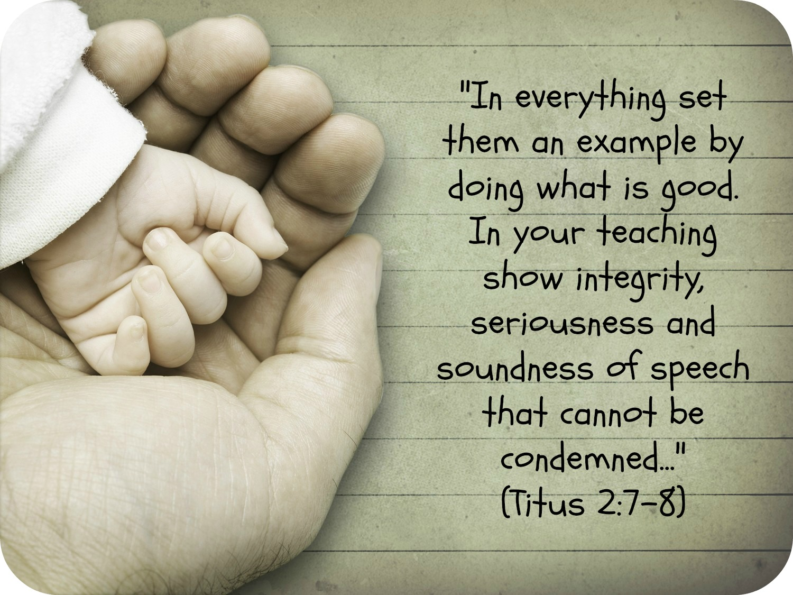

Slide 48


Slide 49
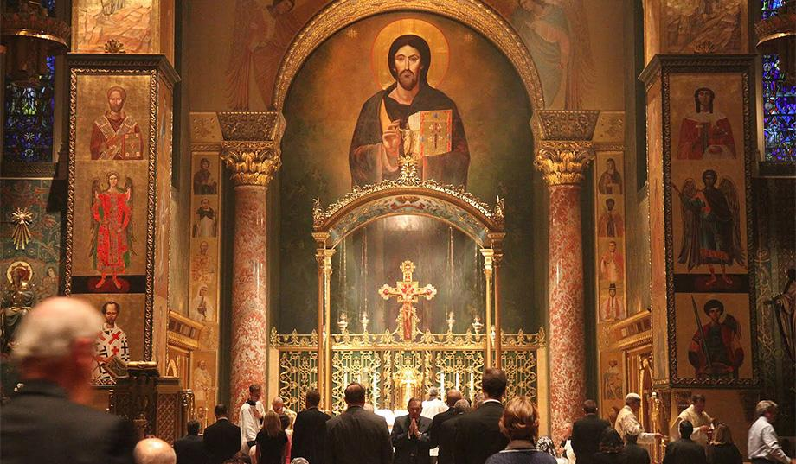

Slide 50
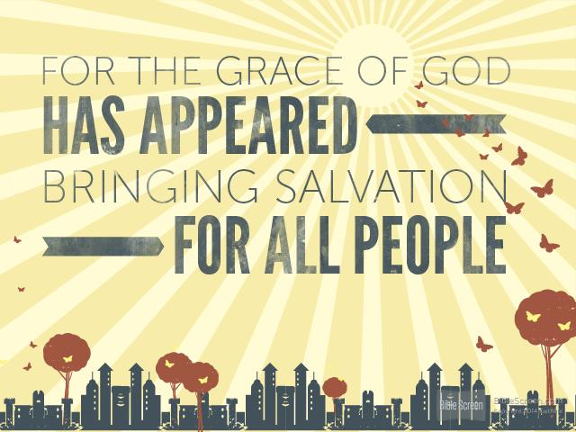

Slide 51
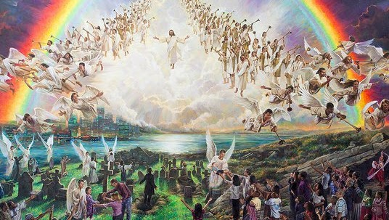

Slide 52
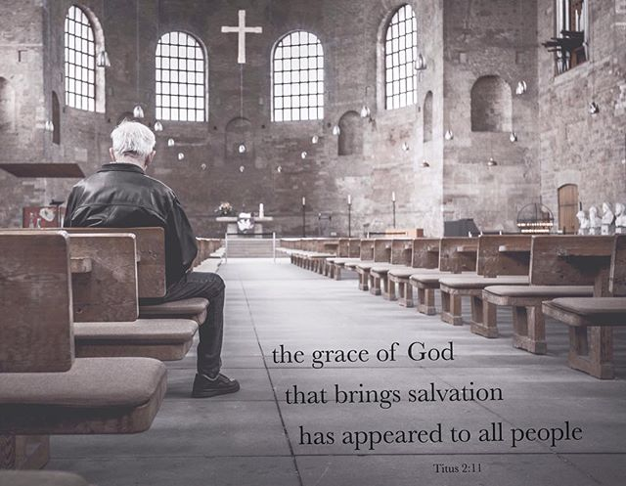

Slide 53
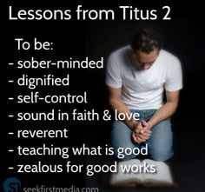

Slide 54
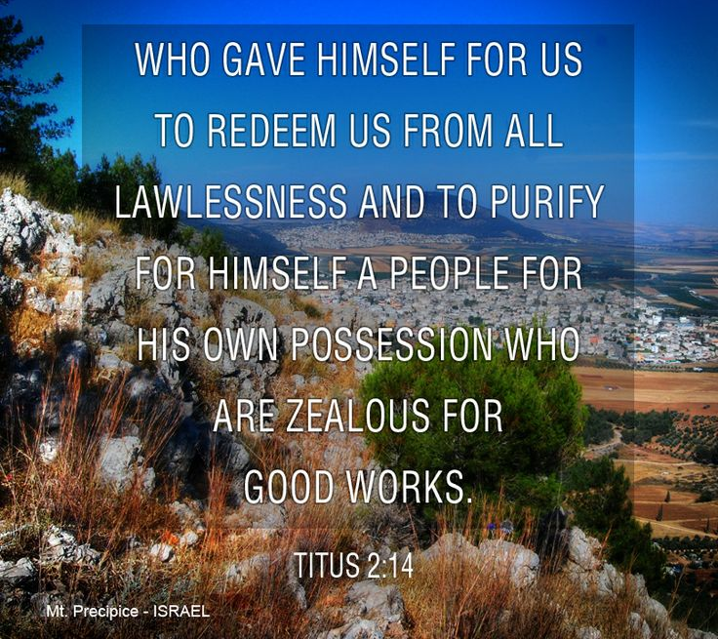

Slide 55
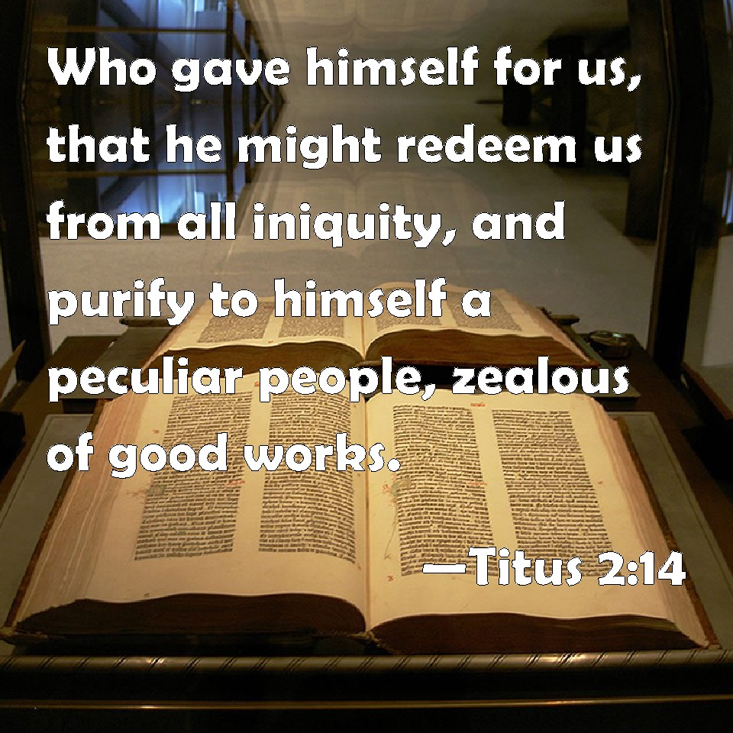

Slide 56
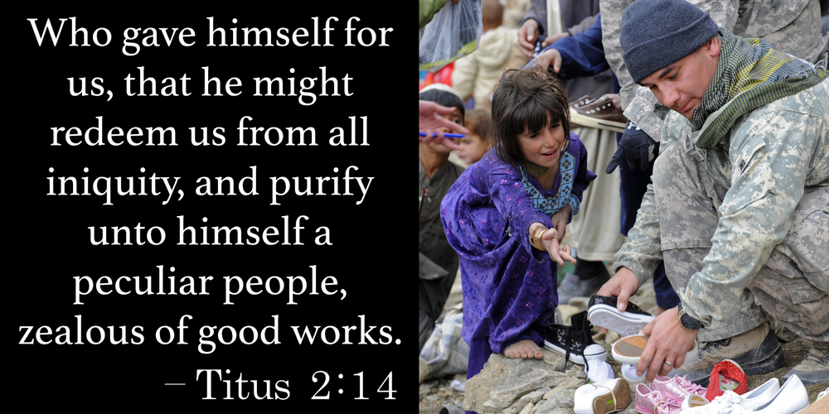

Slide 57
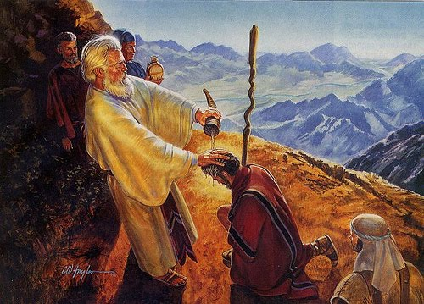

Slide 58
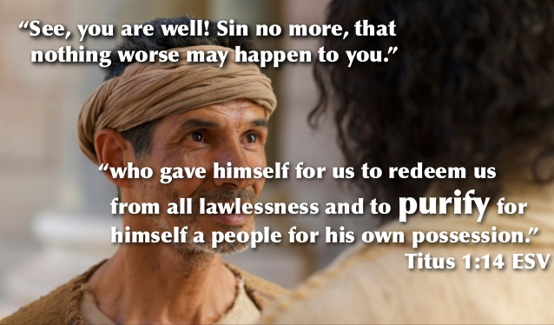

Slide 59
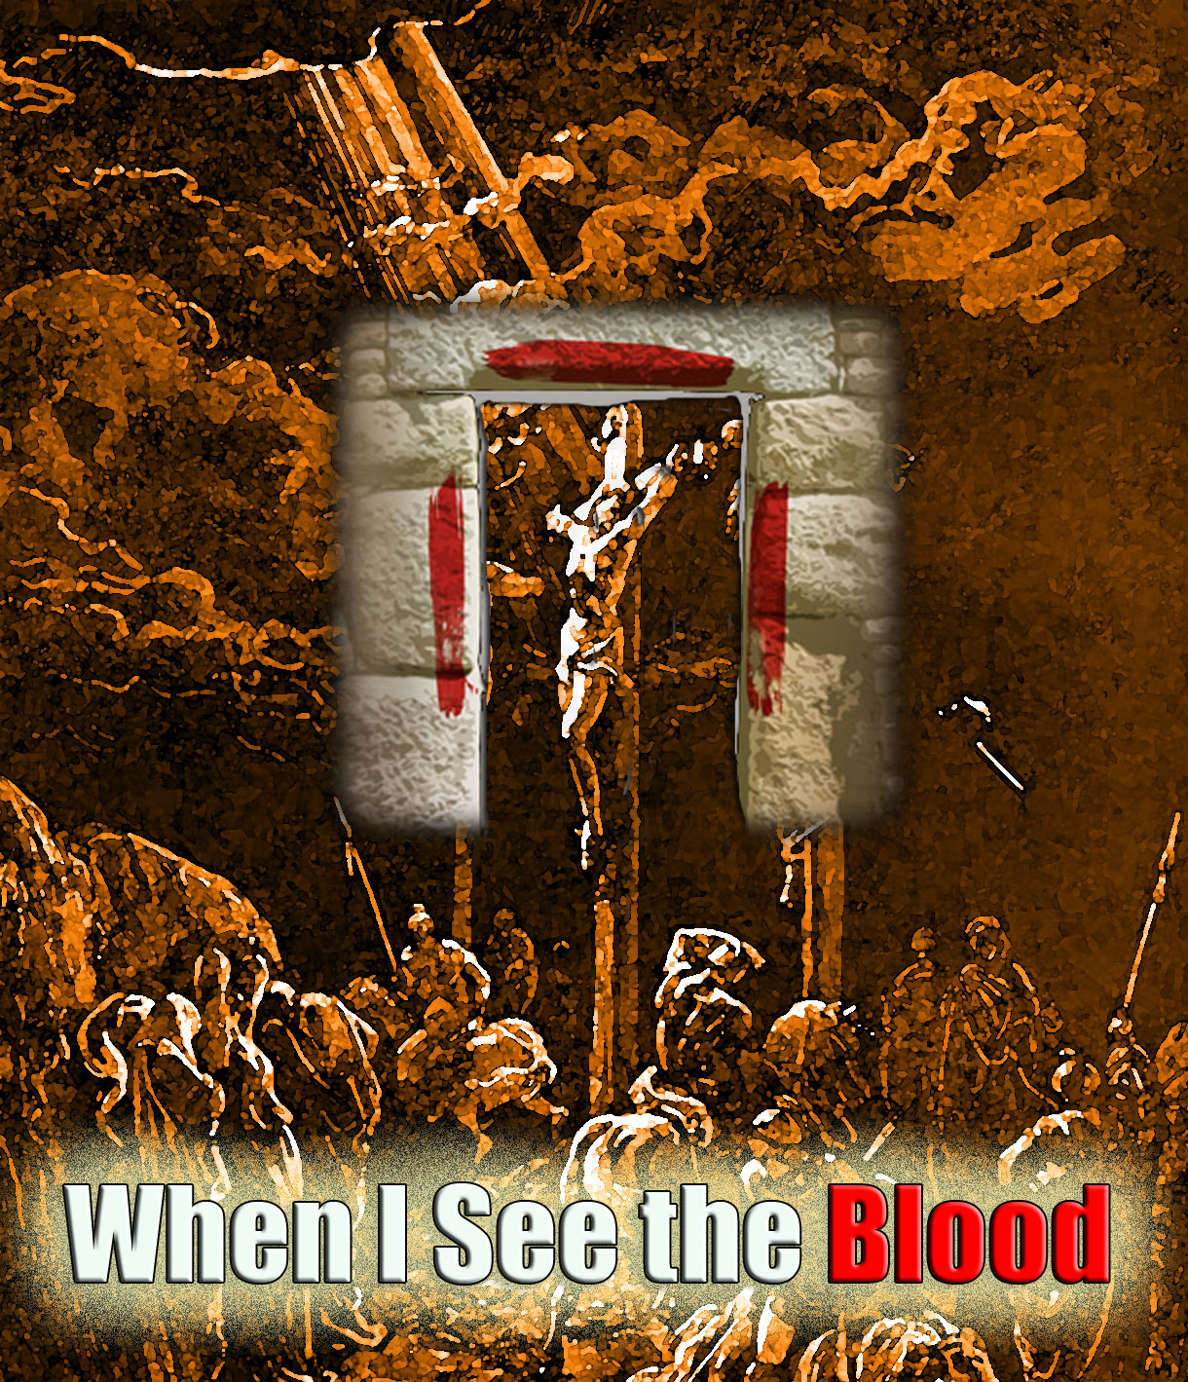

Slide 60
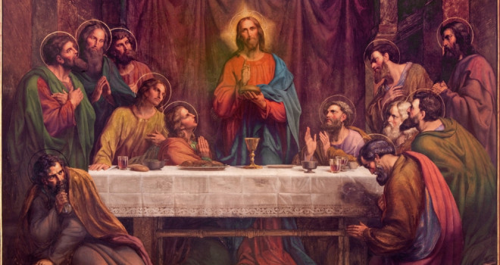

Slide 61
(Titus 3:1-15)
(1) Remind them to be submissive to rulers and authorities, to be obedient, to be ready for every good work, (2) to speak evil of no one, to avoid quarreling, to be gentle, and to show perfect courtesy toward all people. (3) For we ourselves were once foolish, disobedient, led astray, slaves to various passions and pleasures, passing our days in malice and envy, hated by others and hating one another.
(4) But when the goodness and loving kindness of God our Savior appeared, (5) he saved us, not because of works done by us in righteousness, but according to his own mercy, by the washing of regeneration and renewal of the Holy Spirit, (6) whom he poured out on us richly through Jesus Christ our Savior, (7) so that being justified by his grace we might become heirs according to the hope of eternal life.

Slide 62
B. THE STUDY NOTES
Rulers and authorities – be submissive and obedient
(Rom 13:1-7; 1 Pet 2:13-17; 2 Tim 2:21)
2. Our civic duties:
-To be ready for every good work,
(Eph 2:10; 2 Tim 3:17)
-to speak evil of no one, (Eph 4:31)
-to avoid quarreling, (1 Tim 3:3)
-to be gentle,
(Gal 6:1; Eph 4:2; Php 4:5)
-to show perfect courtesy toward all people.
(2 Tim 2:25)

Slide 63
3. The works of the old Adam –
-For we ourselves were once foolish, disobedient, led astray, (1 Cor 6:11)
-slaves to various passions and
pleasures,
(Eph 2:2; 4:17,18; 5:8)
-passing our days in malice and envy,
hated by others and hating one
another.

Slide 64
4. When the goodness and loving kindness of God our Savior appeared
(The Gospel):
(Lk 1:47; Rom 2:4; Eph 2:7; 1 Jn 4:9)
-He saved us, not because of works done by us in righteousness, but according to his own mercy,
(Rom 3:27; 11:14; Eph 2:4,8,9; 2 Tim 1:9; 1 Pet 1:3)
-by the washing of regeneration and renewal of the Holy Spirit,
(John 3:5; Rom 12:2; 1 Cor 6:11; 1 Pet 3:21) whom he poured out on us richly through Jesus Christ our Savior,
(Joel 2:28; 3:1; Ezek 36:25; Jn 7:39;
Acts 2:33; 10:45; 22:16; Rom 5:5; 12:2; Eph 5:26)
BAPTISM:
-so that being justified by his grace
(Rom 3:24; 5:1)
-we might become heirs according to the hope of eternal life
(Mt 25:46; Rom 8:17-24)

Slide 65
Luther’s Small Catechism:
- The Power of Baptism – Third Part:
How can water do such great things?
Certainly not just water, but the word of God in and with the water does these things, along with the faith which trusts this word of God in the water. For without God's word the water is plain water and no Baptism. But with the word of God it is a Baptism, that is, a life-giving water, rich in grace, and a washing of the new birth in the Holy Spirit, as St. Paul says in Titus chapter three:
"He saved us through the washing of rebirth and renewal by the Holy Spirit, whom He poured out on us generously through Jesus Christ our Savior, so that, having been justified by His grace, we might become heirs having the hope of eternal life. This is a trustworthy saying." [Titus 3:5-8]

Slide 66
C. LIFE APPLICATION
1. Why is it essential that we as Christians be submissive to rulers and authorities, and be obedient?
Note: The Kingdom of the Left – The State and Government.
2. How does the old Adam reveal itself in us as slaves to various passions and pleasures? Note: Sinful nature
3. Who is for us the goodness and loving kindness of God our Savior which has appeared?
Note: The Incarnation
4. When was the washing of regeneration and renewal of the Holy Spirit, poured out on you richly through Jesus Christ our Savior? Note: The date of your baptism
5. If you are justified by his grace and have become heirs according to the hope of eternal life, in what ways does this shape your everyday life? Note: Eternal inheritance

Slide 67


Slide 68


Slide 69


Slide 70


Slide 71


Slide 72


