Slide 1
The Book of Titus
The Life of Christians in a Congregation:
“The Knowledge of the Truth
Which Accords With Godliness”
Trinity Lutheran Church Norman, OK. Pastor David Nehrenz
Date: 7-31-16 Study: 5

Slide 2
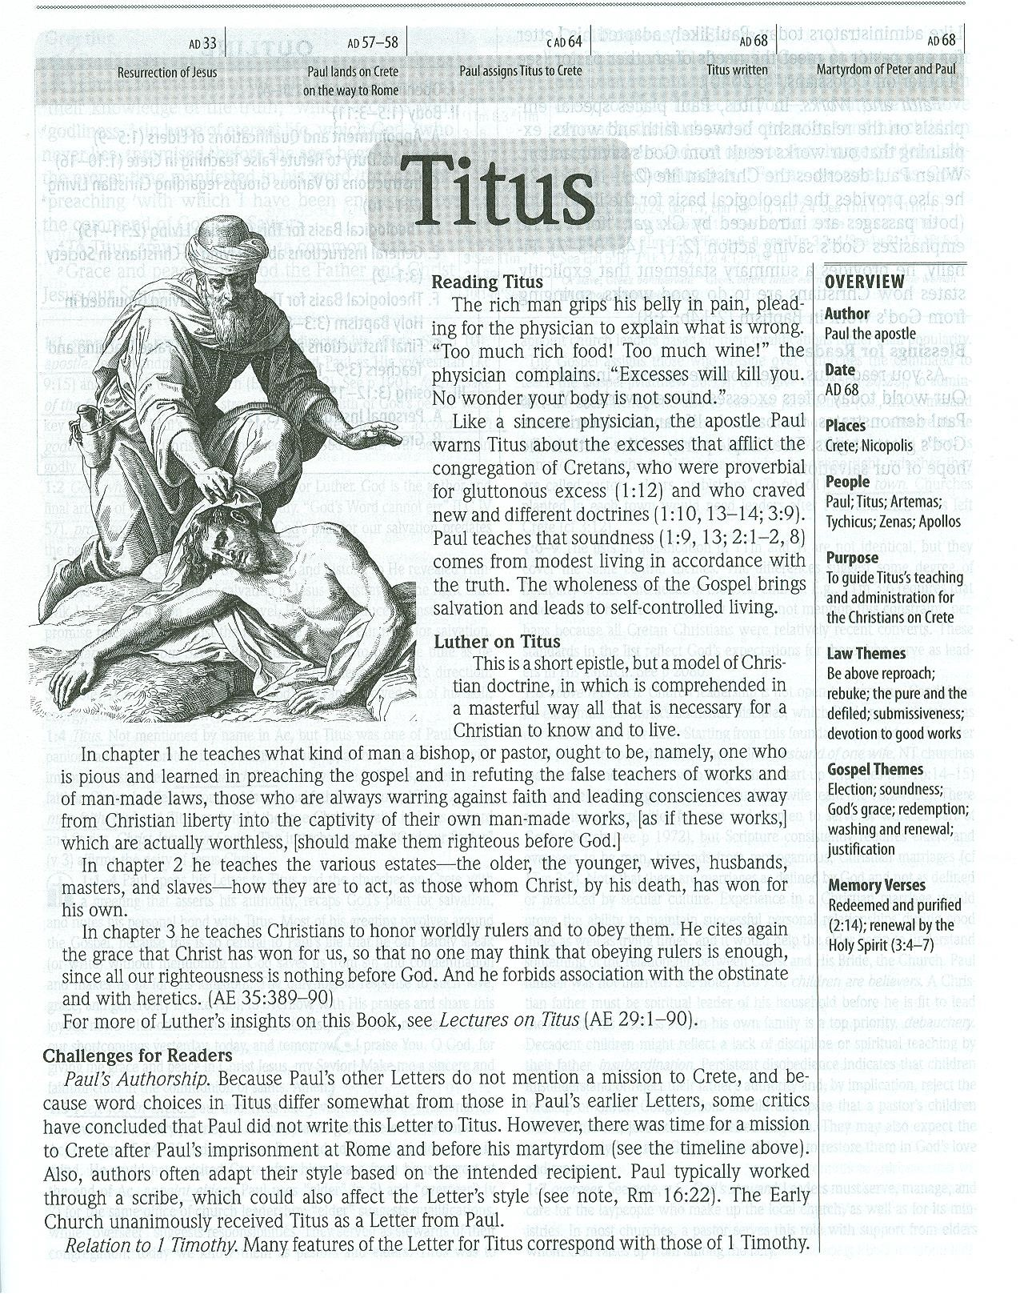

Slide 3
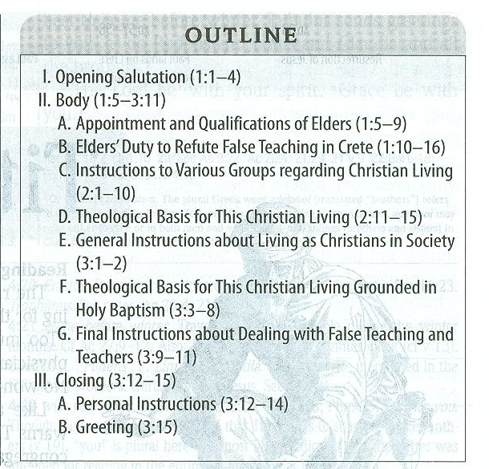

Slide 4
A. THE TEXT (Titus 2)
(1) But as for you, teach what accords with sound doctrine.
(2) Older men are to be sober-minded, dignified, self-controlled, sound in faith, in love, and in steadfastness.
(3) Older women likewise are to be reverent in behavior, not slanderers or slaves to much wine. They are to teach what is good, (4) and so train the young women to love their husbands and children, (5) to be self-controlled, pure, working at home, kind, and submissive to their own husbands, that the word of God may not be reviled.
(6) Likewise, urge the younger men to be self-controlled. (7) Show yourself in all respects to be a model of good works, and in your teaching show integrity, dignity, (8) and sound speech that cannot be condemned, so that an opponent may be put to shame, having nothing evil to say about us.
(9) Slaves are to be submissive to their own masters in everything; they are to be well-pleasing, not argumentative, (10) not pilfering, but showing all good faith, so that in everything they may adorn the doctrine of God our Savior.

Slide 5
(11) For the grace of God has appeared, bringing salvation for all people, (12) training us to renounce ungodliness and worldly passions, and to live self-controlled, upright, and godly lives in the present age, (13) waiting for our blessed hope, the appearing of the glory of our great God and Savior Jesus Christ, (14) who gave himself for us to redeem us from all lawlessness and to purify for himself a people for his own possession who are zealous for good works.
(15) Declare these things; exhort and rebuke with all authority. Let no one disregard you.

Slide 6
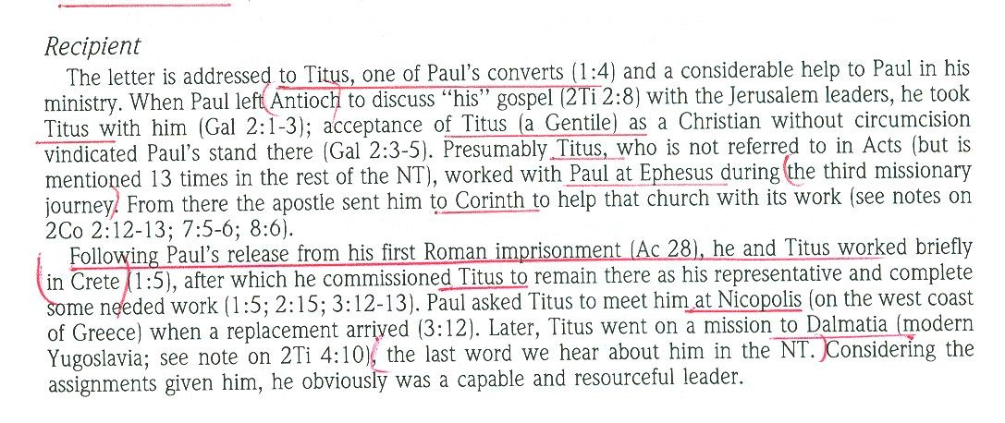
B. THE STUDY NOTES

Slide 7
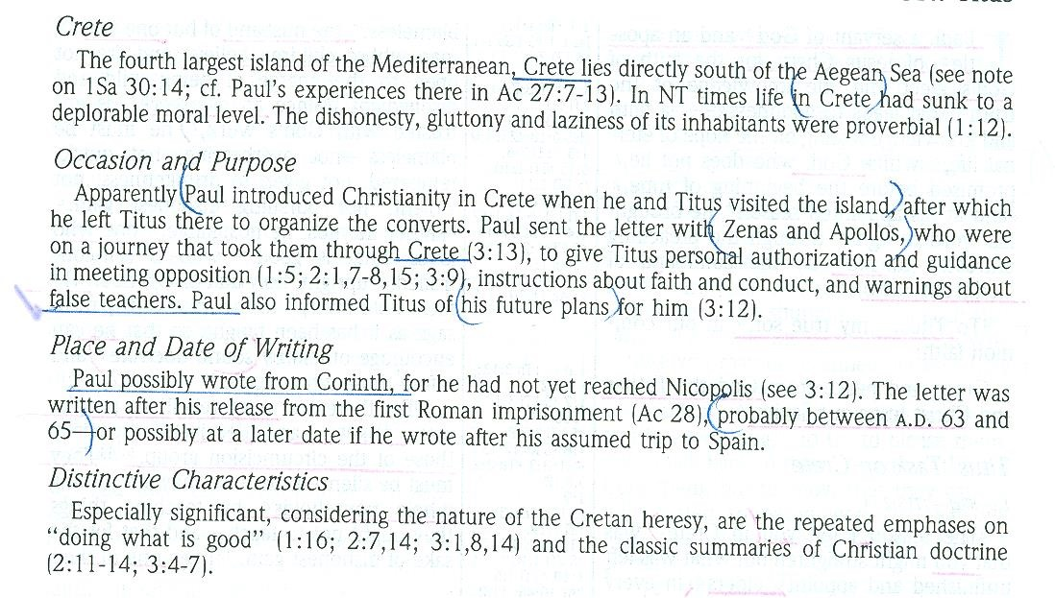

Slide 9
Titus in the New Testament:
(2 Corinthians 2:12-13) When I came to Troas to preach the gospel of Christ, even though a door was opened for me in the Lord, (13) my spirit was not at rest because I did not find my brother Titus there. So I took leave of them and went on to Macedonia.
(2 Corinthians 7:6-7) But God, who comforts the downcast, comforted us by the coming of Titus, (7) and not only by his coming but also by the comfort with which he was comforted by you, as he told us of your longing, your mourning, your zeal for me, so that I rejoiced still more.
(2 Corinthians 7:13-16) Therefore we are comforted. And besides our own comfort, we rejoiced still more at the joy of Titus, because his spirit has been refreshed by you all. (14) For whatever boasts I made to him about you, I was not put to shame. But just as everything we said to you was true, so also our boasting before Titus has proved true. (15) And his affection for you is even greater, as he remembers the obedience of you all, how you received him with fear and trembling. (16) I rejoice, because I have perfect confidence in you.

Slide 10
(2 Corinthians 8:6) Accordingly, we urged Titus that as he had started, so he should complete among you this act of grace.
(2 Corinthians 8:15-24) As it is written, "Whoever gathered much had nothing left over, and whoever gathered little had no lack." (16) But thanks be to God, who put into the heart of Titus the same earnest care I have for you. (17) For he not only accepted our appeal, but being himself very earnest he is going to you of his own accord. (18) With him we are sending the brother who is famous among all the churches for his preaching of the gospel. (19) And not only that, but he has been appointed by the churches to travel with us as we carry out this act of grace that is being ministered by us, for the glory of the Lord himself and to show our good will. (20) We take this course so that no one should blame us about this generous gift that is being administered by us, (21) for we aim at what is honorable not only in the Lord's sight but also in the sight of man. (22) And with them we are sending our brother whom we have often tested and found earnest in many matters, but who is now more earnest than ever because of his great confidence in you. (23) As for Titus, he is my partner and fellow worker for your benefit. And as for our brothers, they are messengers of the churches, the glory of Christ. (24) So give proof before the churches of your love and of our boasting about you to these men.

Slide 11
(2 Corinthians 12:18) I urged Titus to go, and sent the brother with him. Did Titus take advantage of you? Did we not act in the same spirit? Did we not take the same steps?
(Galatians 2:1-3) Then after fourteen years I went up again to Jerusalem with Barnabas, taking Titus along with me. (2) I went up because of a revelation and set before them (though privately before those who seemed influential) the gospel that I proclaim among the Gentiles, in order to make sure I was not running or had not run in vain. (3) But even Titus, who was with me, was not forced to be circumcised, though he was a Greek.
(2 Timothy 4:10-12) For Demas, in love with this present world, has deserted me and gone to Thessalonica. Crescens has gone to Galatia, Titus to Dalmatia. (11) Luke alone is with me. Get Mark and bring him with you, for he is very useful to me for ministry. (12) Tychicus I have sent to Ephesus.

Slide 12
C. THE PERSON OF TITUS
His relics, now consisting of only his skull, are venerated in the Church of St. Titus, Heraklion, Crete to which it was returned in 1966 after being removed to Venice during the Turkish occupation.
St. Titus is the patron saint of the United States Army Chaplain Corps. The Corps has established the Order of Titus Award. According to the Department of Defense, the "Order of Titus award is the only award presented by the Chief of Chaplains to recognize outstanding performance of ministry by chaplains and chaplain assistants. The Order of Titus is awarded for meritorious contributions to the unique and highly visible Unit Ministry Team Observer Controller Program. The award recognizes the great importance of realistic, doctrinally guided combat ministry training in ensuring the delivery of prevailing religious support to the American Soldier."

Slide 13
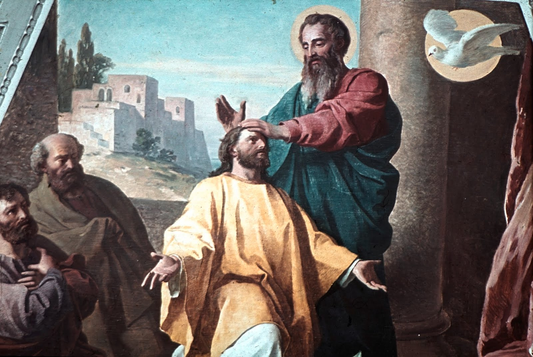

Slide 14
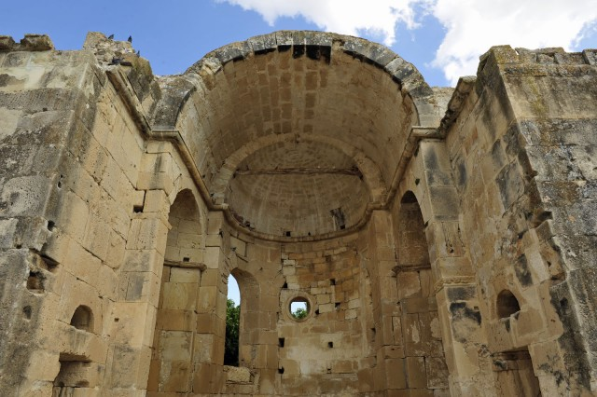

Slide 15
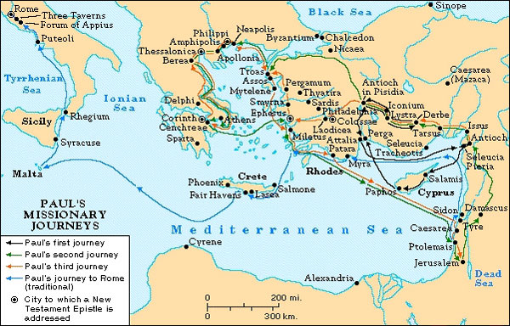

Slide 16
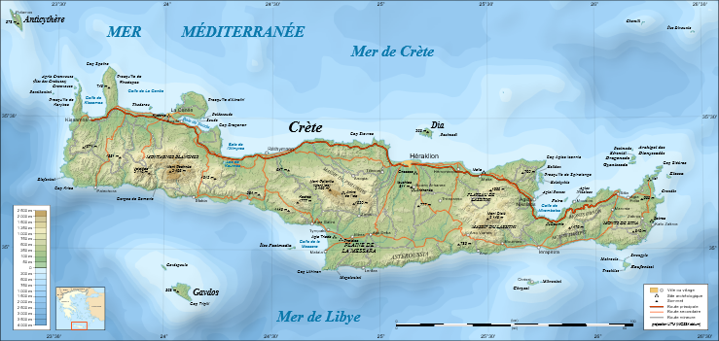

Slide 17
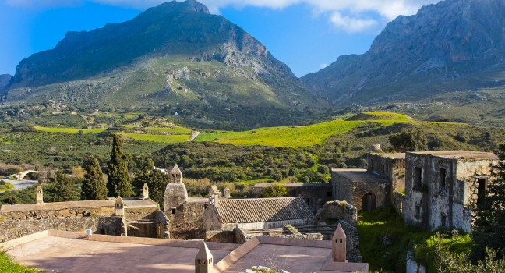

Slide 18
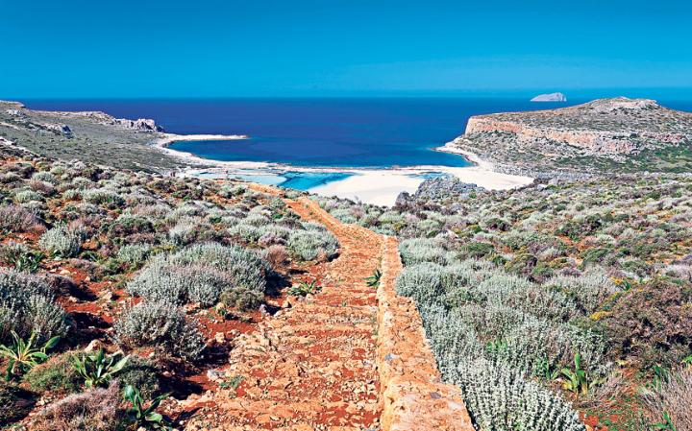

Slide 19
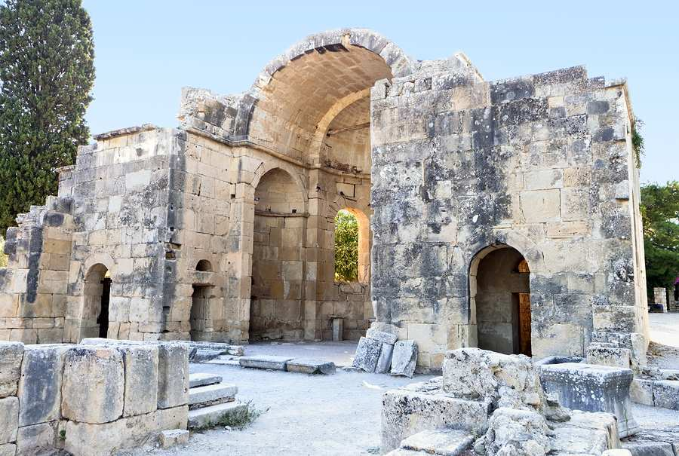

Slide 20
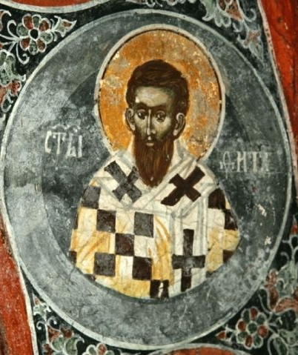

Slide 21
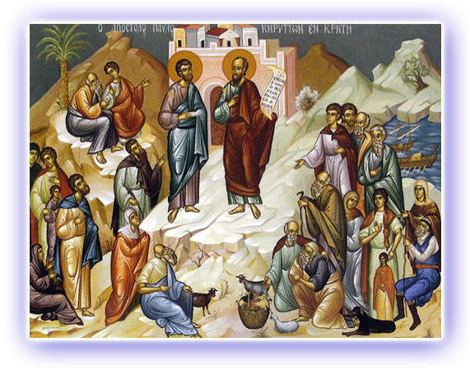

Slide 22
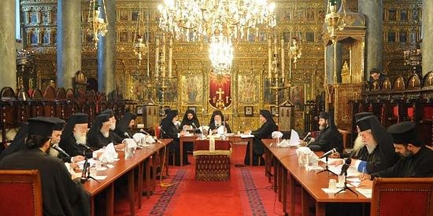

Slide 23


Slide 24
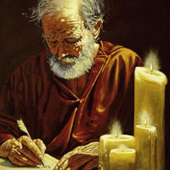

Slide 25


Slide 26
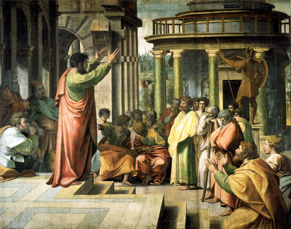

Slide 27


Slide 28


Slide 29
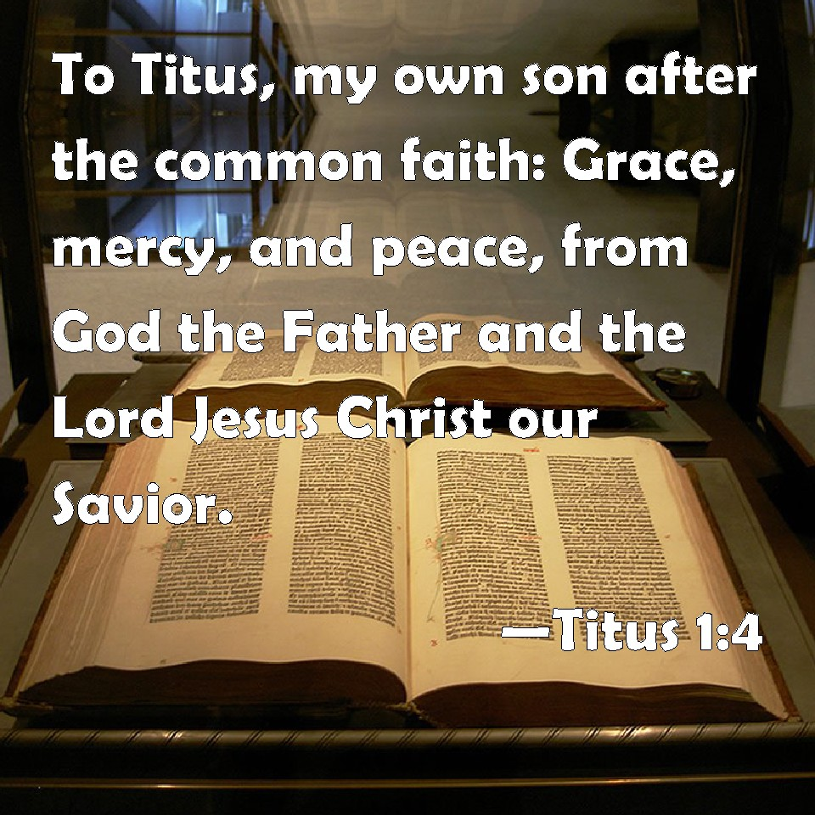

Slide 30
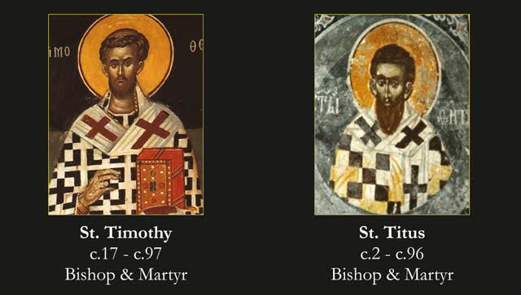

Slide 31
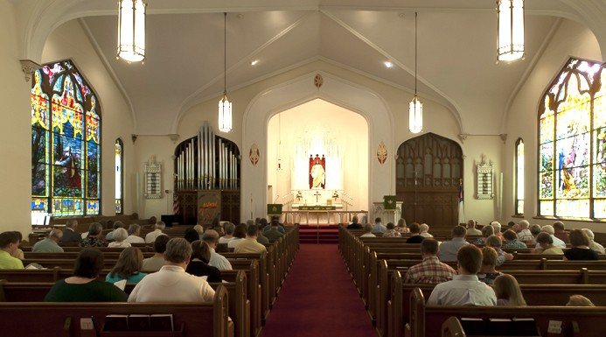

Slide 32
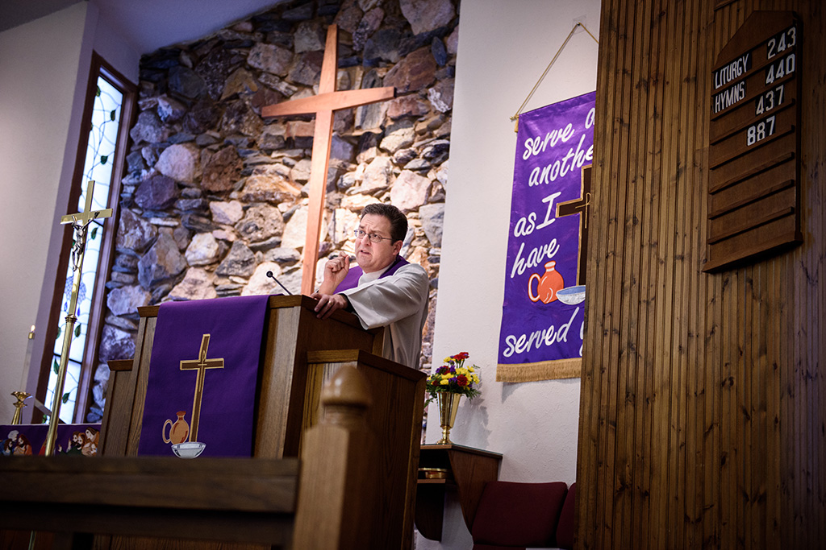

Slide 33
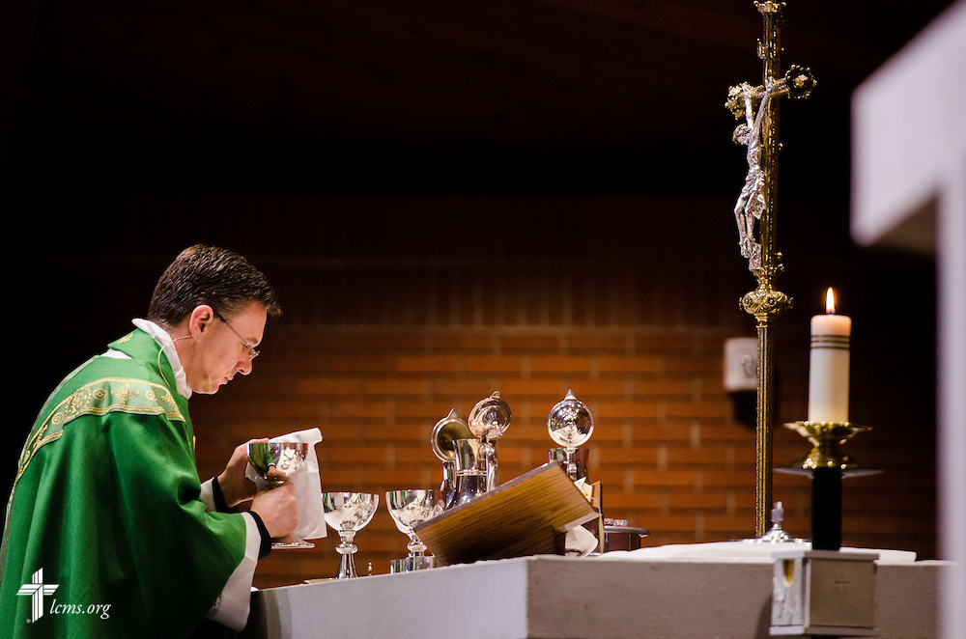

Slide 34
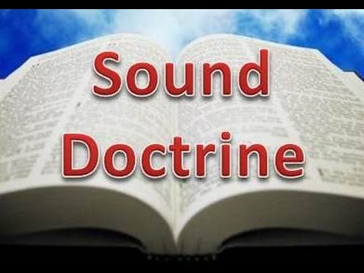

Slide 35
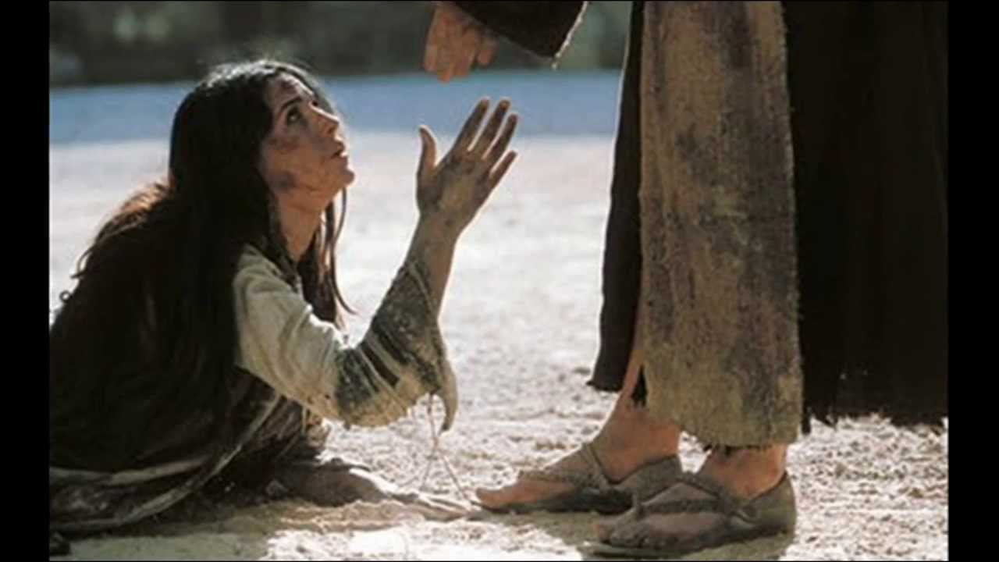

Slide 36


Slide 37


Slide 38


Slide 39
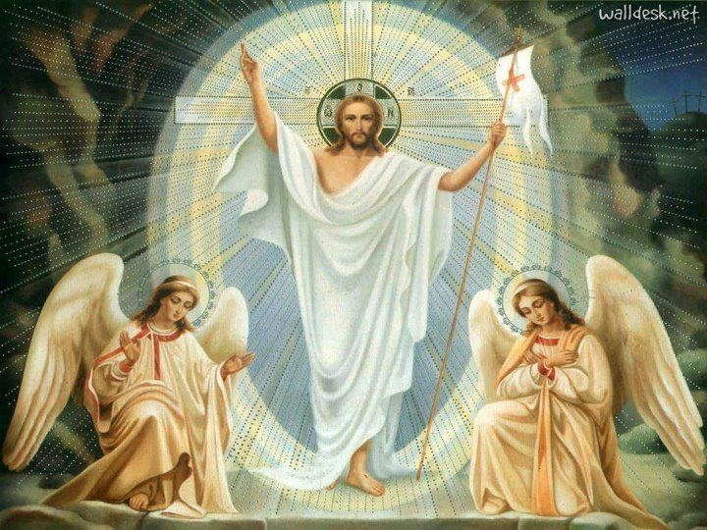

Slide 40
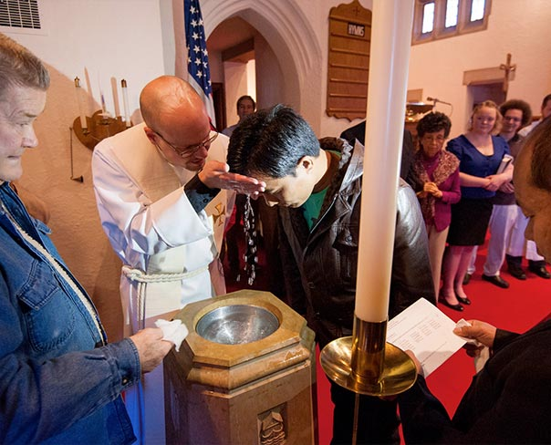

Slide 41
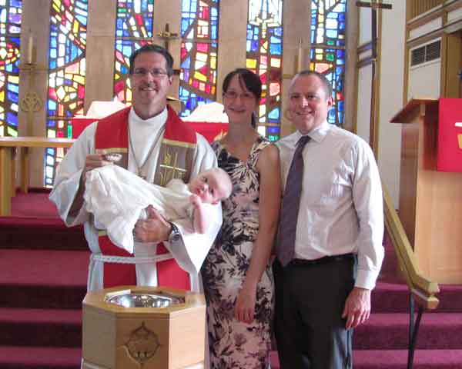

Slide 42
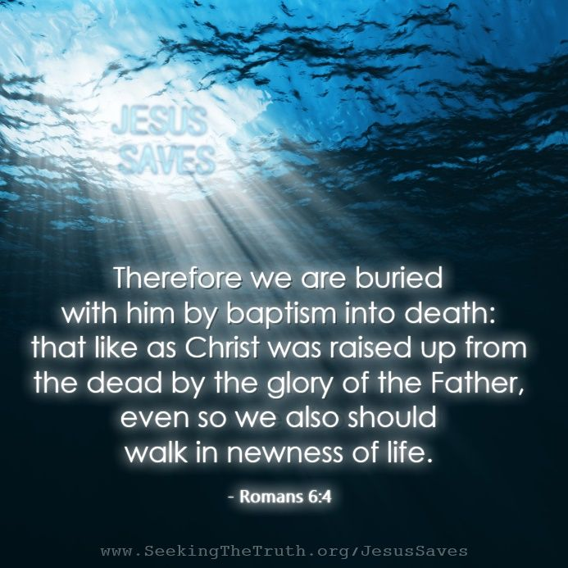

Slide 43
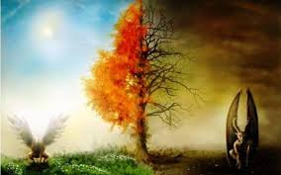

Slide 44
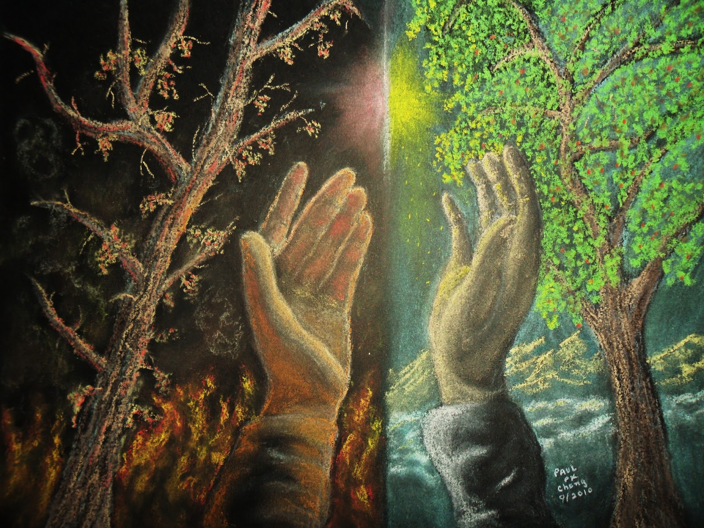

Slide 45
(Titus 2)
(1) But as for you, teach what accords with sound doctrine.
(2) Older men are to be sober-minded, dignified, self-controlled, sound in faith, in love, and in steadfastness.
(3) Older women likewise are to be reverent in behavior, not slanderers or slaves to much wine. They are to teach what is good, (4) and so train the young women to love their husbands and children, (5) to be self-controlled, pure, working at home, kind, and submissive to their own husbands, that the word of God may not be reviled.
(6) Likewise, urge the younger men to be self-controlled. (7) Show yourself in all respects to be a model of good works, and in your teaching show integrity, dignity, (8) and sound speech that cannot be condemned, so that an opponent may be put to shame, having nothing evil to say about us.
(9) Slaves are to be submissive to their own masters in everything; they are to be well-pleasing, not argumentative, (10) not pilfering, but showing all good faith, so that in everything they may adorn the doctrine of God our Savior.

Slide 46
B. THE STUDY NOTES
This section is all about our Christian callings and vocations. We do not need to look for some other calling, for God has already placed us in specific roles - we have faith in God and
serve our neighbor in good works.
2. Teach what accords with sound doctrine (1 Tim 1:10; 6:3; 2 Tim 1:13)

Slide 47
3. Older men should be moral, dignified, reverent, spiritual, responsible and sensible (1 Tim 3:2; 5:1)
Note: In the first century, if you lived to age 80, that was remarkable. The median age of death for men was 46.5 years of age, we learn this from inscriptions on ancient tombs. So an older man would be in his 30s or 40s!

Slide 48
4. Older women are not to be slanderers or gossips, but are to set the example for the younger women as they love their husbands and children (Eph 5:22-25; 1 Tim 3:8,11; 5:2,14,23; 1 Pet 3:1-5)
Note: The median age of death for women
was only 34 years!
“Older” may mean beyond child-bearing age.
Not drinking too much wine, so as to be drunk (Eph 5:18). Drinking in moderation was a part of meals and parties (Jn 2:9-10) and also for medicinal purposes (1 Tim 5:23).
The work of a woman at home is praised as a good and beneficial thing (Prov 31:10-31)

Slide 49
5. The word of God may not be reviled (1 Tim 6:1; Heb 4:12)
6. Younger men who have reached adulthood are to be models of good behavior
(Php 3:17; Jas 3:1; 1 Tim 4:12; 5:1; 6:3; 1 Pet 2:12; 3:16; 5:3; 2 Cor 11:3)

Slide 50
7. Slaves and masters relationship
(Eph 6:5; 1 Pet 2:18; Col 3:22)
Note: As the Gospel went out, slaves became Christians. Yet in the Roman society, they had no rights and were completely under the control of their masters. Some slaves were bakers, cooks, tutors for children, farm-workers and house-servants. But now as Christians, they could be powerful witnesses to the Gospel by their examples in trustworthy, obedient, and willing faithfulness to their masters. In history, it would eventually be the Christian world-view which would end slavery.

Slide 51
8. They may adorn the doctrine of God our Savior
(Mt 5:16; Lk 1:47;
Php 2:15)

Slide 52
Luther’s Preface to the Epistle of St. Paul to Titus 1546 (1522)
“This is a short epistle, but a model of Christian doctrine, in which is comprehended in a masterful way all that is necessary for a Christian to know and to live.
In chapter 1 he teaches what kind of man a bishop, or pastor, ought to be, namely, one who is pious and learned in preaching the gospel and in refuting the false teachers of works and of man-made laws, those who are always warring against faith and leading consciences away from Christian liberty into the captivity of their own man-made works, [as if these works,] which are actually worthless, [should make them righteous before God.]
In chapter 2 he teaches the various estates—the older, the younger, wives, husbands, masters, and slaves—how they are to act, as those whom Christ, by his death, has won for his own.”

Slide 53
C. LIFE APPLICATION
1. Why is it essential to teach what accords with sound doctrine?
2. How important is it that our daily actions be godly, so that the word of God may not be reviled?
3. In our daily vocations, where can we show all good faith, so that in everything we may adorn the doctrine of God our Savior?

Slide 54
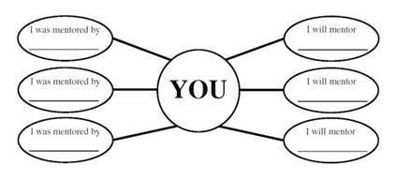

Slide 55
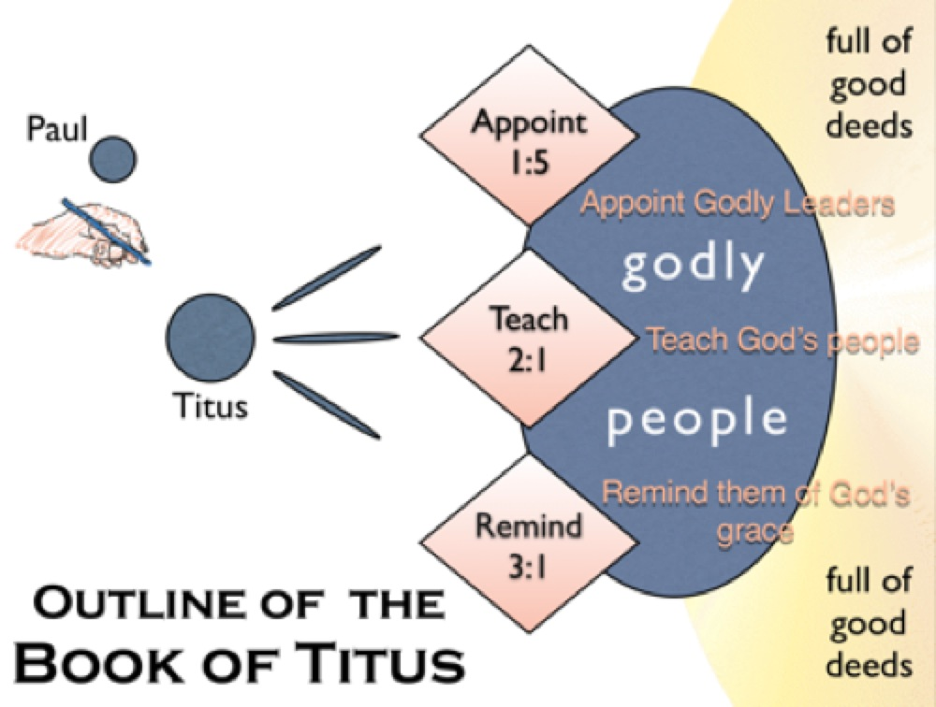

Slide 56


Slide 57
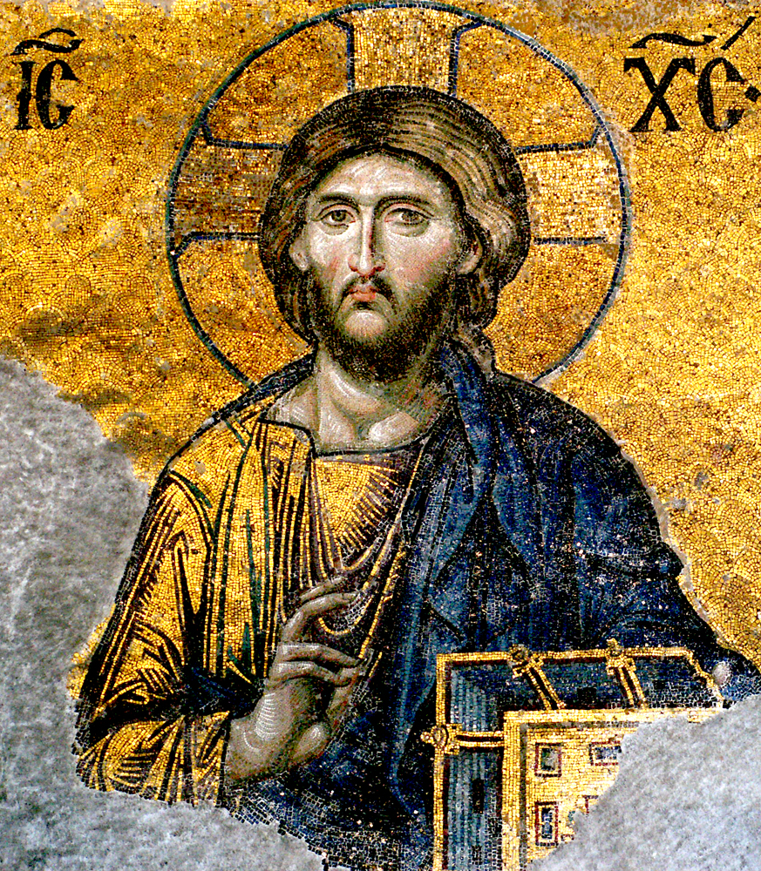

Slide 58
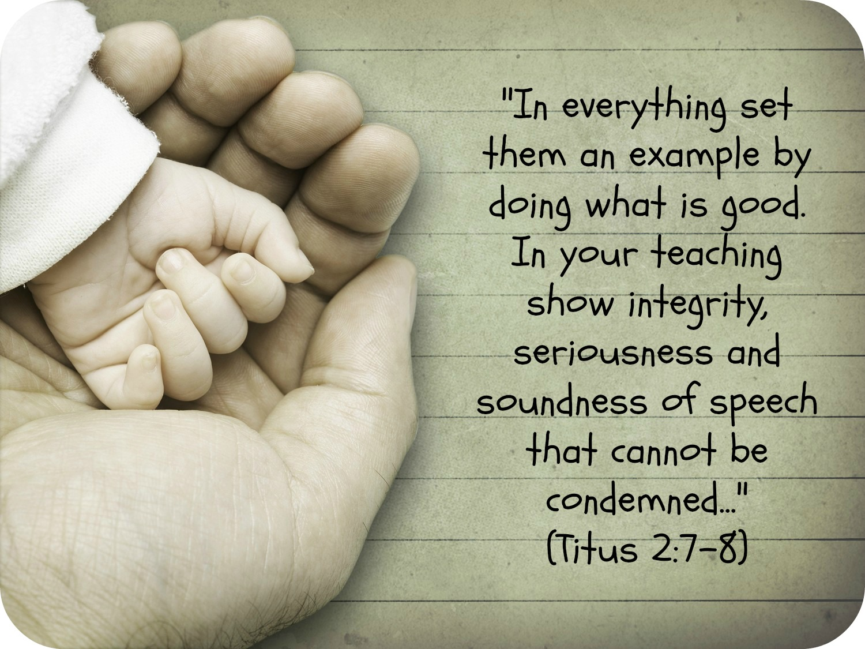

Slide 59


Slide 60
