Slide 1
The Book of Titus
The Life of Christians in a Congregation:
“The Knowledge of the Truth
Which Accords With Godliness”
Trinity Lutheran Church Norman, OK. Pastor David Nehrenz
Date: 7-10-16 Study: 2

Slide 2
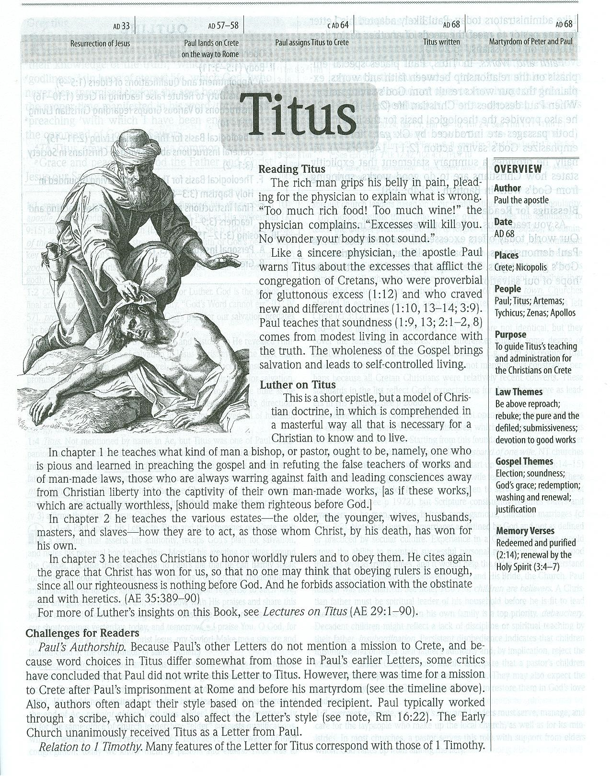

Slide 3
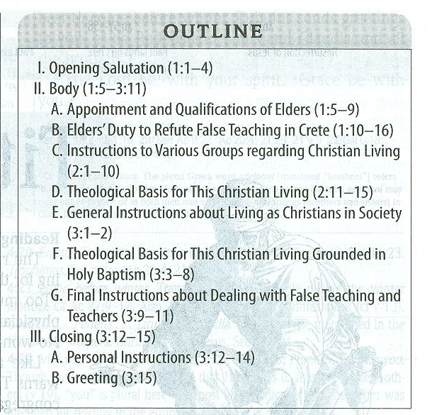

Slide 4
A.THE TEXT
(Titus 1) (1) Paul, a servant of God and an apostle of Jesus Christ, for the sake of the faith of God's elect and their knowledge of the truth, which accords with godliness, (2) in hope of eternal life, which God, who never lies, promised before the ages began (3) and at the proper time manifested in his word through the preaching with which I have been entrusted by the command of God our Savior;

Slide 5
(4) To Titus, my true child in a common faith: Grace and peace from God the Father and Christ Jesus our Savior. (5) This is why I left you in Crete, so that you might put what remained into order, and appoint elders in every town as I directed you-- (6) if anyone is above reproach, the husband of one wife, and his children are believers and not open to the charge of debauchery or insubordination.

Slide 6
(7) For an overseer, as God's steward, must be above reproach. He must not be arrogant or quick-tempered or a drunkard or violent or greedy for gain, (8) but hospitable, a lover of good, self-controlled, upright, holy, and disciplined. (9) He must hold firm to the trustworthy word as taught, so that he may be able to give instruction in sound doctrine and also to rebuke those who contradict it.

Slide 7
(10) For there are many who are insubordinate, empty talkers and deceivers, especially those of the circumcision party. (11) They must be silenced, since they are upsetting whole families by teaching for shameful gain what they ought not to teach. (12) One of the Cretans, a prophet of their own, said, "Cretans are always liars, evil beasts, lazy gluttons." (13) This testimony is true. Therefore rebuke them sharply, that they may be sound in the faith, (14) not devoting themselves to Jewish myths and the commands of people who turn away from the truth.
(15) To the pure, all things are pure, but to the defiled and unbelieving, nothing is pure; but both their minds and their consciences are defiled. (16) They profess to know God, but they deny him by their works. They are detestable, disobedient, unfit for any good work.

Slide 8
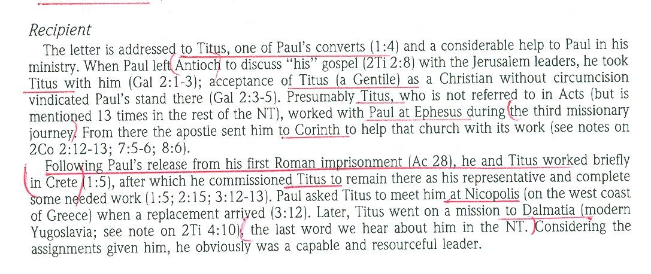
B. THE STUDY NOTES

Slide 9
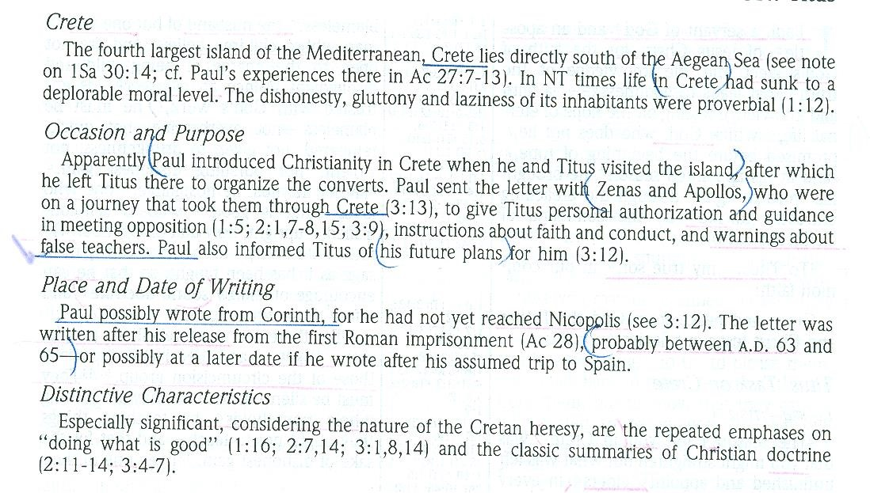

Slide 11
Titus in the New Testament:
(2 Corinthians 2:12-13) When I came to Troas to preach the gospel of Christ, even though a door was opened for me in the Lord, (13) my spirit was not at rest because I did not find my brother Titus there. So I took leave of them and went on to Macedonia.
(2 Corinthians 7:6-7) But God, who comforts the downcast, comforted us by the coming of Titus, (7) and not only by his coming but also by the comfort with which he was comforted by you, as he told us of your longing, your mourning, your zeal for me, so that I rejoiced still more.
(2 Corinthians 7:13-16) Therefore we are comforted. And besides our own comfort, we rejoiced still more at the joy of Titus, because his spirit has been refreshed by you all. (14) For whatever boasts I made to him about you, I was not put to shame. But just as everything we said to you was true, so also our boasting before Titus has proved true. (15) And his affection for you is even greater, as he remembers the obedience of you all, how you received him with fear and trembling. (16) I rejoice, because I have perfect confidence in you.

Slide 12
(2 Corinthians 8:6) Accordingly, we urged Titus that as he had started, so he should complete among you this act of grace.
(2 Corinthians 8:15-24) As it is written, "Whoever gathered much had nothing left over, and whoever gathered little had no lack." (16) But thanks be to God, who put into the heart of Titus the same earnest care I have for you. (17) For he not only accepted our appeal, but being himself very earnest he is going to you of his own accord. (18) With him we are sending the brother who is famous among all the churches for his preaching of the gospel. (19) And not only that, but he has been appointed by the churches to travel with us as we carry out this act of grace that is being ministered by us, for the glory of the Lord himself and to show our good will. (20) We take this course so that no one should blame us about this generous gift that is being administered by us, (21) for we aim at what is honorable not only in the Lord's sight but also in the sight of man. (22) And with them we are sending our brother whom we have often tested and found earnest in many matters, but who is now more earnest than ever because of his great confidence in you. (23) As for Titus, he is my partner and fellow worker for your benefit. And as for our brothers, they are messengers of the churches, the glory of Christ. (24) So give proof before the churches of your love and of our boasting about you to these men.

Slide 13
(2 Corinthians 12:18) I urged Titus to go, and sent the brother with him. Did Titus take advantage of you? Did we not act in the same spirit? Did we not take the same steps?
(Galatians 2:1-3) Then after fourteen years I went up again to Jerusalem with Barnabas, taking Titus along with me. (2) I went up because of a revelation and set before them (though privately before those who seemed influential) the gospel that I proclaim among the Gentiles, in order to make sure I was not running or had not run in vain. (3) But even Titus, who was with me, was not forced to be circumcised, though he was a Greek.
(2 Timothy 4:10-12) For Demas, in love with this present world, has deserted me and gone to Thessalonica. Crescens has gone to Galatia, Titus to Dalmatia. (11) Luke alone is with me. Get Mark and bring him with you, for he is very useful to me for ministry. (12) Tychicus I have sent to Ephesus.

Slide 14
C. THE PERSON OF TITUS
His relics, now consisting of only his skull, are venerated in the Church of St. Titus, Heraklion, Crete to which it was returned in 1966 after being removed to Venice during the Turkish occupation.
St. Titus is the patron saint of the United States Army Chaplain Corps. The Corps has established the Order of Titus Award. According to the Department of Defense, the "Order of Titus award is the only award presented by the Chief of Chaplains to recognize outstanding performance of ministry by chaplains and chaplain assistants. The Order of Titus is awarded for meritorious contributions to the unique and highly visible Unit Ministry Team Observer Controller Program. The award recognizes the great importance of realistic, doctrinally guided combat ministry training in ensuring the delivery of prevailing religious support to the American Soldier."

Slide 15
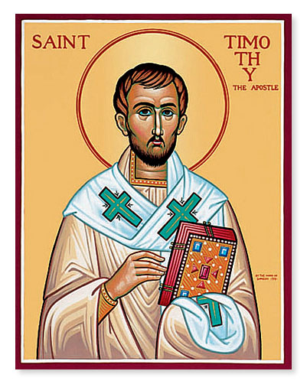

Slide 16
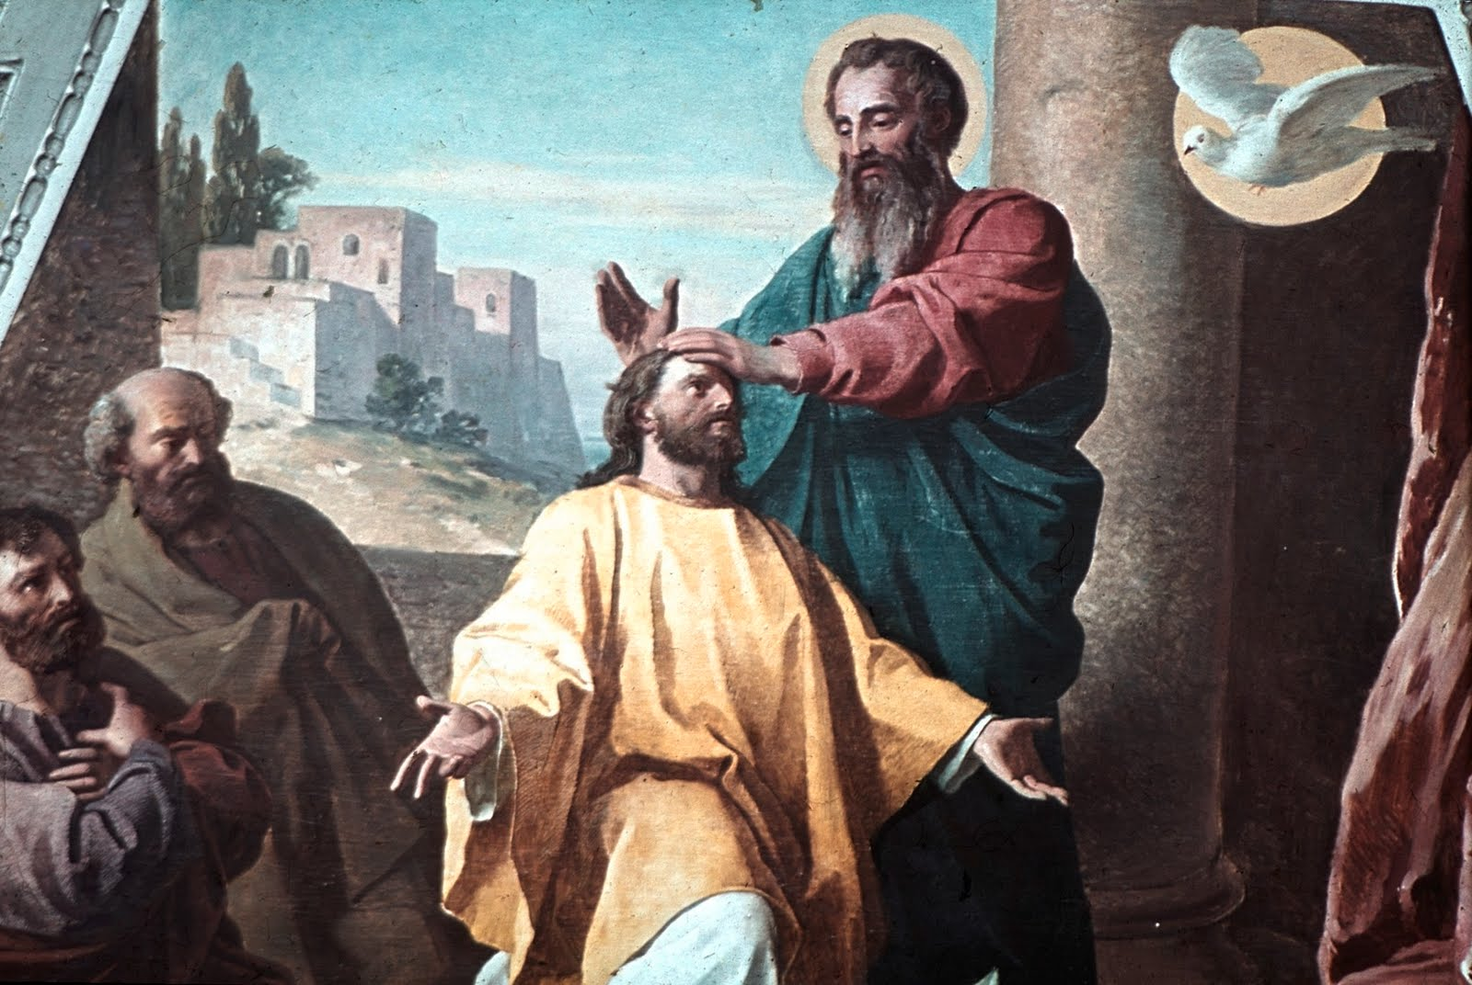

Slide 17
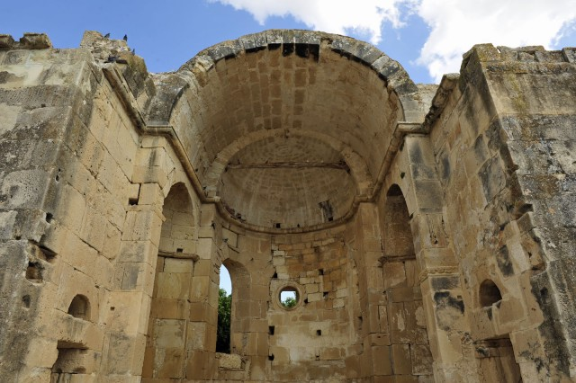

Slide 18
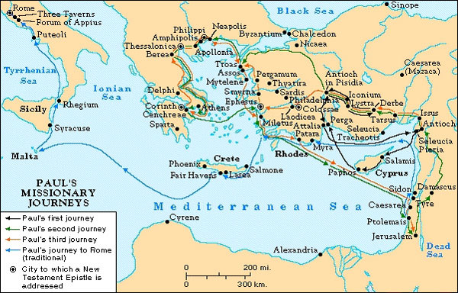

Slide 19
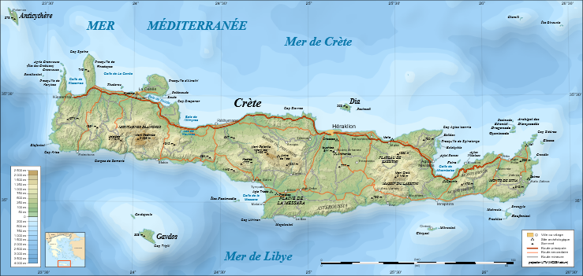

Slide 20
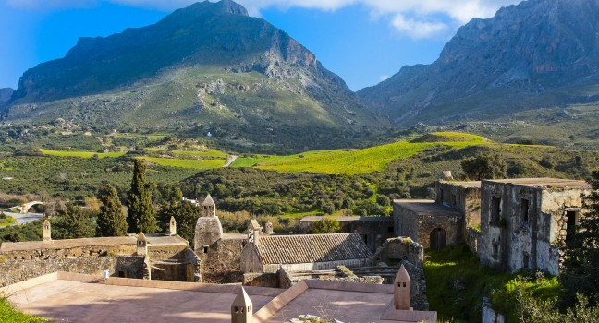

Slide 21
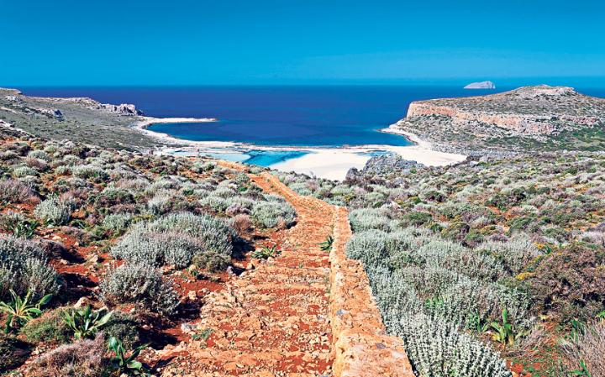

Slide 22
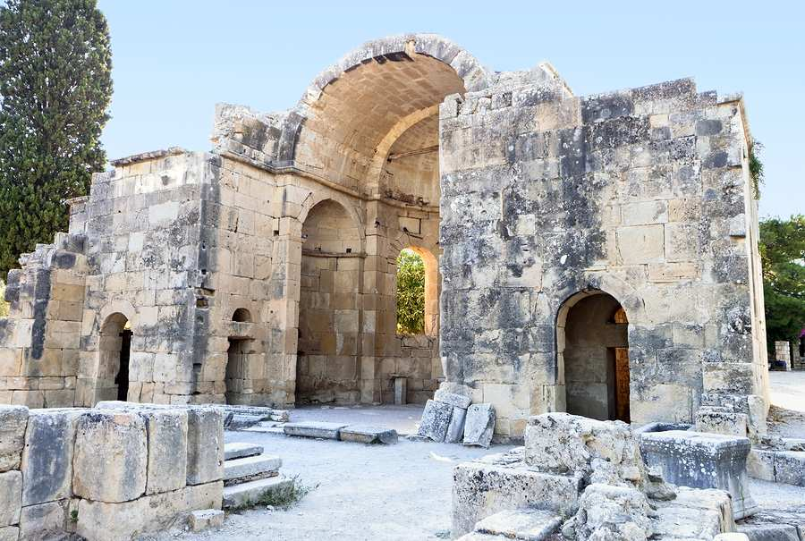

Slide 23
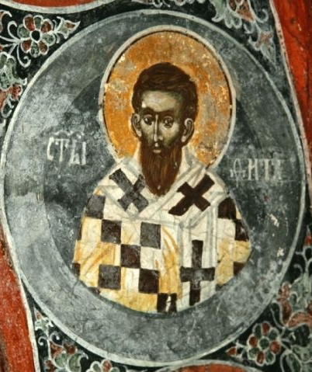

Slide 24
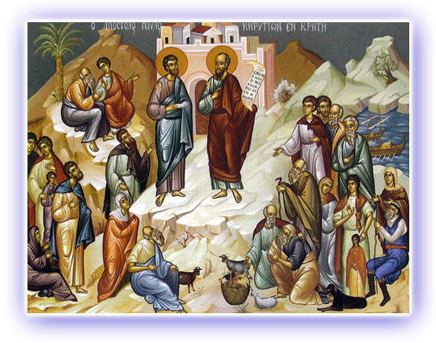

Slide 25
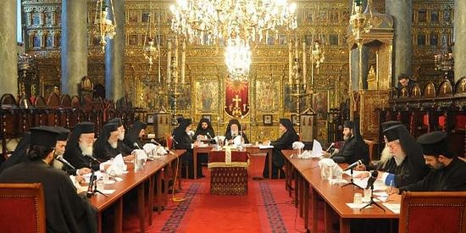

Slide 26
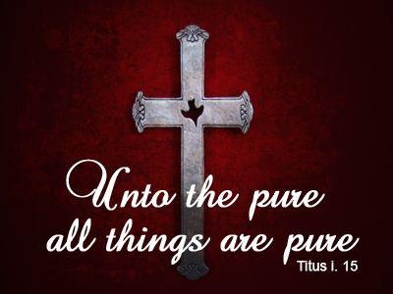

Slide 27
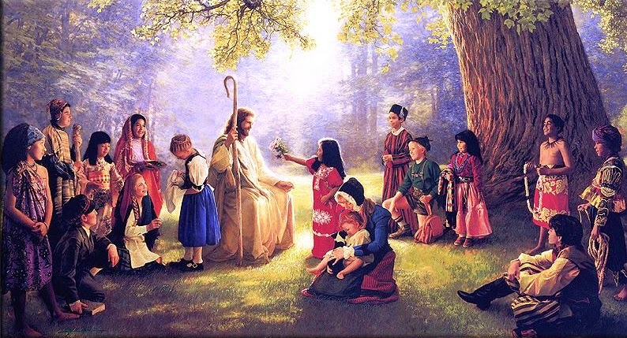

Slide 28
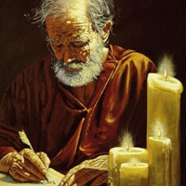

Slide 29
B. THE STUDY NOTES
1. An apostle is one set apart personally by Jesus as his “sent messenger” of authoritative words of truth
(Mk 6:30; 1 Co 1:1; Eph 4:11-12; Heb 3:1)
There were 12 apostles and Paul was the 13th apostle to the Gentiles. There can be no more apostles.
2. Every epistle by Paul begins with an introduction of who he is as the author, and then has an intensely packed
greeting which summarizes a large amount of doctrine in a very few sentences.
It all needs to be “un-packed” before one starts through the rest of the letter.

Slide 30
a. for the sake of the faith of God's elect (Acts 9:15; 22:15; 26:16-18)
b. their knowledge of the truth,
(1 Tim 2:2-4)
c. which accords with godliness, (Eph 1:4; 1 Tim 3:16)

Slide 31
d. in hope of eternal life,
(Col 1:5; 2 Tim 1:1; Heb 9:15)
e. God, who never lies, promised before the ages began
(Num 23:19; Heb 6:18;
2 Tim 1:9; 2:13)
f. and at the proper time manifested
(Mk 1:15; 1 Tim 2:6; 6:15; Gal 4:4)

Slide 32
g. in his word through the preaching
(Ac 9:6,15; 20:24; Rom 10:14; Gal 1:1; Eph 1:9-10; 1 Th 2:4)
h. which I have been entrusted by the command of God our Savior
(Lk 1:47; 1 Cor 1:17;
1 Tim 1:1,11; 2:3; 4:10)
Note: Both Jesus and God the Father are called “Savior” in the New Testament

Slide 33
LUTHER -THE WORD GOD CAN BE TRUSTED, GOD DOES NOT LIE: Vol 4, p. 34
“Therefore the true church of God is the one which does not misuse the name of God but hears and keeps the Word of Christ, that is, believes the promises. When I hear its name, I prostrate myself in true humility and worship it, for I am sure that the Father, the Son, and the Holy Spirit dwell in it. But when those who do not keep the Word of Christ but persecute it and walk in their self-chosen forms of worship adorn themselves with the name “church,” then the word which by its nature has only one meaning becomes equivocal.
Therefore just as it would be folly to be afraid of a painting of a man drawing a sword, so it is folly to be frightened by the name “church” when it is used in a blasphemous manner; for it is merely the picture or mask of the church. But the true church is where Isaac, the son of the promise, is. There the name of God should be feared. There is our salvation and our strength, as the psalm says (Prov. 18:10): “The name of the Lord is a strong tower; the righteous man runs into it.”
In short, where the Word of Christ is and is kept—that is, believed—do not be in doubt about the church, even if he who either administers the sacraments or teaches is godless and a blasphemer. “For the Word of the Lord, like rain, does not return empty” (Is. 55:10–11).

Slide 34
C. LIFE APPLICATION
1. How have we acquired the knowledge of the truth, which accords with godliness?
2. Why does the sure hope of eternal life put your daily life into proper perspective?
3. In your faith pilgrimage, when has God manifested the truth in his word through the preaching you have heard all your life?
4. The Gospel is a LIVING VOICE in preaching, teaching, baptizing, absolving, communing!

Slide 35
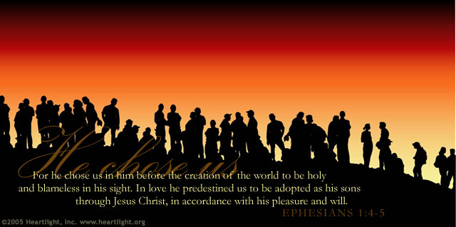

Slide 36
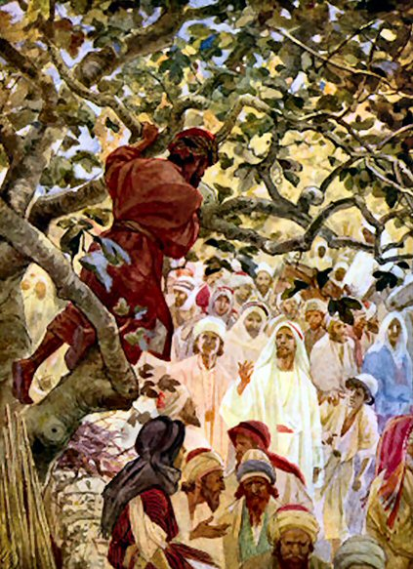

Slide 37
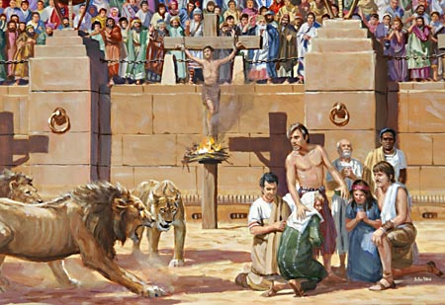

Slide 38
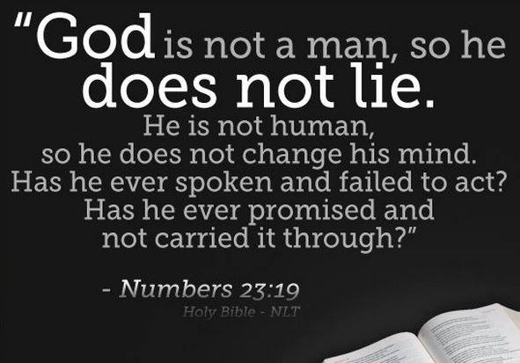

Slide 39
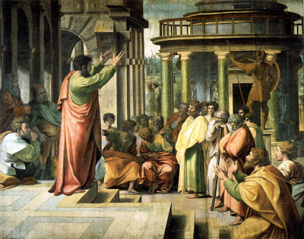

Slide 40
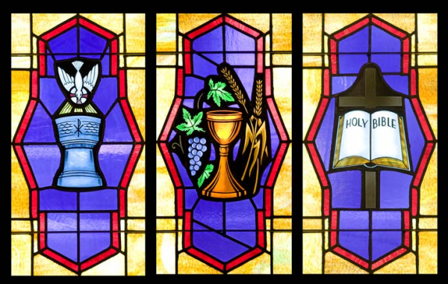

Slide 41
