Slide 1

Created • Redeemed • Called
LIFE SUNDAY 1-24-16
Combined Bible Class – All Teens and Adults
Schedule for the day:
Combined Bible Class – All Teens and Adults
Schedule for the day:
9:15 a.m. – Responsive Prayer
9:20 a.m. - 3 Foundational Truths from God’s Word
9:50 a.m. - Video “Lutherans for Life”
10:15 a.m. - Closing Prayer

Slide 2
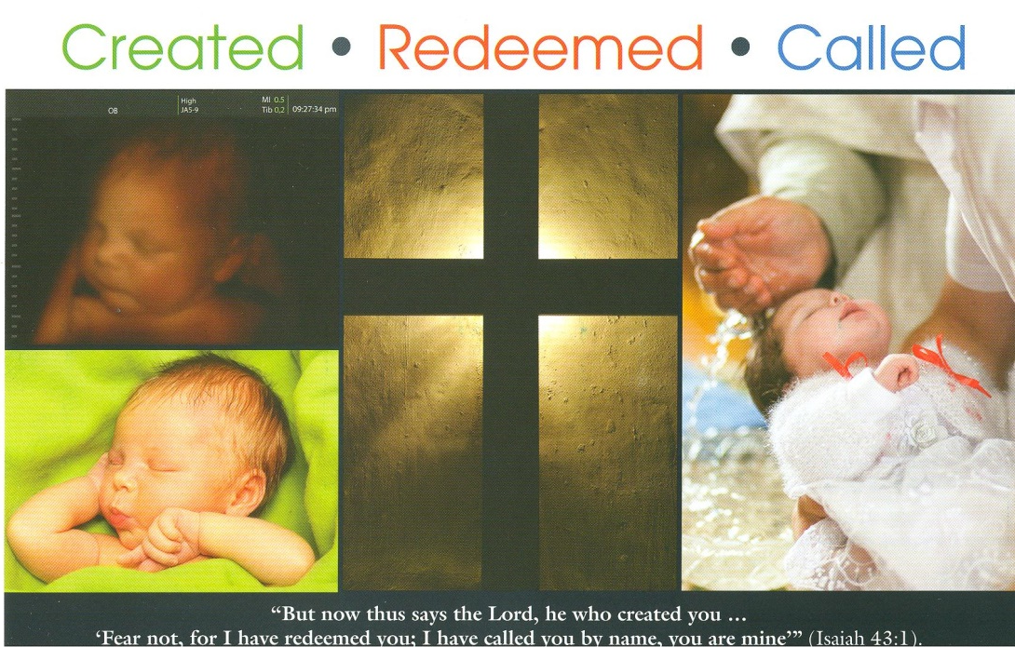

Slide 3
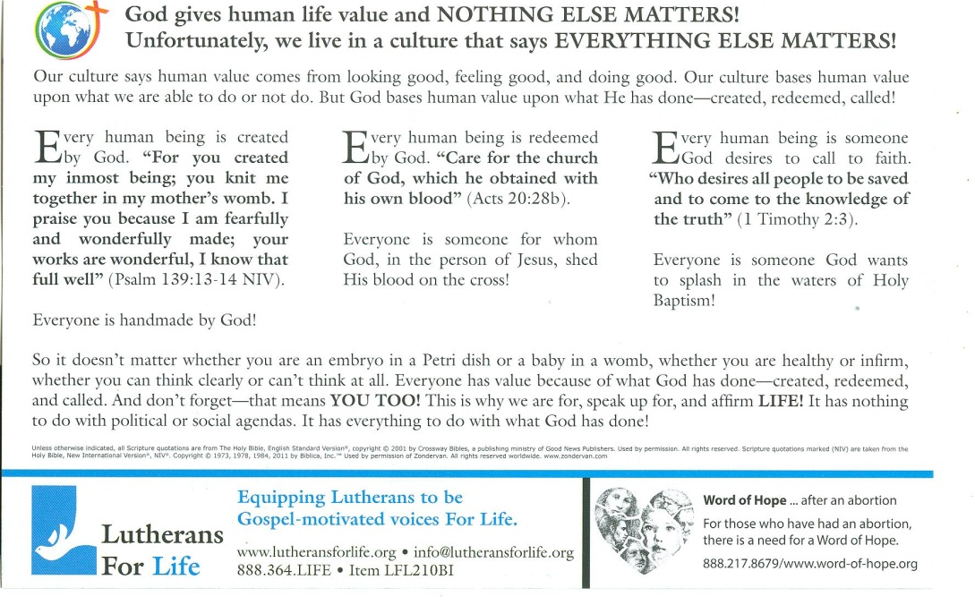

Slide 4
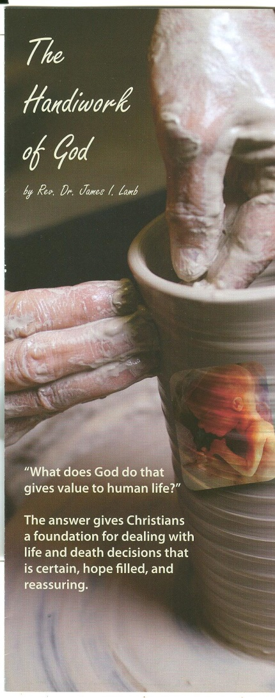

Slide 5
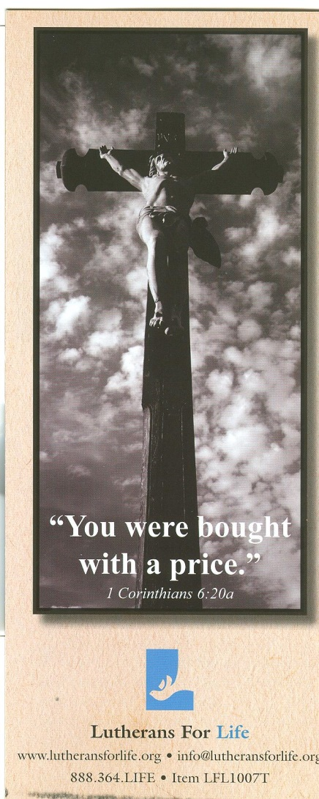

Slide 6
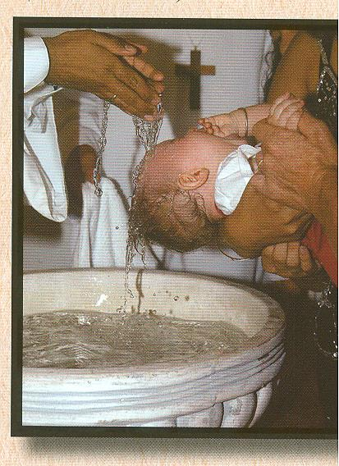

Slide 7
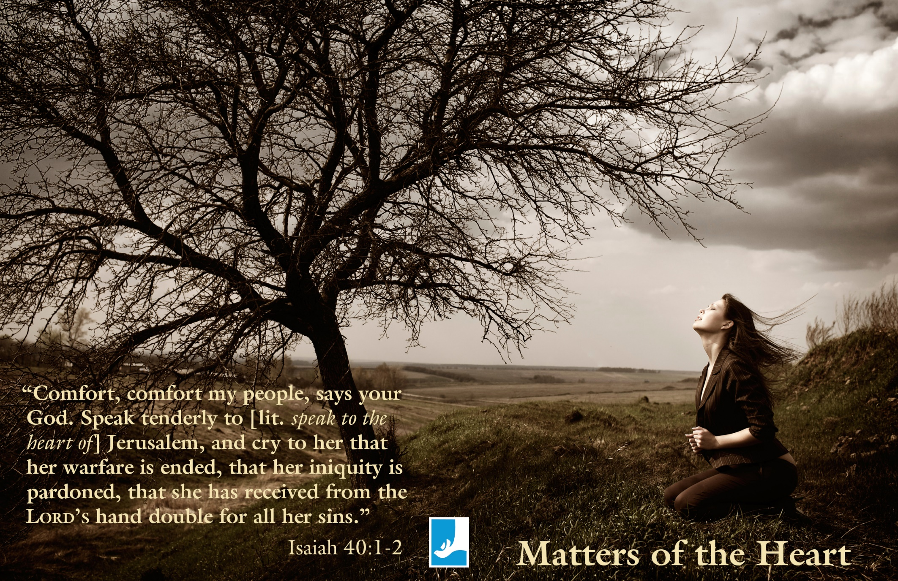

Slide 8
P Father in Heaven, we come before You as people who live in the victory over death won by Your Son, Jesus Christ.
Therefore we are confident You will hear our prayer.
C We pray for our nation and its leaders.
P Instill in them a sense of the innate value given to all human life regardless of condition of health, age, or abilities.
C We pray for Your Church.
P May she boldly and courageously proclaim Christ’s glorious victory over sin and death and connect the comfort and hope of this message to those who are living with dying.
C We pray for Your people in this congregation.
P Enable us to turn to You and the assurance of Your promises in the midst of our suffering and uncertainties.
C We pray for those facing difficult situations and end-of-life decisions.
P Help them trust in Your great love given in Jesus that assures them of Your presence and power. Move us to care for them in real, practical ways.
C We pray for those who have made wrong choices or are uncertain about choices made.
P Surround and uphold them with Your grace and give them peace through the blood of the cross.
C We pray for Lutherans For Life and Eden Clinic and Birth Choice.
P May they continue to serve You by equipping us all to be Gospel-motivated voices For Life to one another and to the world.
As Your children, we bring these needs and joys of our congregation
before You. Into Your hands we commend all for whom we pray,
trusting in Your mercy; through Your Son Jesus Christ our Lord. Amen

Slide 9
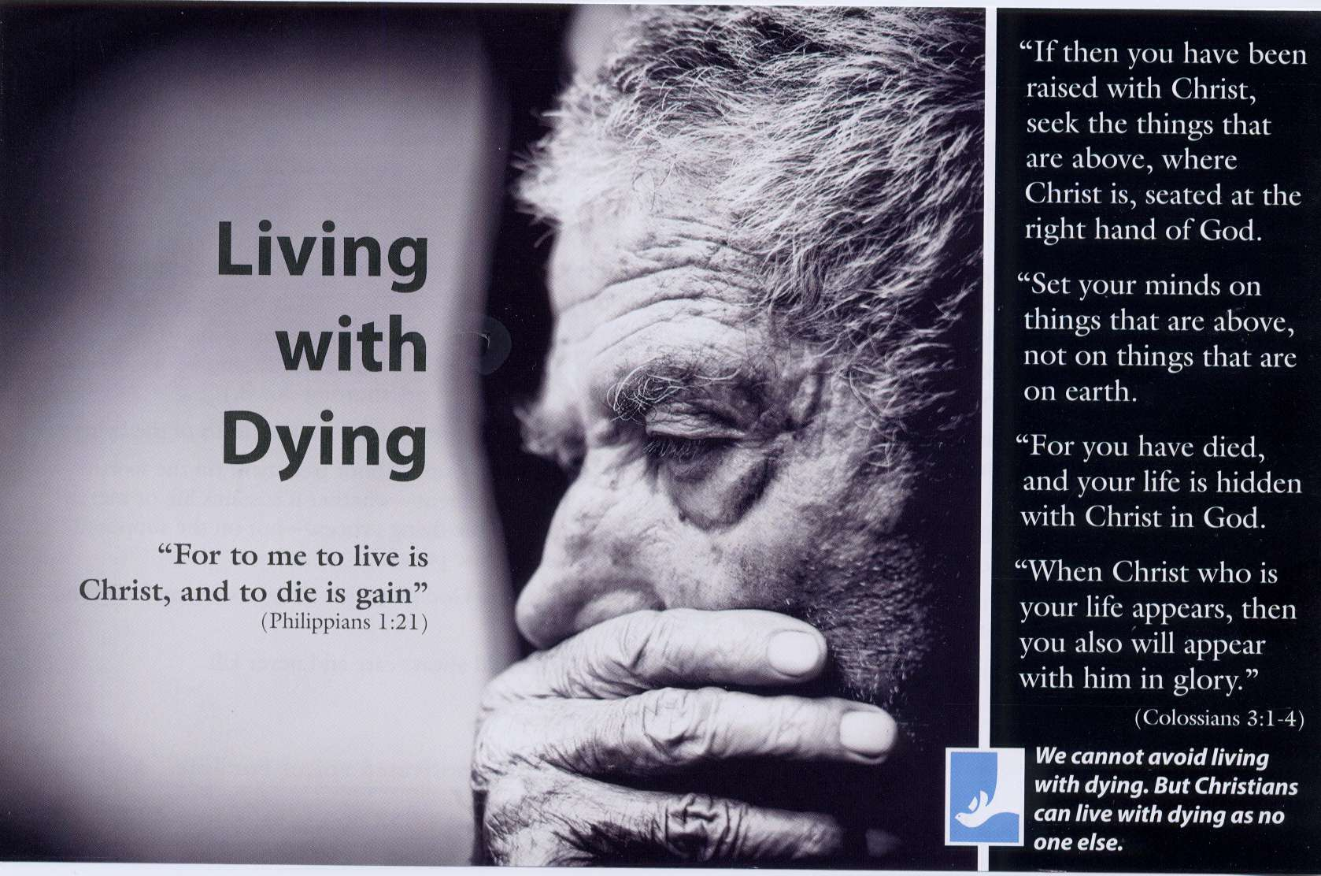

Slide 10
Introduction
Foundations are important. Things stand or fall based upon foundations. Jesus’ “house on the rock” illustration spoke of the importance of the foundation of His Word (Matthew 7:24-27). When it comes to the life issues, the Christian’s approach builds upon the Word of Life. Other foundations exist—political, economic, social, moral—but these shift and change. The Word of Life stands forever (1 Peter 1:24-25).
This study will look at the bedrock—the foundational—truth of what God does that gives value to human life—with His hands.

Slide 12
Foundational Truth #1
- CREATED BY THE FATHER
Human life has value because God creates life.
“I believe that God has made me and all creatures; that He has given me my body and soul, eyes, ears, and all my members, my reason and all my senses, and still takes care of them.”
What do these verses—Genesis 1:26-27; 2:7; 2:22—say about the value of human life from the beginning of time?
God now uses biology to create life. When does life begin? (Psalm 139)
So what do the above say about the value of human life? (See also Psalm 8:5)

Slide 14
Foundational Truth #2 - REDEEMED BY THE SON
Human life has value because God redeemed life.
“I believe that Jesus Christ, true God, begotten of the Father from eternity, and also true man, born of the Virgin Mary, is my Lord, who has redeemed me, a lost and condemned person, purchased and won me from all sins, from death, and from the power of the devil; not with gold or silver, but with His holy, precious blood and with His innocent suffering and death.”
What was the price for our redemption? (1 Peter 1:18-19; Galatians 3:13; Matthew 27:46) Read Genesis 2:17, Ezekiel 18:20a, and Romans 6:23a and fill in the blank.
God is above all else holy and perfectly just. Thus, He must _______________ sin.
Read 1 John 4:10 and then fill in the blank.
God is above all else holy and perfectly loving. Thus, He must _______________ the sinner.
So what does this say about the value of life (1 Corinthians 6:20)

Slide 16
Foundational Truth #3 - CALLED BY THE HOLY SPIRIT
Human life has value because God desires to call us and hold us forever.
“I believe that I cannot by my own reason or strength believe in Jesus Christ, my Lord, or come to Him; but the Holy Spirit has called me by the Gospel, enlightened me with His gifts, sanctified and kept me in the true faith.”
Are we holding or held? (Isaiah 42:6a)
Where are we held? (Isaiah 49:14-16)
When did the holding begin? (Romans 6:3-4)
How long have we been held? (John 10:28-30)
So what does this say about the value of life? (Romans 8:37-39)
So what?
(Discuss some practical applications to the life issues.)

Slide 18
Conclusion
Foundations are important. For Life Lutherans base their message of life, not upon political or economic or social or moral foundations, but upon the foundation laid with God’s hands. He created us with His hands. He redeemed us with His hands. He holds us in His hands. This message is one of power and love and forgiveness and hope. This message changes hearts. This message leads us to influencing our culture.
So what does this say about our actions? (1 John 4:11; Luke 10:27; Matthew 5:13-16; Proverbs 31:8-9)

Slide 19
NOTE:
“Life Issues” cover the whole range of respect for life, from conception in the womb until old age. Thus we honor God’s gift of life and oppose all attacks upon it by the devil, the world and our own sinful self!
“Life Issues” therefore means that we:
SPEAK AGAINST: Abortion but STAND UP for Adoption
SPEAK AGAINST: Infanticide but STAND UP for Mercy for the Disabled
SPEAK AGAINST: Suicide but STAND UP for Godly Self-Identity
SPEAK AGAINST: Genocide but STAND UP for All God’s Children
SPEAK AGAINST: Euthanasia but STAND UP for Dignity for the Elderly
Lutherans For Life • www.lutheransforlife.org 888.364.LIFE

Slide 21
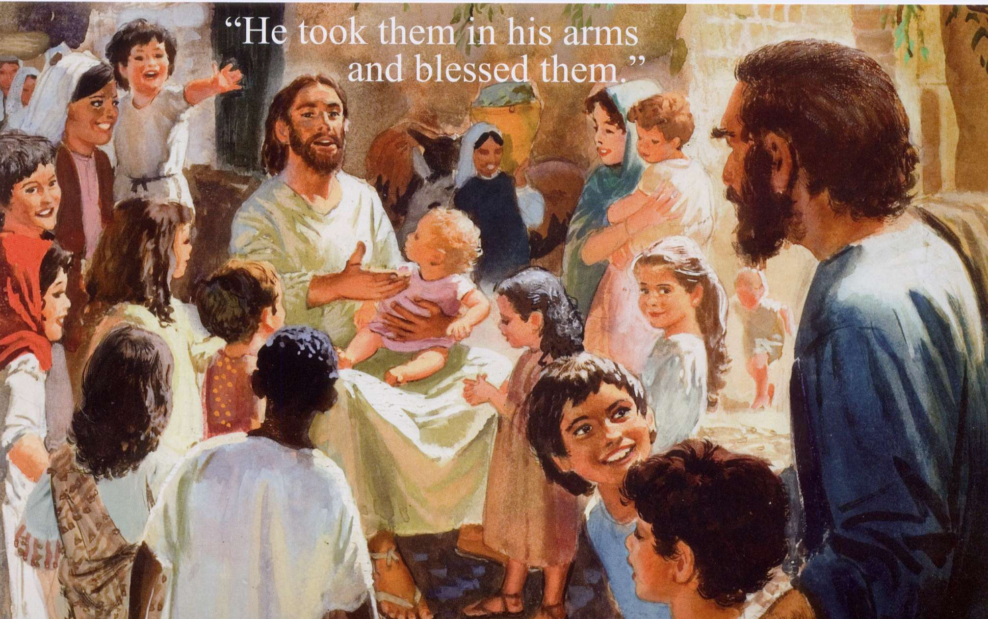

Slide 22
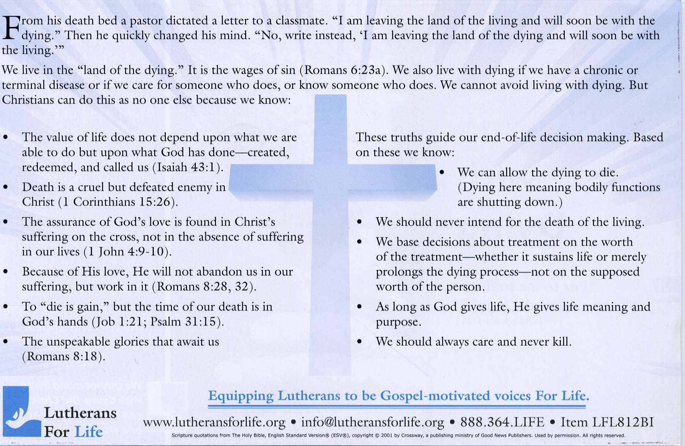

Slide 23


Slide 24


Slide 25
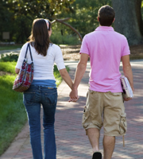

Slide 26
“SAVE THE CHILDREN”
Listen to the gentle heartbeat,
Of the little baby in the womb.
Will this child be allowed to live?
Or will the womb become a tomb?
CHORUS:
Save the children
Who though unborn are living.
Don’t take their lives.
Save the children
Who though unborn are living.
Don’t take their lives.
This most defenseless human being.
Lives nine months before he is born.
Some people don’t want him around,
If he dies, none of them will mourn.
What is your answer my friend?
Can we allow this to go on?
With such a means, what is the end?
I hope you see that it is wrong.

Slide 27
(Written by David Nehrenz in 1979, while he was a 2nd year seminarian at
Concordia Theological Seminary Ft. Wayne, Indiana.
This song was sung in January 1979 on the steps of the United States Capitol Building in Washington D.C.
The occasion was the annual “March for Life” organized at the time by Nellie Gray.
My friends and fellow seminarians Marty Kaarre, David Weber and I were members of a Christian band called “Tarkkuus” (the Finnish word for “truth”). We marched at the head of the line with over 50,000 people down the streets heading to the Capitol building. In the 10 degree weather, we took off our gloves, pulled out our guitars and sang this song over the P.A. system, before the United States Congressmen and Senators spoke.
To hear these 50,000 people join us in singing this chorus of “Save the Children” was inspiring.
The people in the Pro-Life Movement are some of the finest people I have ever met.
They are filled with mercy, kindness and love because they are helping other people save their own children.)

Slide 28
Ps.139: 23,24 – Closing Prayer
“Search me, O God, and know my heart!
Try me and know my thoughts!
And see if there be any grievous way in me,
and lead me in the way everlasting! Amen.”
.

