Slide 1
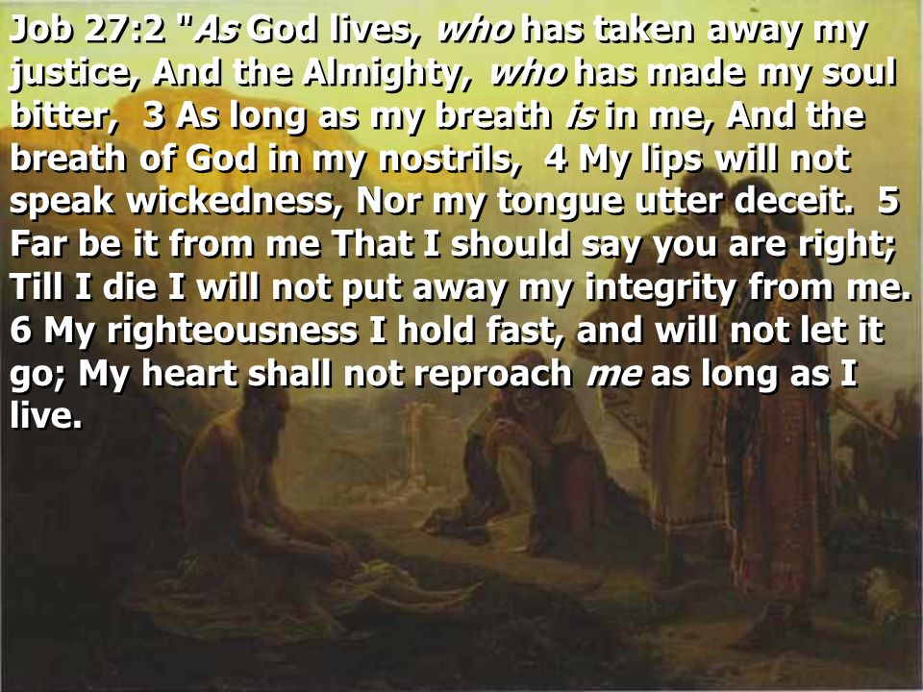
Begins July 16

Slide 2
THE BOOK OF JOB –
“The Suffering and Consolation of the Christian”
Date: 3-4-18 Lesson: 14
Text: Chapters 26,27
Theme:
“As God Lives, the Almighty”

Slide 3
(Job 26:1-14) Then Job answered and said: (2) "How you have helped him who has no power! How you have saved the arm that has no strength! (3) How you have counseled him who has no wisdom, and plentifully declared sound knowledge! (4) With whose help have you uttered words, and whose breath has come out from you?
(5) The dead tremble under the waters and their inhabitants. (6) Sheol is naked before God, and Abaddon has no covering. (7) He stretches out the north over the void and hangs the earth on nothing. (8) He binds up the waters in his thick clouds, and the cloud is not split open under them. (9) He covers the face of the full moon and spreads over it his cloud. (10) He has inscribed a circle on the face of the waters at the boundary between light and darkness.
(11) The pillars of heaven tremble and are astounded at his rebuke. (12) By his power he stilled the sea; by his understanding he shattered Rahab. (13) By his wind the heavens were made fair; his hand pierced the fleeing serpent. (14) Behold, these are but the outskirts of his ways, and how small a whisper do we hear of him! But the thunder of his power who can understand?"

Slide 4
(Job 27:1-23) And Job again took up his discourse, and said: (2) "As God lives, who has taken away my right, and the Almighty, who has made my soul bitter, (3) as long as my breath is in me, and the spirit of God is in my nostrils, (4) my lips will not speak falsehood, and my tongue will not utter deceit. (5) Far be it from me to say that you are right; till I die I will not put away my integrity from me. (6) I hold fast my righteousness and will not let it go; my heart does not reproach me for any of my days.
(7) "Let my enemy be as the wicked, and let him who rises up against me be as the unrighteous. (8) For what is the hope of the godless when God cuts him off, when God takes away his life? (9) Will God hear his cry when distress comes upon him? (10) Will he take delight in the Almighty? Will he call upon God at all times? (11) I will teach you concerning the hand of God; what is with the Almighty I will not conceal. (12) Behold, all of you have seen it yourselves; why then have you become altogether vain?

Slide 5
(13) "This is the portion of a wicked man with God, and the heritage that oppressors receive from the Almighty: (14) If his children are multiplied, it is for the sword, and his descendants have not enough bread. (15) Those who survive him the pestilence buries, and his widows do not weep. (16) Though he heap up silver like dust, and pile up clothing like clay, (17) he may pile it up, but the righteous will wear it, and the innocent will divide the silver. (18) He builds his house like a moth's, like a booth that a watchman makes. (19) He goes to bed rich, but will do so no more; he opens his eyes, and his wealth is gone.
(20) Terrors overtake him like a flood; in the night a whirlwind carries him off. (21) The east wind lifts him up and he is gone; it sweeps him out of his place. (22) It hurls at him without pity; he flees from its power in headlong flight. (23) It claps its hands at him and hisses at him from its place.

Slide 6
.
STUDY NOTES:
Almighty God
(who can understand Him? - chapter 26):
He stretches out the north - He binds up the waters - He covers the face –
He has inscribed a circle
His rebuke - his power - his understanding - his wind - his hand- the thunder of his power
(Ps 139:1-12; Prov 3:19,20; 15:11; 30:4;
1 Cor 13:12; Heb 4:13; 11:3; Jas 1:5; Rev 9:11)

Slide 7
2. As God lives (- chapter 27) - who has taken away my right, and the Almighty, who has made my soul bitter,
- as long as my breath is in me, and the spirit of God is in my nostrils,
- my lips will not speak falsehood, and my tongue will not utter deceit.
- far be it from me to say that you are right; till I die I will not put away my integrity from me.
- I hold fast my righteousness and will not let it go;
- my heart does not reproach me for any of my days.
(Ps 144:4; 119:121; 132:9; Mt 26:63,64; Acts 23:1; Rom 2:15; 1 Pet 1:5)

Slide 8
3. The wicked - the unrighteous- the godless when God cuts him off,
when God takes away his life:
- Will God hear his cry when distress comes upon him?
-Will he take delight in the Almighty?
-Will he call upon God at all times?
-This is the portion of a wicked man with God, and the heritage that oppressors receive from the
Almighty:- He goes to bed rich, but will do so no more; he opens his eyes,
and his wealth is gone.
(Ps 109:6-15; 137:8,9; Prov 13:22; 28:8; Eccl 2:26; Lk 12:20; Rom 12:19; Rev 6:10)

Slide 9
LUTHER’S WORKS - Vol. 21, p. 328 – The Almighty God
“He who is mighty.” Truly, in these words she takes away all might and power from every creature and bestows them on God alone. What great boldness and robbery on the part of so young and tender a maiden! She dares, by this one word, to make all the strong feeble, all the mighty weak, all the wise foolish, all the famous despised, and God alone the Possessor of all strength, wisdom, and glory.
For this is the meaning of the phrase: “He who is mighty.” There is none that does anything, but as St. Paul says in Ephesians 1: “God accomplishes all in all,” and all creatures’ works are God’s works. Even as we confess in the Creed: “I believe in God the Father, the Almighty.” He is almighty because it is His power alone that works in all and through all and over all. Thus St. Anna, the mother of Samuel, sings in 1 Samuel 2:9: “Not by might shall a man prevail.” St. Paul says in 2 Corinthians 3:5: “Not that we are sufficient of ourselves to claim anything as coming from us; our sufficiency is from God.”
This is a most important article of faith, including many things; it completely puts down all pride, arrogance, blasphemy, fame, and false trust, and exalts God alone. It points out the reason why God alone is to be exalted—because He does all things. That is easily said but hard to believe and to translate into life. For those who carry it out in their lives are most peaceable, composed, and simple-hearted folk, who lay no claim to anything, well knowing it is not theirs but God’s.

Slide 10
LIFE APPLICATION:
If as God lives as the Almighty - how can we,
as long as our breath is in us,
and the spirit of God is in our nostrils,
see to it that our lips will not speak falsehood, and our tongues will not utter deceit?

Slide 11
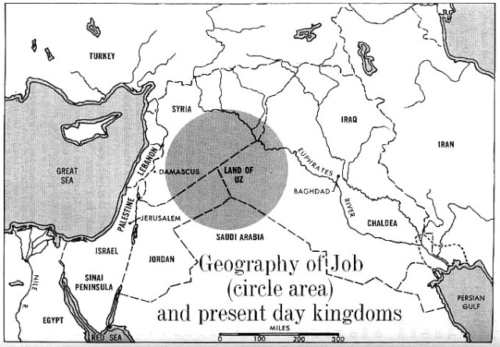

Slide 12


Slide 13
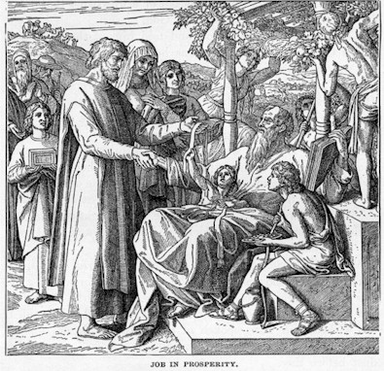

Slide 14
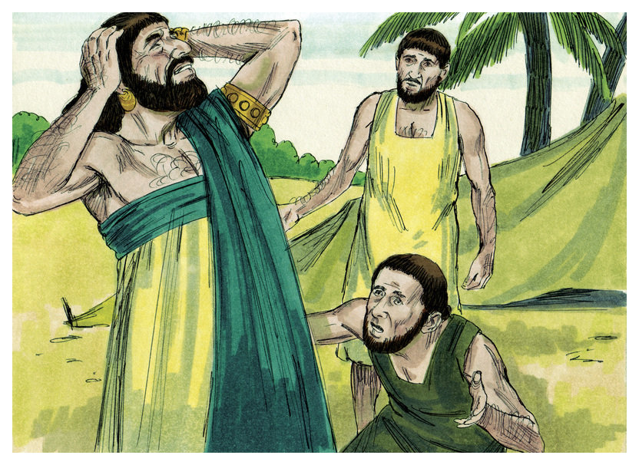

Slide 15
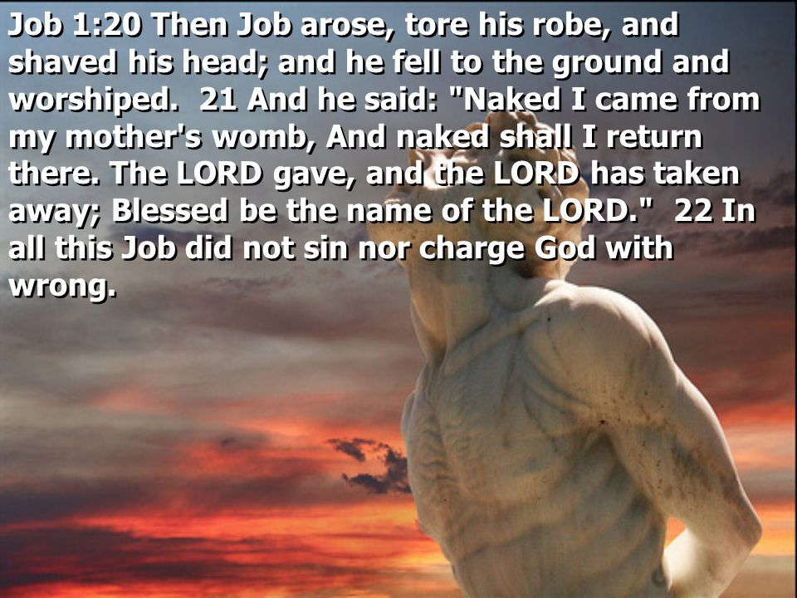

Slide 16
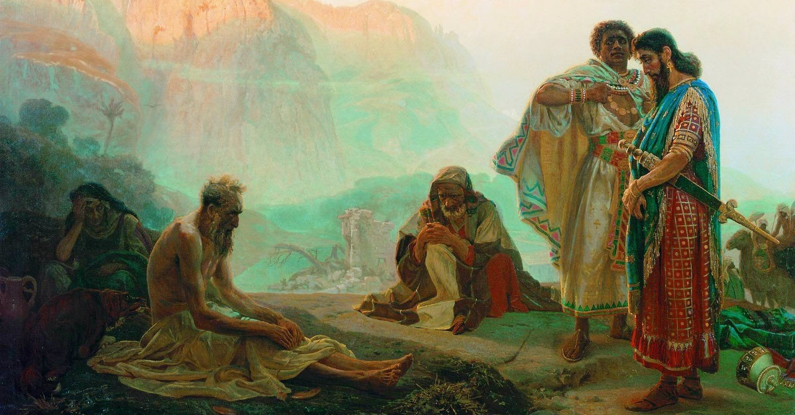

Slide 17


Slide 18
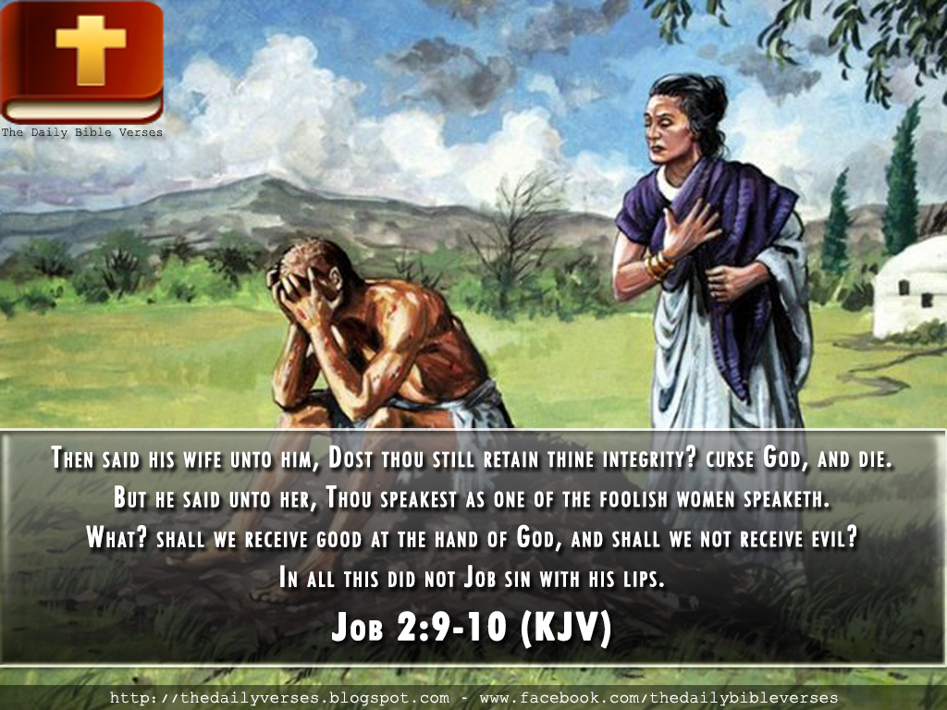

Slide 19
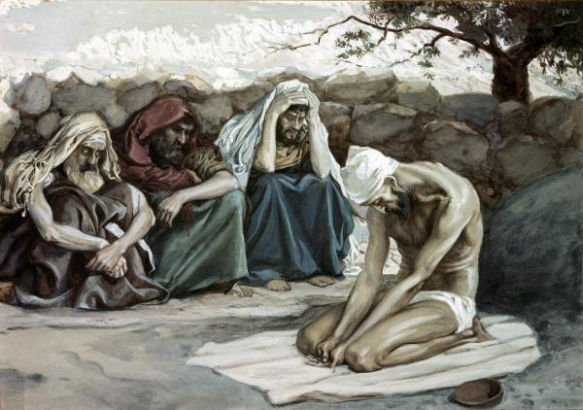

Slide 20
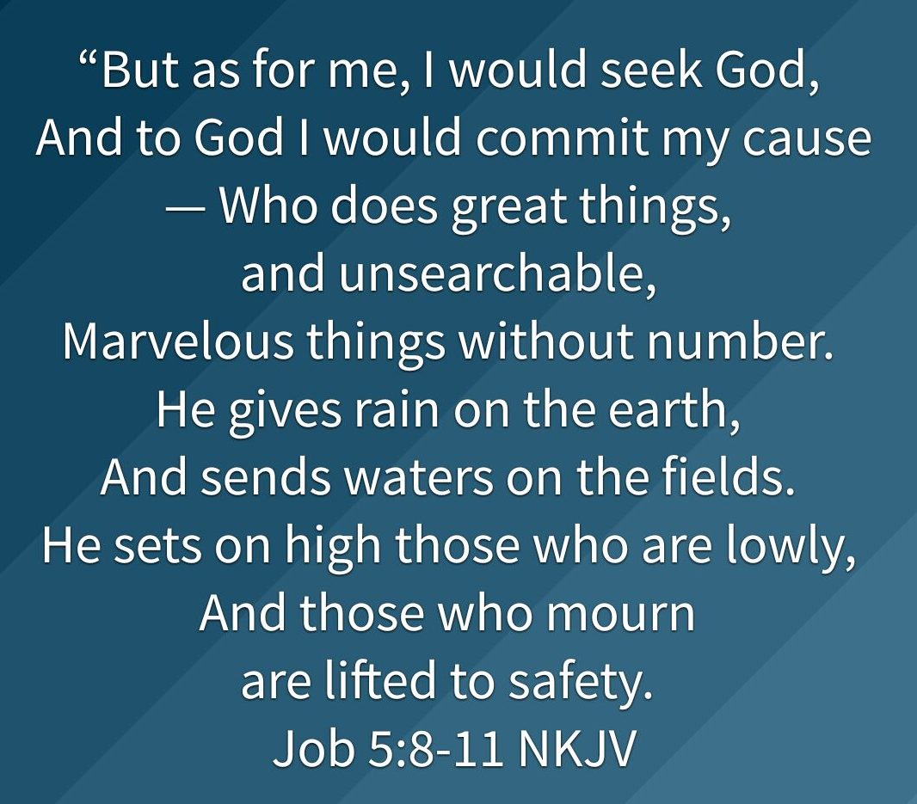

Slide 21
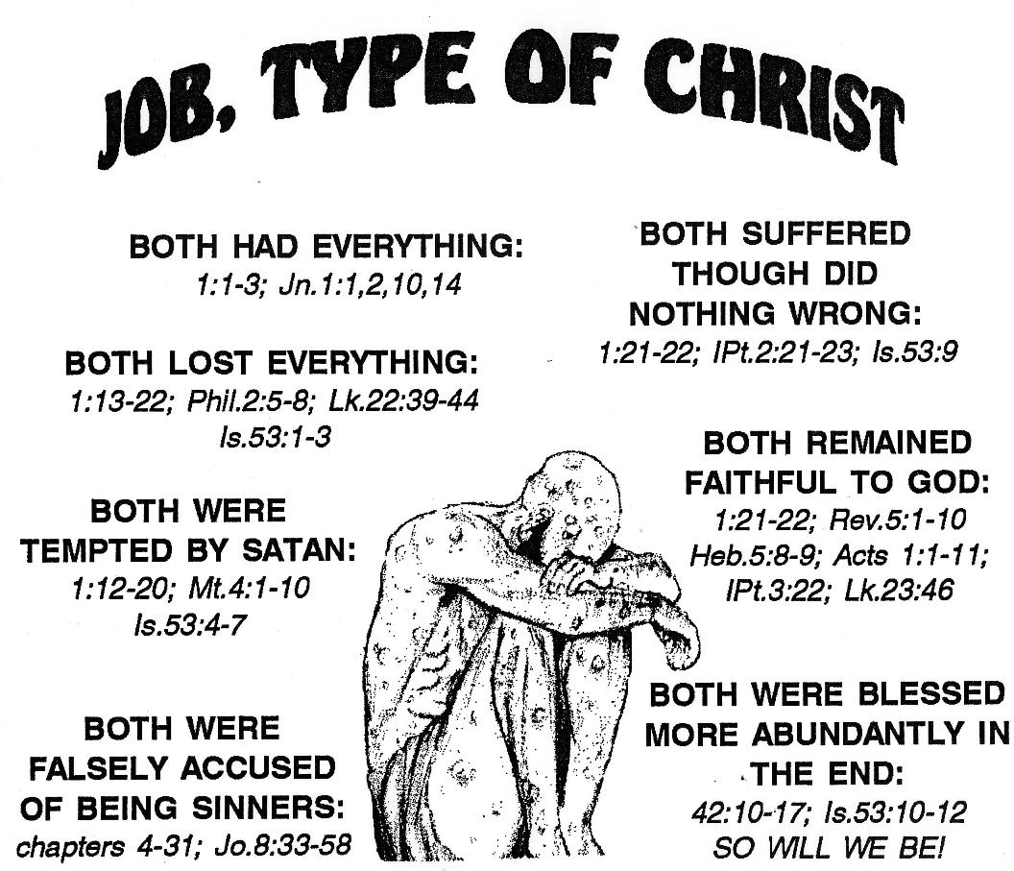

Slide 22
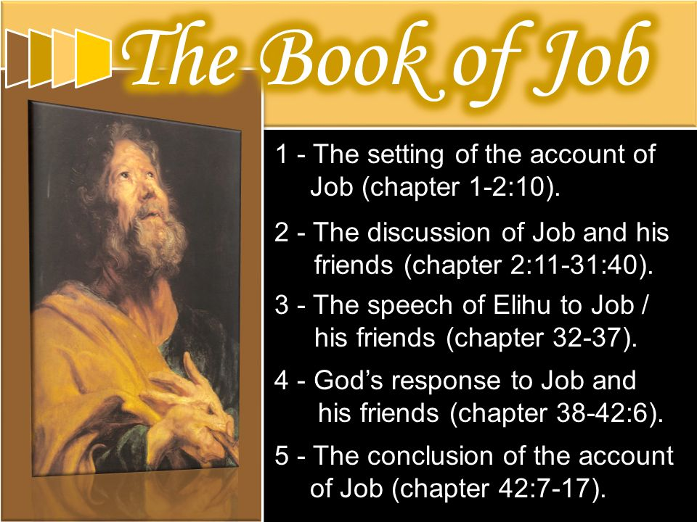

Slide 23
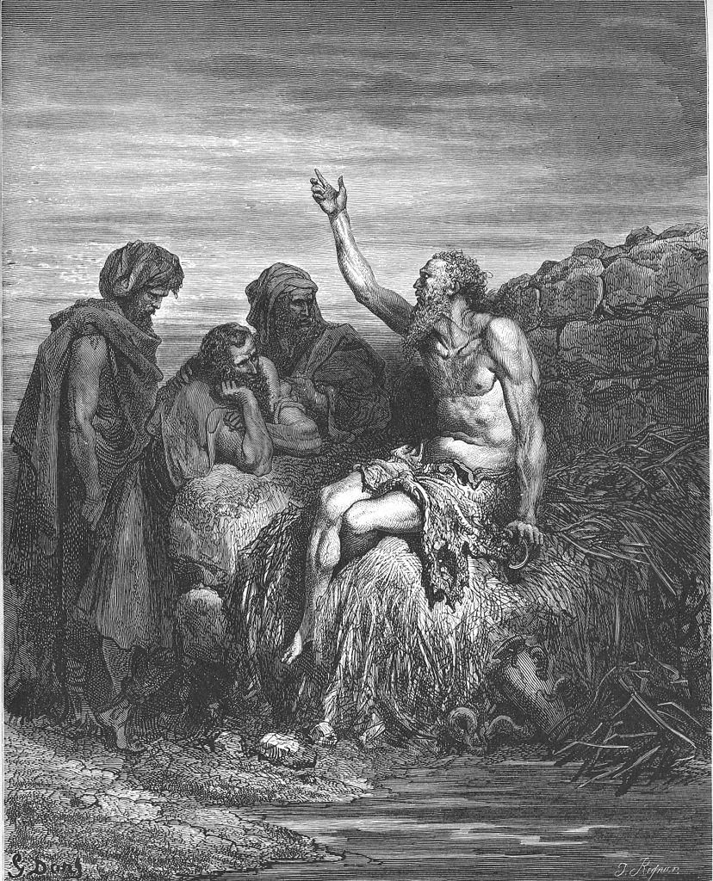

Slide 24
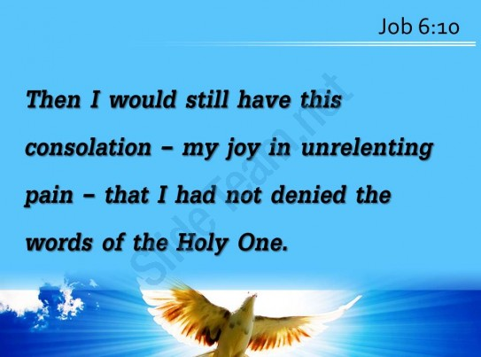

Slide 25
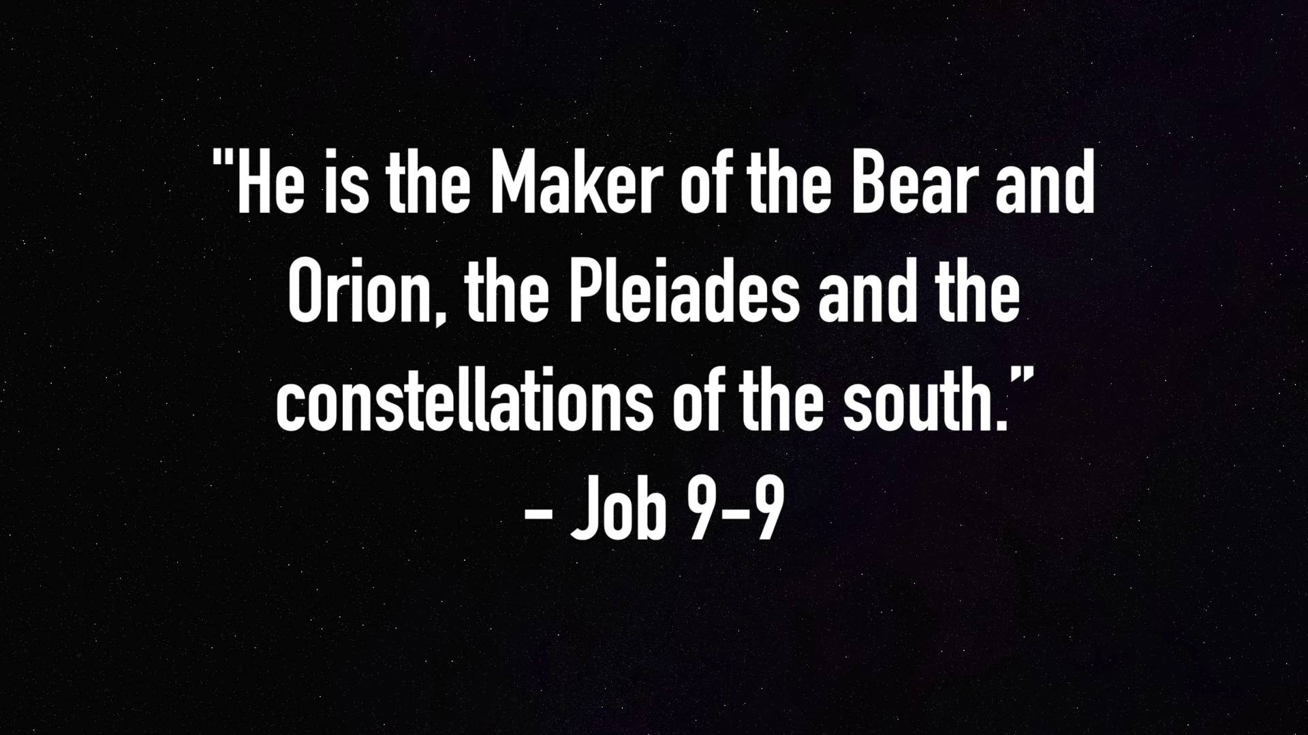

Slide 26
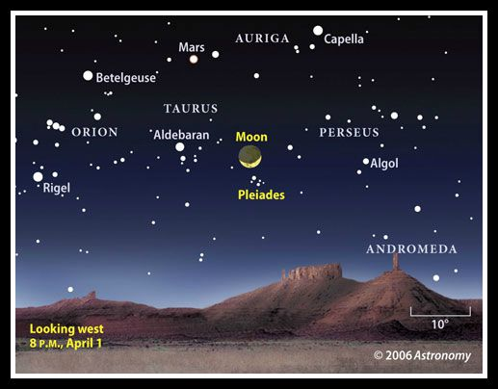

Slide 27


Slide 28
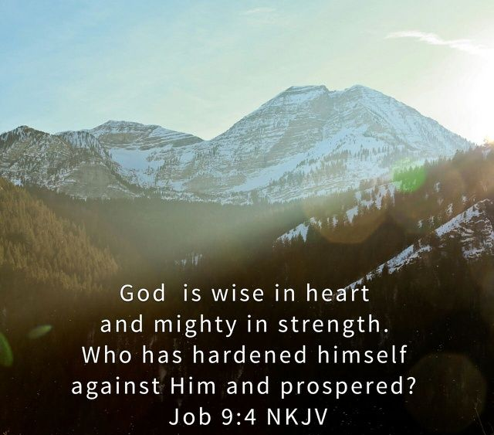

Slide 29
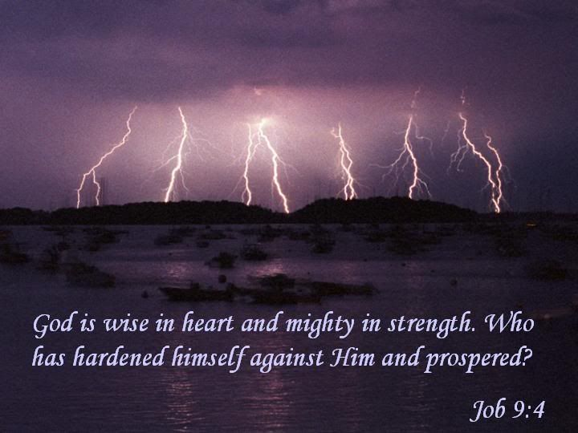

Slide 30
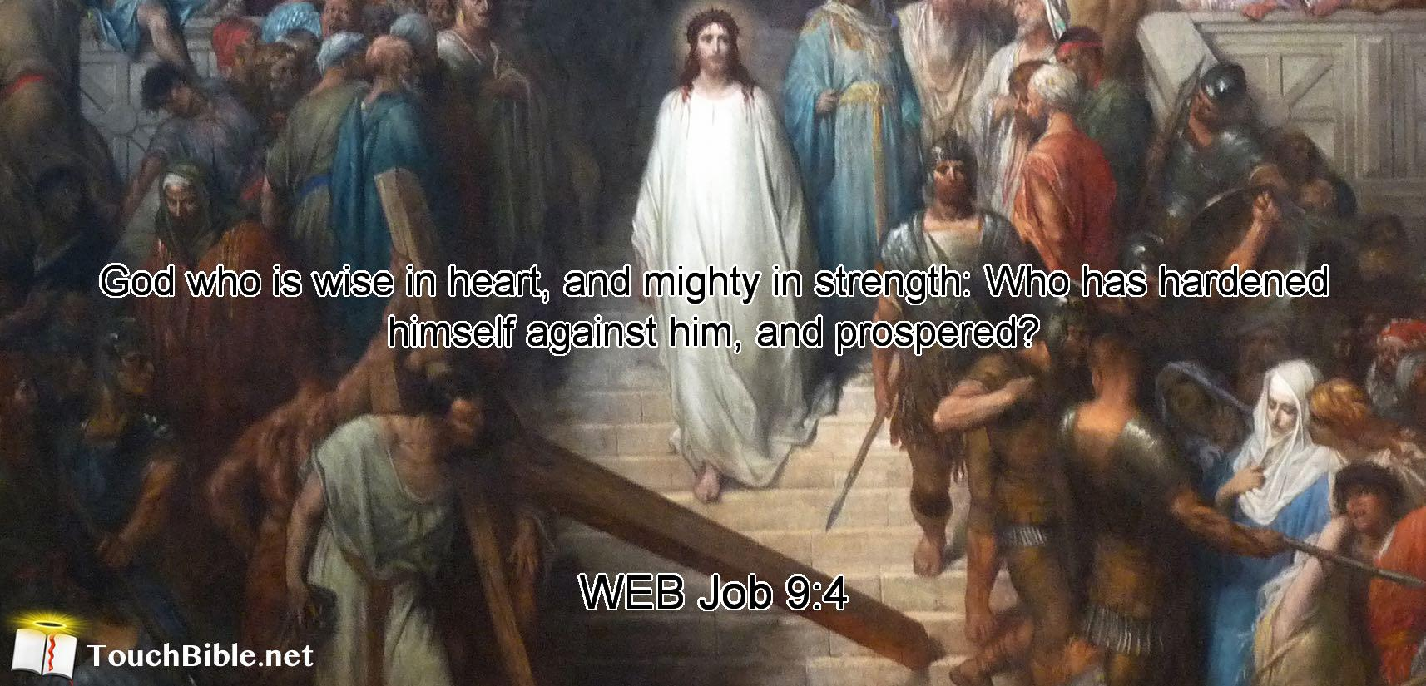

Slide 31


Slide 32
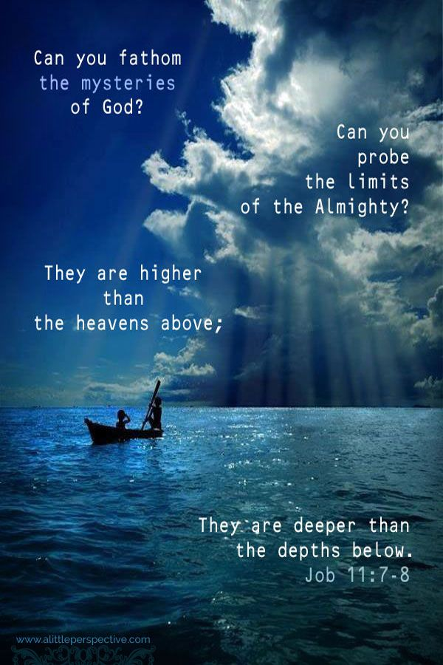

Slide 33
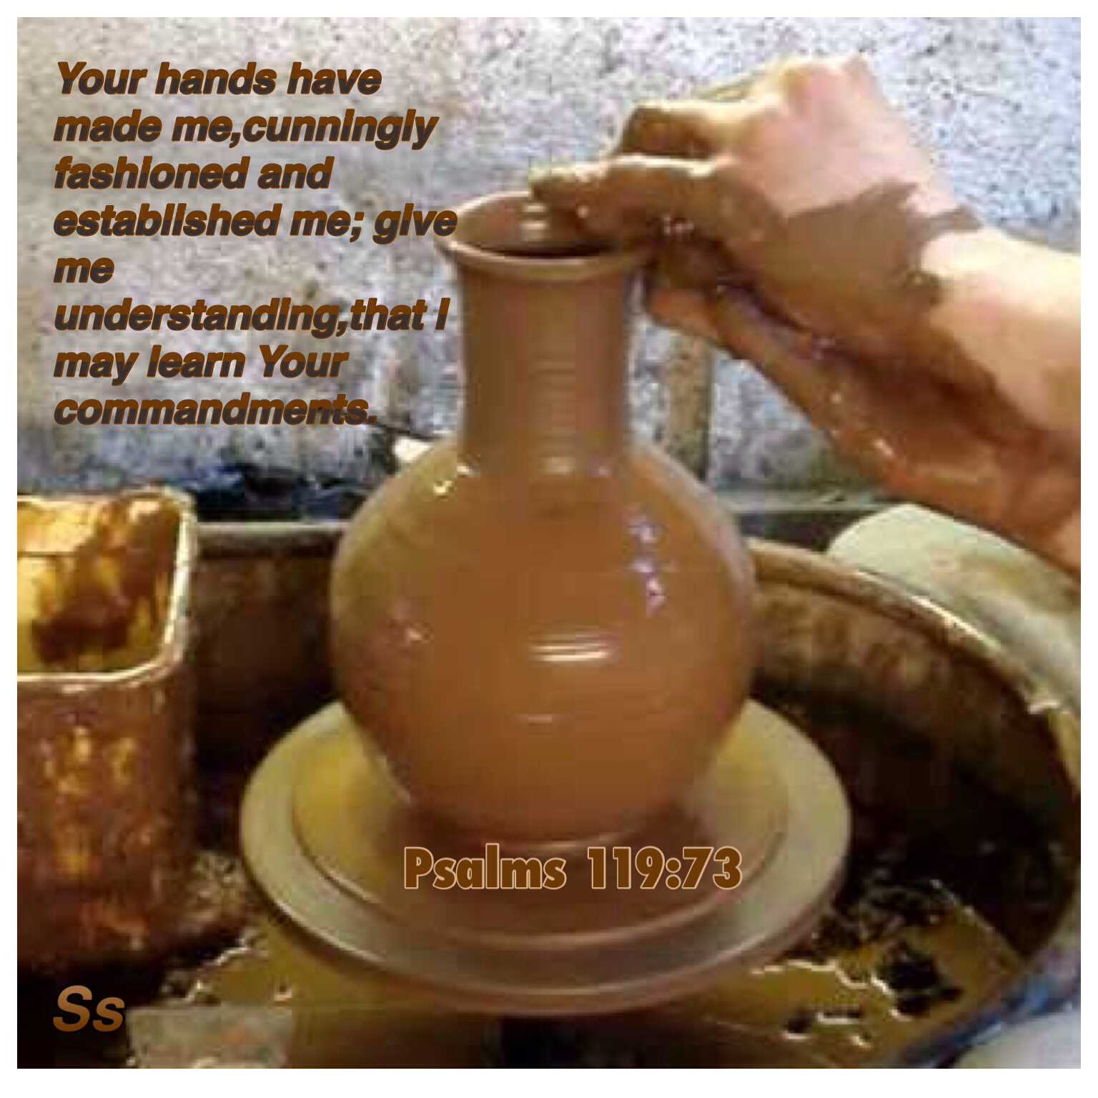

Slide 34


Slide 35
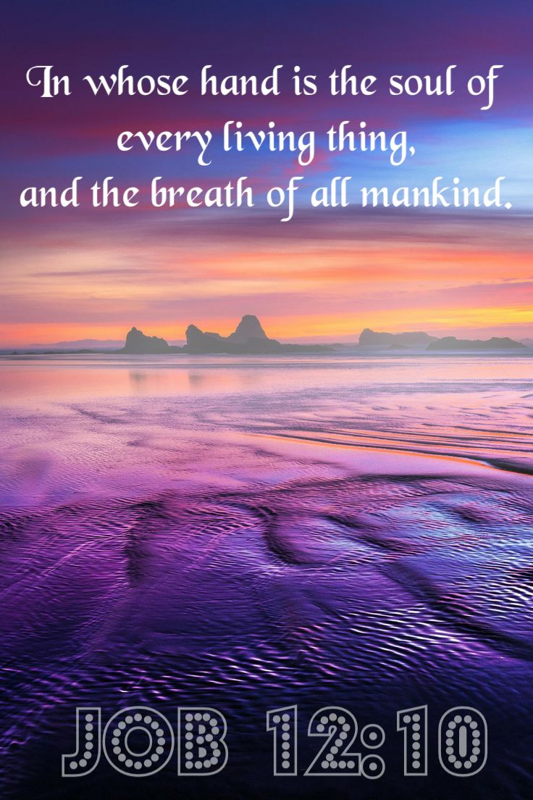

Slide 36


Slide 37
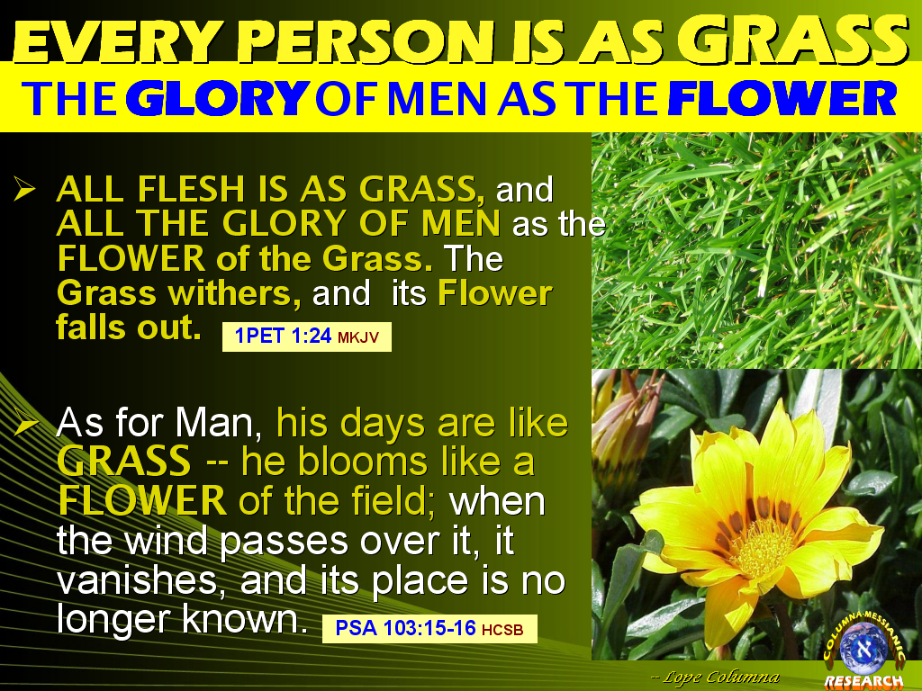

Slide 38
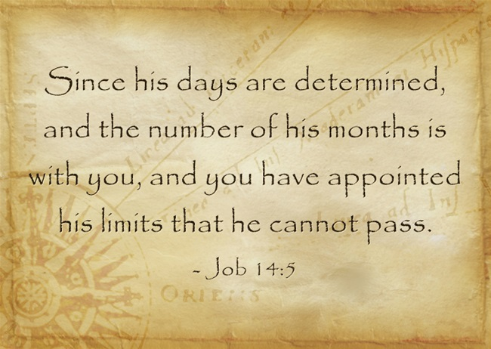

Slide 39
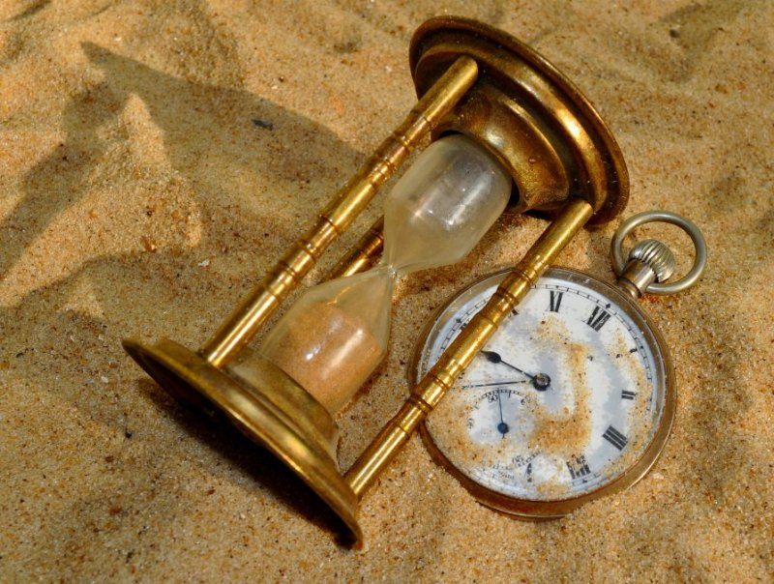

Slide 40
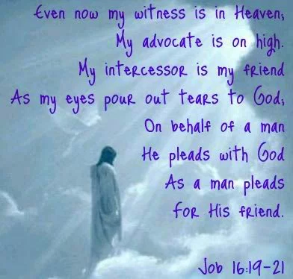

Slide 41
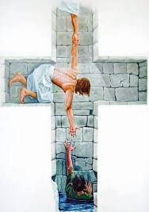

Slide 42
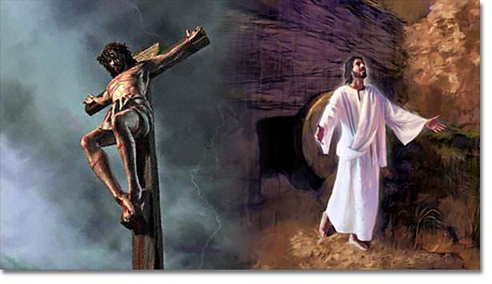

Slide 43
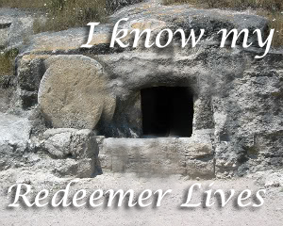

Slide 44
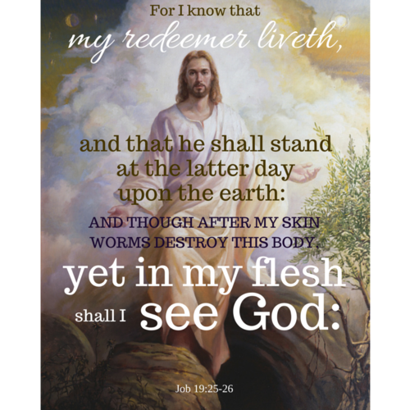

Slide 45
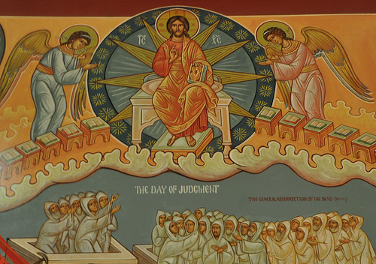

Slide 46


Slide 47
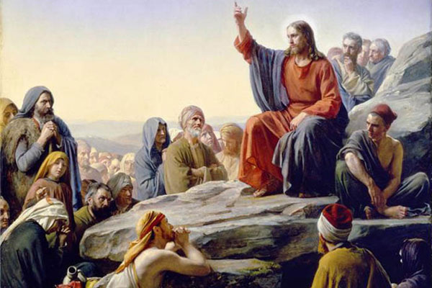

Slide 48
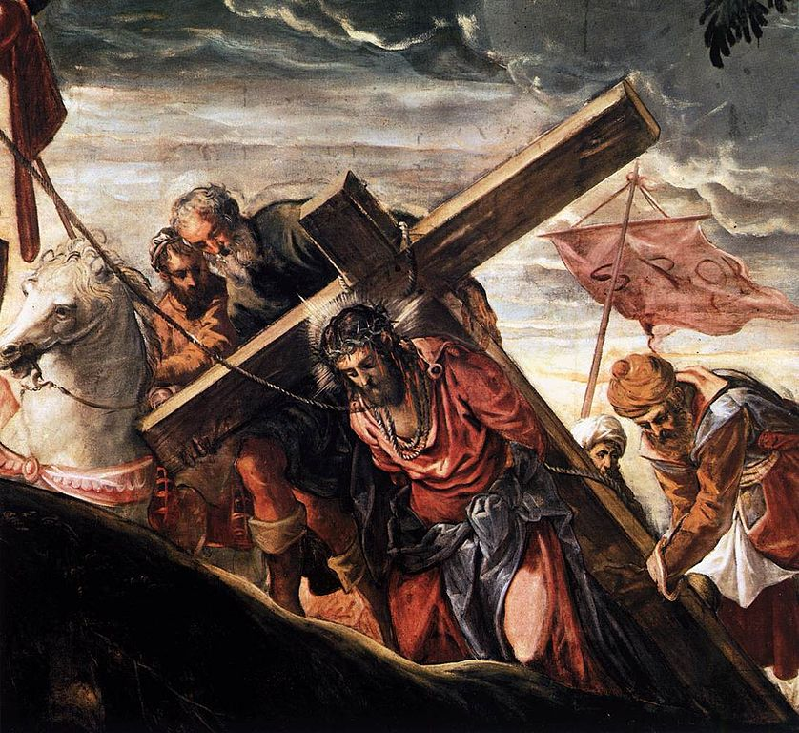

Slide 49
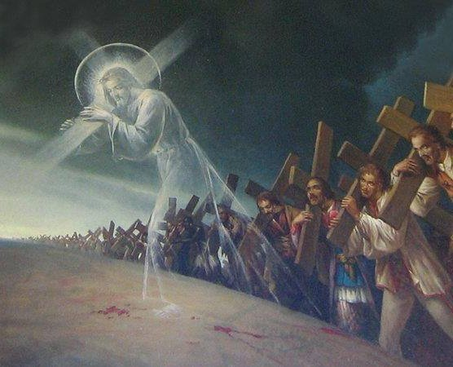

Slide 50
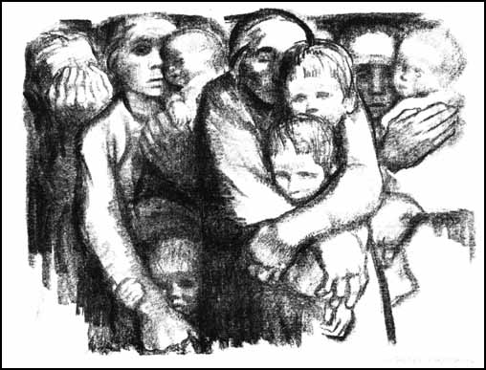

Slide 51
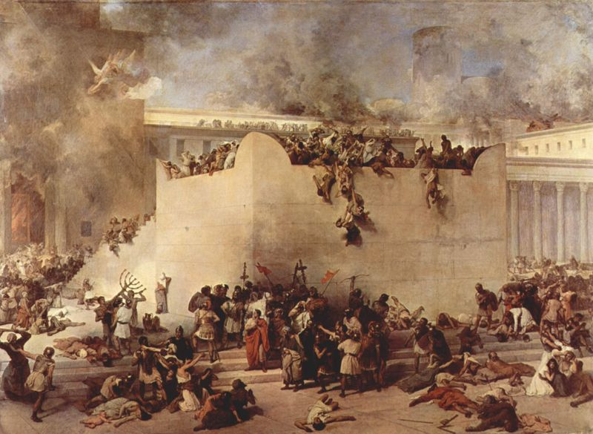

Slide 52
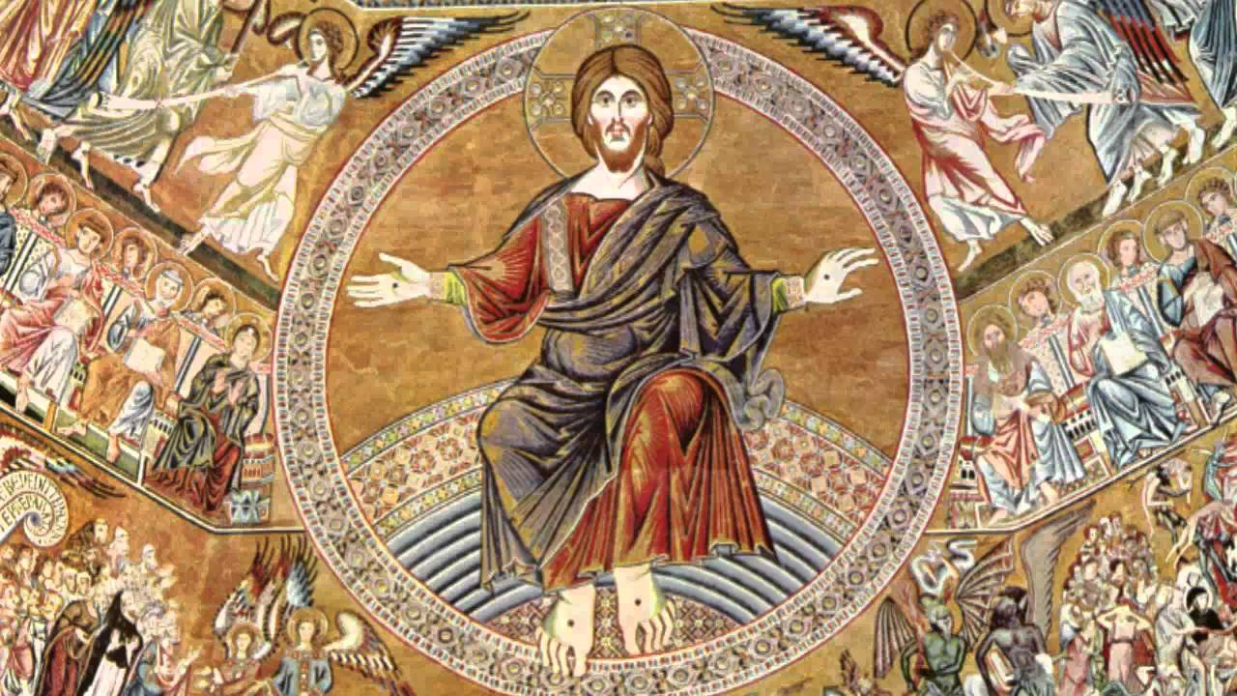

Slide 53
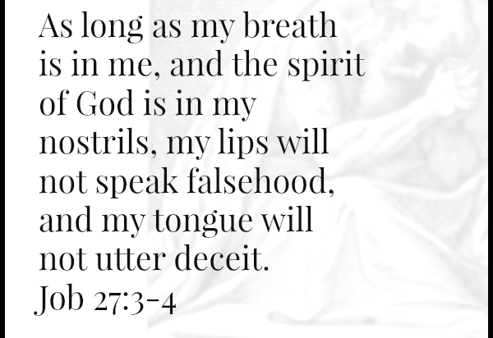

Slide 54
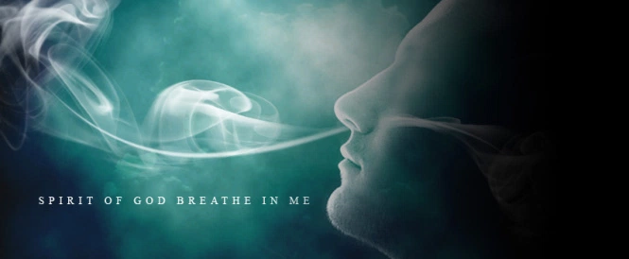

Slide 55
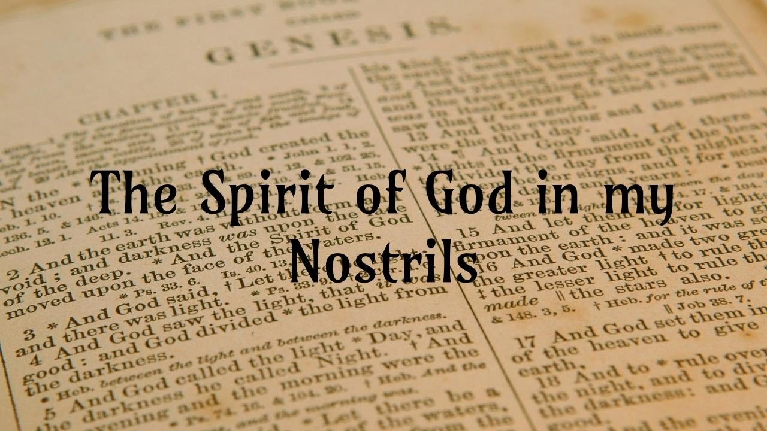

Slide 56
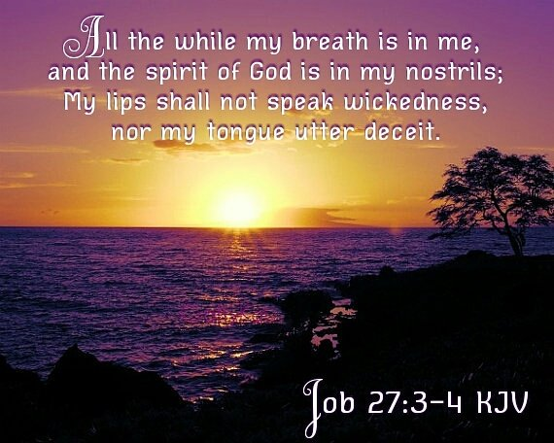

Slide 57
