Slide 1
Trinity Lutheran Church
Norman, Oklahoma – www.tlcnorman.org
The Epistle of James
Theme:
“The Testing of Your Faith”
Date:1-8-22
Lesson: 1 - Chapter 1:1-4

Slide 2
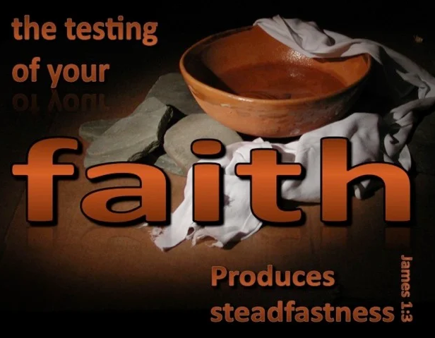

Slide 3
TEXT
(1:1-4) James, a servant of God and of the Lord Jesus Christ,
To the twelve tribes in the Dispersion:
Greetings.
(2) Count it all joy, my brothers, when you meet trials of various kinds,
(3) for you know that the testing of your faith produces steadfastness.
(4) And let steadfastness have its full effect, that you may be perfect and complete, lacking in nothing.

Slide 4
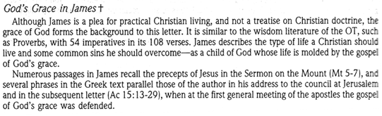
STUDY NOTES

Slide 5
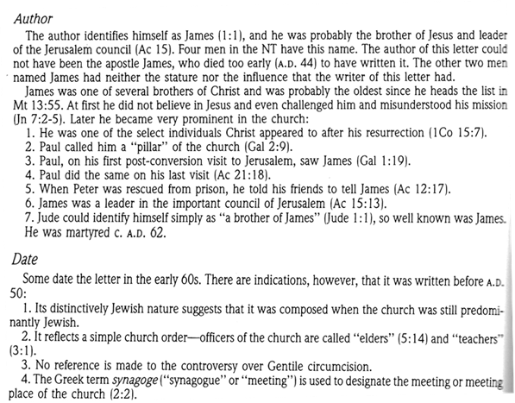

Slide 6
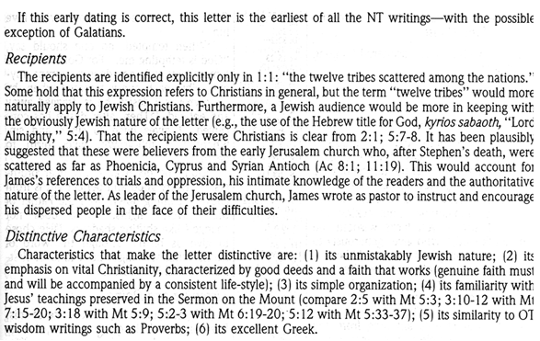

Slide 7
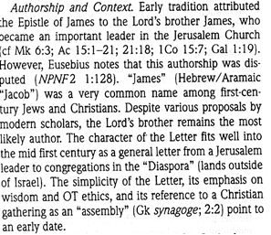

Slide 8
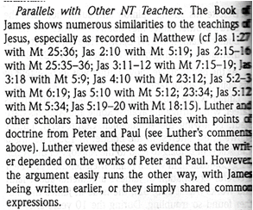

Slide 9
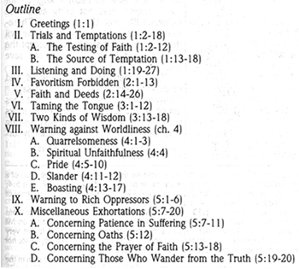

Slide 10
LIFE APPLICATION
All joy - trials of various kinds,
the testing of your faith - produces steadfastness
steadfastness
perfect – complete - lacking in nothing.
This is the theology of the cross which fits daily reality
for the Christian.
Explain how this is true.

Slide 11


