Slide 1
Trinity Lutheran Church
Norman, Oklahoma – www.tlcnorman.org
The Epistle of James
Theme:
“The Testing of Your Faith”
Date: 2-4-24
Lesson: 41 - Chapter 5:17,18

Slide 2
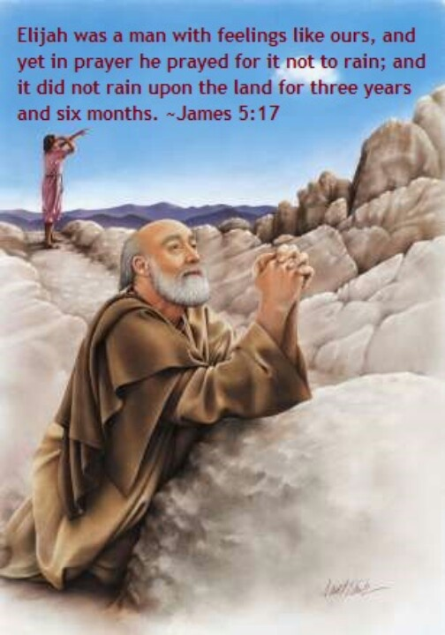

Slide 3
TEXT AND STUDY NOTES
(17) Elijah was a man with a nature like ours, and he prayed fervently that it might not rain, and for three years and six months it did not rain on the earth.
(1 Kings 17:1,7,14; 18:1,37-46;
Lk 4:24-26;
Acts 12:1-17; 14:15; 18:24-28;
Rom 12:9-12; 2 Cor 8:16,17,22,23)

Slide 4
(18) Then he prayed again, and heaven gave rain, and the earth bore its fruit.
(Jonah 2:1-10; Job 5:8-10;
Ps 72:6; 147:8;
Is 45:8; 55:10,11; Joel 2:23;
Zech 10:1;
Mt 5:44-47;
Acts 10:1,2; Heb 6:7; Rev 11:1-8)

Slide 5
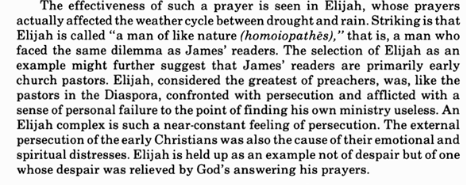
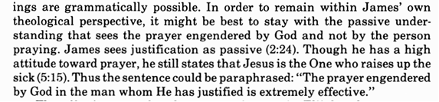

Slide 6
Explain the
“balance of prayer”:
-On the one hand pray fervently to God
– On the other hand pray that God’s will be done

Slide 7
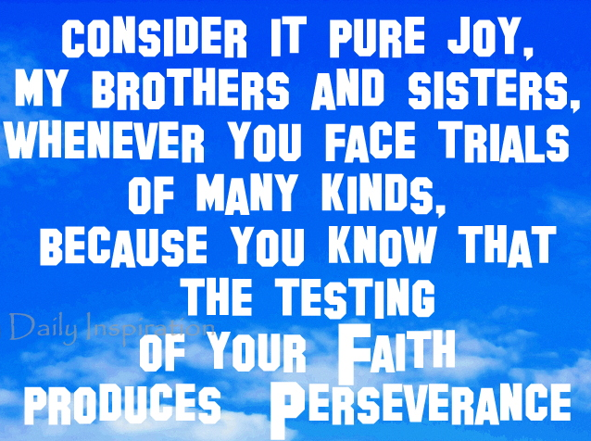

Slide 8
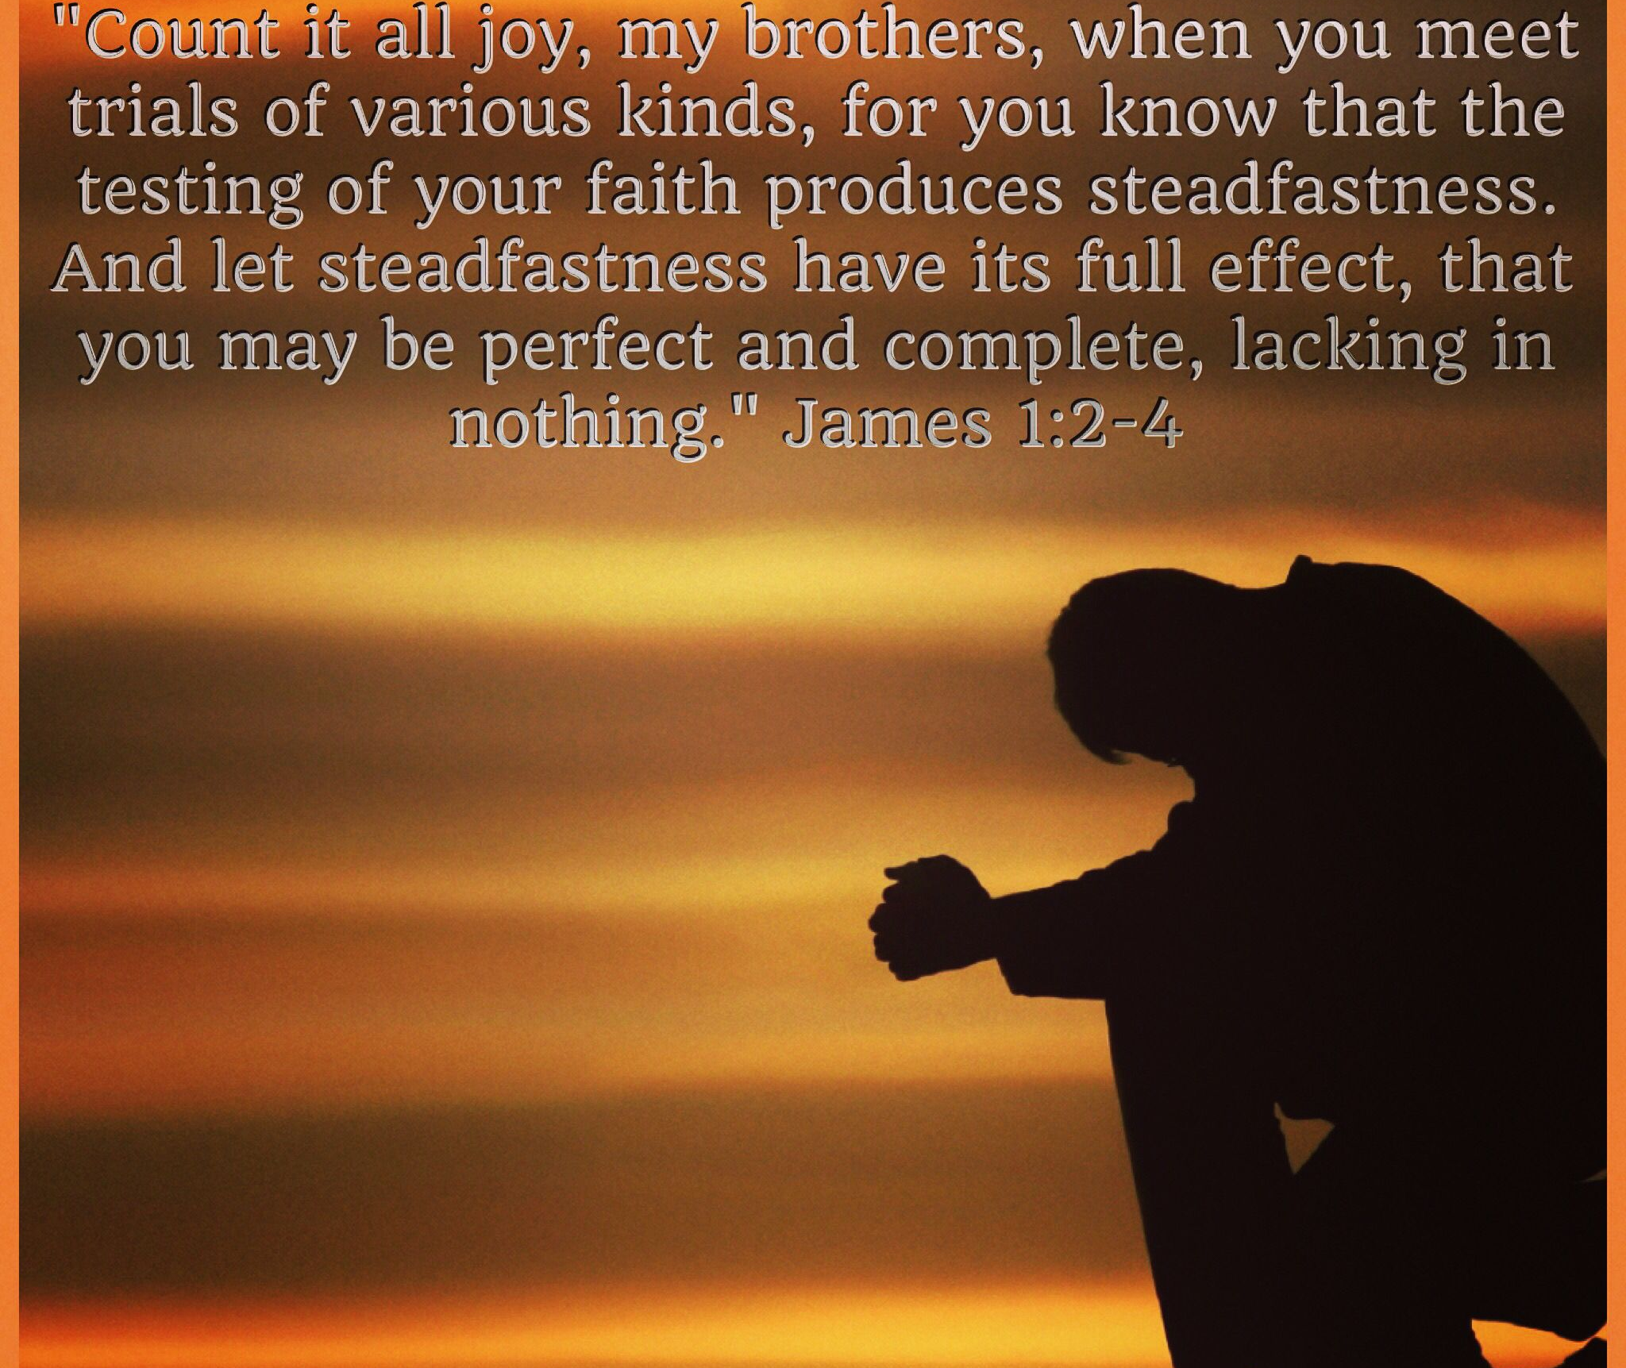

Slide 9
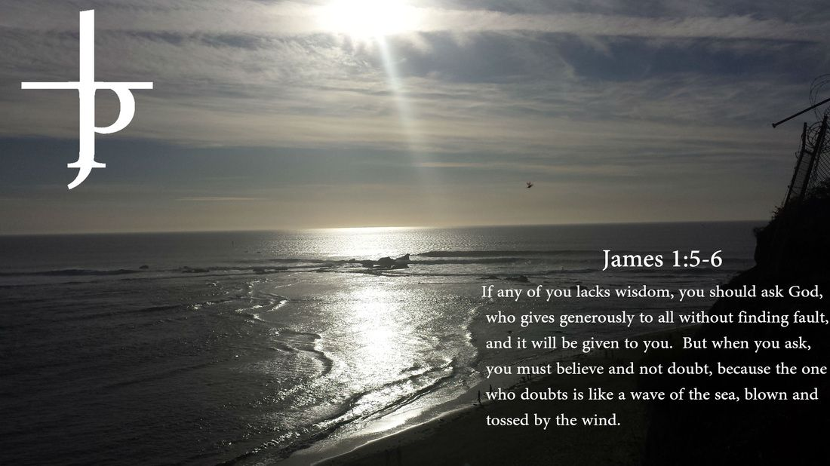

Slide 10
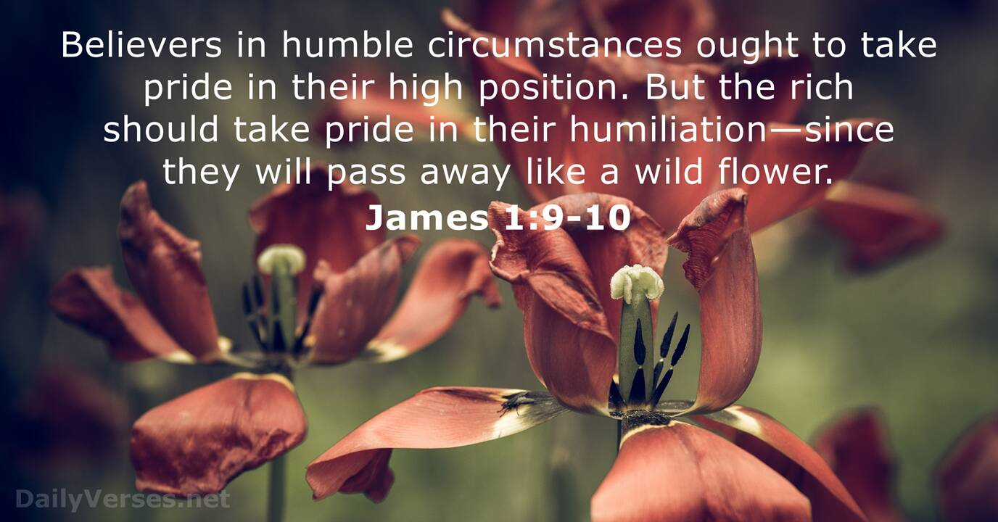

Slide 11
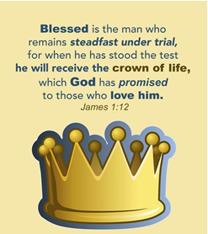

Slide 12
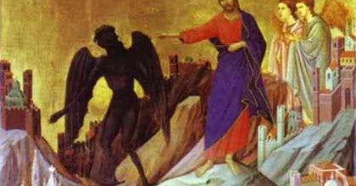

Slide 13
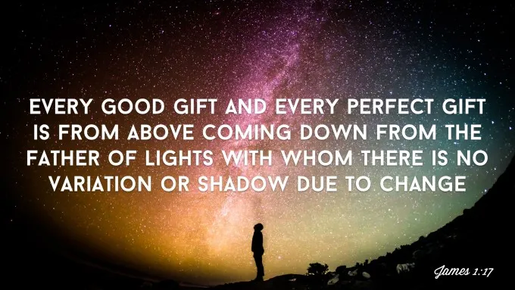

Slide 14
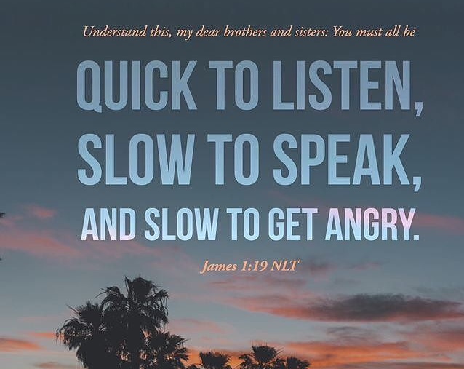

Slide 15
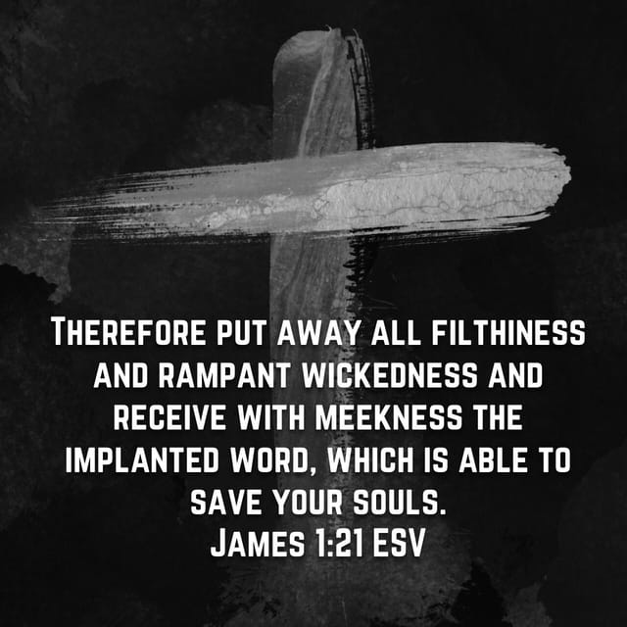

Slide 16
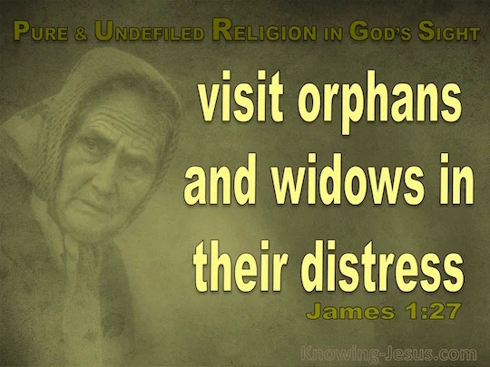

Slide 17
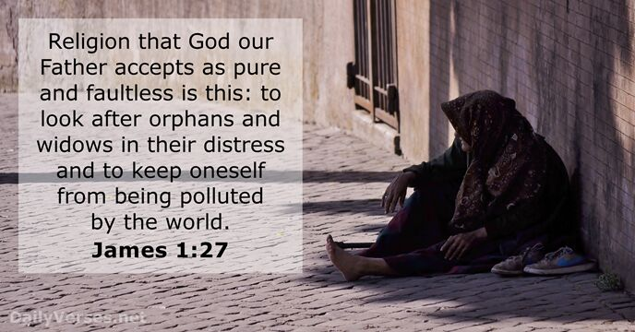

Slide 18
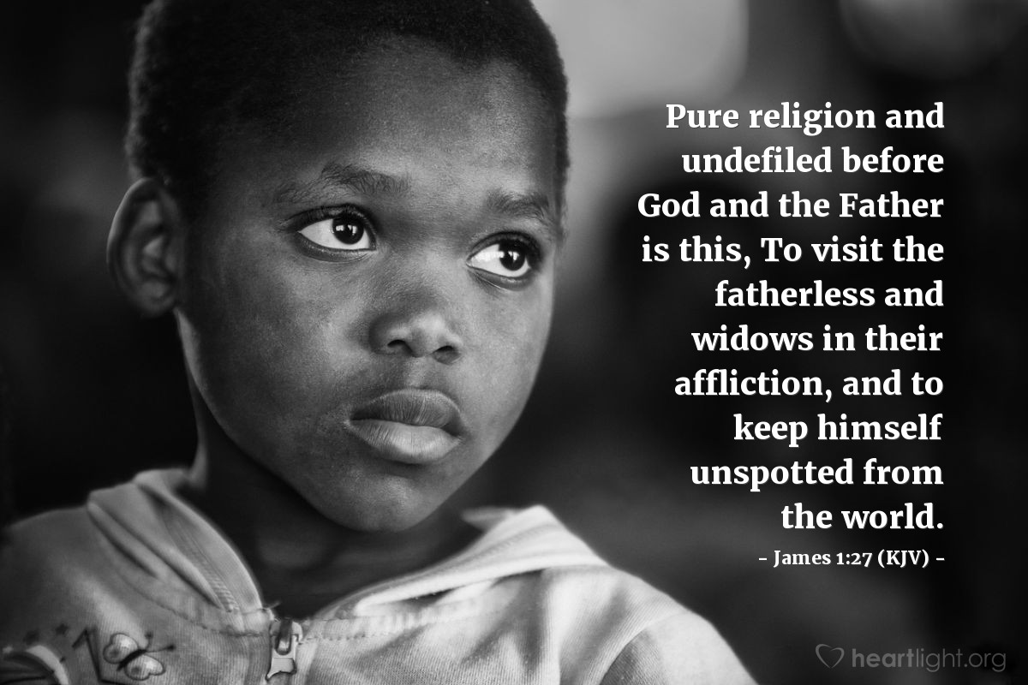

Slide 19
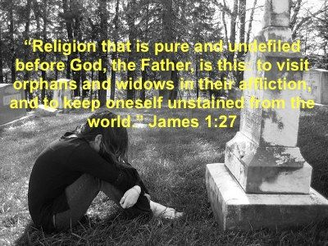

Slide 20
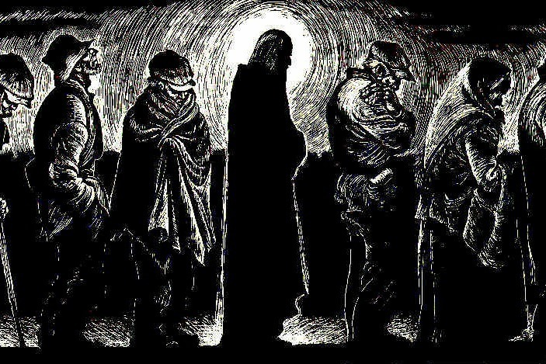

Slide 21
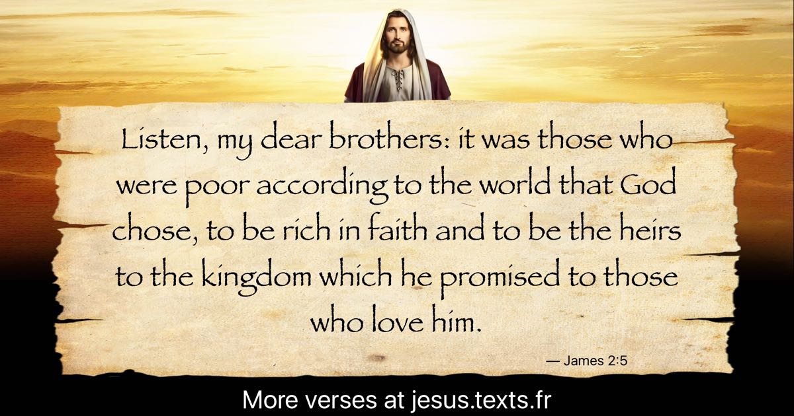

Slide 22
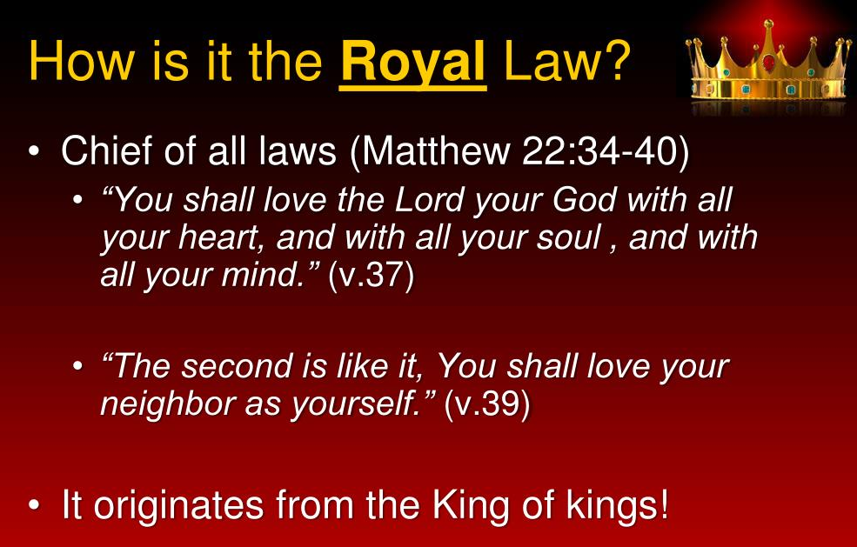

Slide 23
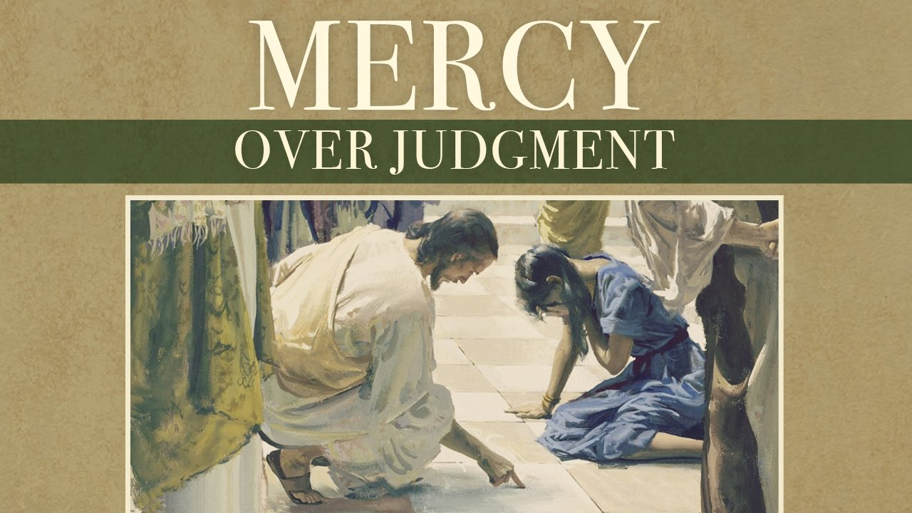

Slide 24


Slide 25
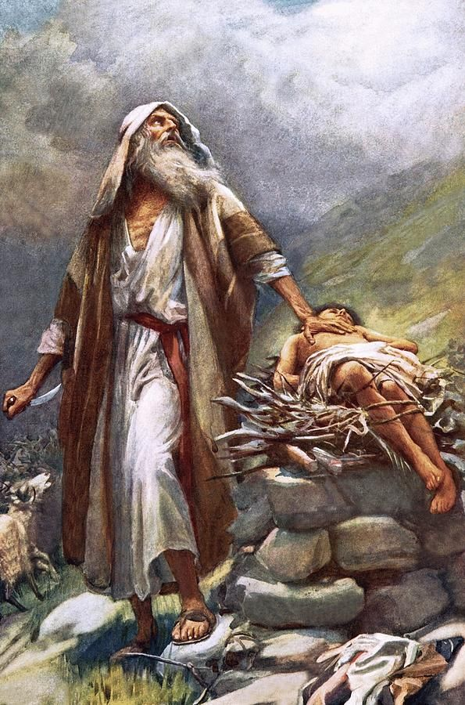

Slide 26
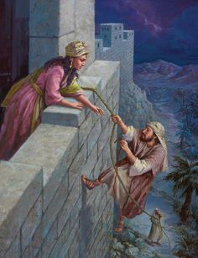

Slide 27
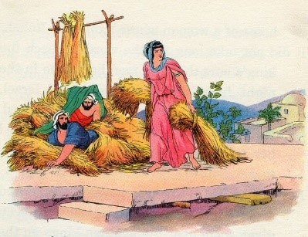

Slide 28


Slide 29


Slide 30
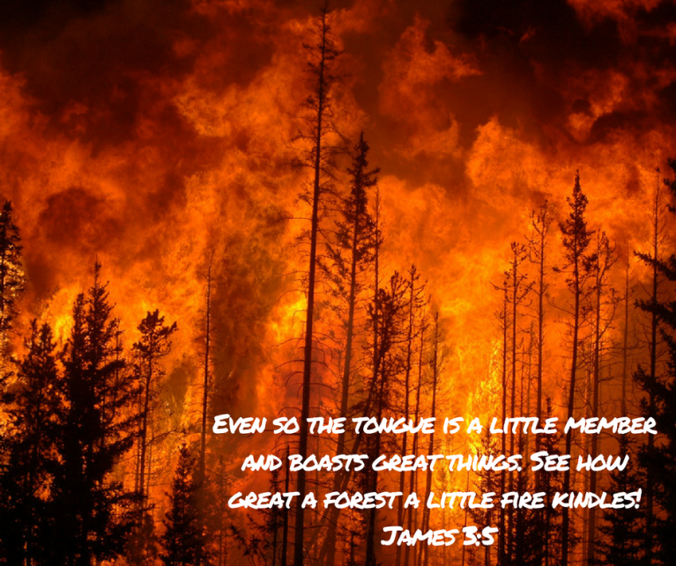

Slide 31
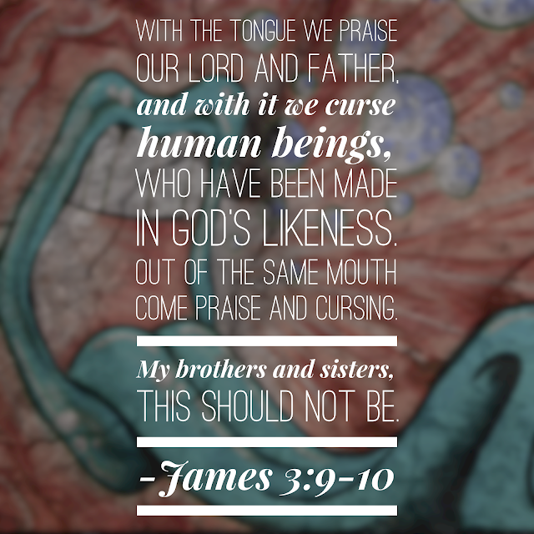

Slide 32
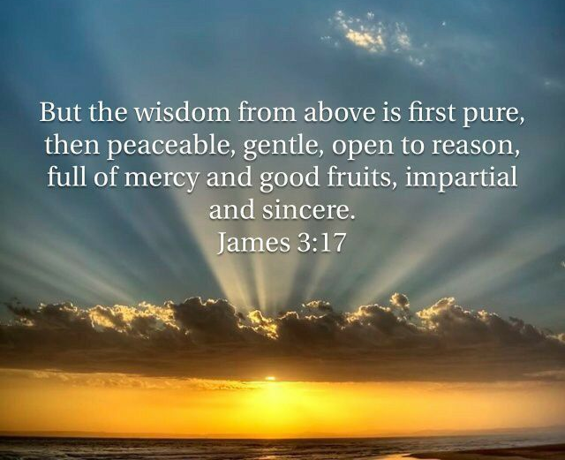

Slide 33


Slide 34


Slide 35
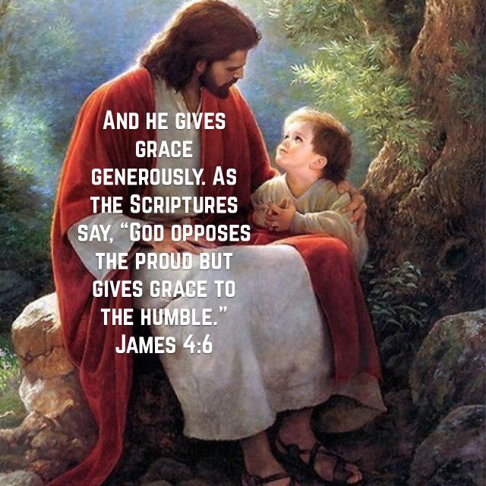

Slide 36
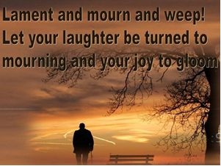

Slide 37
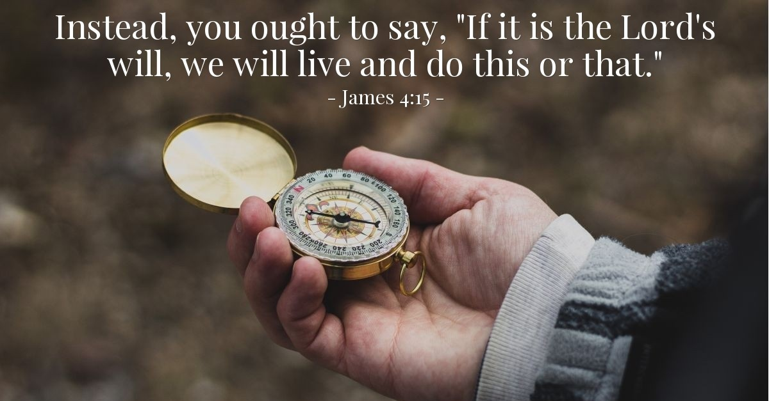

Slide 38


Slide 39
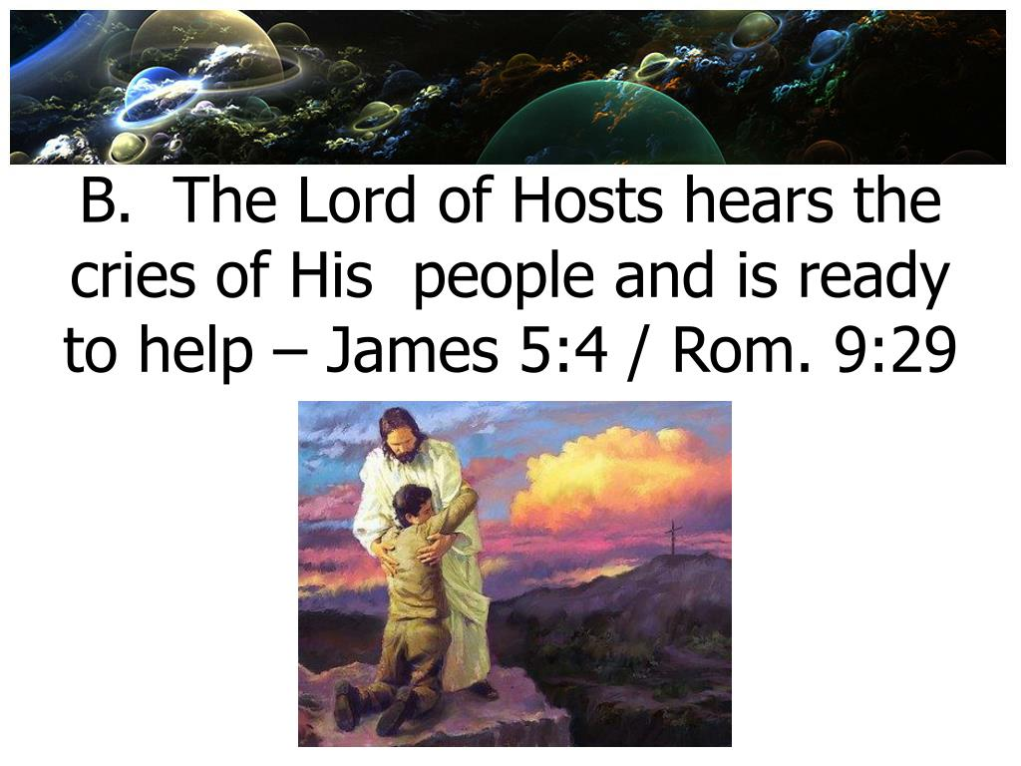

Slide 40
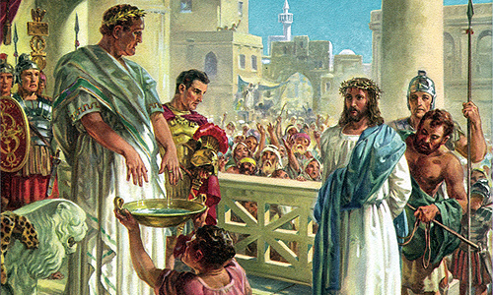

Slide 41
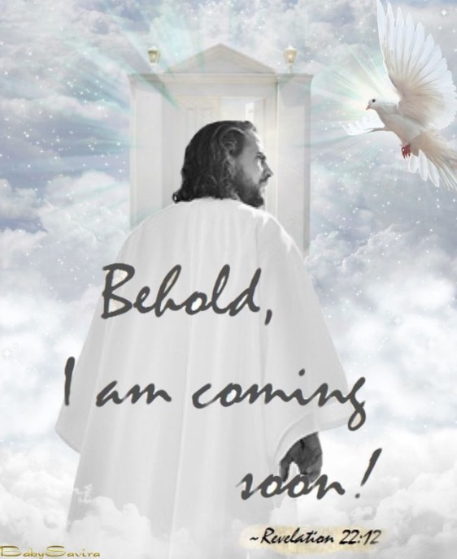

Slide 42
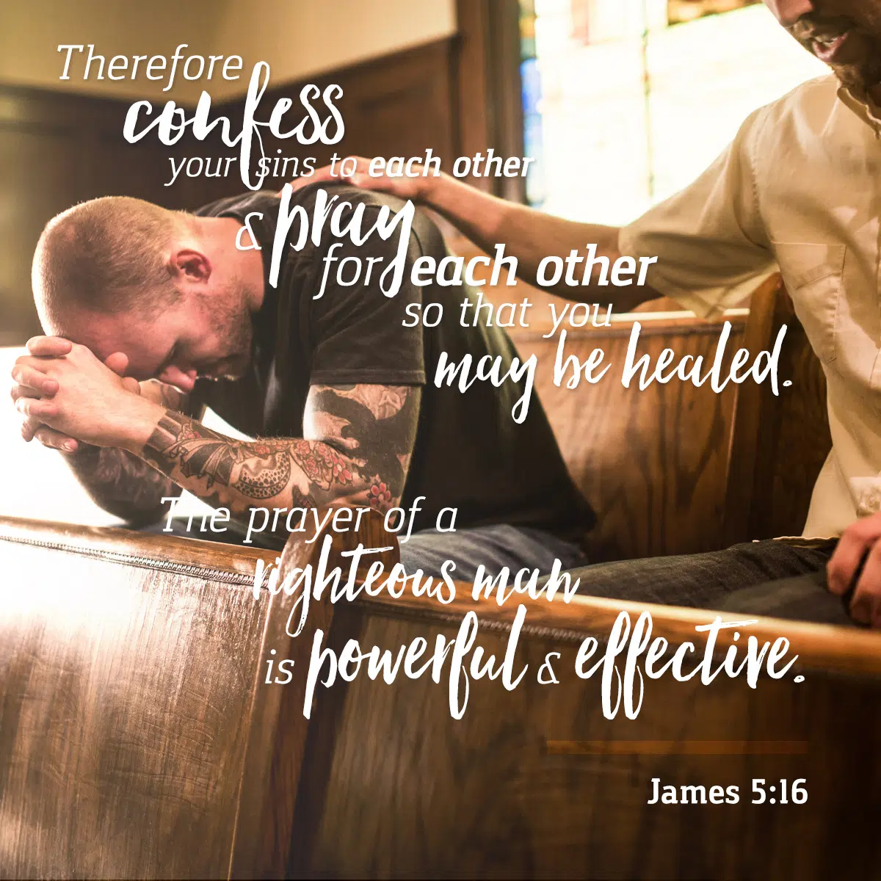

Slide 43
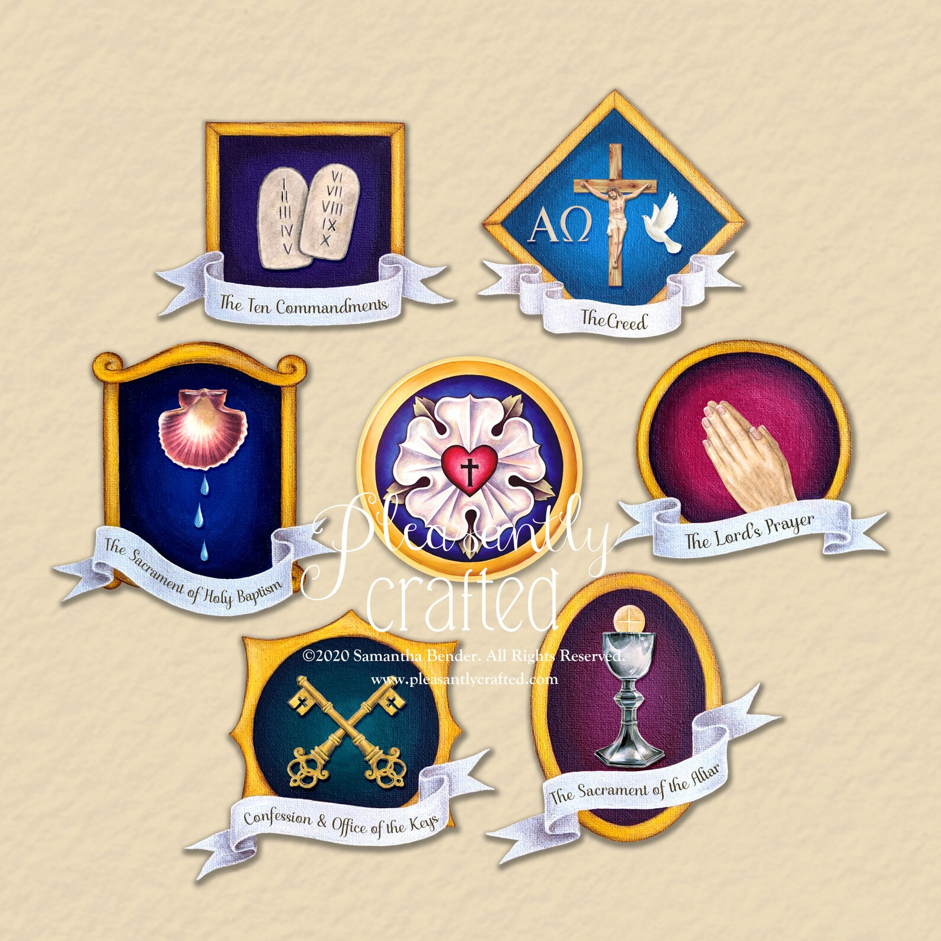

Slide 44
