Slide 1
Trinity Lutheran Church
Norman, Oklahoma – www.tlcnorman.org
The Epistle of James
Theme:
“The Testing of Your Faith”
Date: 12-3-23
Lesson: 35 - Chapter 5:10-12

Slide 2
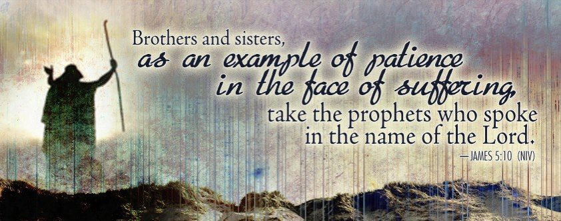

Slide 3
TEXT AND STUDY NOTES
(10) As an example of suffering and patience,
brothers, take the prophets who spoke
in the name of the Lord.
(11) Behold, we consider those blessed who remained steadfast.
You have heard of the steadfastness of Job, and you have seen the purpose of the Lord,
how the Lord is compassionate and merciful.
(Ex 34:6; Nu 14:18; 2 Chr 36:16;
Job 1:20-22; 2:9,10; 3; 12:1-3; 13:15; 16:1-3; 21:4;
Ps 103:8;
Mt 5:10-12; 23:34; Ac 7:52;
Heb 10:36; 11:32-38)

Slide 4
(12) But above all, my brothers, do not swear, either by heaven or by earth or by any other oath, but let your “yes” be yes and your “no” be no, so that you may not fall under condemnation.
(Lev 19:12;
Mt 5:33-37; 23:16-22)

Slide 5
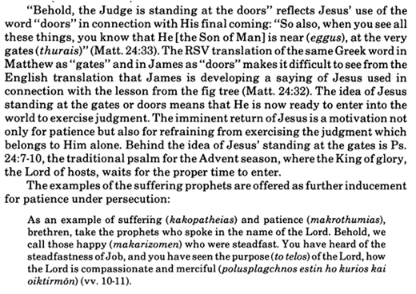
Commentary on James – “The Epistle of Faith”
– Dr. David Scaer – CPH

Slide 6
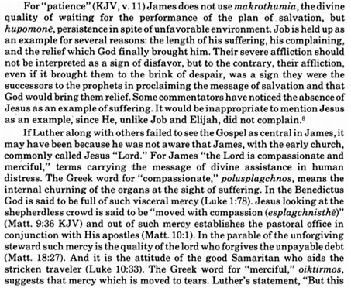

Slide 7
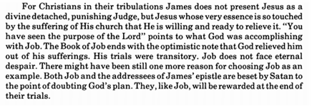
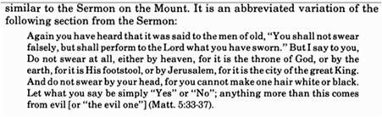

Slide 8
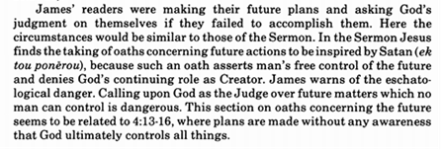

Slide 9
LIFE APPLICATION
“Those blessed who remained steadfast.
You have heard of the steadfastness of Job, and you have seen the purpose of the Lord,
how the Lord is compassionate and merciful.”
Since the Lord has been merciful to us,
what are the ways we are merciful to others and remain steadfast in the purposes of the Lord?

Slide 10


Slide 11
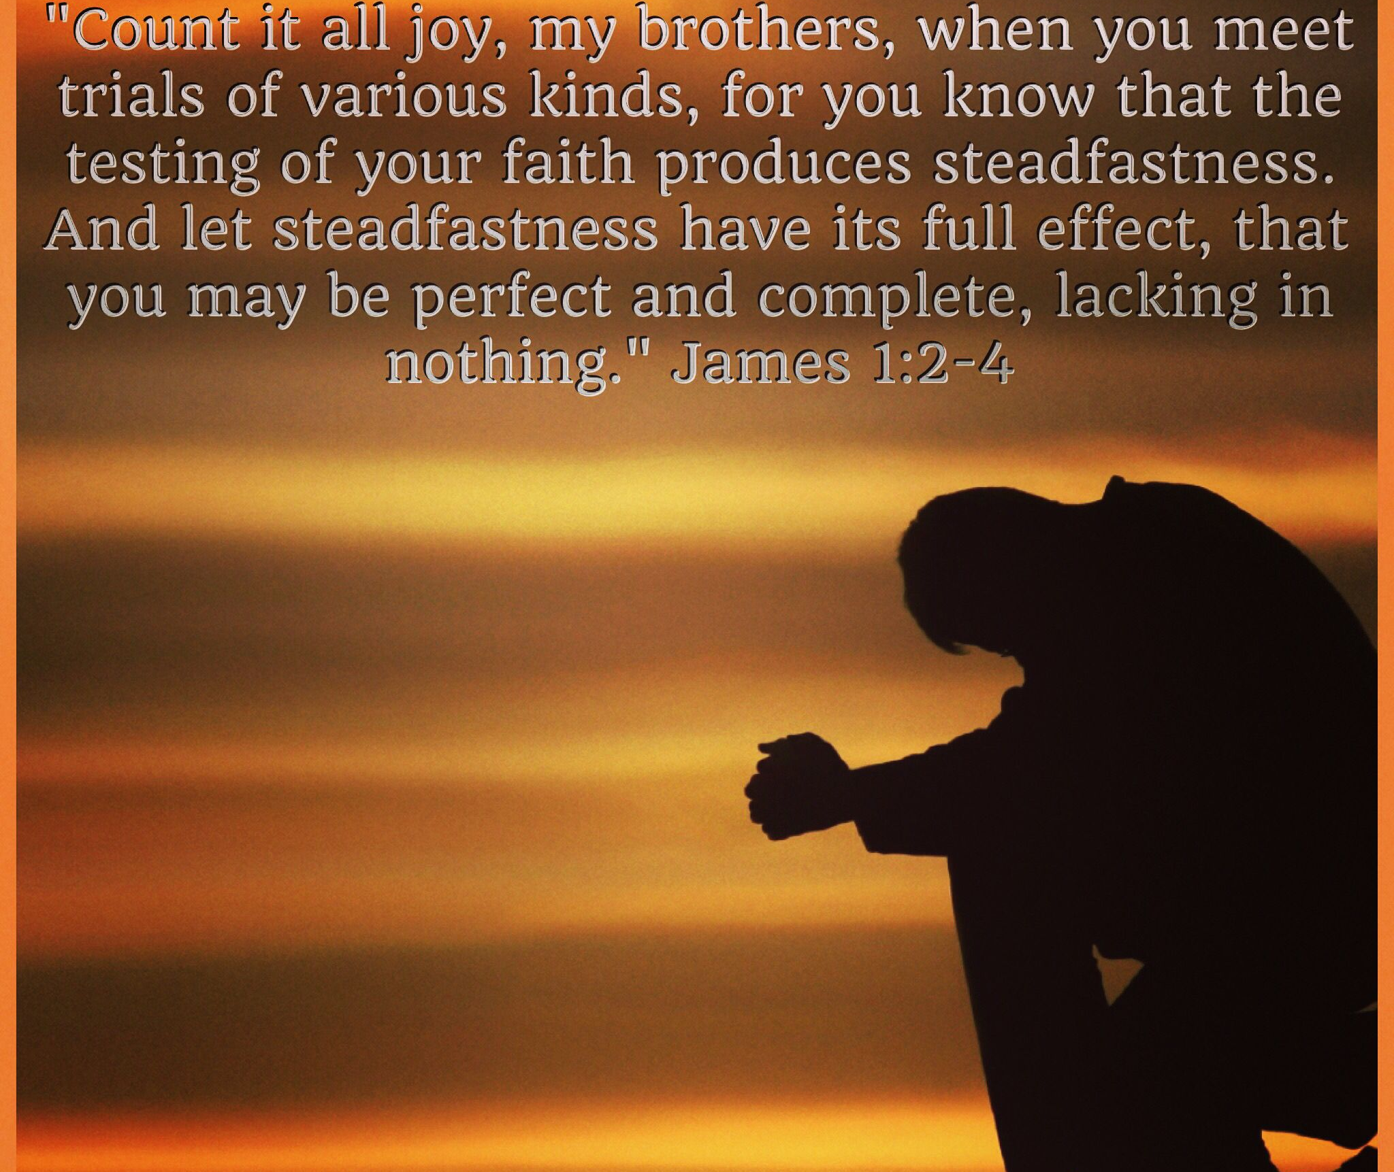

Slide 12
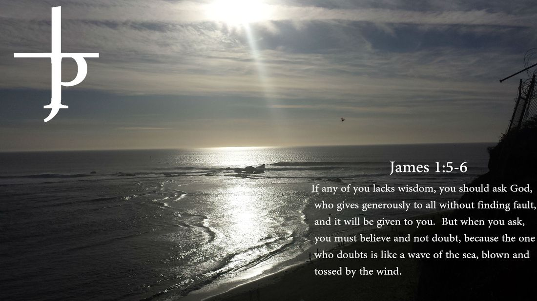

Slide 13


Slide 14
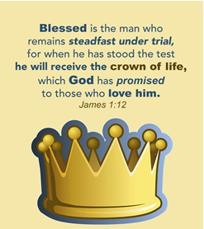

Slide 15
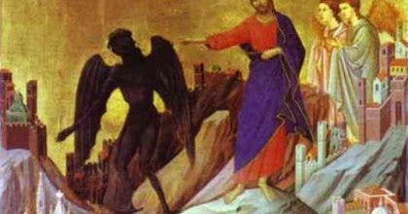

Slide 16
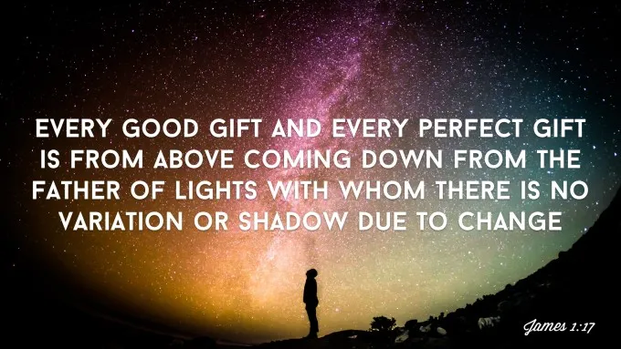

Slide 17


Slide 18
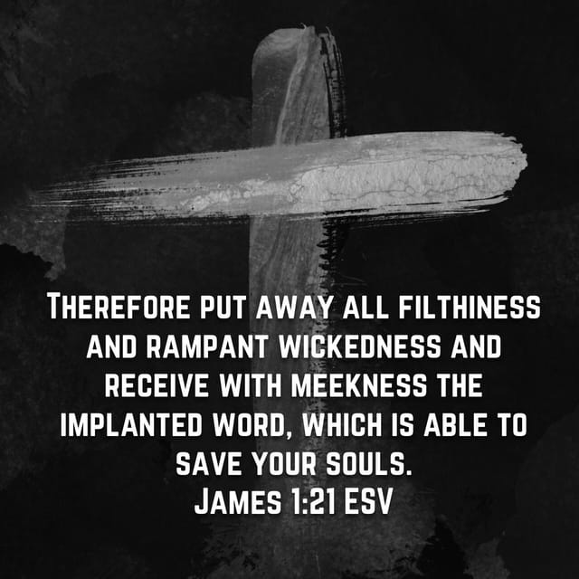

Slide 19
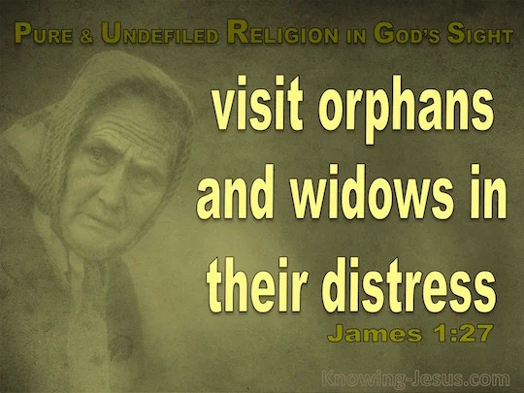

Slide 20
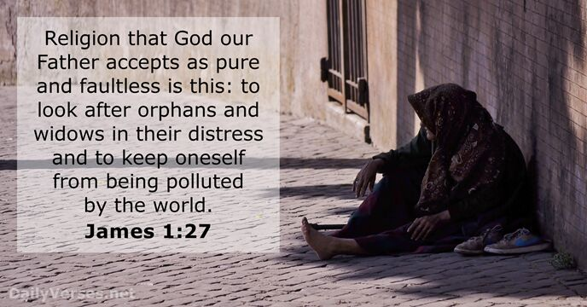

Slide 21
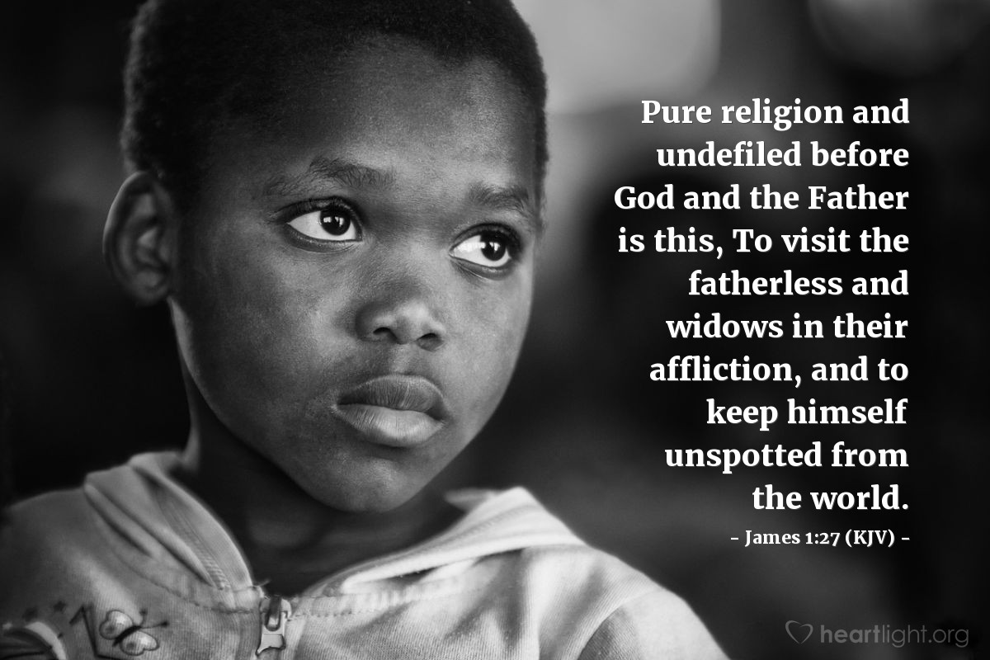

Slide 22
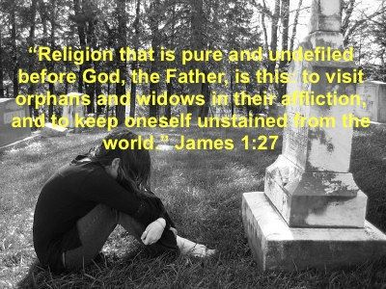

Slide 23
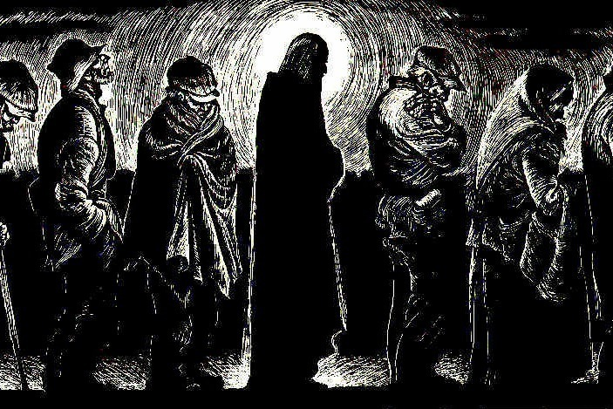

Slide 24
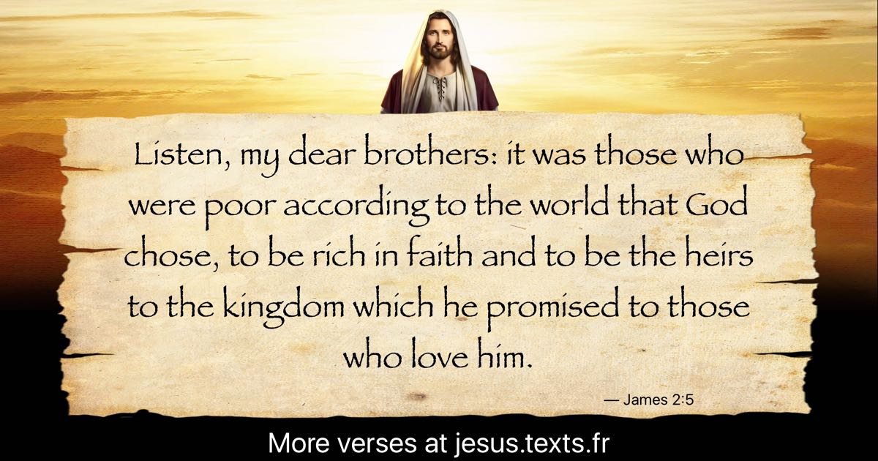

Slide 25
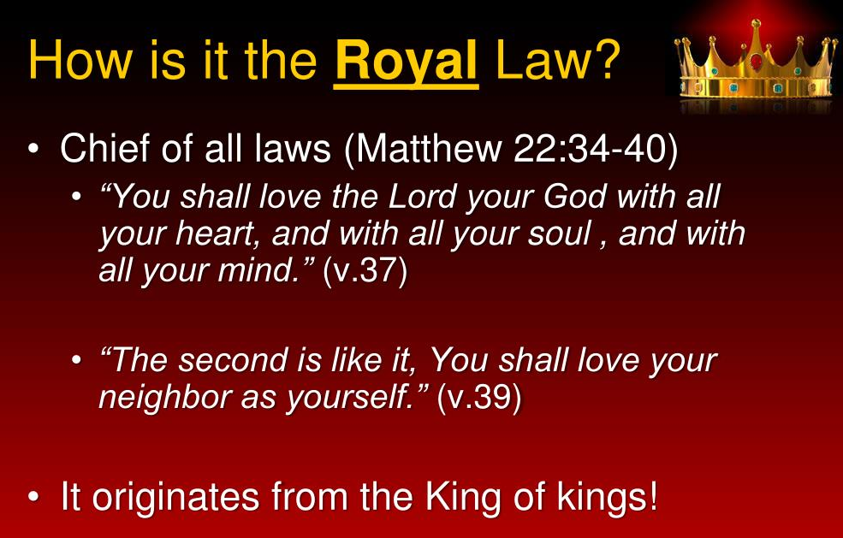

Slide 26
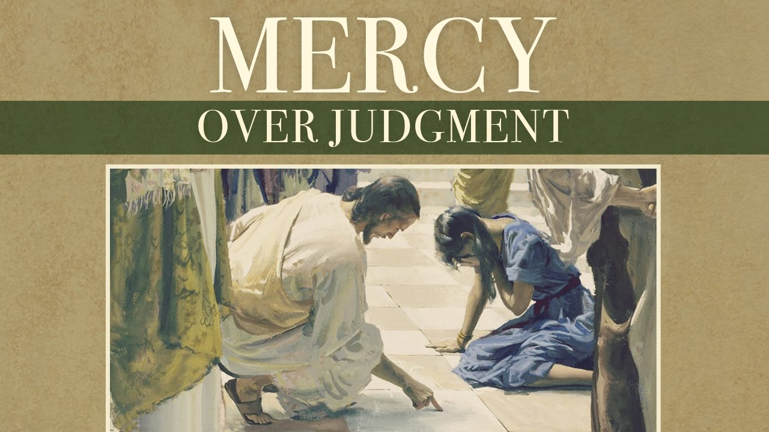

Slide 27


Slide 28
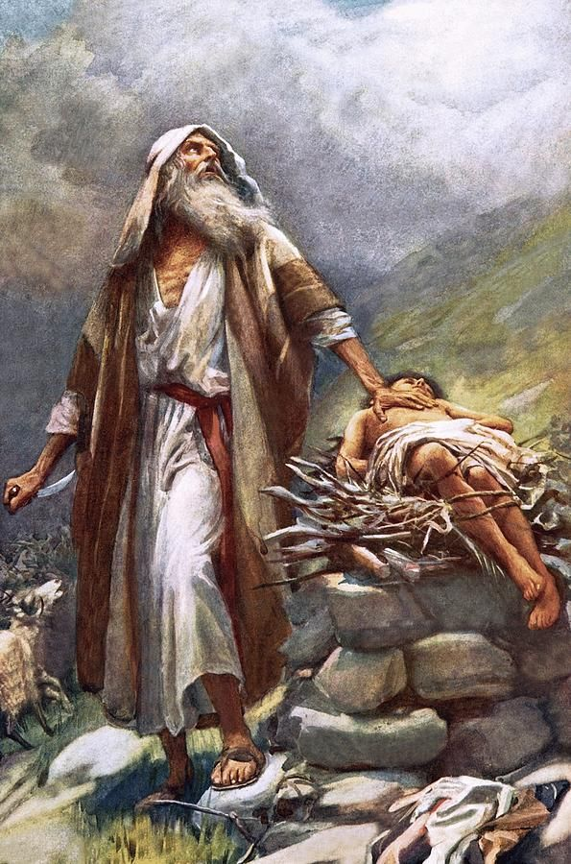

Slide 29
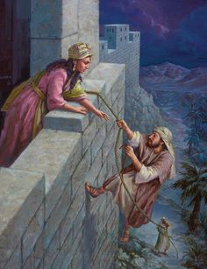

Slide 30
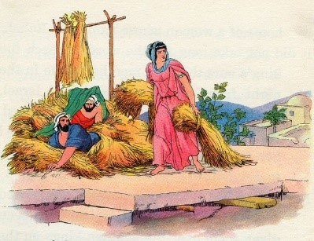

Slide 31


Slide 32


Slide 33
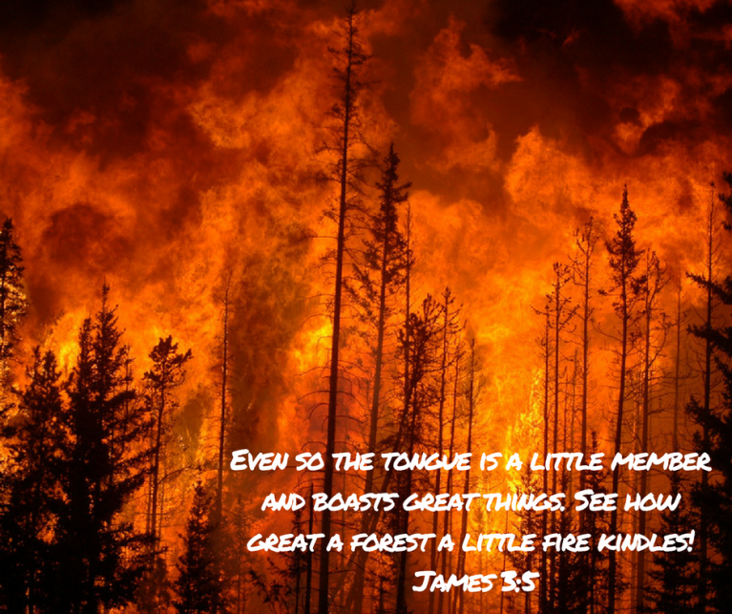

Slide 34
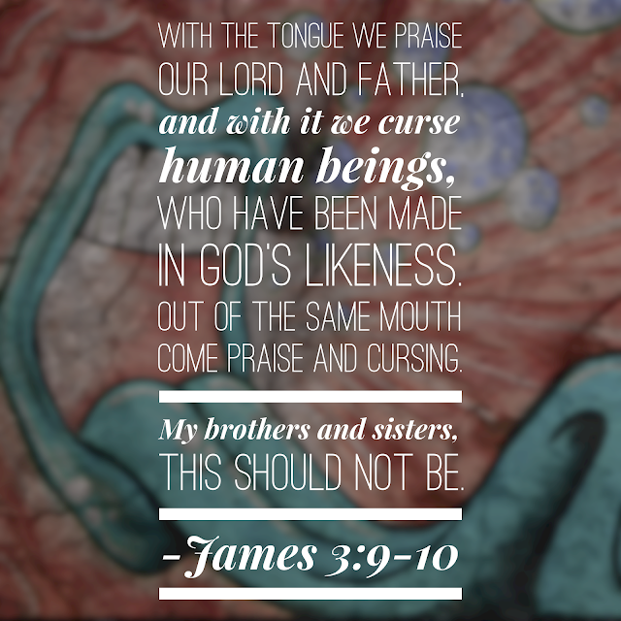

Slide 35


Slide 36


Slide 37


Slide 38


Slide 39
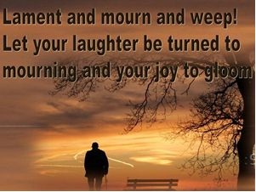

Slide 40


Slide 41


Slide 42
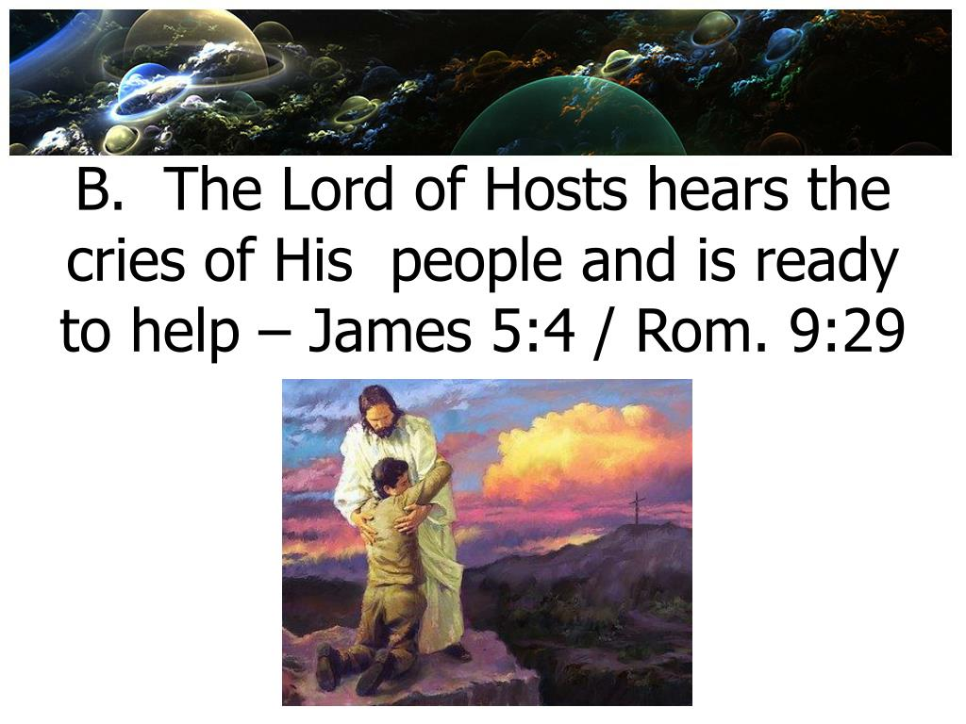

Slide 43
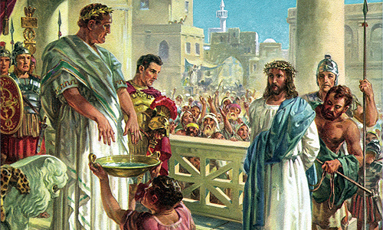

Slide 44
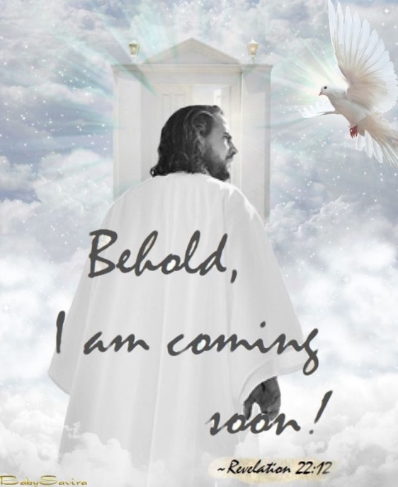

Slide 45
