Slide 1
Trinity Lutheran Church
Norman, Oklahoma – www.tlcnorman.org
The Epistle of James
Theme:
“The Testing of Your Faith”
Date: 7-23-23
Lesson: 20 - Chapter 2:24-26

Slide 2


Slide 3
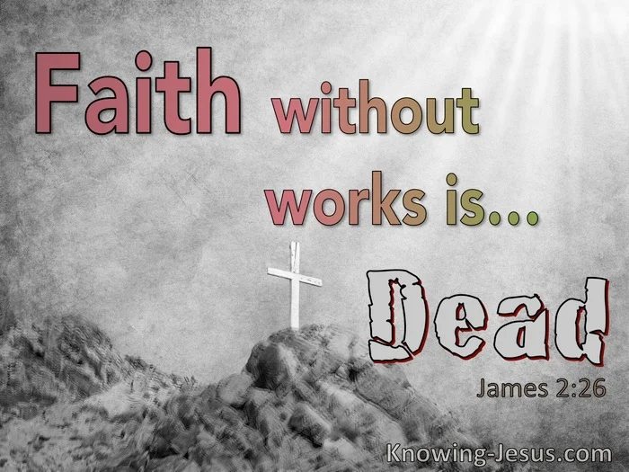

Slide 4
TEXT AND STUDY NOTES
(24) You see that a person is justified by works
and not by faith alone.
(25) And in the same way was not also Rahab the prostitute justified by works when she received the messengers and sent them out by another way?
(Josh 2:1-27; Mt 1:5; Heb 11:31)
For as the body apart from the spirit is dead,
so also faith apart from works is dead.
(Gen 2:7; Eccl 12:7;
Mt 27:50; Mk 14:38; Lk 23:46; Jn 19:30;
Acts 7:55-60;
Php 1:23,24; Heb 12:23)

Slide 5
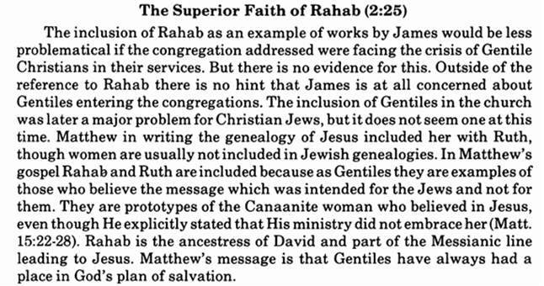
Commentary on James – “The Epistle of Faith” – Dr. David Scaer - CPH

Slide 6
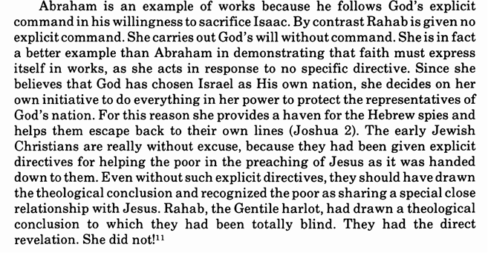

Slide 7
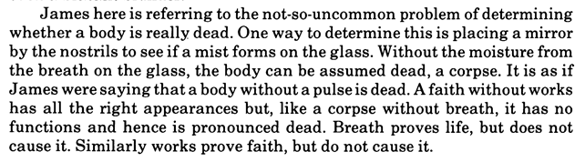

Slide 8
LIFE APPLICATION
“For as the body apart
from the spirit is dead,
so also faith apart from works is dead.”
You and I are body and soul
at the same time.
You and I have faith and do good works
at the same time.
Explain how this affects your daily vocation?

Slide 9


Slide 10
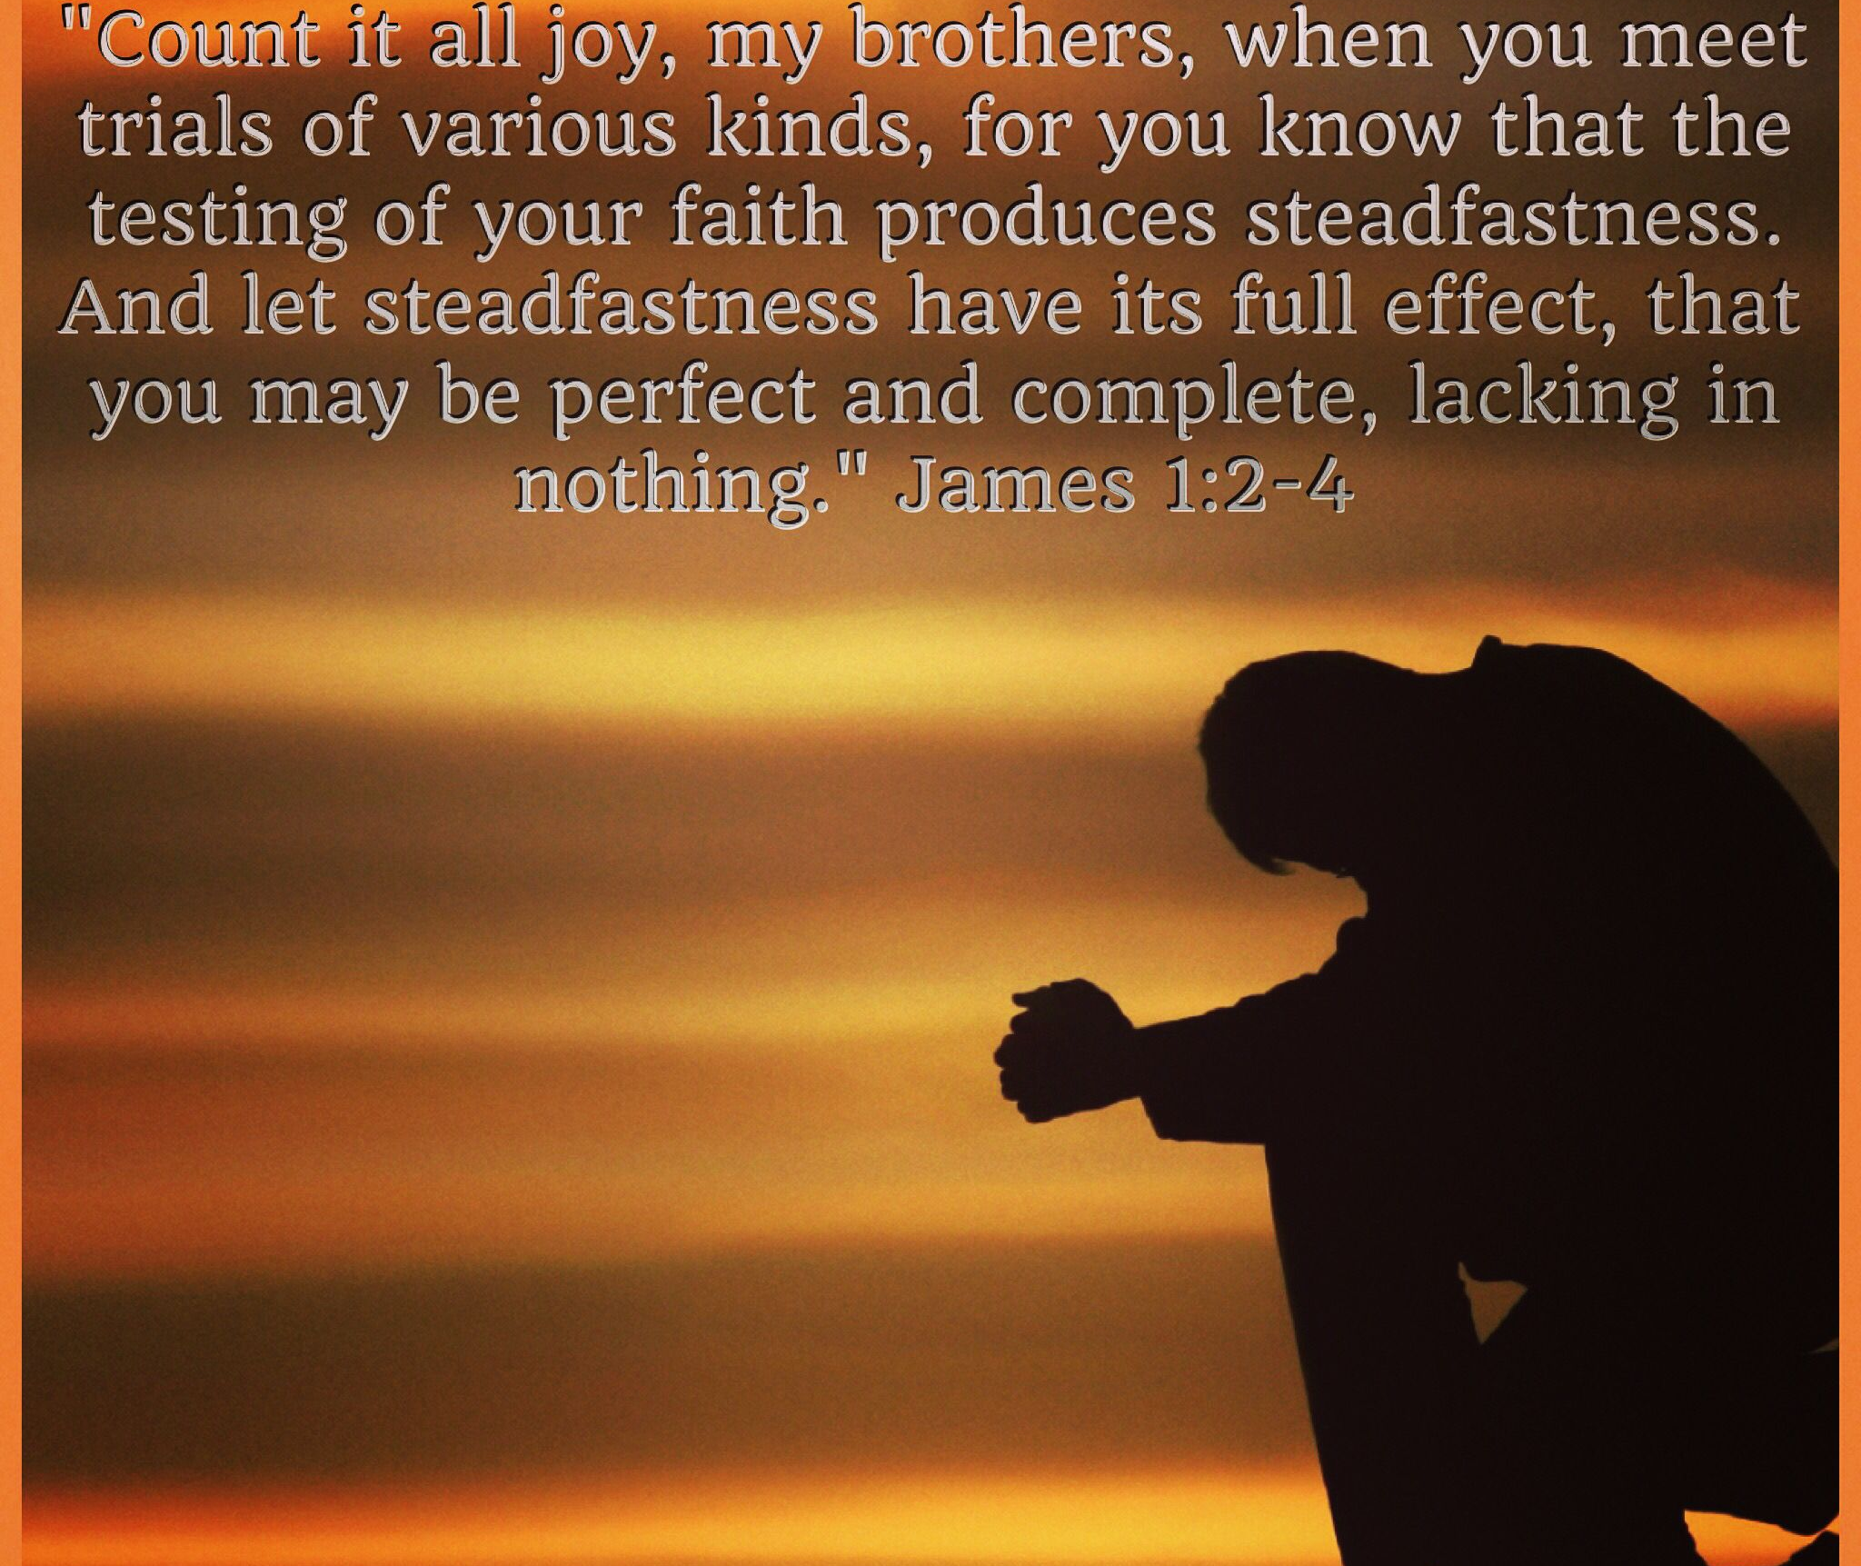

Slide 11
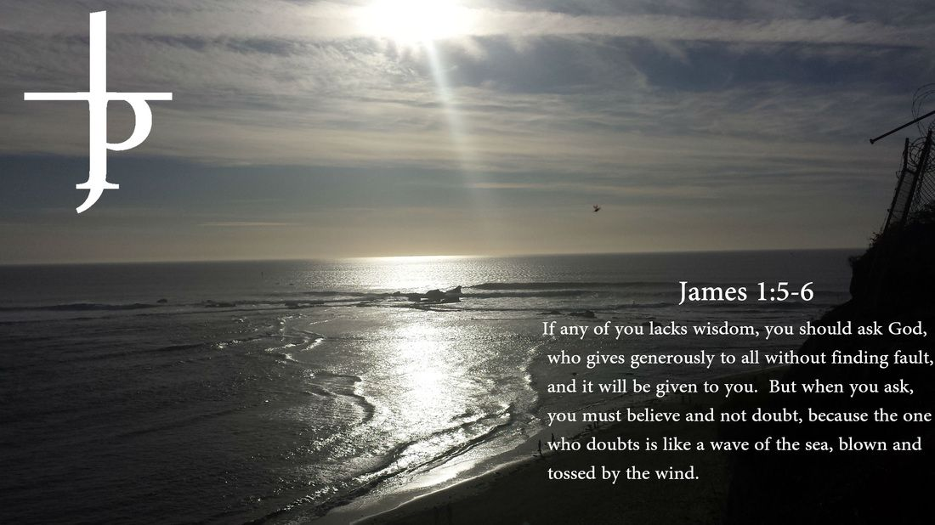

Slide 12


Slide 13
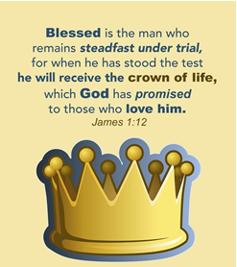

Slide 14
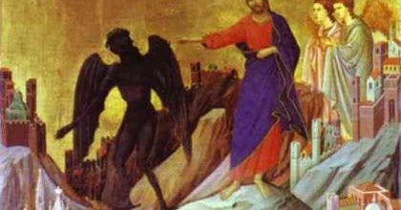

Slide 15
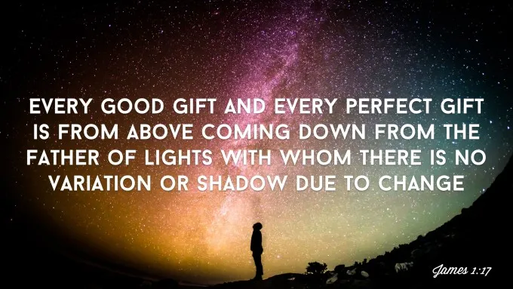

Slide 16
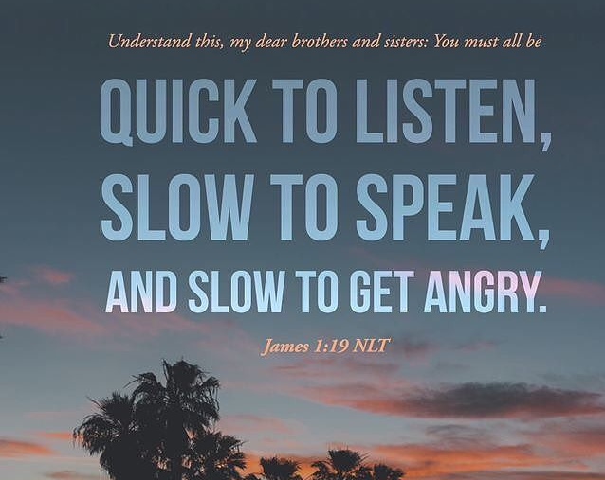

Slide 17
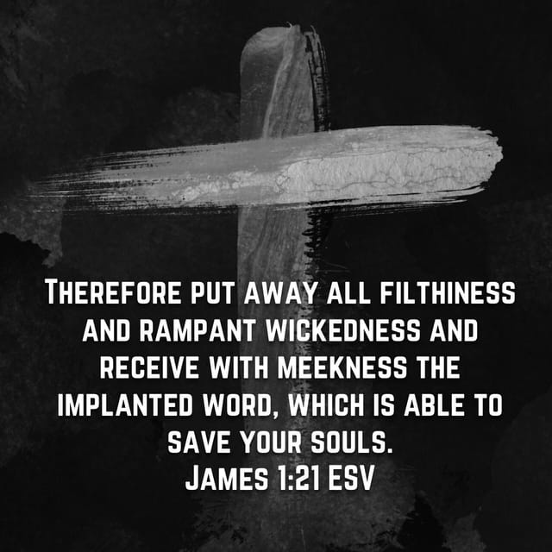

Slide 18
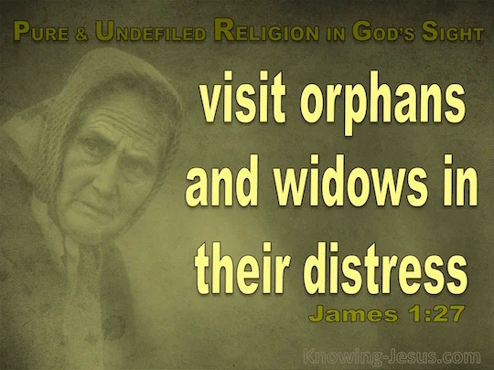

Slide 19
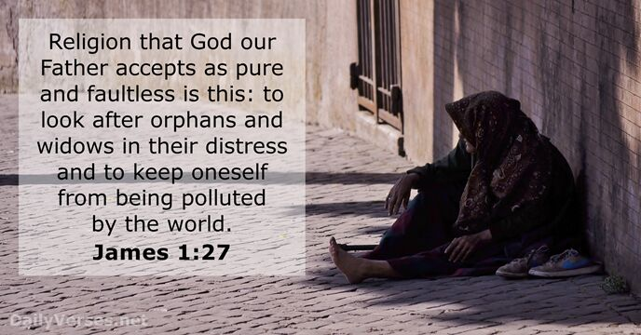

Slide 20
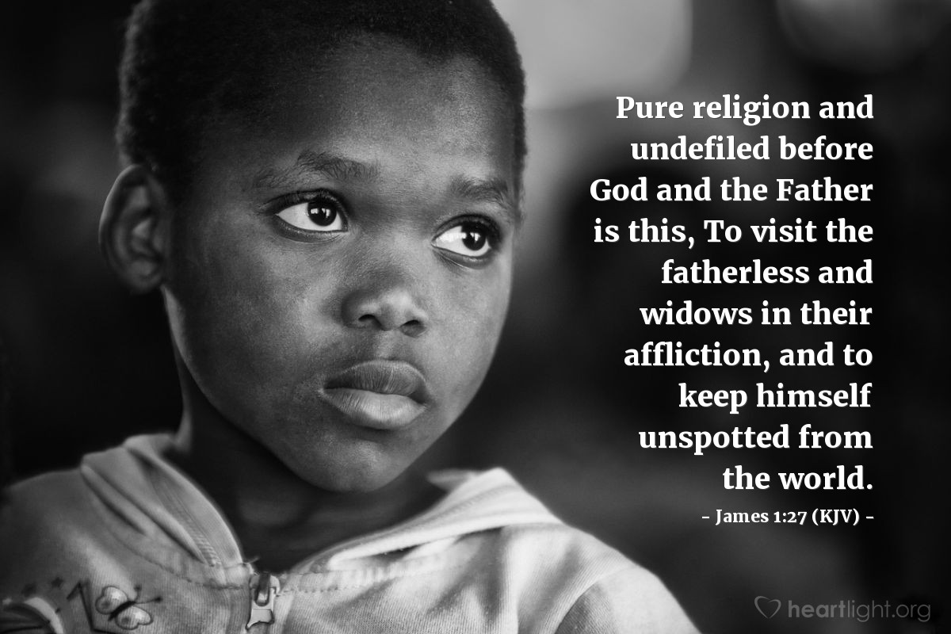

Slide 21
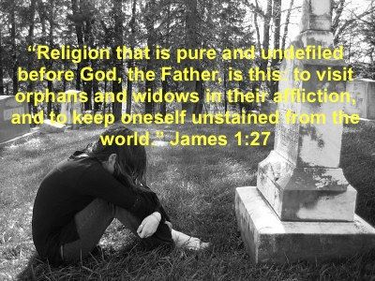

Slide 22
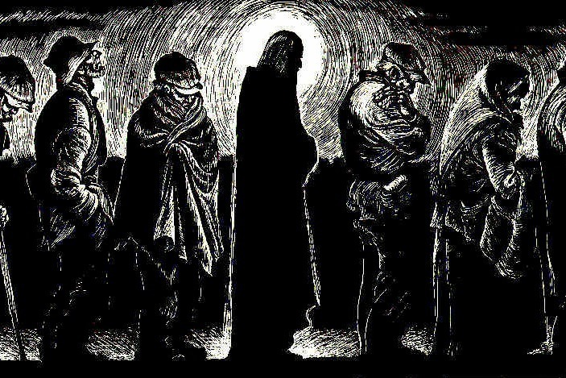

Slide 23


Slide 24
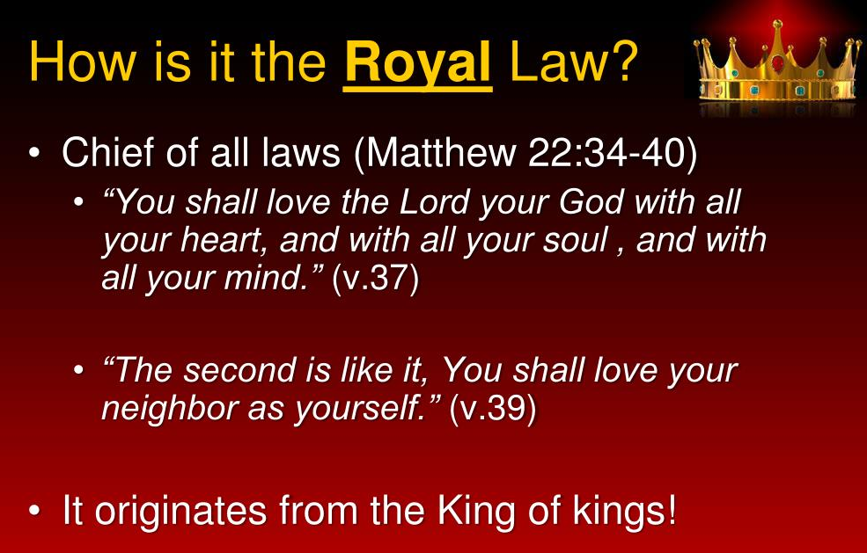

Slide 25
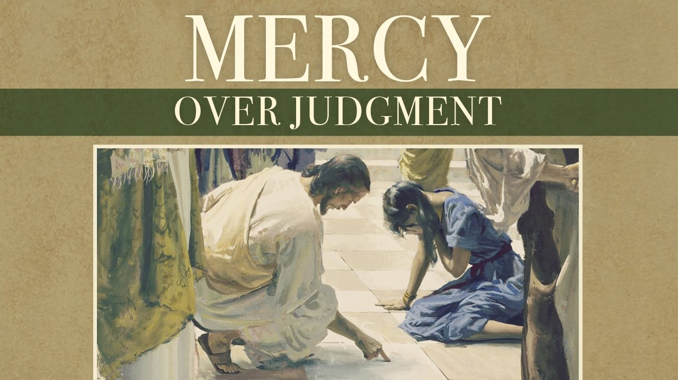

Slide 26


Slide 27
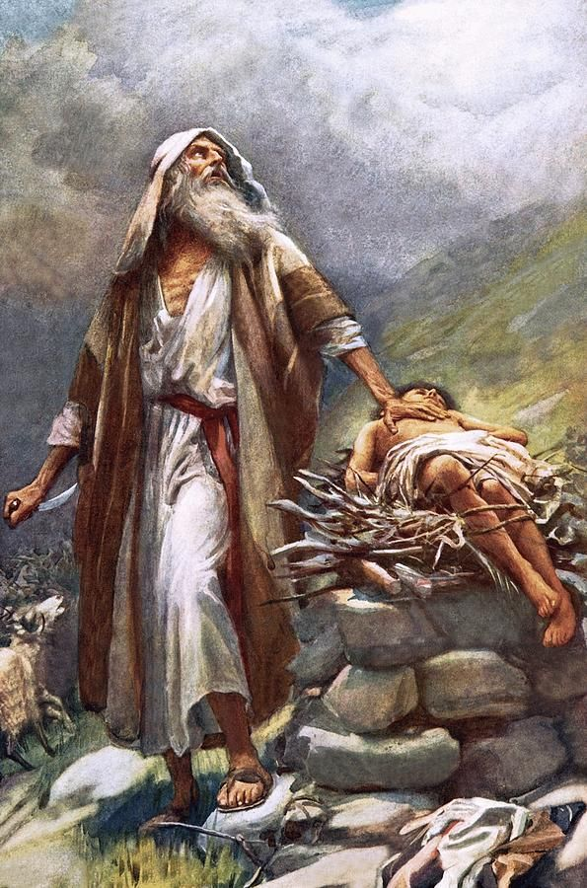

Slide 28
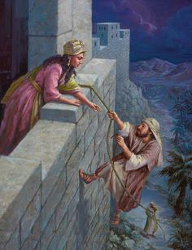

Slide 29
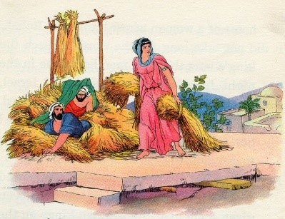

Slide 30


