Slide 1
Trinity Lutheran Church
Norman, Oklahoma – www.tlcnorman.org
The Epistle of James
Theme:
“The Testing of Your Faith”
Date:1-15-22
Lesson: 2 - Chapter 1:1-12

Slide 2
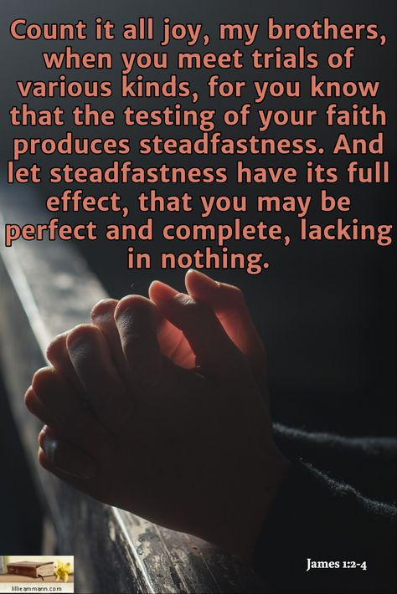

Slide 3
TEXT and STUDY NOTES
(1) James, a servant of God and of the Lord Jesus Christ,
To the twelve tribes in the Dispersion:
Greetings.
(Dt 32:26; Jn 7:35;
Ac 2:18: 4:29; 15:13,23; 26:7;
Rom 1:1; Titus 1:1; 1 Pet 1:1)

Slide 4
(2) Count it all joy, my brothers, when you meet trials of various kinds,
(3) for you know that the testing of your faith produces steadfastness.
(4) And let steadfastness have its full effect, that you may be perfect and complete, lacking in nothing.
(Mt 5:11,12; Lk 8:13-15; 22:28; Rom 5:3; 1 Cor 2:6; Heb 10:34-36; 12:11;
1 Pet 1:6-9)

Slide 5
(5) If any of you lacks wisdom,
let him ask God, who gives generously to all without reproach, and it will be given him.
(6) But let him ask in faith, with no doubting,
for the one who doubts is like a wave of the sea that is driven and tossed by the wind.
(7) For that person must not suppose that he will receive anything from the Lord;
(8) he is a double-minded man, unstable in all his ways.
(1 Ki 3:9-12; Ps 51:6; 119:113;
Prov 1:2-4; 2:3-6,10-15; 4:5-9; 9:10-12;
Dan 1:17; 2:21;
Mt 7:7; 21:21; Mk 11:24; Lk 11:9-13; 16:13;
Eph 4:14; 1 Pet 2:14; 3:16)

Slide 6
(9) Let the lowly brother boast in his exaltation,
(10) and the rich in his humiliation, because like a flower of the grass he will pass away.
(11) For the sun rises with its scorching heat and withers the grass; its flower falls, and its beauty perishes. So also will the rich man fade away in the midst of his pursuits.
(Job 14:2; Ps 102:4,11; 103:15,16; Is 40:6-8;
Mt 19:23-26; 20:12; 23:12; Lk 1:46-55;
1 Cor 7:31; 1 Pet 1:24)

Slide 7
(12) Blessed is the man who remains steadfast under trial, for when he has stood the test he will receive
the crown of life, which God has promised to those who love him.
(Gen 22:1; Ex 20:6; Ps 1:1;
Jer 17:7-8; Dan 12:12; Mt 5:3-12; 10:22;
1 Cor 2:9; 8:3; 9:25; 2 Tim 4:8;
1 Pet 3:14; 5:4;
Rev 1:3; 2:10; 3:11,19)

Slide 8
LUTHER’S WORKS - VOLUME 4 - Page 132
Thus God’s testing is a fatherly one, for James says in his letter (1:13): “God is not a tempter for evil”; that is, He does not test in order that we may fear and hate Him like a tyrant but to the end that He may exercise and stir up faith and love in us.
Satan, however, tempts for evil, in order to draw you away from God and to make you distrust and blaspheme God. God sports with the children He loves and, as it seems to the flesh, shows Himself angry and dreadful. Hence there arise the well-known laments “I am driven far from Thy sight” (Ps. 31:22) and “Hide not Thy face from me” (Ps. 27:9). But these are merely instances of sporting. God will not deceive or cheat you. Just hold fast to His infallible and unchanging promise.
Even though you should lose honors, riches, and life itself, you should nevertheless not maintain that God is angry with you and therefore has cast you aside; but you should expect other far more excellent gifts, honor, and a better life from Him, as Job 13:15 states: “Even though He kills me, I will hope in Him.”

Slide 9
As for the rest, the fathers have interpreted the verb “I know” in this passage as “I have caused you to come to know,” that is, to realize that you are one who fears God, just as Peter admonishes us to make our call and election sure and firm by doing good works (2 Peter 1:10).
If someone has overcome a trial in this manner, he is made more certain of God’s help and can say: “This is sure proof that I have been helped by God, because by my own powers I would not have been able to achieve this.” Thus the fruits of the Spirit are called evidences of faith which assure us of our election and call.
Furthermore, in this passage the rule concerning God’s twofold cognition or vision should be observed. When Holy Scripture says: “God saw,” there a twofold cognition is posited: the one, eternal and invisible, by which God sees things before they are in existence; the other, by which he observes things that exist. By means of that second vision, with which He looks at existing things, God did not see Mary before she existed, and yet He saw her from eternity. Thus God saw all the creatures before they were made, and now that they have been made, it is also said that He sees or knows them.

Slide 10
LIFE APPLICATION
‘When you meet trials of various kinds,
you know that the testing of your faith produces steadfastness.
And let steadfastness have its full effect, that you may be perfect and complete, lacking in nothing.’
What are examples of the trials and tests of your faith that you experience?
How does steadfastness help you survive this earthly life to enter into heaven?

Slide 11


Slide 12
