Slide 1
THE BOOK OF HAGGAI
“Theology of Glory vs.
Theology of the Cross”
Pastor David Nehrenz
Trinity Lutheran Church Norman, OK.
Date: 3-6-16 Lesson: 3

Slide 2
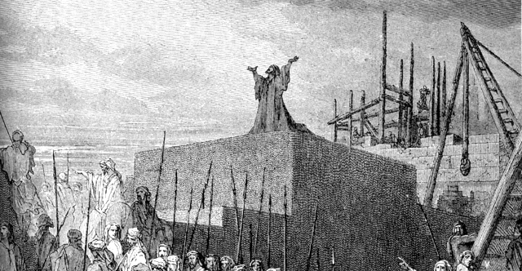

Slide 3
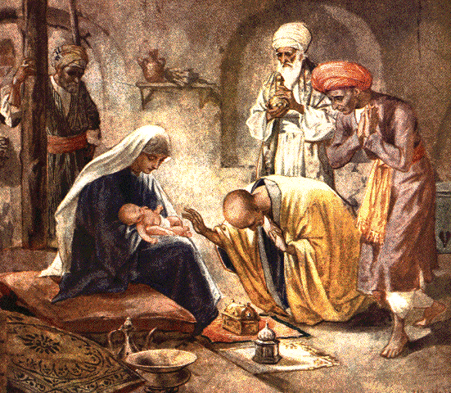

Slide 4
A. THE TEXT
(Haggai 2:1-9)
In the seventh month, on the twenty-first day of the month, the word of the Lord came by the hand of Haggai the prophet, (2) "Speak now to Zerubbabel the son of Shealtiel, governor of Judah, and to Joshua the son of Jehozadak, the high priest, and to all the remnant of the people, and say, (3) 'Who is left among you who saw this house in its former glory? How do you see it now? Is it not as nothing in your eyes?
(4) Yet now be strong, O Zerubbabel, declares the Lord. Be strong, O Joshua, son of Jehozadak, the high priest. Be strong, all you people of the land, declares the Lord. Work, for I am with you, declares the Lord of hosts, (5) according to the covenant that I made with you when you came out of Egypt. My Spirit remains in your midst. Fear not.

Slide 5
(6) For thus says the Lord of hosts: Yet once more, in a little while, I will shake the heavens and the earth and the sea and the dry land. (7) And I will shake all nations, so that the treasures (desire) of all nations shall come in, and I will fill this house with glory, says the Lord of hosts. (8) The silver is mine, and the gold is mine, declares the Lord of hosts. (9) The latter glory of this house shall be greater than the former, says the Lord of hosts. And in this place I will give peace, declares the Lord of hosts.'"

Slide 6
B. THE KEY PEOPLE and THE HISTORICAL BACKGROUND
1. Darius the king – Hystaspis ruler of Persia (522-486 B.C.)
2. Haggai the prophet (Ezr 5:1-2; 6:14)
3. Zerubbabel the son of Shealtiel, governor of Judah –
Sheshbazzar (Ezr 1:8)
4. Joshua the son of Jehozadak, the high priest (taken captive by Nebuchadnezzar in 1 Chr 6:15)
5. The remnant of the people
6. The last day of the Feast of Tabernacles
- 21st day of the 7th month = Oct. 17, 520 B.C.
7. From 333-330 B.C. Alexander the Great would defeat the Persians, nations rise and fall.

Slide 7
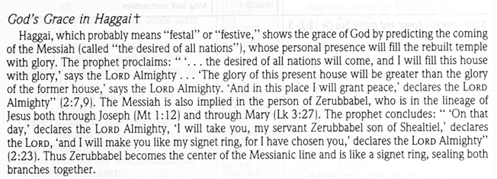
C. THE HISTORICAL BACKGROUND

Slide 8
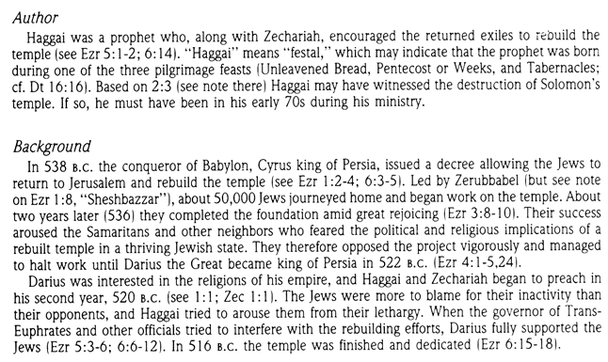

Slide 9
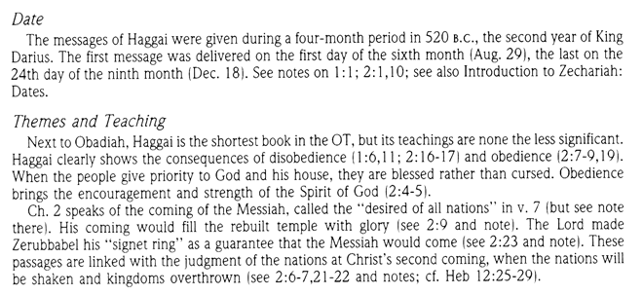

Slide 10
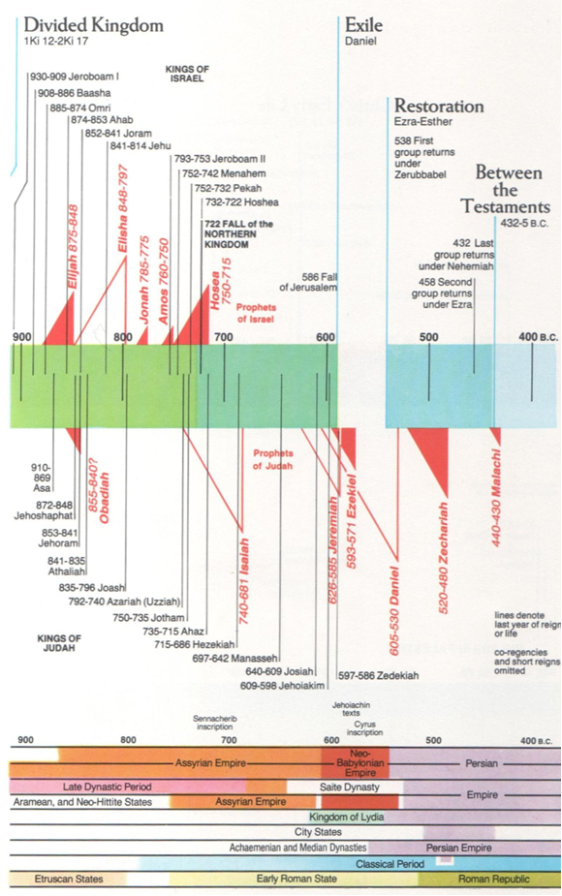

Slide 11
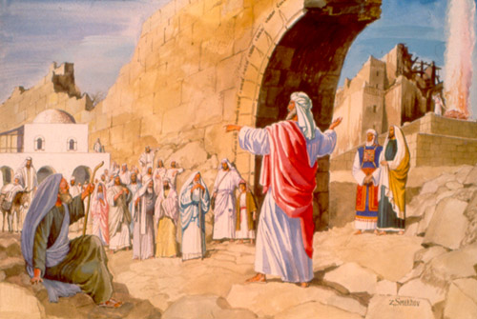

Slide 12
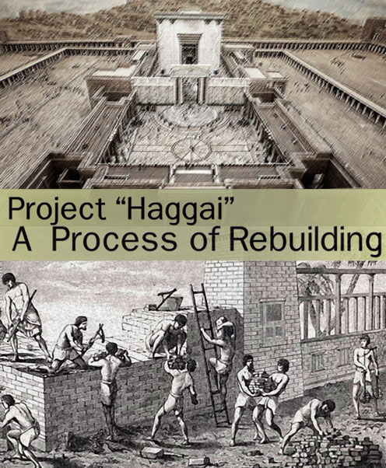

Slide 13
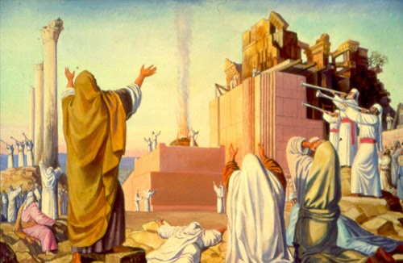

Slide 14
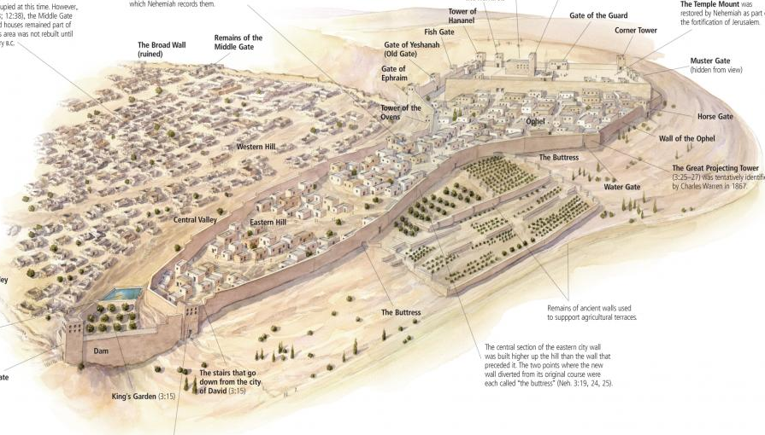

Slide 15
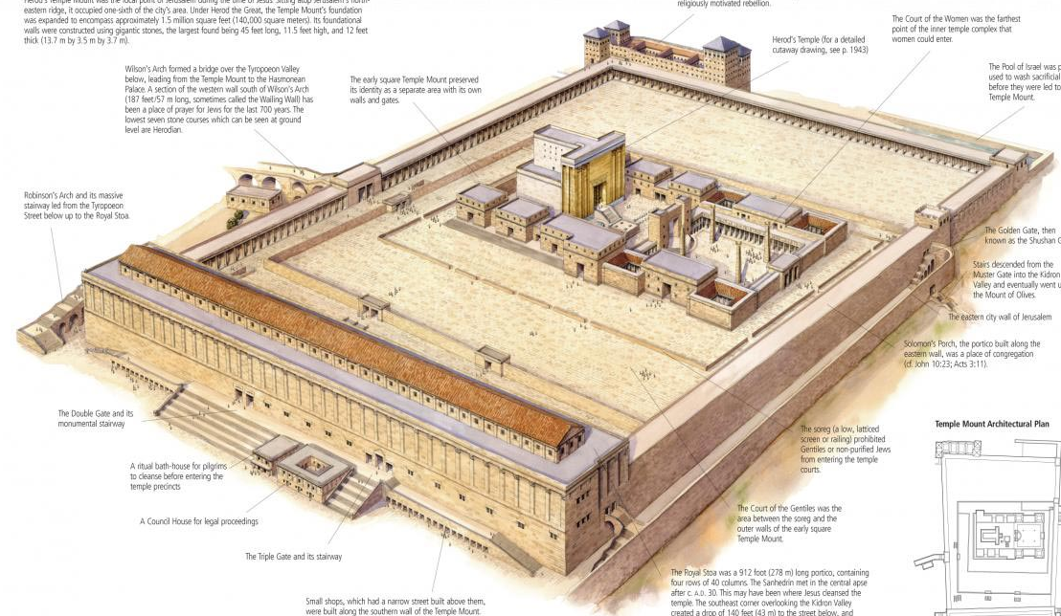

Slide 16
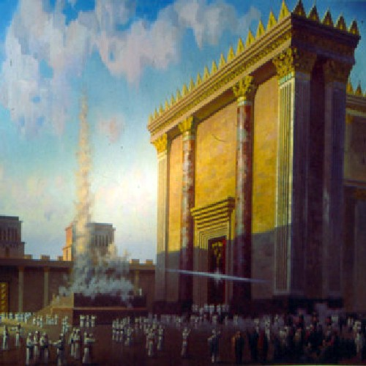

Slide 17
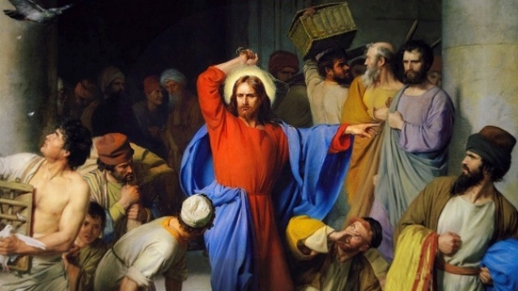

Slide 18
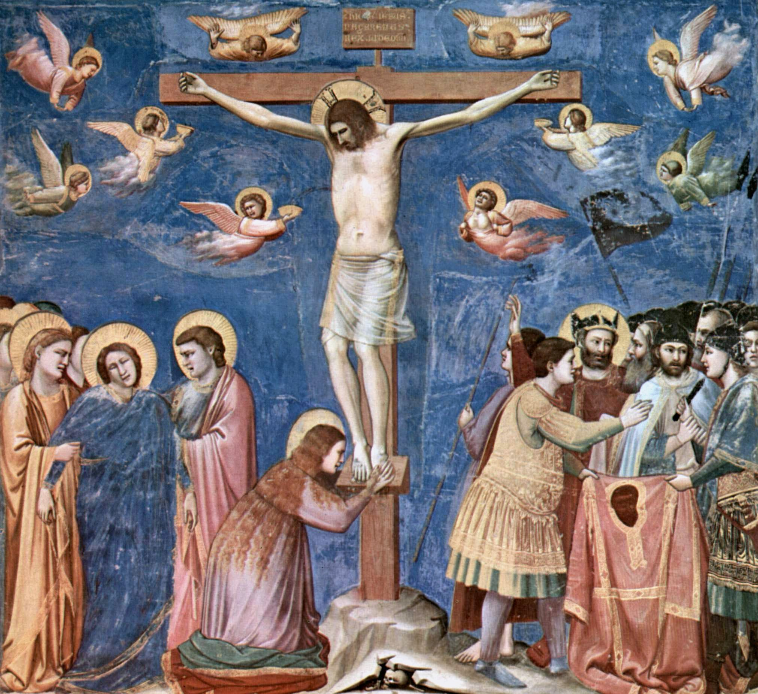

Slide 19


Slide 20
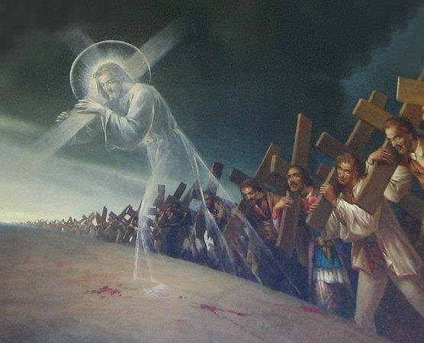

Slide 21
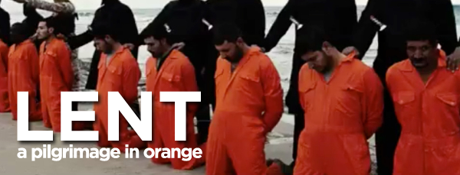

Slide 22
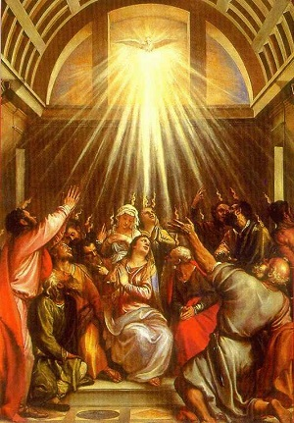

Slide 23
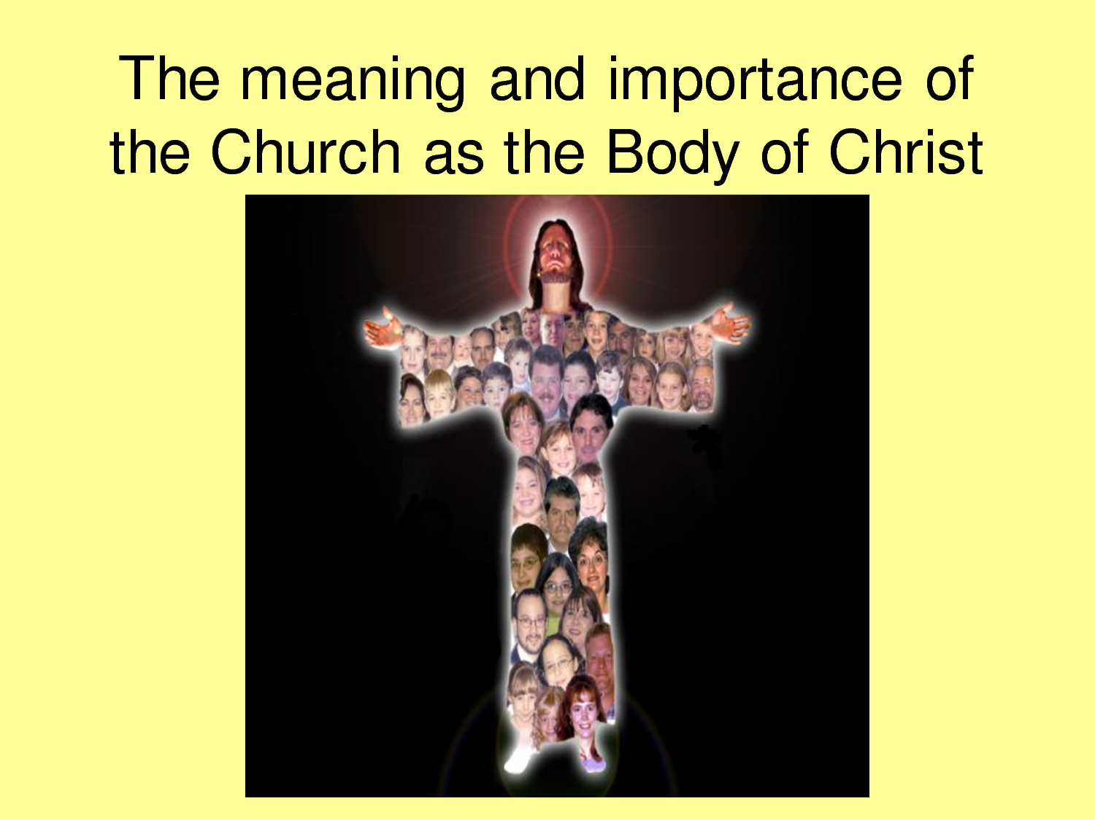

Slide 24
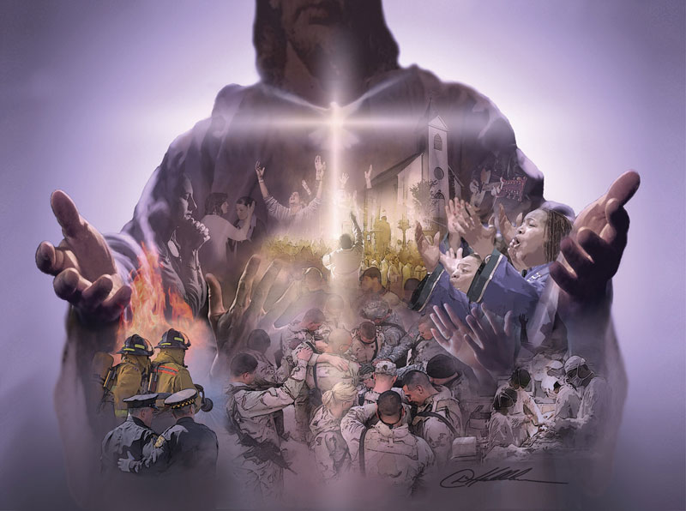

Slide 25
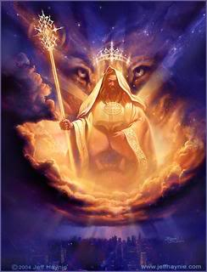

Slide 26
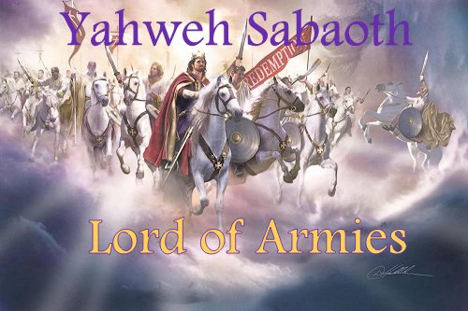

Slide 27
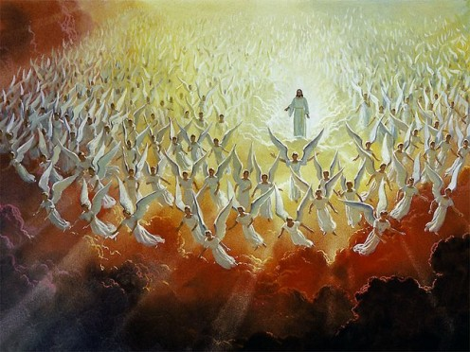

Slide 28
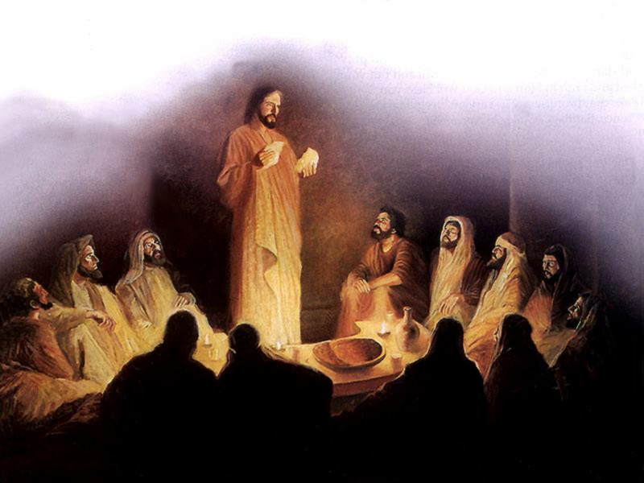

Slide 29
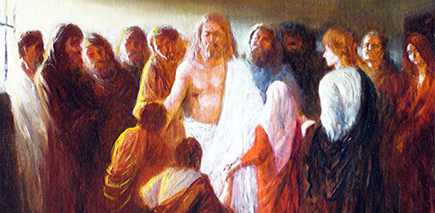

Slide 30
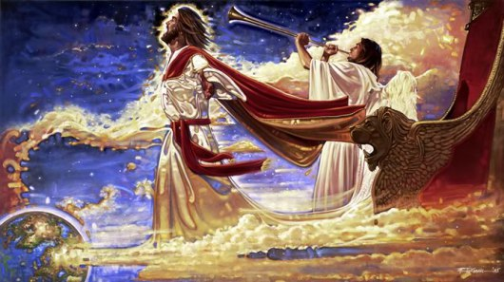

Slide 31
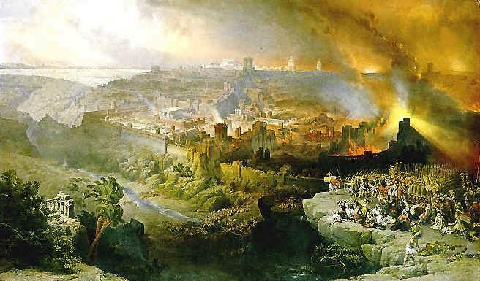

Slide 32
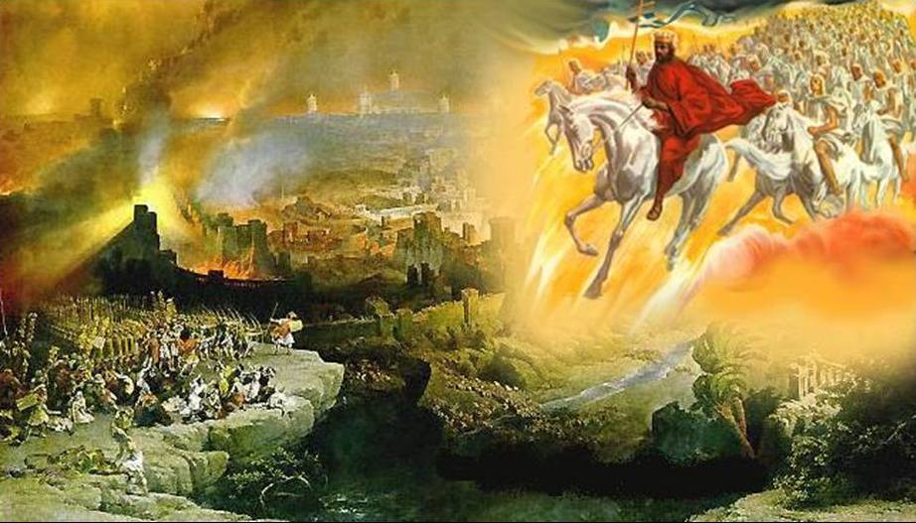

Slide 33
