Slide 1
THE BOOK OF HAGGAI
“Theology of Glory vs.
Theology of the Cross”
Pastor David Nehrenz
Trinity Lutheran Church Norman, OK.
Date: 2-28-16 Lesson: 2

Slide 2
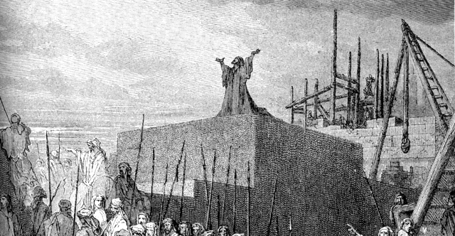

Slide 3
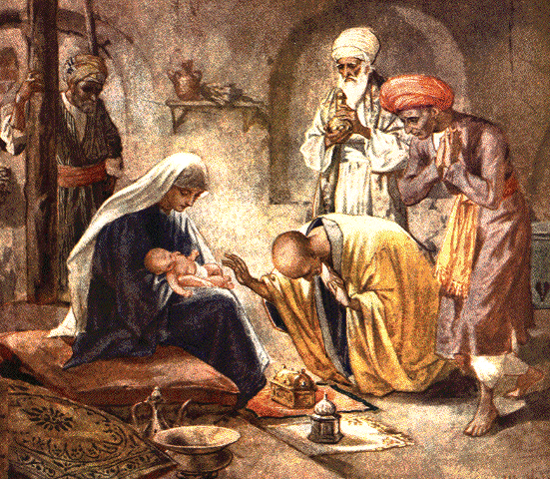

Slide 4
A. THE TEXT
(Haggai 2:1-9)
In the seventh month, on the twenty-first day of the month, the word of the Lord came by the hand of Haggai the prophet, (2) "Speak now to Zerubbabel the son of Shealtiel, governor of Judah, and to Joshua the son of Jehozadak, the high priest, and to all the remnant of the people, and say, (3) 'Who is left among you who saw this house in its former glory? How do you see it now? Is it not as nothing in your eyes?
(4) Yet now be strong, O Zerubbabel, declares the Lord. Be strong, O Joshua, son of Jehozadak, the high priest. Be strong, all you people of the land, declares the Lord. Work, for I am with you, declares the Lord of hosts, (5) according to the covenant that I made with you when you came out of Egypt. My Spirit remains in your midst. Fear not.

Slide 5
(6) For thus says the Lord of hosts: Yet once more, in a little while, I will shake the heavens and the earth and the sea and the dry land. (7) And I will shake all nations, so that the treasures (desire) of all nations shall come in, and I will fill this house with glory, says the Lord of hosts. (8) The silver is mine, and the gold is mine, declares the Lord of hosts. (9) The latter glory of this house shall be greater than the former, says the Lord of hosts. And in this place I will give peace, declares the Lord of hosts.'"

Slide 6
B. THE KEY PEOPLE and THE HISTORICAL BACKGROUND
1. Darius the king – Hystaspis ruler of Persia (522-486 B.C.)
2. Haggai the prophet (Ezr 5:1-2; 6:14)
3. Zerubbabel the son of Shealtiel, governor of Judah –
Sheshbazzar (Ezr 1:8)
4. Joshua the son of Jehozadak, the high priest (taken captive by Nebuchadnezzar in 1 Chr 6:15)
5. The remnant of the people
6. The last day of the Feast of Tabernacles
- 21st day of the 7th month = Oct. 17, 520 B.C.
7. From 333-330 B.C. Alexander the Great would defeat the Persians, nations rise and fall.

Slide 7
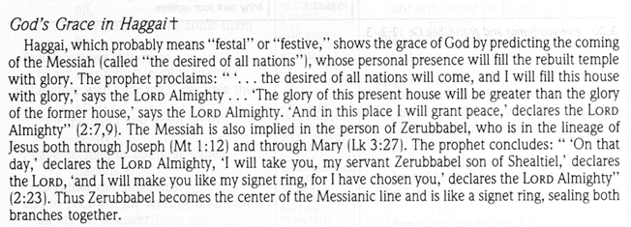
C. THE HISTORICAL BACKGROUND

Slide 8
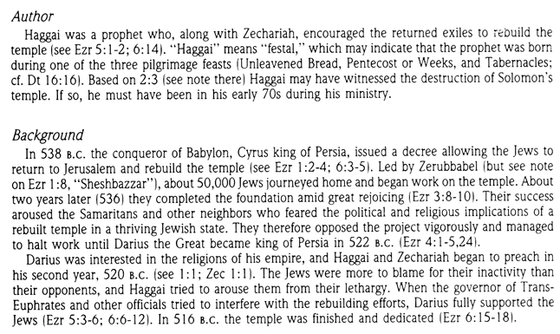

Slide 9
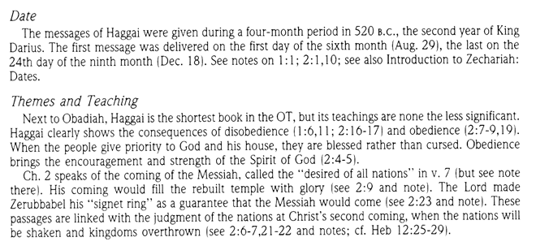

Slide 10
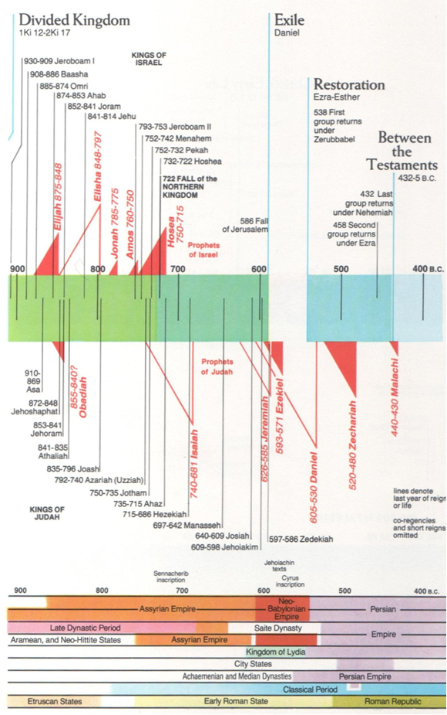

Slide 11
C. THE STUDY NOTES
1. This house in its former glory – Solomon had dedicated the original temple during this same Feast. Some of the older exiles like Haggai had seen Solomon’s temple before it was destroyed 66 years earlier by the Babylonians. This rebuilt temple will not be able to match the glory of the original one (Ezr 3:12)
2. Be strong, I am with you, declares the Lord of hosts (Josh 1:6,7,9,18; 1 Chr 28:20; 1 Cor 16:13; Eph 6:10)
3. The covenant that I made with you when you came out of Egypt. (Gen 6:18; Ex 19:5,6; 25:8; 29:46)
4. My Spirit remains in your midst. Fear not.
(Nu 11:16,17,25; Is 41:10; 63:11; Zech 4:6; Mt 10:31; Lk 12:32; Rev 1:17)

Slide 12
5. Yet once more, in a little while, I will shake the heavens and the earth and the sea and the dry land. This recalls the judgment on Egypt at the Red Sea
(Ex 19:18; Job 9:6; Is 10:25; 14:16,17;
Ezek 38:19; Heb 12:25-29)
6. And I will shake all nations, so that the treasures “desire” of all nations shall come in, and I will fill this house with glory, says the Lord of hosts.
(Ex 40:34,35; 1 Ki 8:10,11; 1 Sam 9:20;
Dan 9:23; Mal 3:1; Matt 24:27-39; 2 Pet 3:10-14)

Slide 13
7. The silver is mine, and the gold is mine, declares the
Lord of hosts. (1 Chr 29:2,7; Ezr 6:5)
8. The latter glory of this house shall be greater than the former, says the Lord of hosts. (Is 60:17)
The Messiah will come and bring the greatest glory
(Is 11:10; 60:7; Lk 2:27, 32, 46)
9. And in this place I will give peace, declares the Lord of hosts.
(Lev 26:6; Nu 6:26; Ps 85:9 Is 60:7; Lk 2:14,29;
John 14:27; 20:21-23; Eph 2:14; Col 1:20)

Slide 14
D. THE MEANING FOR US
“Theology of Glory vs. Theology of the Cross”
“Theology of Glory” = If I really serve God, I will be successful and victorious in this life
“Theology of the Cross” = If I really serve God, I will bear the cross until the victory in the next life
1. For the remnant in Haggai’s day:
“Theology of Glory” = If I really serve God, I will be successful and victorious in this life. The people were content to have their own houses built and were satisfied and happy
“Theology of the Cross” = If I really serve God, I will bear the cross until the victory in the next life. The people needed to face the opposition, carry the cross of the difficult task of rebuilding the temple, where they would receive God’s gift of atonement in the sacrificial lambs and the sprinkling of the blood for their redemption.
But the glory would be dim compared to the first temple.

Slide 15
2. For the remnant in our day:
“Theology of Glory” = If I really serve God, I will be successful and victorious in this life. I will go to church if my life is good right now and I have all my needs met, and I will listen to health, wealth and prosperity preachers who show me how to play “let’s make a deal” with God
“Theology of the Cross” = If I really serve God, I will bear the cross until the victory in the next life. I go to church to confess my sins, receive the divine service of forgiveness of sins life and salvation and will be faithful in my vocation by carrying my cross and be prepared to even be persecuted for my faith.
But the glory will be dim because the temple of our bodies are mortal and broken and need to die and be raised again in baptism and on the Last Day.

Slide 16
3. How can you be strong, and recall the words, “I am with you, declares the Lord of hosts?”
4. Where do we see that God’s Spirit remains in our midst so that we fear not?
5. Why is it that when the Messiah comes, he brings the greatest glory?
6. When God shakes all nations, so that the treasure or “desire” of all nations shall come, in the person of His Son Jesus Christ, how will we have peace, from the Lord of hosts?

Slide 17
E. LUTHER’S COMMENTARY ON HAGGAI CHAPTER 2
“So that the treasures of all nations shall come in. Read “treasure” or “what is treasureable” among all nations. We can take it as a passive or an active. I take it in the form that befits all nations, that is, as a treasure that had to be published through the Gospel. So he speaks of a most pleasing treasure, of which the Gentiles were so unaware that they were unable to desire it. In this way he indicates that the kingdom has to be spread throughout the world to all nations, as Christ also says in the last chapter of Luke (Luke 24:47): “And that repentance and forgiveness of sins should be preached in His name to all nations, etc.”
….Surely we have received from them nothing other than the preaching of the Gospel, which is the noblest treasure and desirable good.
And I shall fill this house with splendor. He spreads the word of this treasure more widely that the people may know that they are going to worship the Lord in the new temple along with the Gentiles. The splendor of that latter temple was that Christ adorned it with His presence and preaching, even though it was enough splendor that also the Gentiles gathered together to that latter temple as they were converted to the faith.”

Slide 18
F. HYMN LSB 357
“O Come. O Come Emmanuel”
“O come, Desire of nations, bind,
In one the hearts of all mankind;
Bid Thou our sad divisions cease,
And be Thyself our King of Peace”

Slide 19
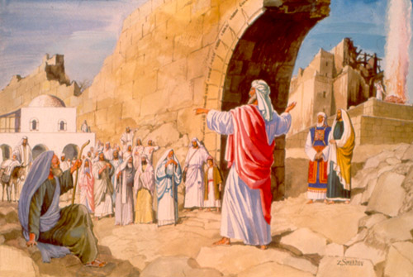

Slide 20


Slide 21
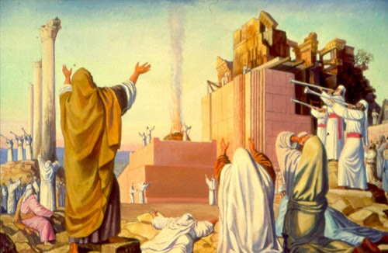

Slide 22
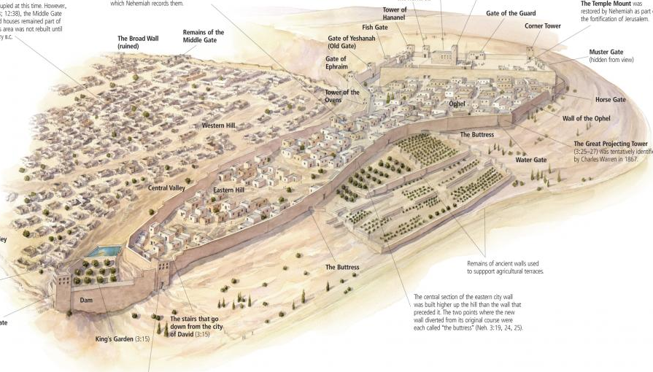

Slide 23
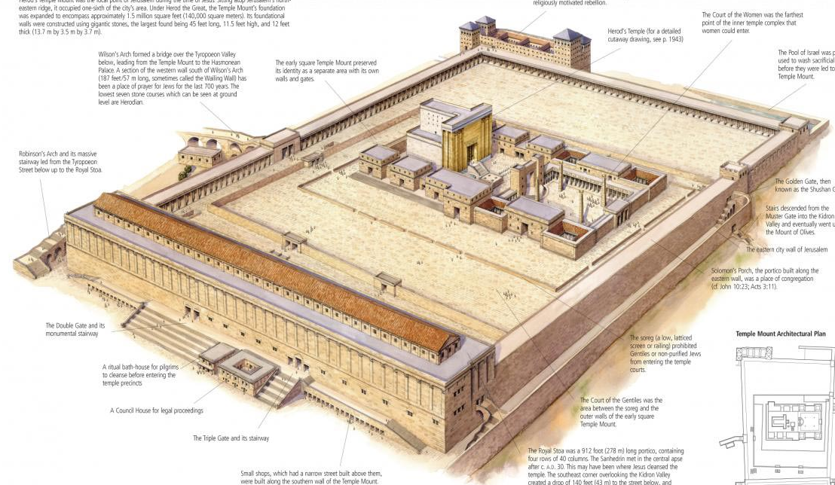

Slide 24
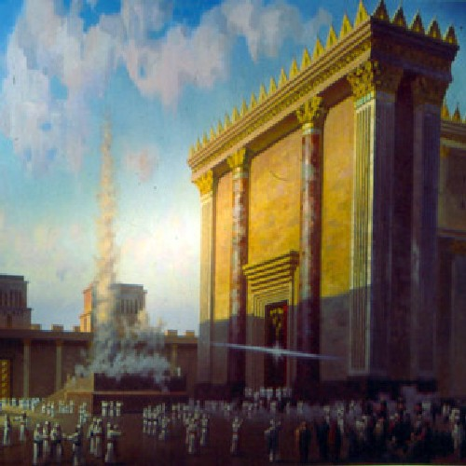

Slide 25
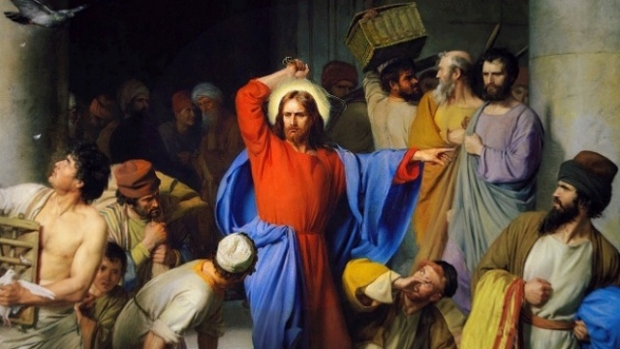

Slide 26
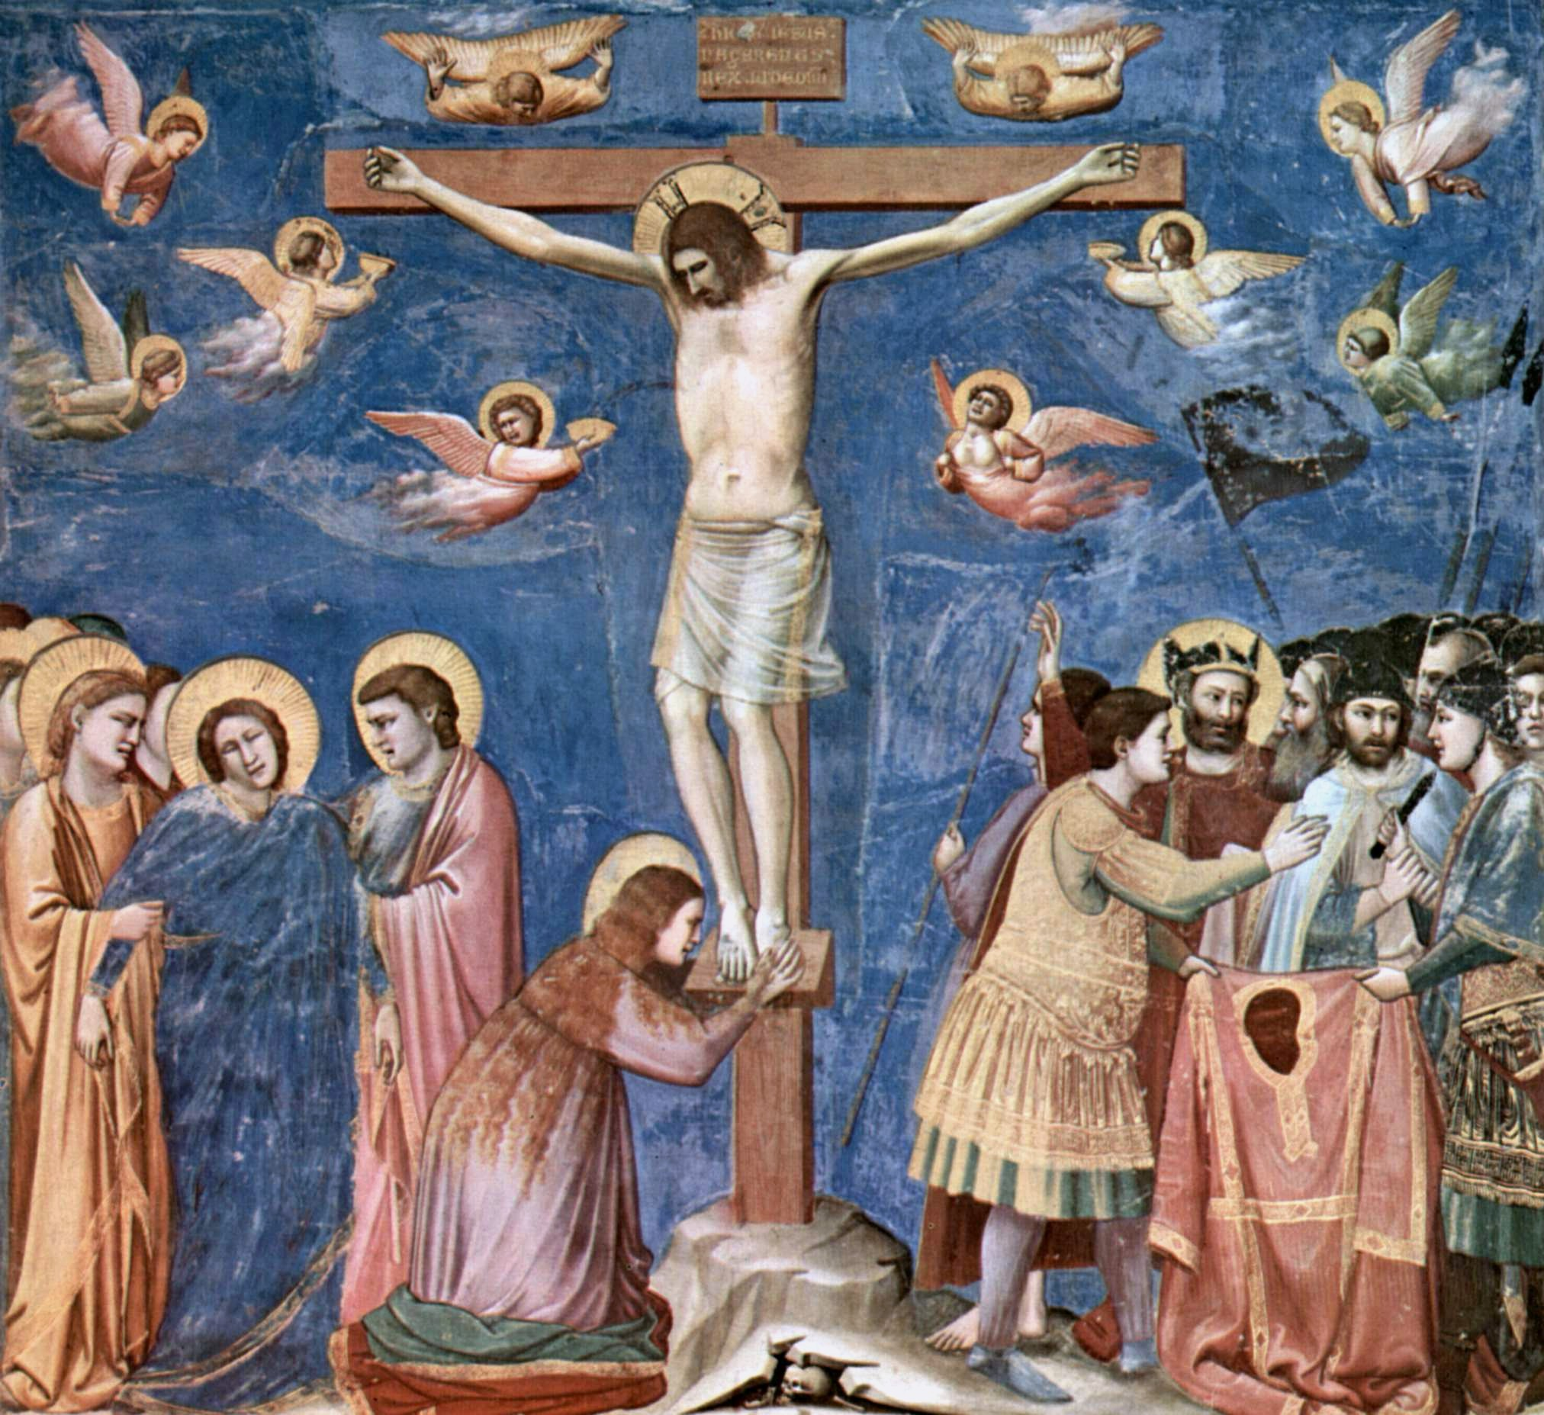

Slide 27
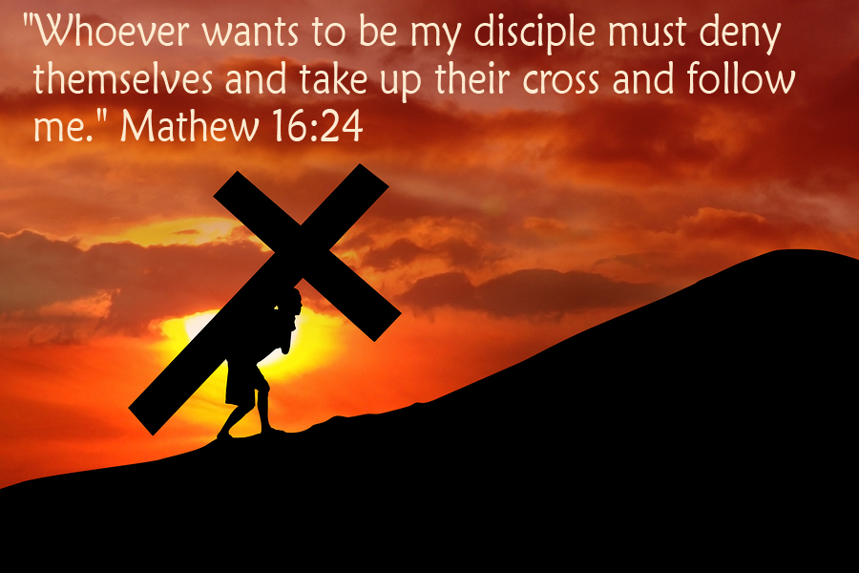

Slide 28
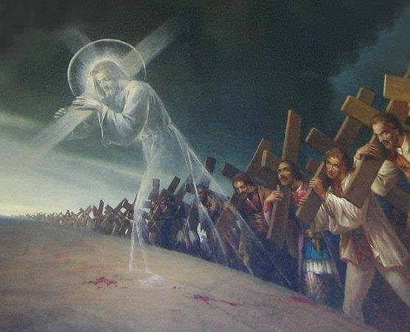

Slide 29
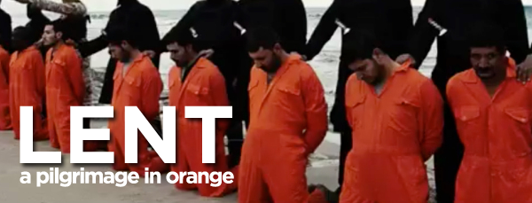

Slide 30
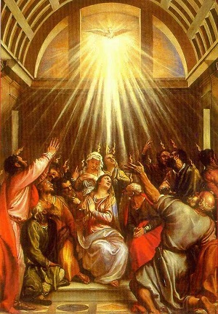

Slide 31
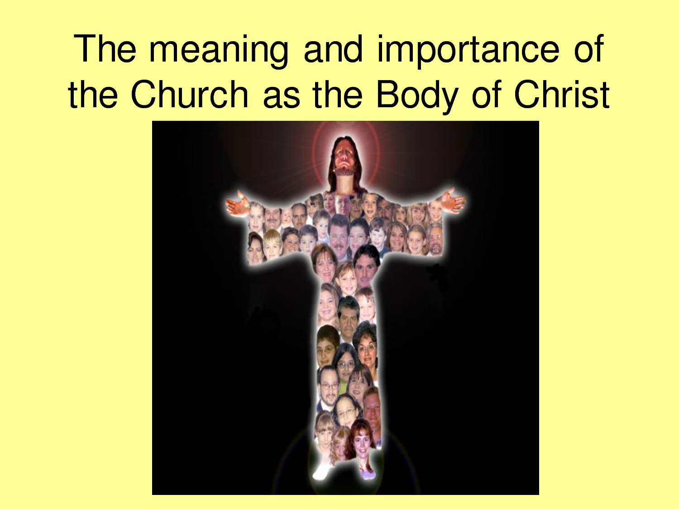

Slide 32
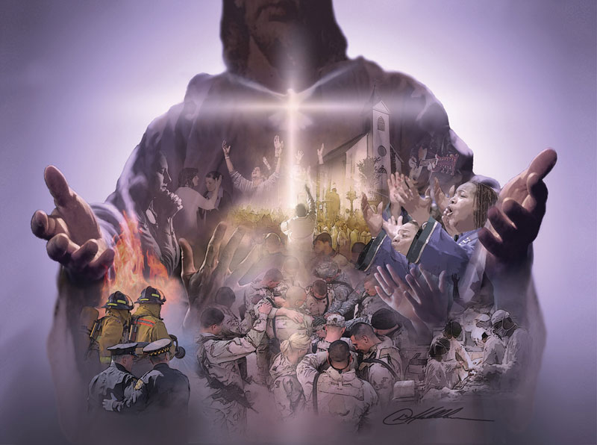

Slide 33
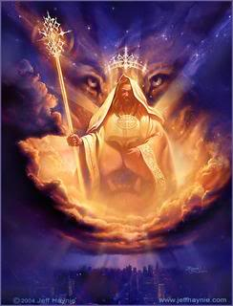

Slide 34
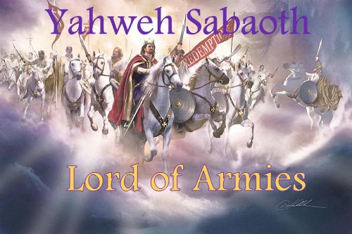

Slide 35
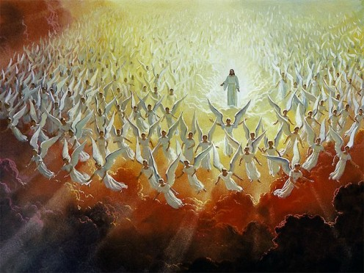

Slide 36
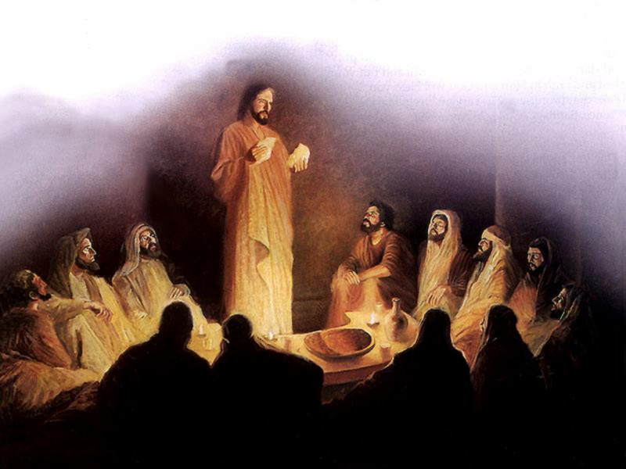

Slide 37
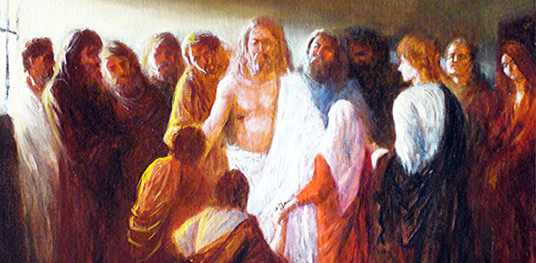

Slide 38
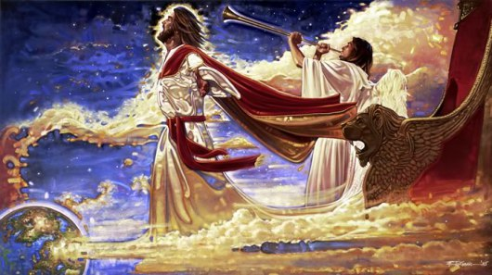

Slide 39
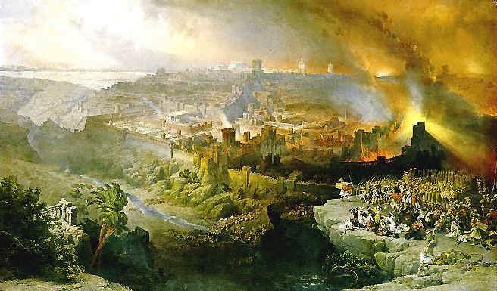

Slide 40
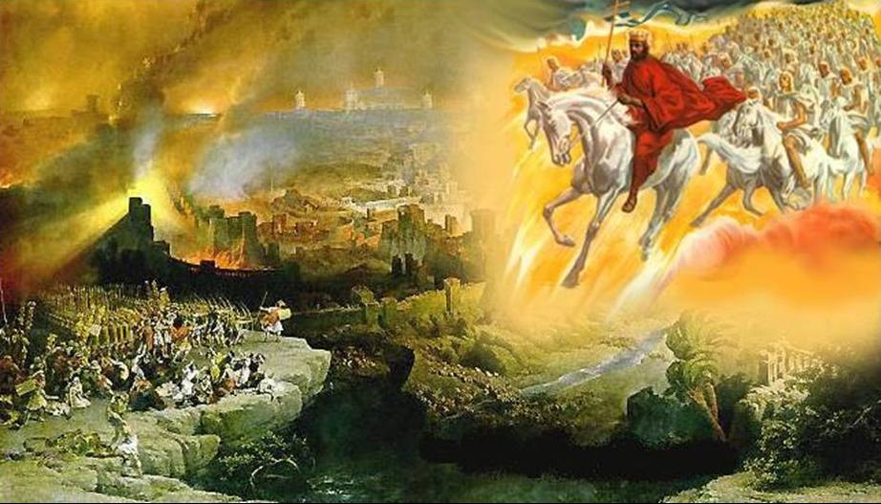

Slide 41
