Slide 1
“Prioritize Our Lives
Work Together”
The Book of Haggai
Making Disciples for Life
Pastor David Nehrenz
Trinity Lutheran Church Norman, OK.
Date: 2-18-24 Lesson: 1

Slide 2
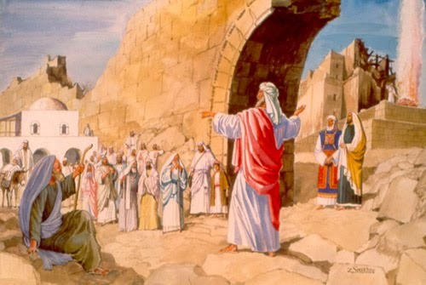

Slide 3


Slide 4


Slide 5
A. THE TEXT
(Haggai 1:1-15) In the second year of Darius the king, in the sixth month, on the first day of the month, the word of the Lord came by the hand of Haggai the prophet to Zerubbabel the son of Shealtiel, governor of Judah, and to Joshua the son of Jehozadak, the high priest: (2) "Thus says the Lord of hosts: These people say the time has not yet come to rebuild the house of the Lord."
(3) Then the word of the Lord came by the hand of Haggai the prophet, (4) "Is it a time for you yourselves to dwell in your paneled houses, while this house lies in ruins? (5) Now, therefore, thus says the Lord of hosts: Consider your ways. (6) You have sown much, and harvested little. You eat, but you never have enough; you drink, but you never have your fill. You clothe yourselves, but no one is warm. And he who earns wages does so to put them into a bag with holes.

Slide 6
(7) "Thus says the Lord of hosts: Consider your ways. (8) Go up to the hills and bring wood and build the house, that I may take pleasure in it and that I may be glorified, says the Lord. (9) You looked for much, and behold, it came to little. And when you brought it home, I blew it away. Why? declares the Lord of hosts. Because of my house that lies in ruins, while each of you busies himself with his own house. (10) Therefore the heavens above you have withheld the dew, and the earth has withheld its produce. (11) And I have called for a drought on the land and the hills, on the grain, the new wine, the oil, on what the ground brings forth, on man and beast, and on all their labors."

Slide 7
(12) Then Zerubbabel the son of Shealtiel, and Joshua the son of Jehozadak, the high priest, with all the remnant of the people, obeyed the voice of the Lord their God, and the words of Haggai the prophet, as the Lord their God had sent him. And the people feared the Lord.
(13) Then Haggai, the messenger of the Lord, spoke to the people with the Lord's message, "I am with you, declares the Lord." (14) And the Lord stirred up the spirit of Zerubbabel the son of Shealtiel, governor of Judah, and the spirit of Joshua the son of Jehozadak, the high priest, and the spirit of all the remnant of the people. And they came and worked on the house of the Lord of hosts, their God, (15) on the twenty-fourth day of the month, in the sixth month, in the second year of Darius the king.

Slide 8
B. THE KEY PEOPLE
1. Darius the king – Hystaspis ruler of Persia
(522-486 B.C.)
2. Haggai the prophet (Ezr 5:1-2; 6:14)
3. Zerubbabel the son of Shealtiel, governor of Judah – Sheshbazzar (Ezr 1:8)
4. Joshua the son of Jehozadak, the high priest (taken captive by Nebuchadnezzar in 1 Chr 6:15)
5. The remnant of the people

Slide 9
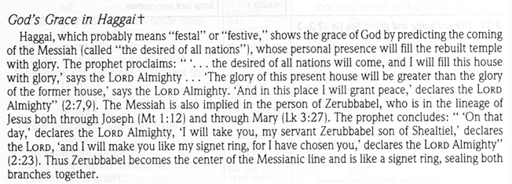
C. THE HISTORICAL BACKGROUND

Slide 10
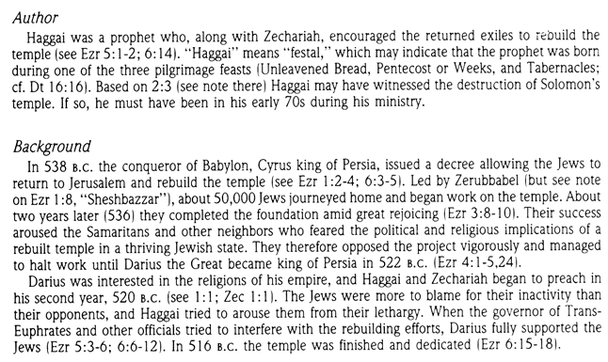

Slide 11
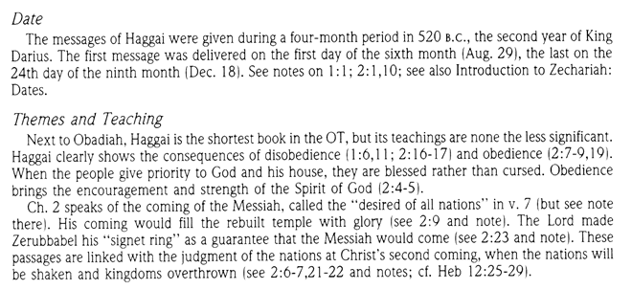

Slide 12
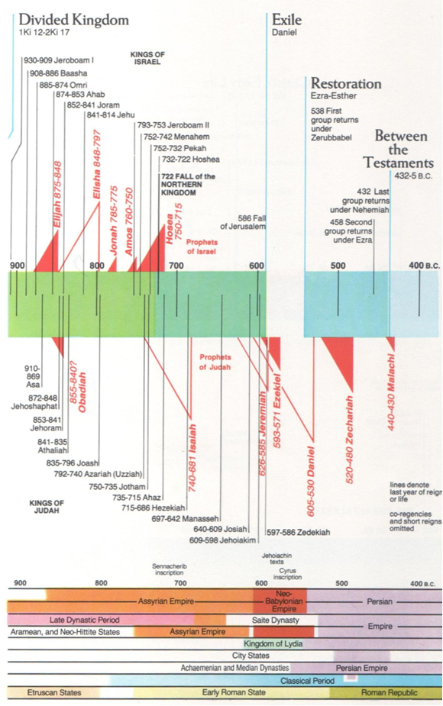

Slide 13
D. THE STUDY NOTES
1. The problem: The foundation of the temple had been laid in 536 B.C., (Ezr 3:8-10) but the people did no more work on the Lord’s house because of opposition that halted the work until 520 B.C. (Ezr 4:1-5,24). Meanwhile, the people had built fine paneled house for themselves.
2. They were cursed for their disobedience (Dt 28:38,39; Lev 26:20; Is 55:1,2; Hos 4:10,11)
3. Obedience, reverence and respect would show true faith in God (Jer 13:11; Dt 31:12,13; Mal 1:6; 3:5,16)
4. When the Lord is with you then godly and good things result (Nu 14:9; Gen 26:3; Mt 28:20; Rom 8:31)
5. When our spirits are stirred up by the Spirit, then things begin to happen, even though we have difficulty and woes, God works through us for his greater purposes (Ezr 1:5; Ex 35:20-22; 2 Chr 36:22; Php 2:13)

Slide 14
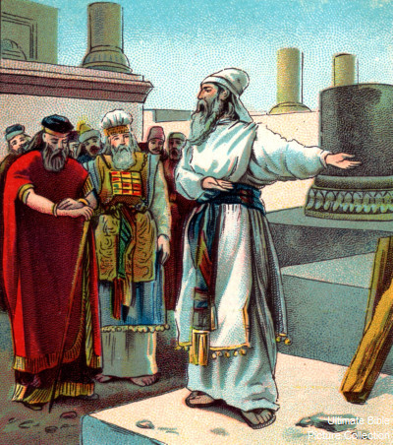

Slide 15
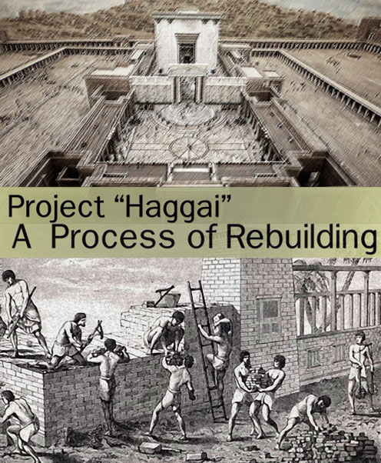

Slide 16
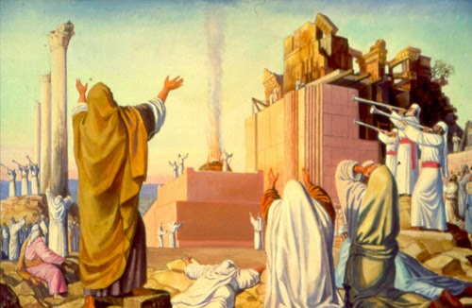

Slide 17
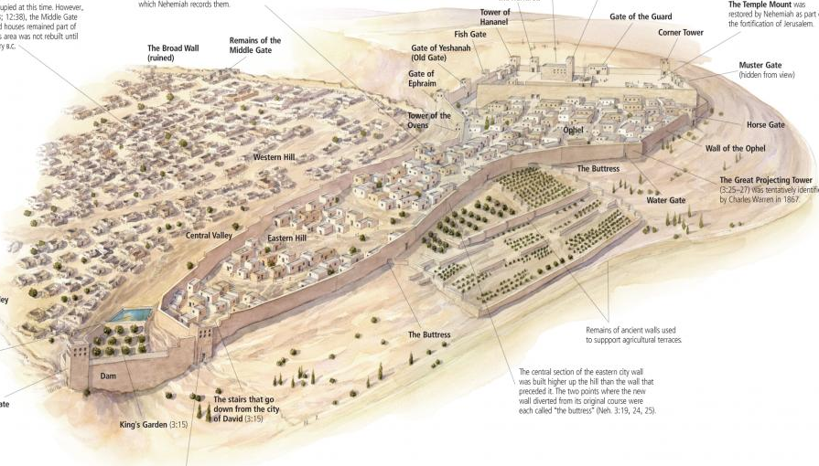

Slide 18
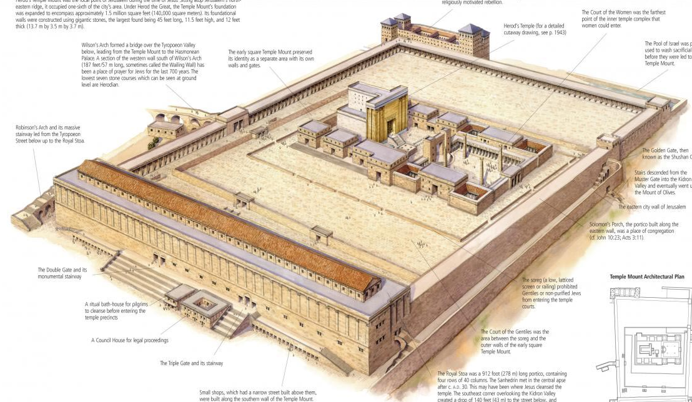

Slide 19
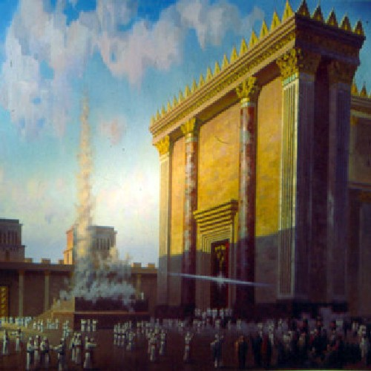

Slide 20
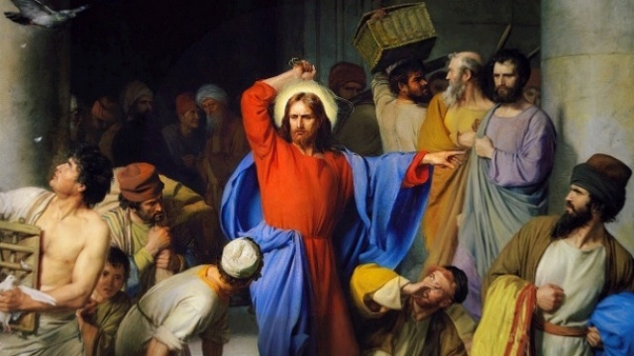

Slide 21
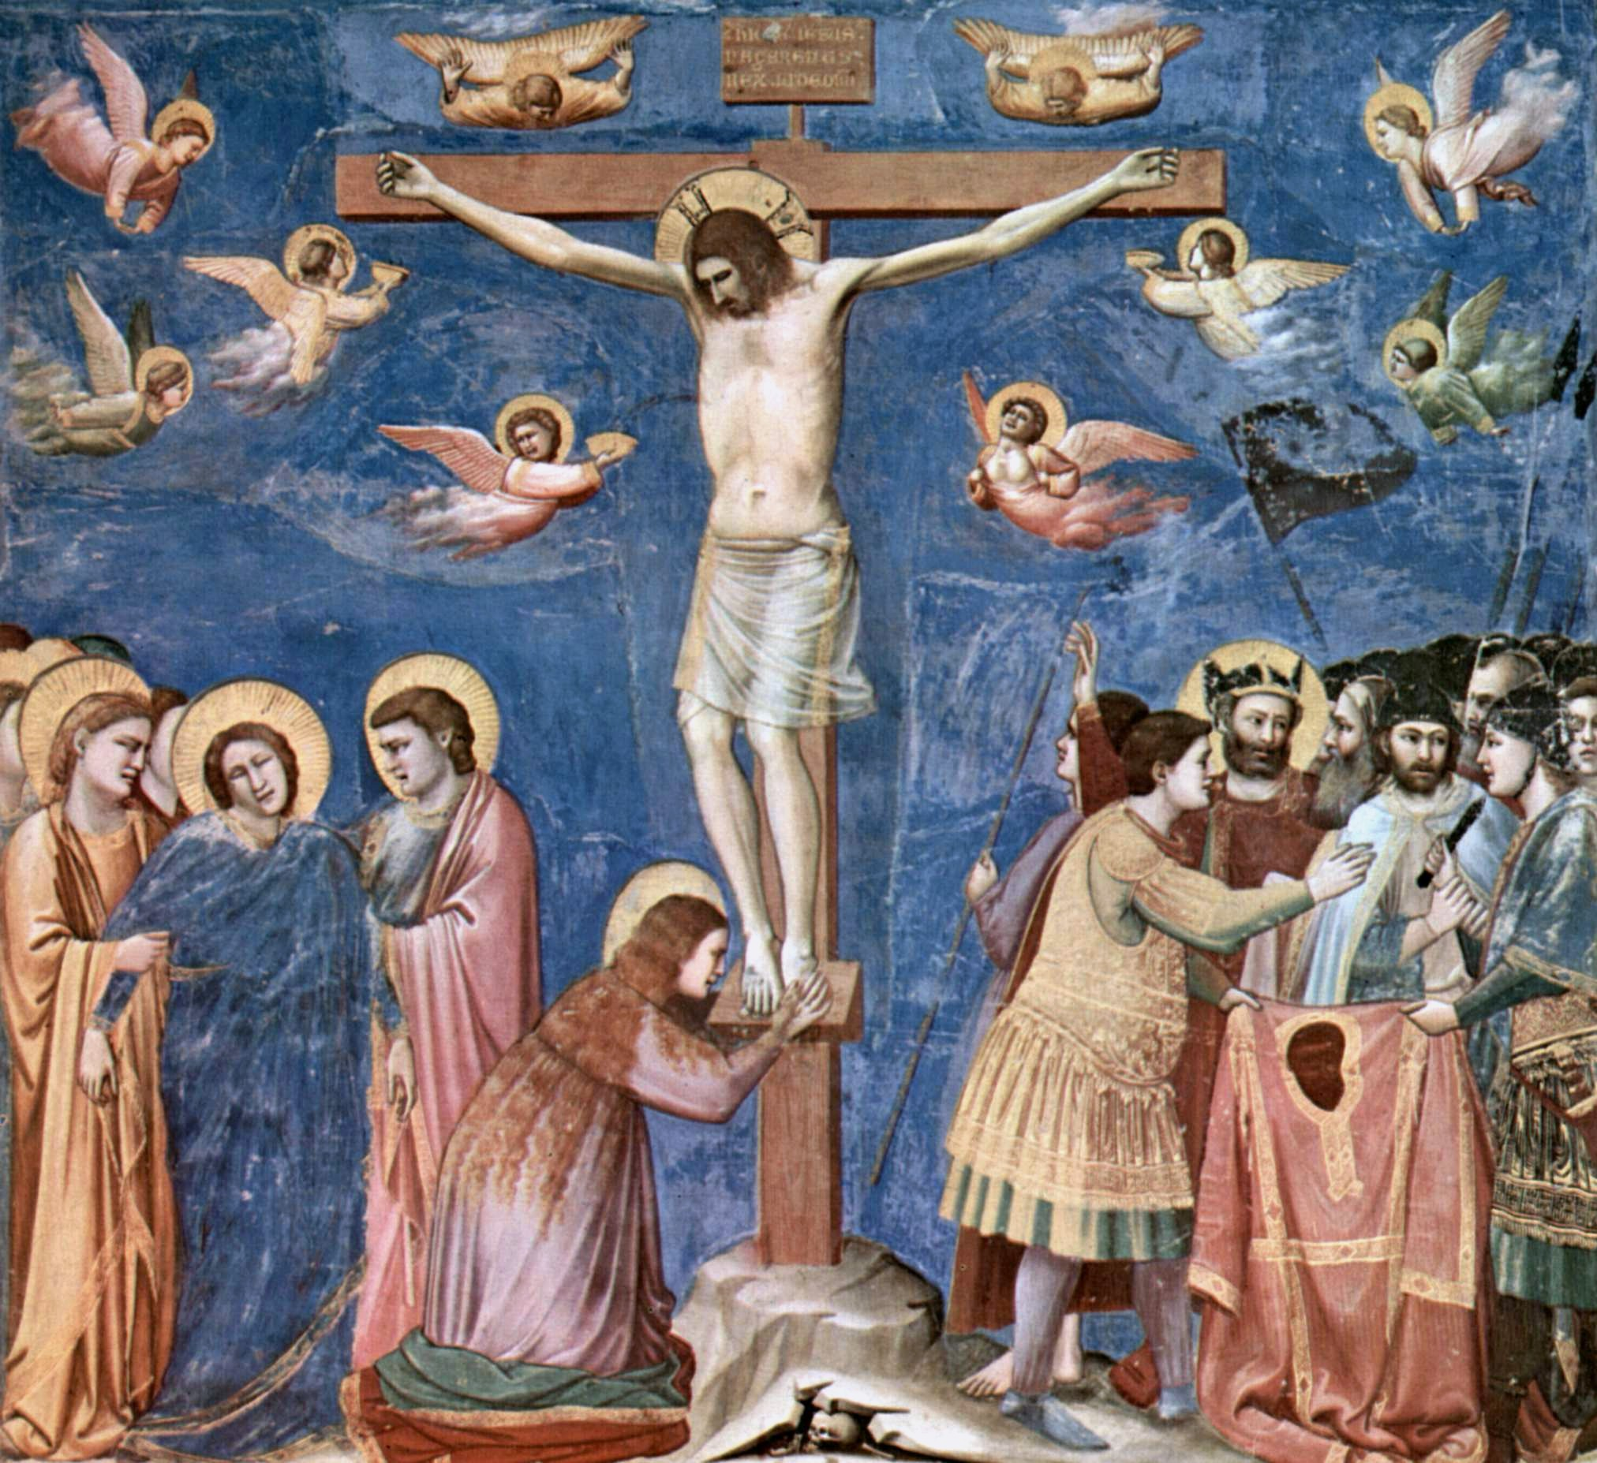

Slide 22
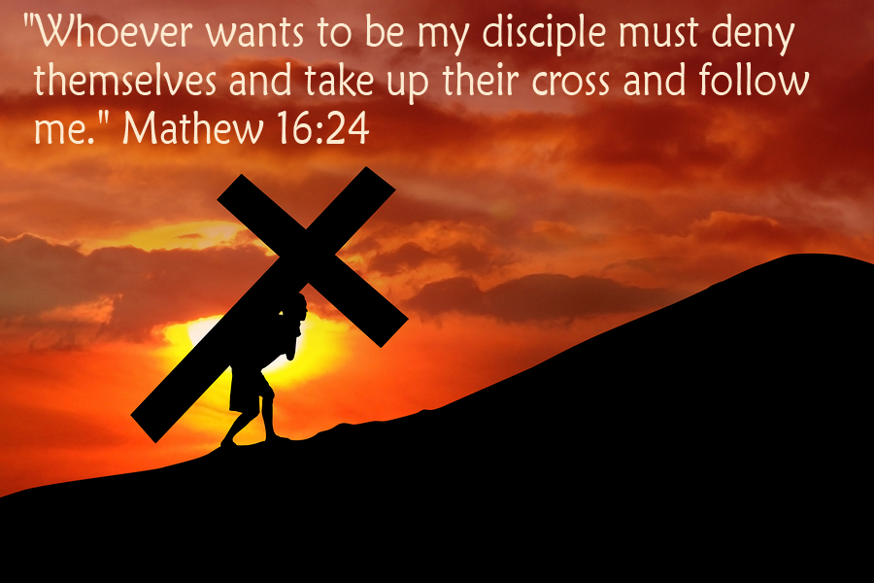

Slide 23
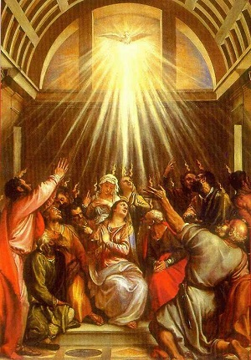

Slide 24


Slide 25
Making Disciples for Life
and the Seven Mission Priorities of the LCMS
THE CHURCH IN THE BOOK OF ACTS
“Go therefore and make disciples of all nations, baptizing them in the name of the Father and of the Son and of the Holy Spirit, teaching them to observe all that I have commanded you. And behold, I am with you always, to the end of the age” (MATT. 28:16–20). Baptizing into Christ and teaching His Word is central to the pattern of making disciples of Jesus for life! Jesus’ catechesis of His disciples made it possible for them to be faithful in their vocations, enduring persecution, confessing Christ and loving their neighbor as Christ had loved them. As the New Testament record makes clear, the apostles continued Jesus’ catechesis in the task of Making Disciples for Life.

Slide 26
The Book of Acts clearly establishes that which is foundational for the church: the preaching of the Gospel and the administration of the Sacraments. The preaching of repentance and the forgiveness of sins in Jesus’ name is always done “according to the Scriptures” of the Old Testament and is creedal in nature, proclaiming all that Christ has done through His suffering, death and resurrection. This content and pattern of preaching was established by Jesus after His resurrection (LUKE 24:44–49). Those who are called to repen­tance and faith by the apostolic preaching are baptized for the forgiveness of sins and the promised gift of the Holy Spirit (ACTS 2:38–39). This pattern of preaching and baptizing in the Book of Acts demonstrates the teaching of the Augsburg Confession that centers on the justification of sinners before God by grace through faith:
Our churches teach that people cannot be justified before God by their own strength, merits, or works. People are freely justified for Christ’s sake, through faith, when they believe that they are received into favor and that their sins are forgiven for Christ’s sake. By His death, Christ made satisfaction for our sins. God counts this faith for righteousness in His sight. (Augsburg Confession, Article IV)

Slide 27
So that we may obtain this faith, the ministry of teaching the Gospel and administering the Sacraments was instituted. Through the Word and Sacraments, as through instruments, the Holy Spirit is given [JOHN 20:22]. He works faith, when and where it pleases God [JOHN 3:8], in those who hear the good news that God justifies those who believe that they are received into grace for Christ’s sake. (Augsburg Confession, Article V) There is no set form of church polity or church government in the Book of Acts. The church is created by the Word of God, and the church is governed by the Word of God. Jesus sent out His apostles to preach the Gospel “according to the Scriptures” of the Old Testament. As the Word was received, converts were baptized for the forgiveness of sins and the promised gift of the Holy Spirit. The newly baptized “devoted themselves to the apostles’ teaching and the fellowship, to the breaking of bread and the prayers” (ACTS 2:42).
Congregations of baptized disciples continued to gather around the preached Word and “the breaking of bread” in the Divine Service. Men were trained and ordained by the apostles to be pastors (elders) of these congregations (TITUS 1:5–9). Their work centered in the ongoing teaching of the Gospel and administration of the Sacraments. The congregations also sent out missionaries to spread the Gospel and assist congregations in other parts of the world (ACTS 13:1–3). The church — her ministers and the baptized faithful — continues to train, call and ordain pastors and missionaries today for the same purpose.

Slide 28
Faith in Christ manifests itself in acts of mercy and charity toward the needy and persecuted Christians, as well as in the temporal support of faithful ministers of the Gospel (MATT. 25:34–40; ACTS 4:32–35; 11:27–30). Faithful teaching of the Gospel (catechesis), which grounds the faith of the disciples of Jesus in the apostolic and prophetic Scriptures, is the most important work of the holy ministry in the Book of Acts and for the church in every age. The preaching of the Gospel and the church’s confession of the truth does not flinch in the face of opposition and persecution (JOHN 15:18, 20). The apostles boldly confessed the faith before both religious and civil authorities (ACTS 4:17–20; 26). Wherever the Gospel and Sacraments are faithfully preached and administered, persecution and suffering follow as testimony of the church’s faithfulness to Christ (MATT. 16:18; 28:20; ACTS 4:23–31). Persecution comes both from unbelievers on the outside of the church and from false brethren from within (ACTS 14:1–7; 15:1–11).
The confession of the truth of the Gospel in creed and preaching, and the faithful administration of the Sacraments of Christ, are those things that create and constitute the church. What the church does in her life, worship, service and suffering identify her in this world as the holy bride of Christ. Luther’s seven “marks of the church” are in evidence throughout the Book of Acts and the missionary journeys of Paul. They indicate how the church is to be recognized in the world and what gifts she possesses:

Slide 29
The Holy Word of God (orally preached, taught and confessed).
The Sacrament of Holy Baptism (taught, believed and administered).
The Sacrament of the Altar (rightly administered, believed and received according to Christ’s institution).
The exercise of the Office of the Keys publicly. “Where one sees sins forgiven or reproved in some persons, be it publicly or privately, one may know that God’s holy people are there.”
The calling of men into the Office of the Ministry to preach, to baptize, to absolve and to administer the Sacraments.
The use of prayer, public praise and thanksgiving to God according to the Scriptures. (The Lord’s Prayer prayed and taught; psalms and other spiritual songs used in accordance with the Word of God and true faith; also, the creed, the Ten Commandments and the catechism used in public.)
The enduring of suffering and persecution (the holy cross). “They must endure every misfortune and persecution, all kinds of trials and evil from the devil, the world, and the flesh (as the Lord’s Prayer indicates) by inward sadness, timidity, fear, outward poverty, contempt, illness, and weakness, in order to become like their head, Christ.”

Slide 30
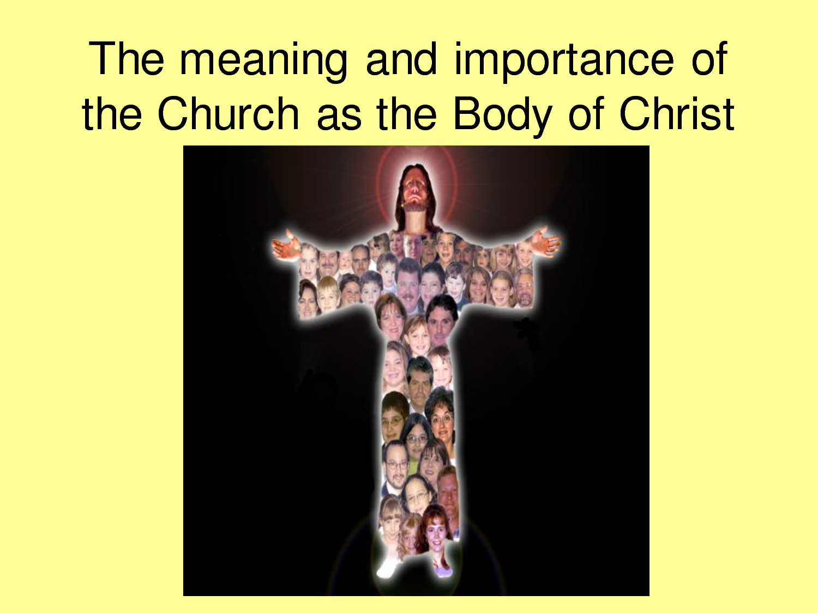

Slide 31
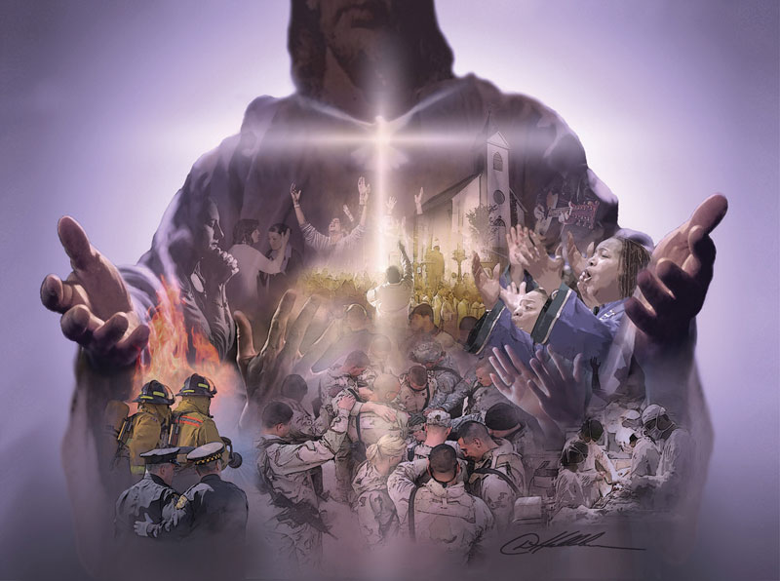

Slide 32
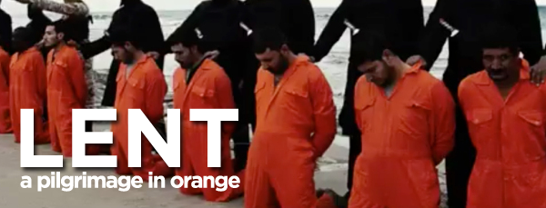

Slide 33
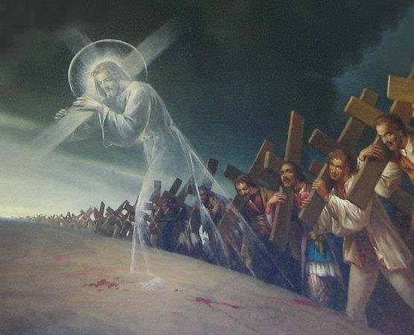

Slide 34

NEXT WEEK 2-25-24 Lesson 2
“My Spirit remains in your midst. Fear not.”
(Haggai 2:1-9)
SEVEN MISSION PRIORITIES
MISSION PRIORITY #1
Plant, sustain and revitalize Lutheran churches
(Acts 14:21–28)

