Slide 1

THE BOOK OF EPHESIANS
“We Are His Workmanship”
Date: 7-7-24 Lesson: 9
Pastor David Nehrenz –
Trinity Lutheran Church – Norman, OK

Slide 2
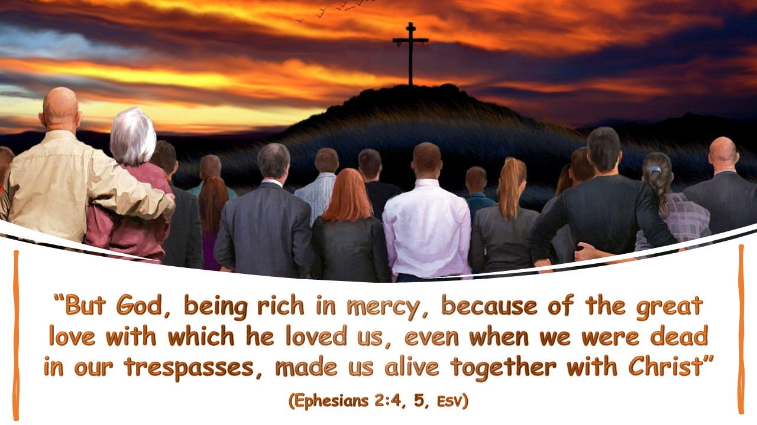

Slide 3
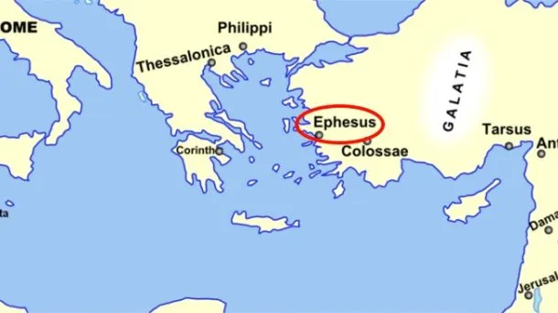
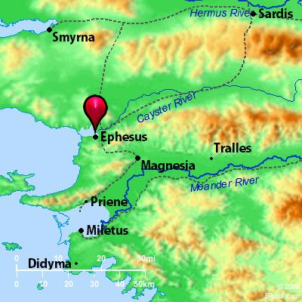
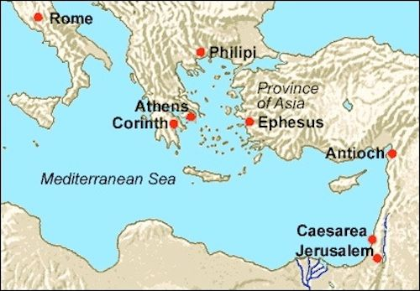

Slide 4
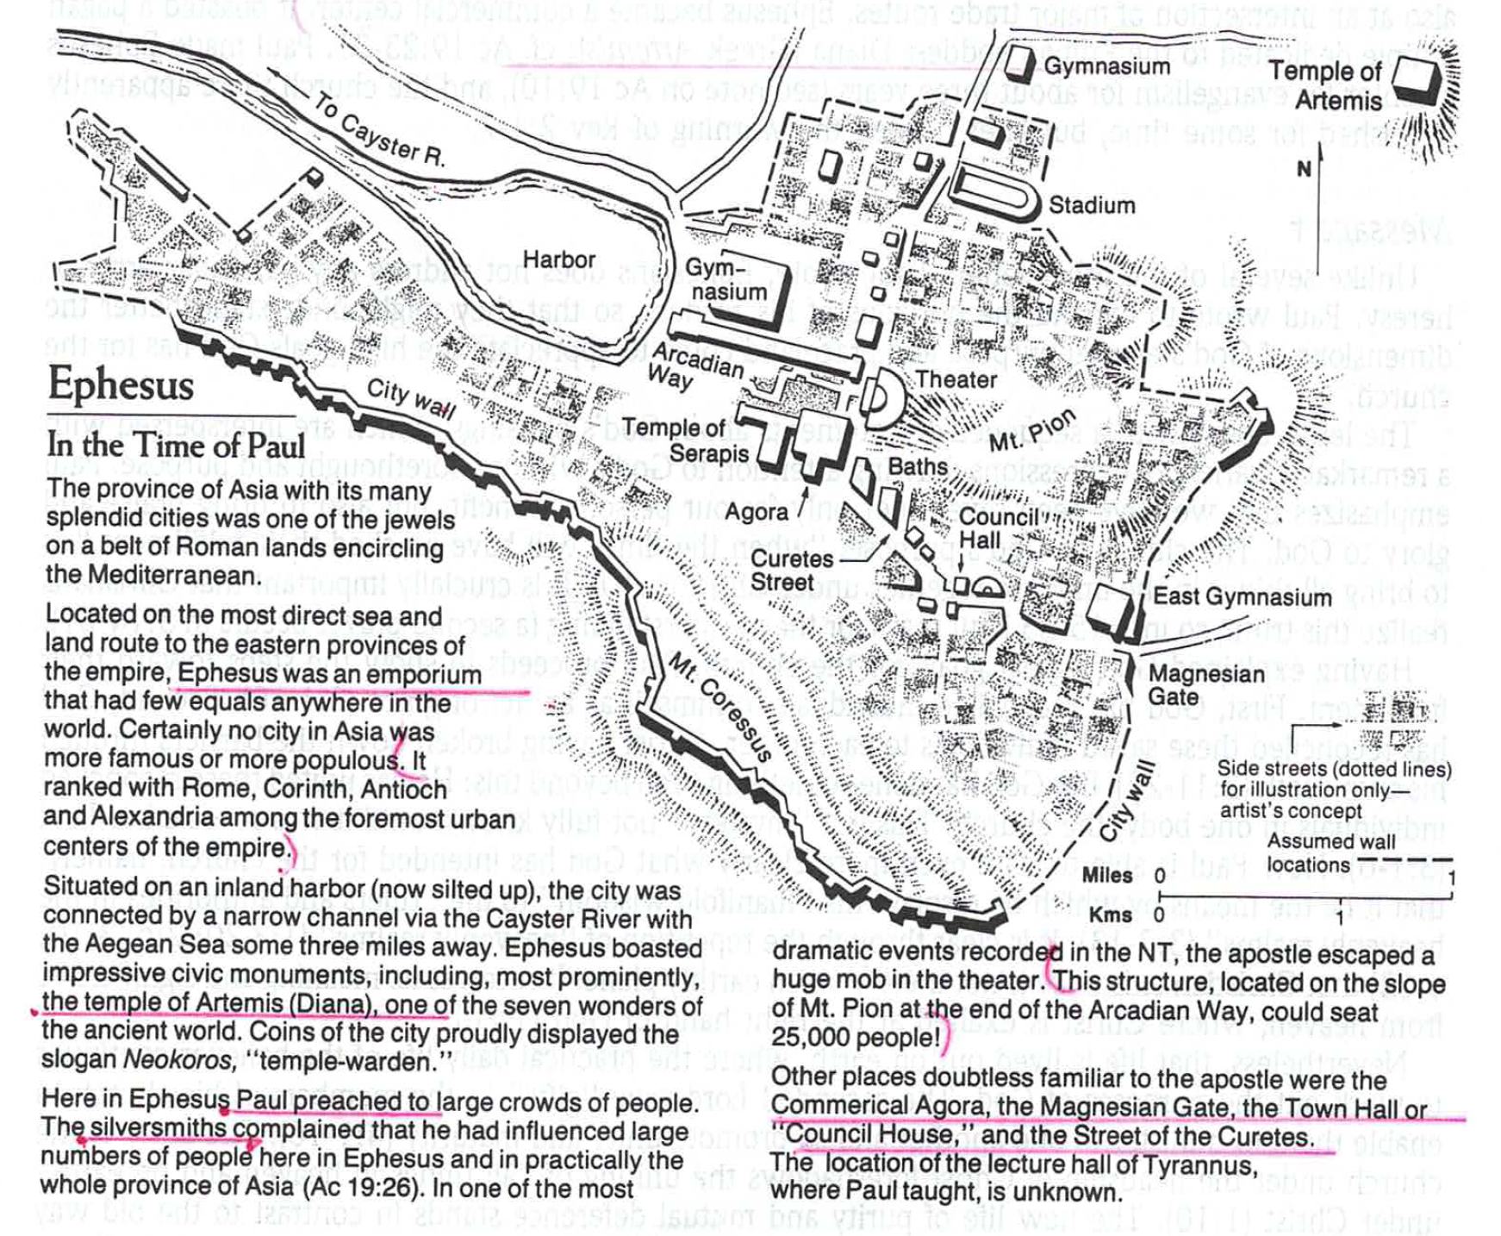

Slide 5
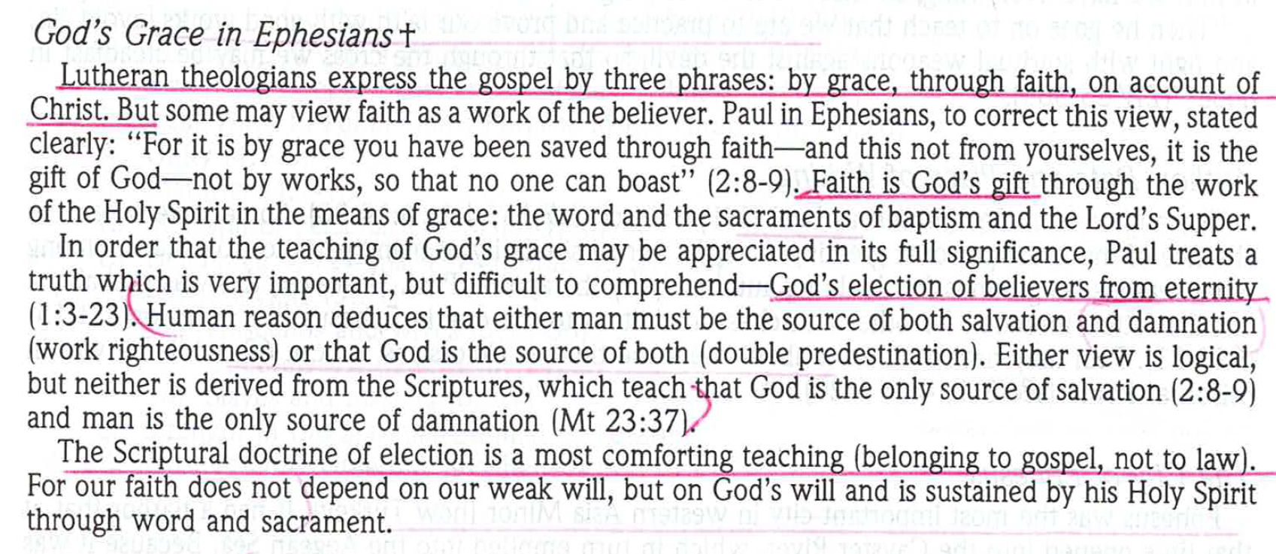

Slide 6
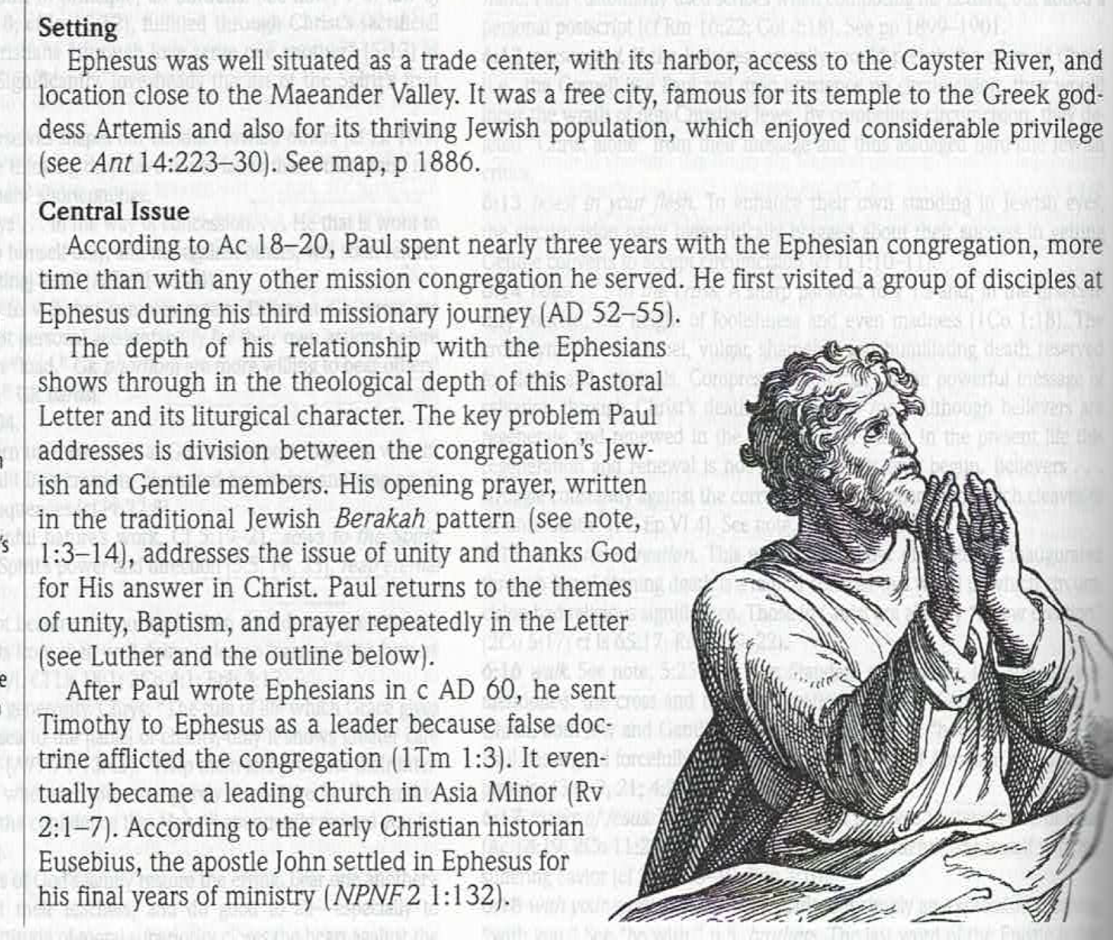

Slide 7
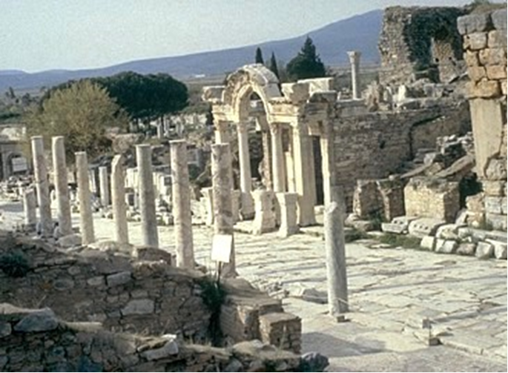

Slide 8
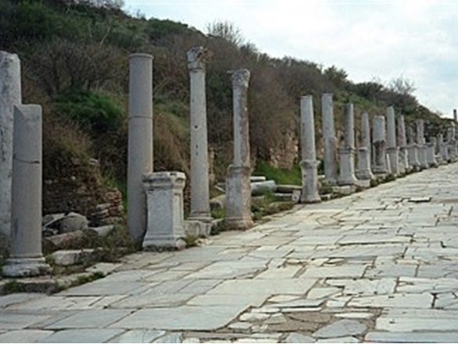

Slide 9
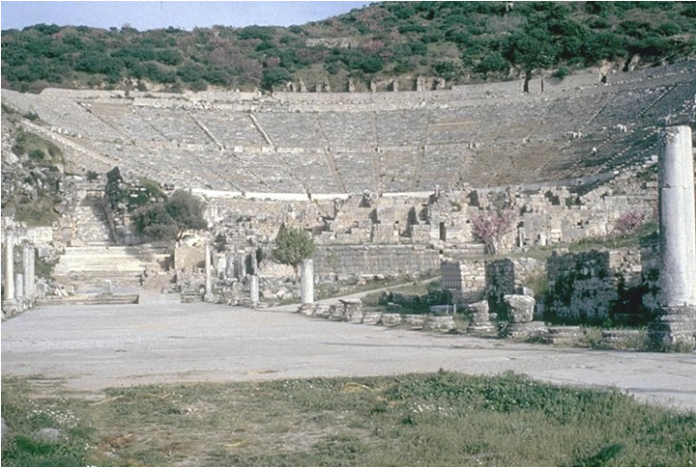

Slide 10
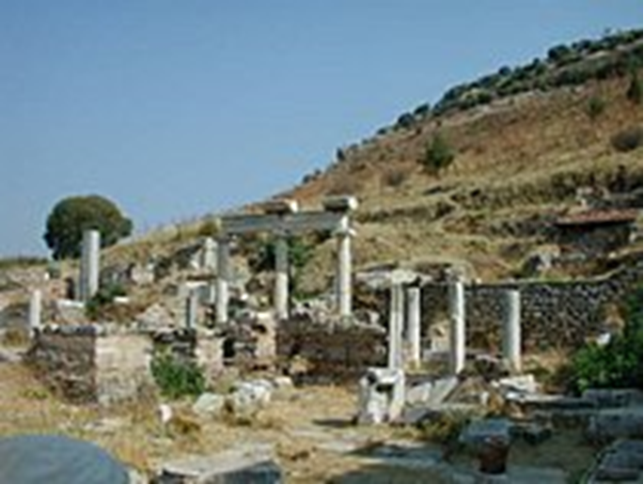

Slide 11
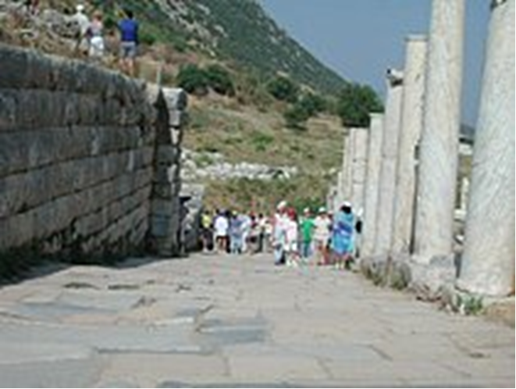
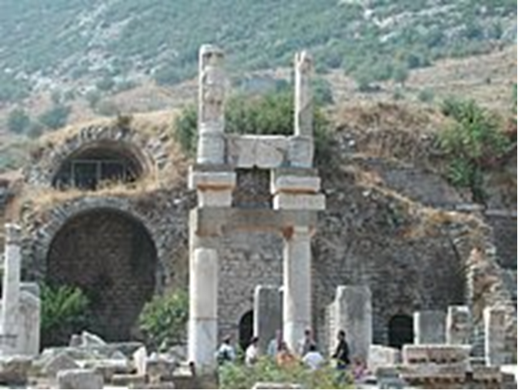

Slide 12
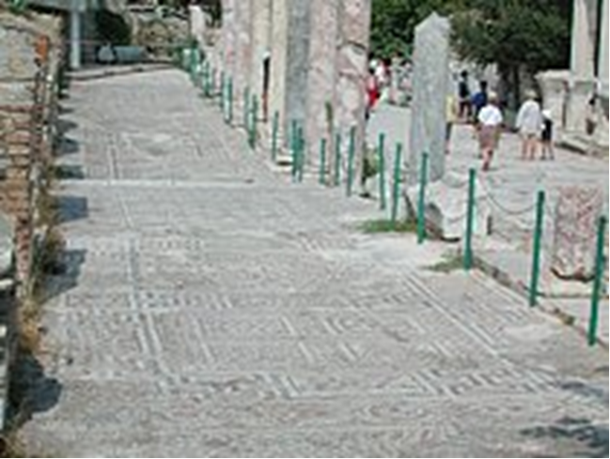
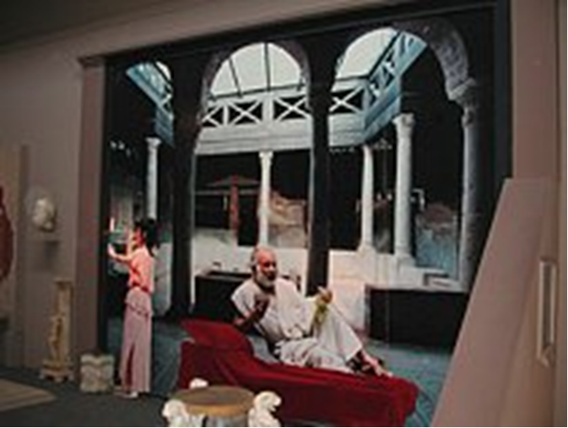

Slide 13
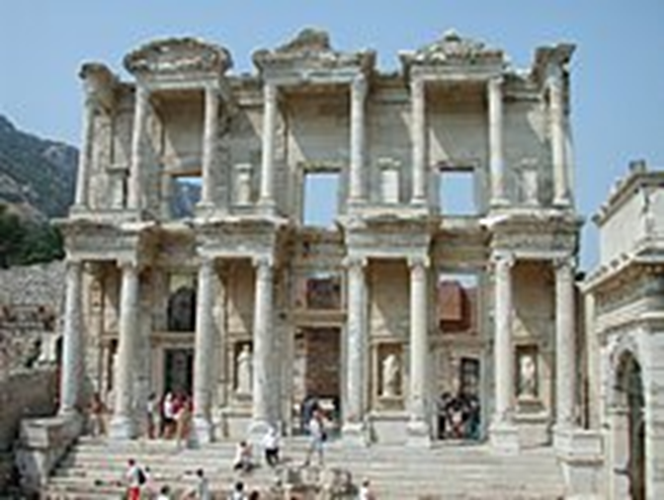

Slide 14
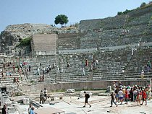
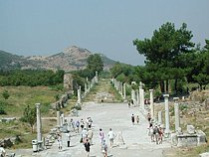

Slide 15
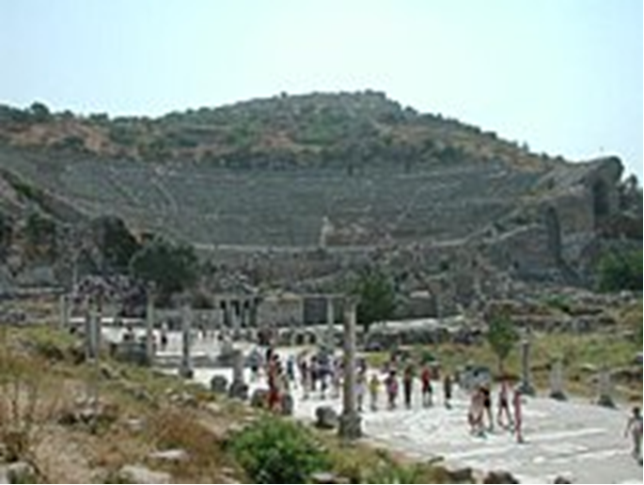
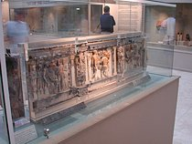

Slide 16
LAW
(1) And you were dead in the trespasses and sins
(2) in which you once walked, following the course of this world, following the prince of the power of the air, the spirit that is now at work in the sons of disobedience—
(3) among whom we all once lived in the passions of our flesh, carrying out the desires of the body and the mind, and were by nature children of wrath, like the rest of mankind.
NOTES:
This is an apt description of our enemies:
The devil, the world and our own sinful flesh
(Job 1:6; Ps 51:5; Is 14:12-15; Ezek 28:1;
Mt 8:22; Lk 15:24; Jn 5:24,25; 12:31; 14:30;
Rom 1:18-20; 2:5; 5:12-21; 6:23; 7:9,10; 9:22; 11:30; 12:2; 1 Cor 6:11; Gal 5:16; Eph 5:6; Col 2:7-13; 3:5-7; Titus 3:3;
1 Pet 1:14; 4:3; 2 Pet 2:14; Rev 9:11)

Slide 17
GOSPEL
(4) But God, being rich in mercy, because of the great love with which he loved us,
(5) even when we were dead in our trespasses, made us alive together with Christ
--by grace you have been saved—
(6) and raised us up with him and seated us with him in the heavenly places in Christ Jesus,
(7) so that in the coming ages he might show the immeasurable riches of his grace in kindness toward us in Christ Jesus.
NOTES:
This is an apt description of our friends:
God the Father, Christ Jesus His Son, the Holy Spirit our Counselor
(Ps 103:12; Mk 10:30; Jn 5:24; 14:19; Ac 15:11;
Rom 2:4; 5:6-10; 6:1-11; 10:12;
2 Cor 4:14; Php 3:20; Col 2:12,13; 3:1; Titus 3:4,5; Rev 3:21; 20:4)

Slide 18
STUDY HELPS
LUTHER’S SMALL CATECHISM
- The Lord’s Prayer - THE THIRD PETITION
Thy will be done on earth as it is in heaven.
What does this mean?
The good and gracious will of God is done indeed without our prayer.
But we pray in this petition that it may be done among us also.
How is this done?
When God breaks and hinders every evil counsel and will that would not let us hallow the name of God nor let His kingdom come, such as the will of the devil, the world, and our flesh.
Instead, He strengthens and keeps us steadfast in His Word and in faith until we die.
This is His gracious and good will.

Slide 19
THE LARGE CATECHISM - THE THIRD PETITION
Note: “By faith we cling to God’s holy name and His holy kingdom. But evil opposes us and tries to snatch God’s kingdom from us. Luther says we pray that God will work His will among us and protect and keep us safe from our old sinful flesh and from all the evil in the world. The devil will spare no effort to make us fall away from God’s kingdom. We Christians bear a holy cross: temptations, dangers, and intense struggle throughout our life. It is foolish for us to think that a Christian’s life is easy. Therefore, we ask God to work His gracious will for us and to provide us with the strength we need.”
[59] Thy will be done on earth as it is in heaven. [60] So far we have prayed that God’s name be honored by us and that His kingdom triumph among us. In these two points is summed up all that deals with God’s honor and our salvation. We receive God as our own and all His riches. But now arises a need that is just as great: we must firmly keep God’s honor and our salvation, and not allow ourselves to be torn from them. [61] In a good government it is not only necessary that there be those who build and govern well. It is also necessary to have those who defend, offer protection, and maintain it firmly. So in God’s kingdom, although we have prayed for the greatest need— for the Gospel, faith, and the Holy Spirit, that He may govern us and redeem us from the devil’s power— we must also pray that God’s will be done. For there will be strange events if we are to abide in God’s will. We shall have to suffer many thrusts and blows on that account from everything that seeks to oppose and prevent the fulfillment of the first two petitions.

Slide 20
[62] No one can believe how the devil opposes and resists these prayers. He cannot allow anyone to teach or to believe rightly. It hurts him beyond measure to have his lies and abominations exposed, which have been honored under the most fancy, sham uses of the divine name. It hurts him when he himself is disgraced, is driven out of the heart, and has to let a breach be made in his kingdom. Therefore, he chafes and rages as a fierce enemy with all his power and might. He marshals all his subjects and, in addition, enlists the world and our own flesh as his allies. [63] For our flesh is in itself lazy and inclined to evil [Romans 7: 18], even though we have accepted and believe God’s Word. The world, however, is perverse and wicked. So he provokes the world against us, fans and stirs the fire, so that he may hinder and drive us back, cause us to fall, and again bring us under his power [2 Corinthians 2: 11; 1 Timothy 3: 6– 7]. [64]
Such is all his will, mind, and thought. He strives for this day and night and never rests a moment. He uses all arts, wiles, ways, and means that he can invent. [65] If we would be Christians, therefore, we must surely expect and count on having the devil with all his angels and the world as our enemies [Matthew 25: 41; Revelation 12: 9]. They will bring every possible misfortune and grief upon us. For where God’s Word is preached, accepted, or believed and produces fruit, there the holy cross cannot be missing [Acts 14: 22]. And let no one think that he shall have peace [Matthew 10: 34]. He must risk whatever he has upon earth— possessions, honor, house and estate, wife and children, body and life.

Slide 21
[66] Now, this hurts our flesh and the old Adam [Ephesians 4: 22]. The test is to be steadfast and to suffer with patience [James 5: 7– 8] in whatever way we are assaulted, and to let go whatever is taken from us [1 Peter 2: 20– 21]. [67] So there is just as great a need, as in all the other petitions, that we pray without ceasing, “Dear Father, Your will be done, not the devil’s will or our enemies’ or anything that would persecute and suppress Your holy Word or hinder Your kingdom. Grant that we may bear with patience and overcome whatever is to be endured because of Your Word and kingdom, so that our poor flesh may not yield or fall away because of weakness or sluggishness.”
As we have said before, we pray that what must be done without us anyway may also be done in us. As His name must be hallowed and His kingdom come whether we pray or not, so also His will must be done and succeed. This is true even though the devil with all his followers raise a great riot, are angry and rage against it, and try to exterminate the Gospel completely. But for our own sakes we must pray that, even against their fury, His will be done without hindrance among us also. We pray so that they may not be able to accomplish anything and that we may remain firm against all violence and persecution and submit to God’s will.
[69] Such prayer, then, is to be our protection and defense now. It is to repel and put down all that the devil, pope, bishops, tyrants, and heretics can do against our Gospel. Let them all rage and attempt their utmost and deliberate and resolve how they may suppress and exterminate us, so that their will and counsel may prevail. Over and against this one or two Christians with this petition alone shall be our wall [Ezekiel 22: 30], against which they shall run and dash themselves to pieces. [70] We have this comfort and confidence: the devil’s will and purpose and all our enemies shall and must fail and come to nothing, no matter how proud, secure, and powerful they know themselves to be. For if their will were not broken and hindered, God’s kingdom could not remain on earth nor His name be hallowed.

Slide 22
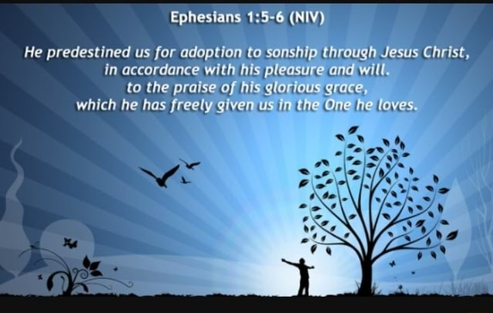

Slide 23
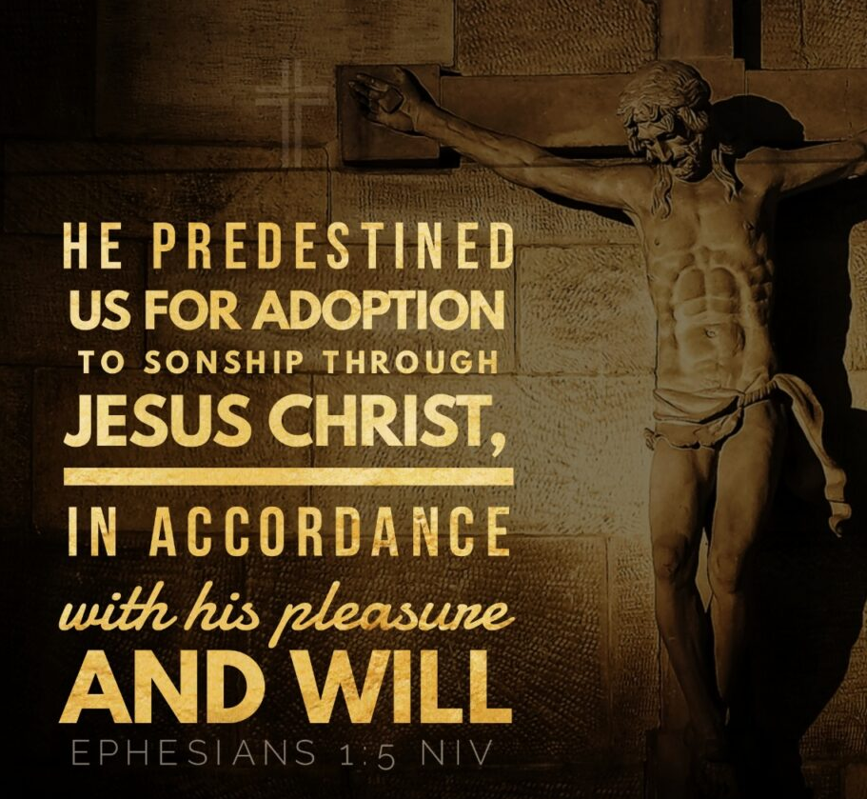

Slide 24
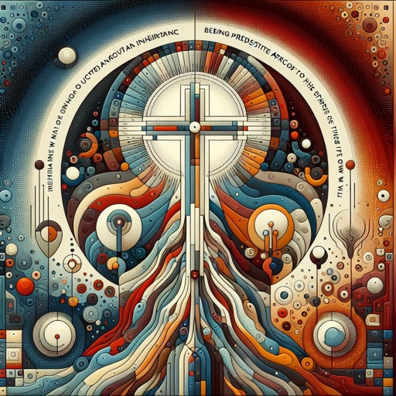

Slide 25
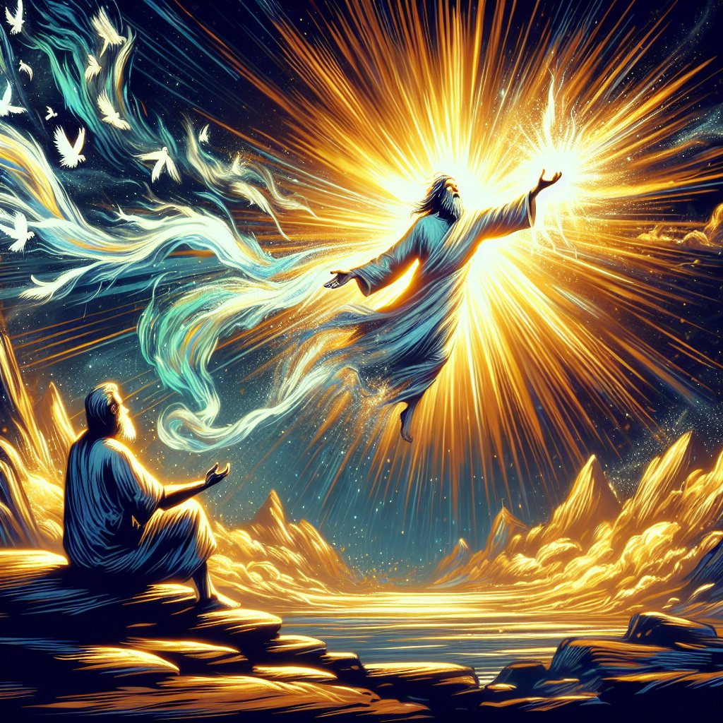

Slide 26
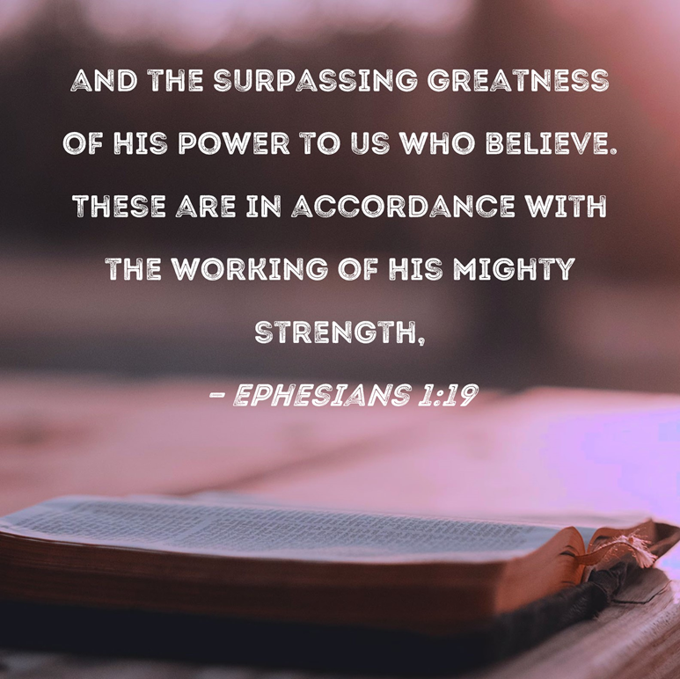

Slide 27
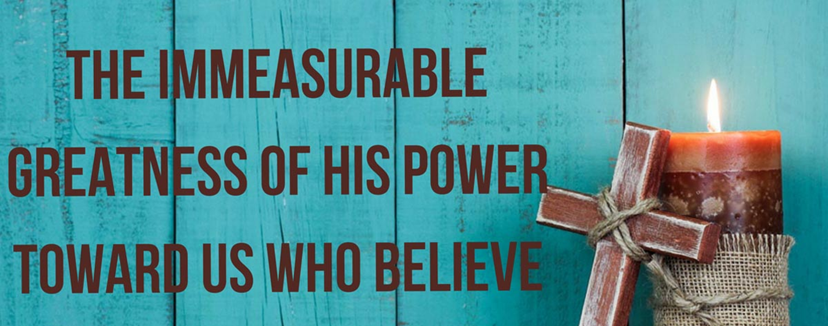

Slide 28
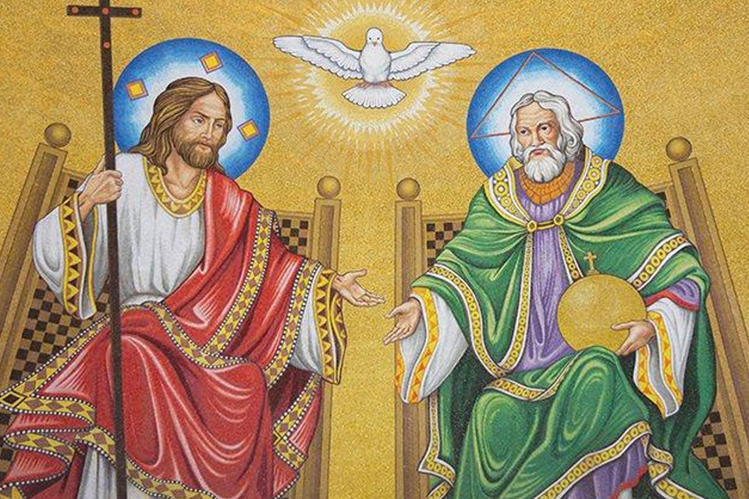

Slide 29
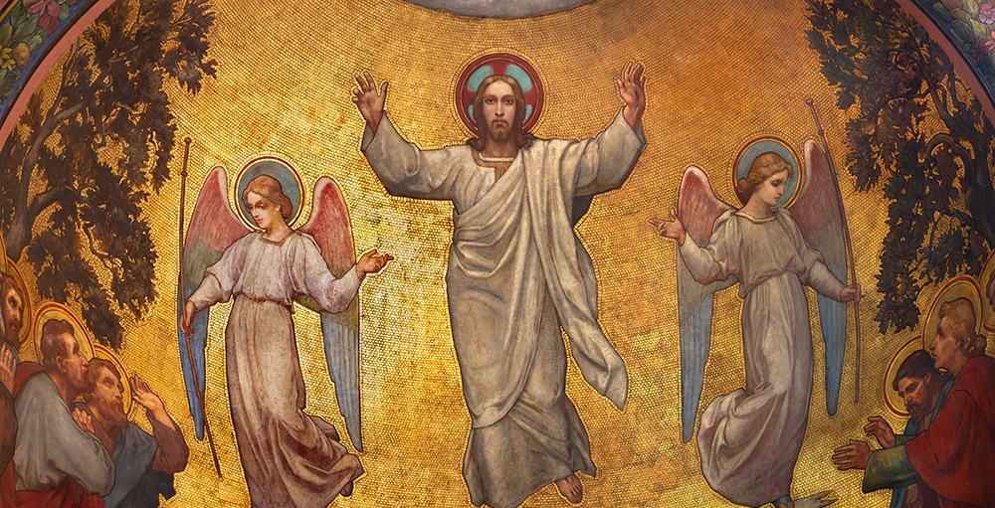

Slide 30
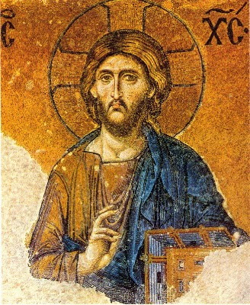

Slide 31
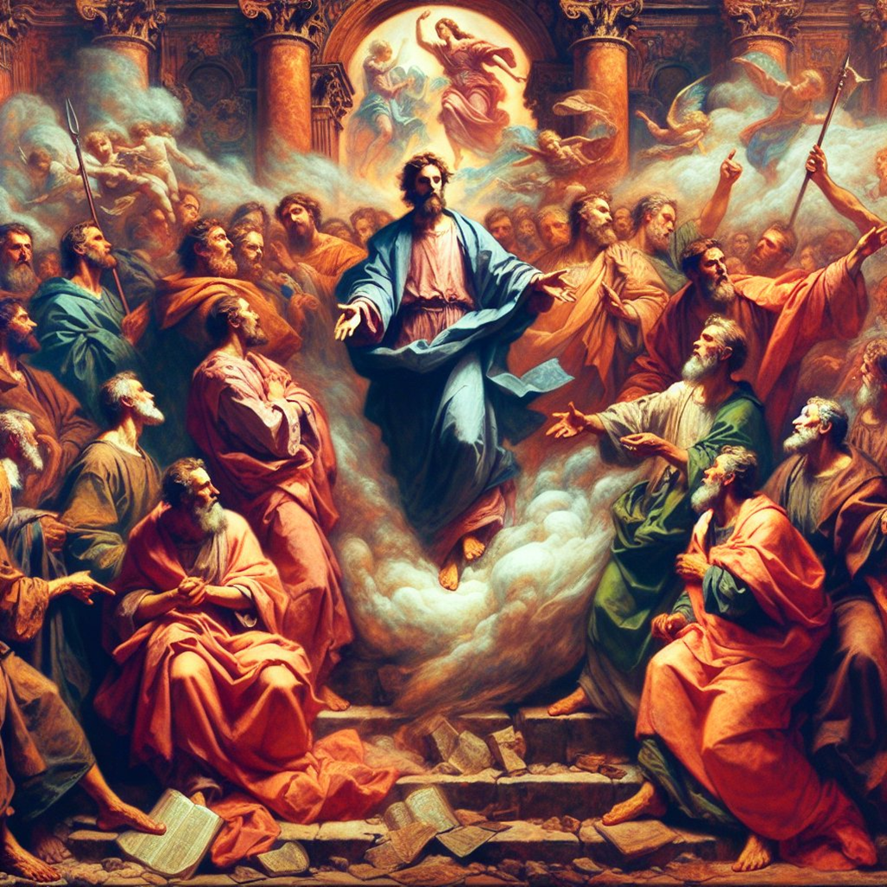

Slide 32
