Slide 1
A BIBLE STUDY OF THE BOOK OF ECCLESIASTES
Theme:
Solomon and Jesus,
Both Sons of David, say:
“Fear God and keep his commandments,
For this is the whole duty of man!”
Trinity Lutheran Church
Norman, Oklahoma
Pastor David Nehrenz
Date: 11-1-15
Lesson: 8

Slide 2
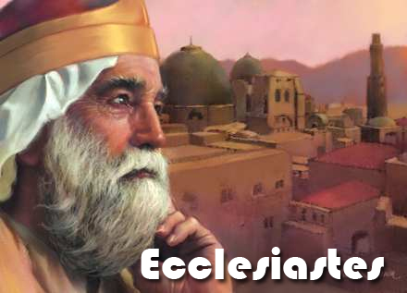

Slide 3
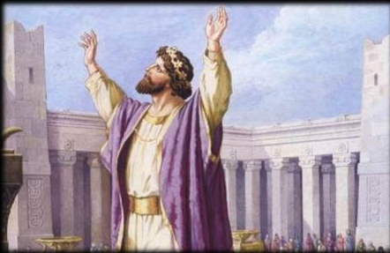

Slide 4
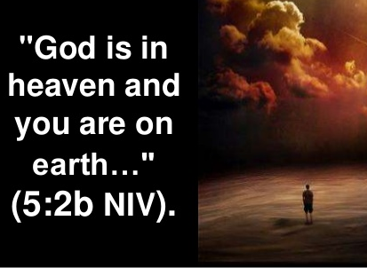

Slide 5
TEXT (Chapter 8)
(1) I say: Keep the king's command, because of God's oath to him. (3) Be not hasty to go from his presence. Do not take your stand in an evil cause, for he does whatever he pleases. (4) For the word of the king is supreme, and who may say to him, "What are you doing?"
(5) Whoever keeps a command will know no evil thing, and the wise heart will know the proper time and the just way.
(6) For there is a time and a way for everything, although man's trouble lies heavy on him. (7) For he does not know what is to be, for who can tell him how it will be? (8) No man has power to retain the spirit, or power over the day of death. There is no discharge from war, nor will wickedness deliver those who are given to it.
(9) All this I observed while applying my heart to all that is done under the sun, when man had power over man to his hurt.
(10) Then I saw the wicked buried. They used to go in and out of the holy place and were praised in the city where they had done such things. This also is vanity. (11) Because the sentence against an evil deed is not executed speedily, the heart of the children of man is fully set to do evil.

Slide 6
(12) Though a sinner does evil a hundred times and prolongs his life, yet I know that it will be well with those who fear God, because they fear before him. (13) But it will not be well with the wicked, neither will he prolong his days like a shadow, because he does not fear before God.
(14) There is a vanity that takes place on earth, that there are righteous people to whom it happens according to the deeds of the wicked, and there are wicked people to whom it happens according to the deeds of the righteous. I said that this also is vanity.
(15) And I commend joy, for man has no good thing under the sun but to eat and drink and be joyful, for this will go with him in his toil through the days of his life that God has given him under the sun.
(16) When I applied my heart to know wisdom, and to see the business that is done on earth, how neither day nor night do one's eyes see sleep, (17) then I saw all the work of God, that man cannot find out the work that is done under the sun. However much man may toil in seeking, he will not find it out. Even though a wise man claims to know, he cannot find it out.

Slide 7
STUDY NOTES:
1. Loyalty to the king and to those over you
(1 Chr 29:24; Rom 13:1)
2. Who can say, “What are you doing?”
(Esther 1:19; 4:10,11; Is 45:9; Rom 9:20)
3. A man’s misery and troubles lie heavily upon him
(Mt 6:34; Php 4:14)
4. No man knows or has true power over life
(Ps 31:15; 2 Cor 5:1-10; Jas 4:13-16)

Slide 8
5. The wicked are buried with undeserved respect
(Job 21:28-33; Lk 16:22)
6. The righteous get what the wicked deserve; the wicked get what the righteous deserve
(Job ch. 21-24; Ps 73; Jn 5:28,29)
7. Eat and drink and be glad
(Ex 32:6; Dt. ch 8; Ps 42:8) but this is also done in arrogance
(Lk 12:19,20; 1 Cor 15:32)

Slide 9
8. No one can comprehend what we are allowed and not allowed to understand
(Dt 29:29; Job 28:3,23; Rom 11:33)
9. In the end, for the wicked who do not fear God, it will not go well
(Dt 4:40; Job 5:26; Ps 34:12; Is 65:20)
10. A man’s wisdom makes his face shine (Prov 4:8,9; 17:24; 21:29; Acts 6:15)

Slide 10
11. When justice is not done speedily against the wicked, others then commit more evil, not afraid that they will be caught or punished
(Ps 10:6; 50:21; Is 26:10; Rom 2:4; 2 Pet 3:9)
12. It will be well for those who fear God
(Ps 37:11-19; Mt 25:34)
13. Man will never be able to find out the whole work of God
(Ps 73:16; Prov 25:2)

Slide 11
Luther’s Works on ch. 8:
“This passage can be understood in two ways. One way is actively, so that it means: “Wisdom illumines the face of the righteous man,” which is the same as: “Wisdom makes him a man of happy countenance.” On the other hand, hypocrites go about in sadness, as Christ says of the Pharisees in Matt. 6:16: “They disfigure their faces,” that is, they have a sour expression.
A wise man, however, always goes about with a serene countenance, because he does what he can. The wicked man always has a hateful and cloudy countenance. This is therefore a kind of proverbial saying, as though he were saying: “One can readily tell by the eyes where there is a happy heart.” Wicked men almost always have a rumpled forehead; for as their heart is, so their face is.
Secondly, the passage can be understood the same way in a passive sense, namely, that a man who has a happy face is also pleasant to others and makes others happy. His conduct is joyful and happy. In this way also this is a flourish in praise of wisdom.”

Slide 12
LIFE APPLICATION:
1. The wise heart will know the proper time and the just way.
From where does such discernment come?
2. He does not know what is to be, for who can tell him how it will be.
Why is this a frustrating part of life for all of us?
3. I know that it will be well with those who fear God, because they fear before him.
How do we know that this will be true?
4. I saw all the work of God, that man cannot find out the work that is done under the sun.
When does this properly put us in our place,
since none of us are God?

Slide 13
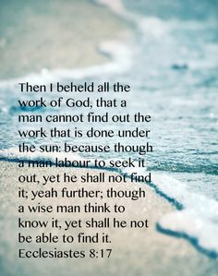

Slide 14
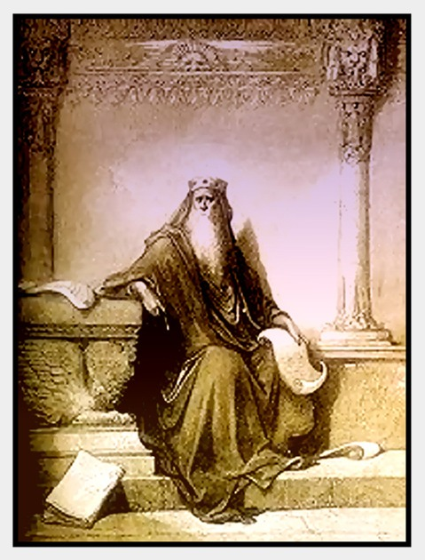

Slide 15
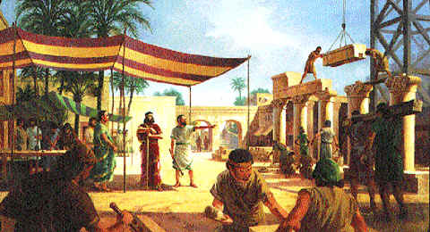

Slide 16
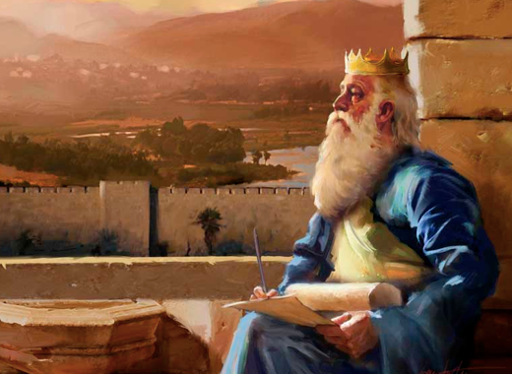

Slide 17
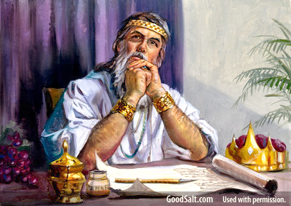

Slide 18
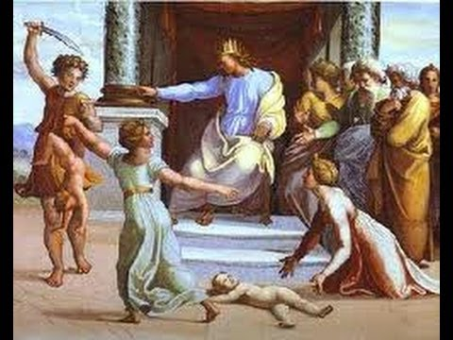

Slide 19
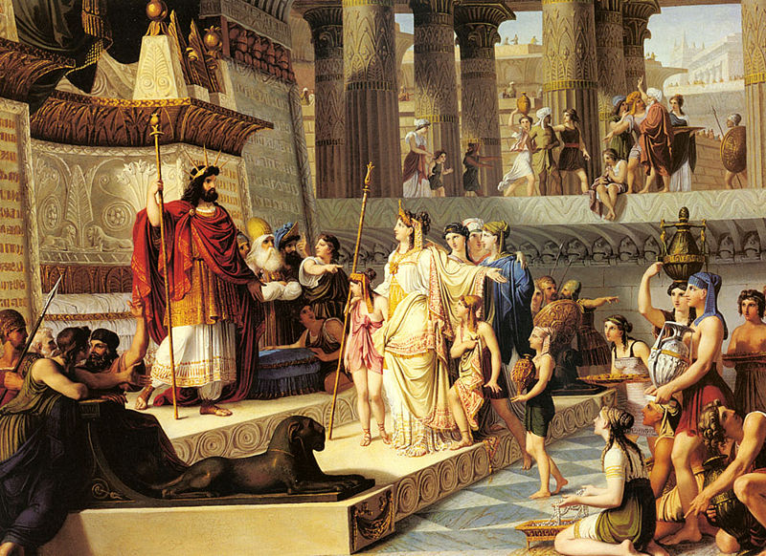

Slide 20
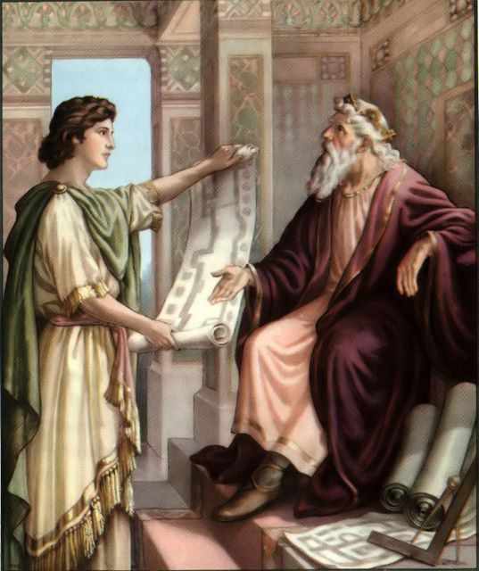

Slide 21
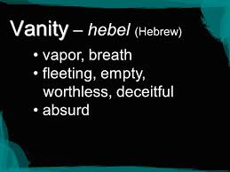

Slide 22
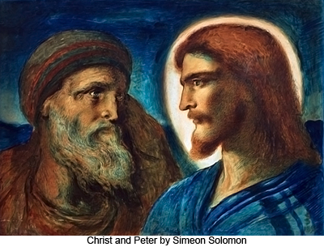

Slide 23
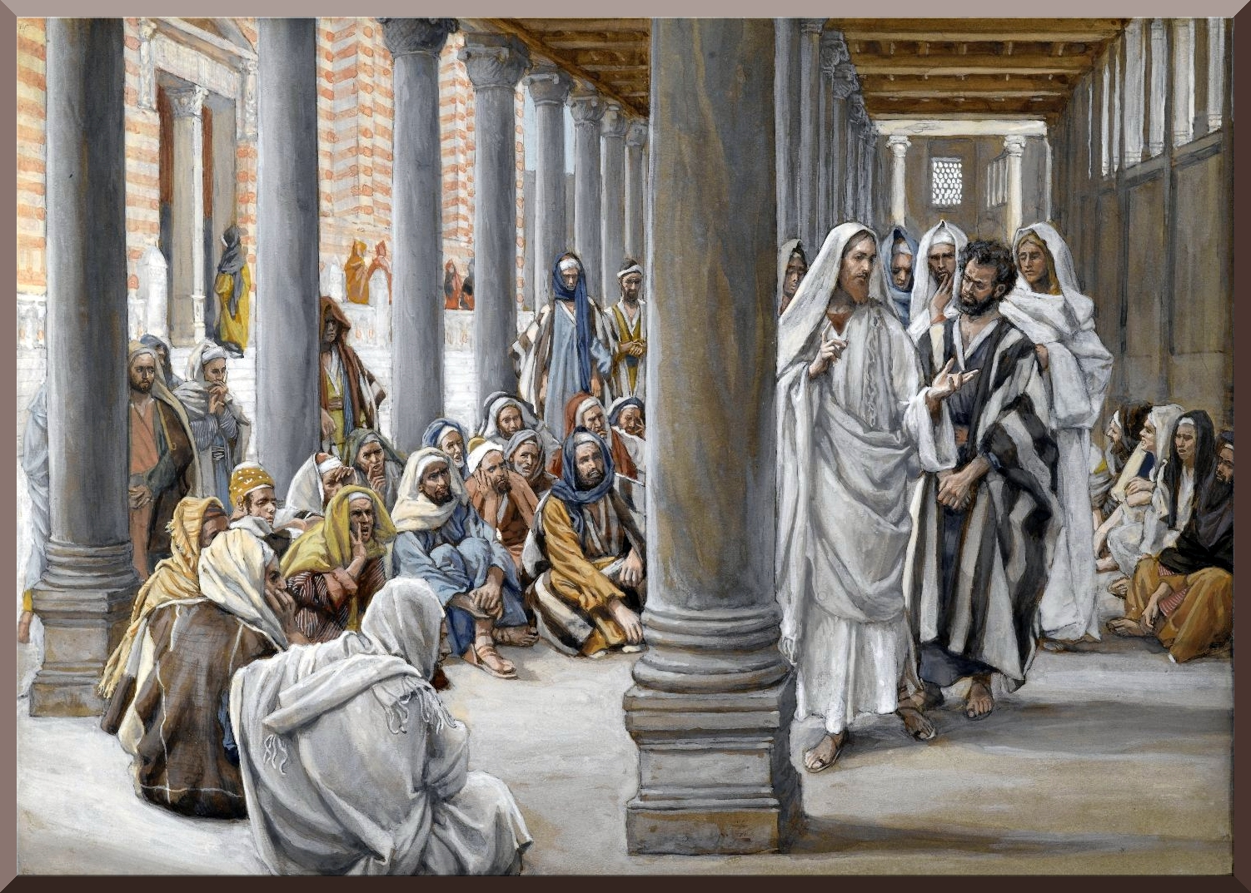

Slide 24


Slide 25
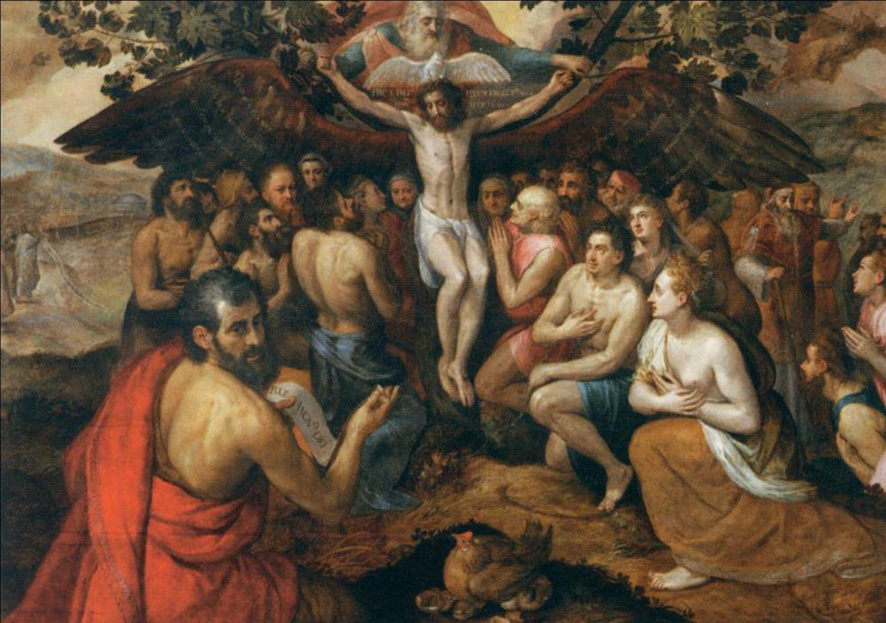

Slide 26
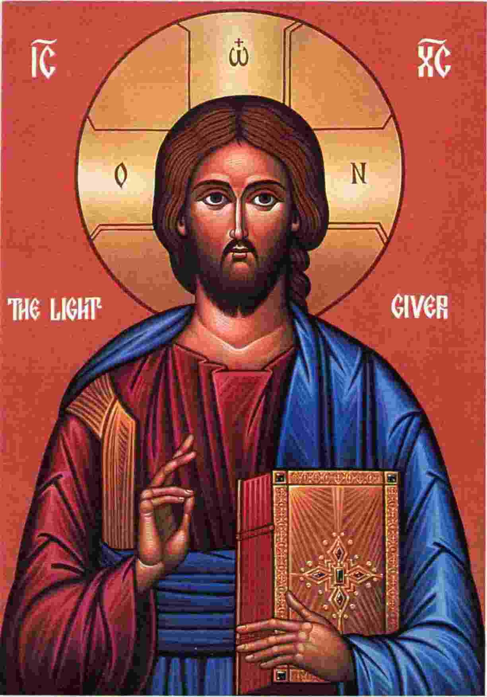

Slide 27


Slide 28
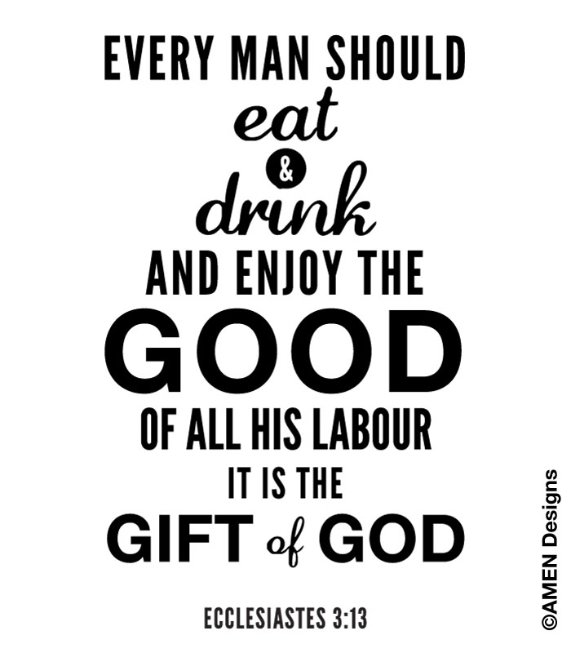

Slide 29


Slide 30
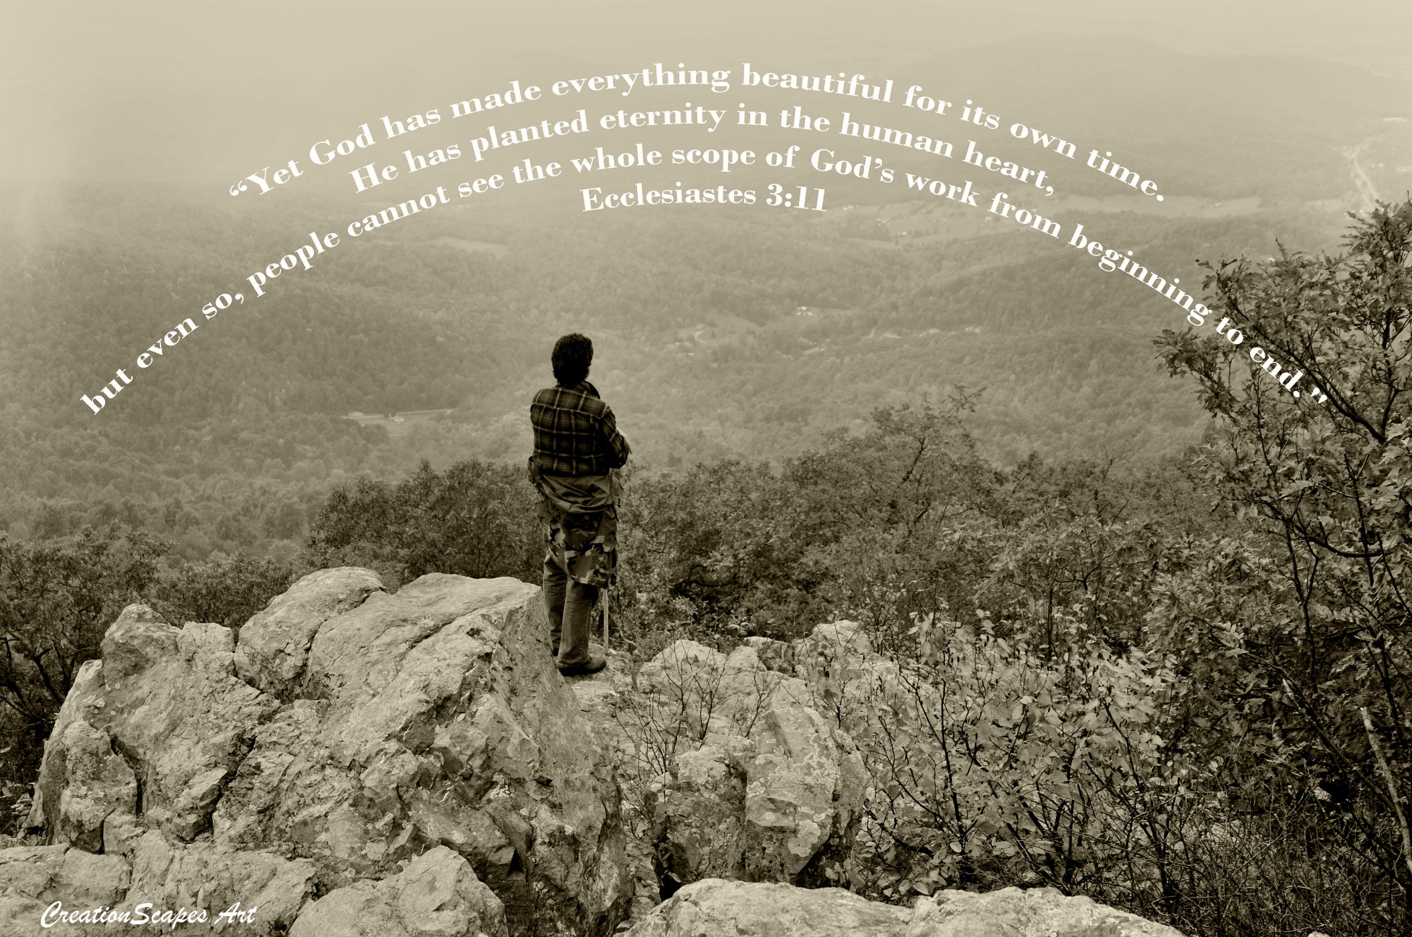

Slide 31
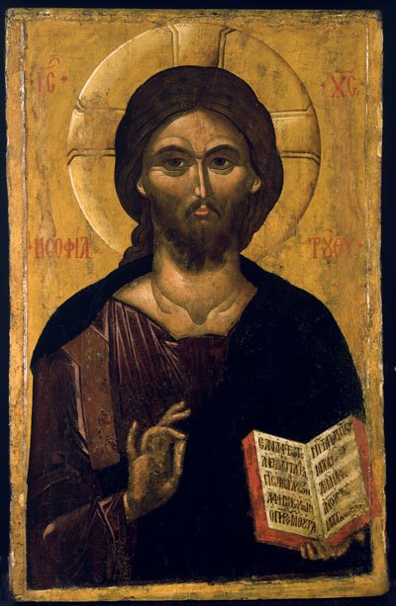

Slide 32
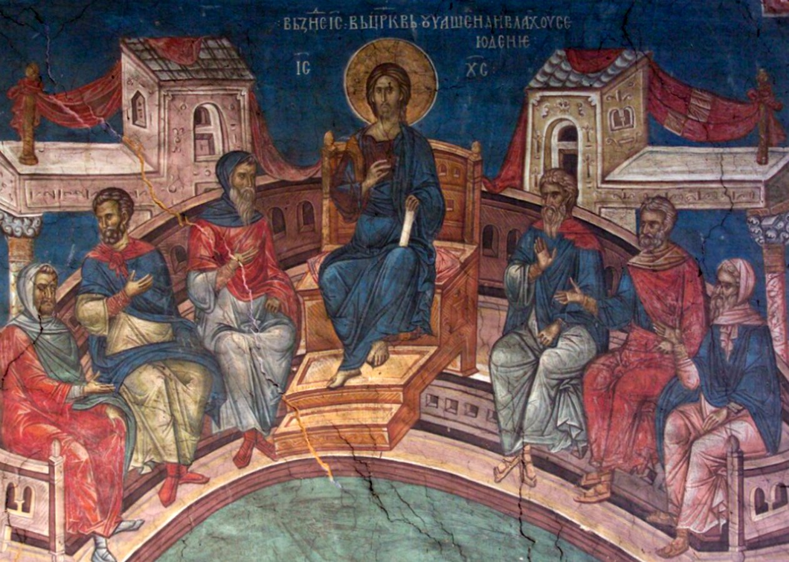

Slide 33


Slide 34


Slide 35
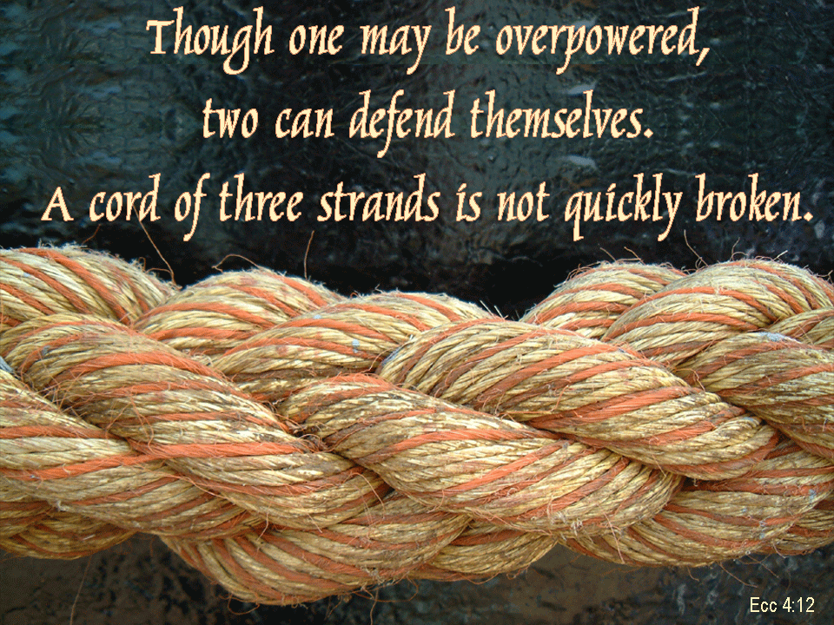

Slide 36


Slide 37


Slide 38

"Better is a handful of quietness than two hands full of toil and a striving after wind." ~ Ecclesiastes 4:6

Slide 39
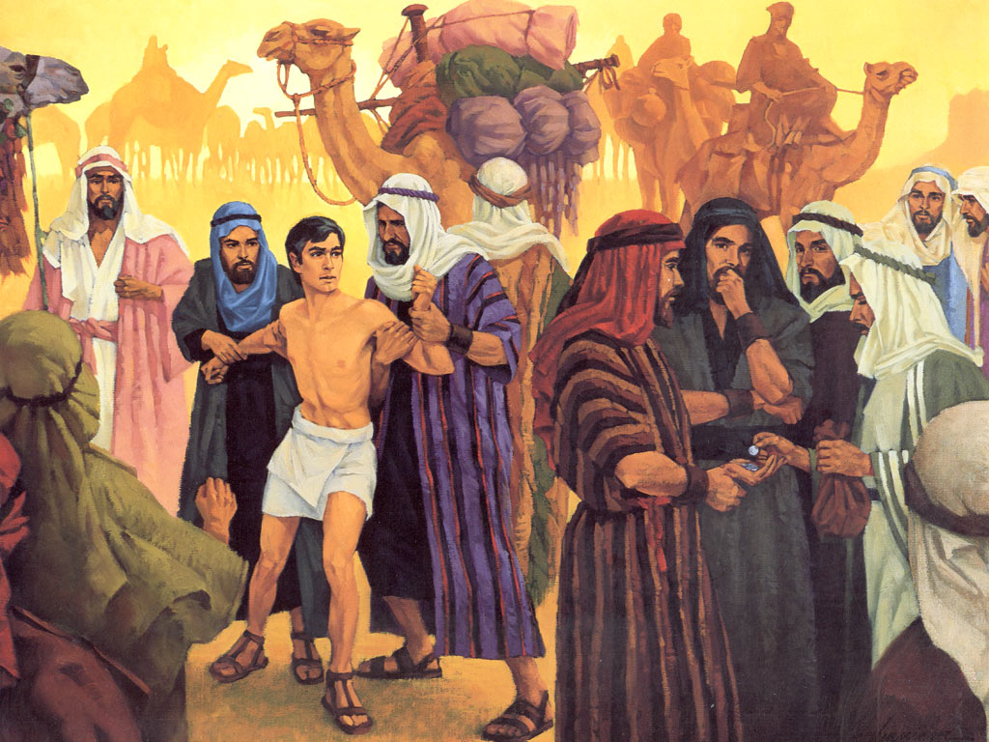

Slide 40
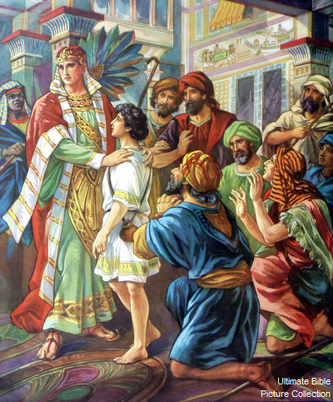

Slide 41


Slide 42
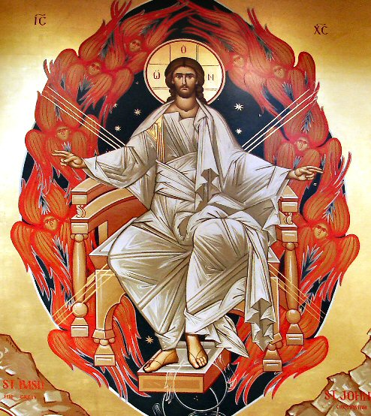

Slide 43
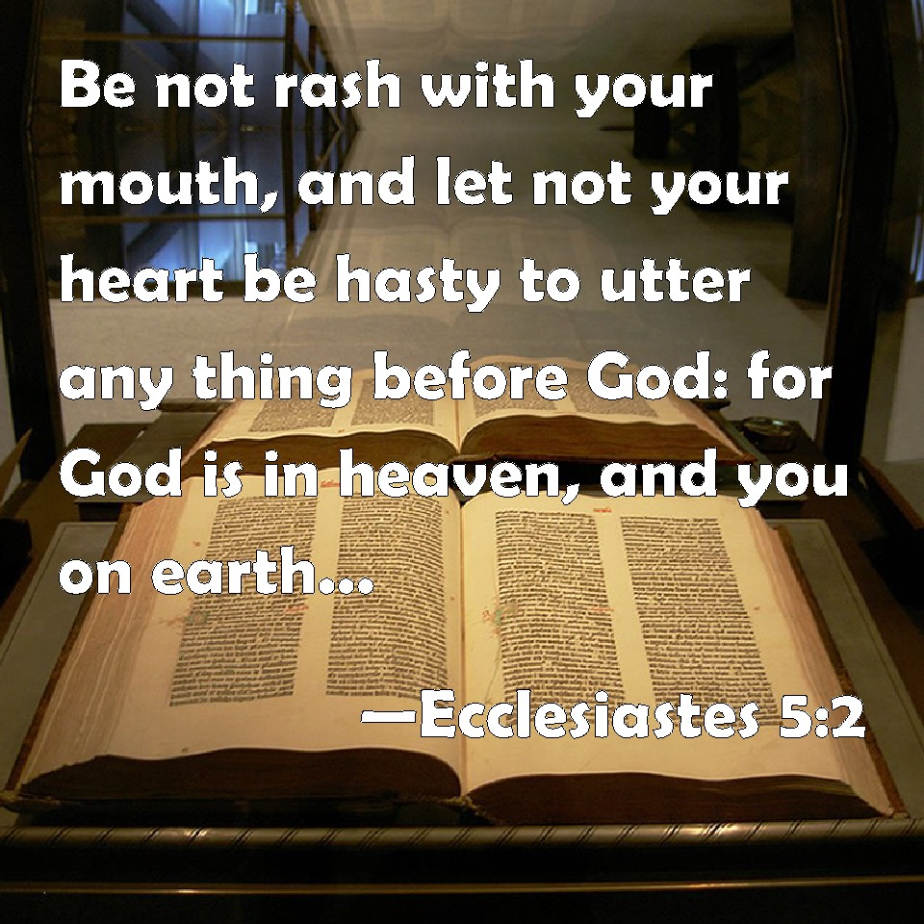

Slide 44


Slide 45


Slide 46
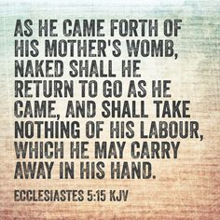

Slide 47


Slide 48
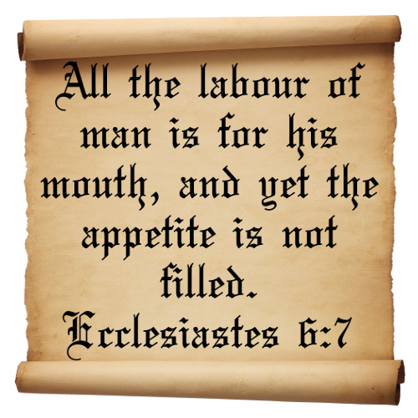

Slide 49
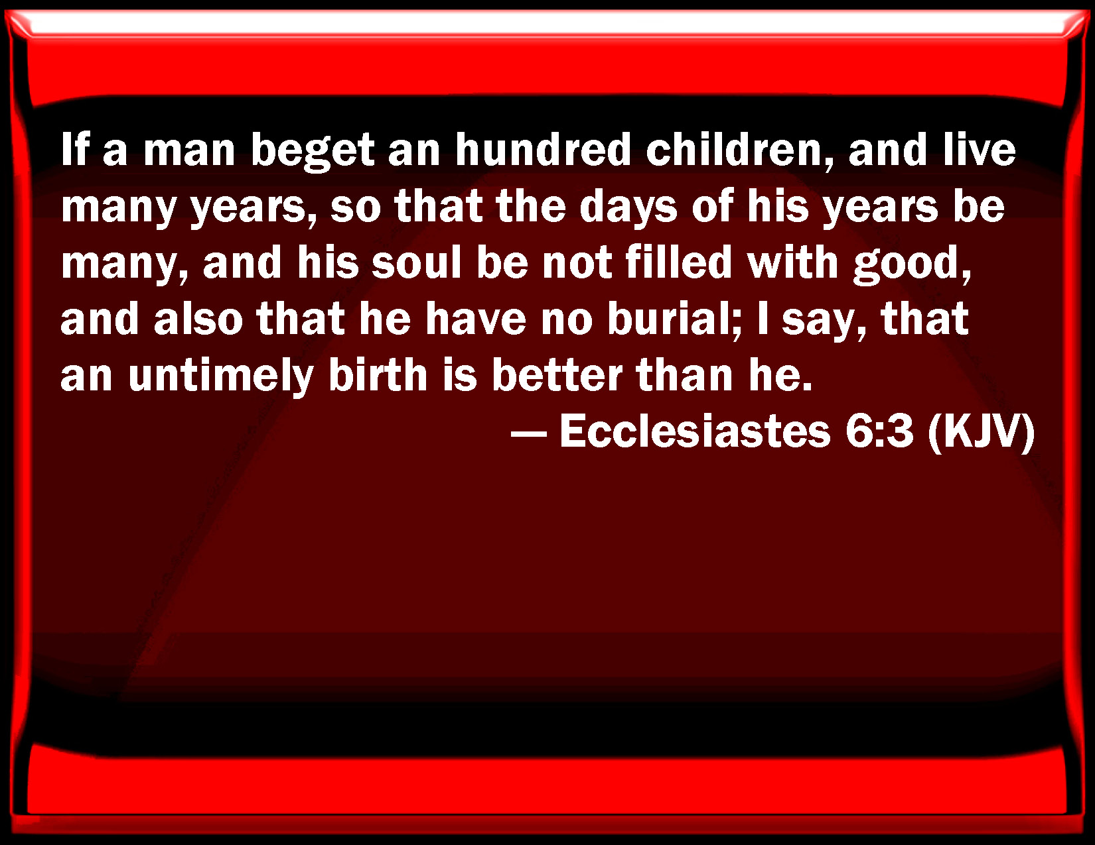

Slide 50
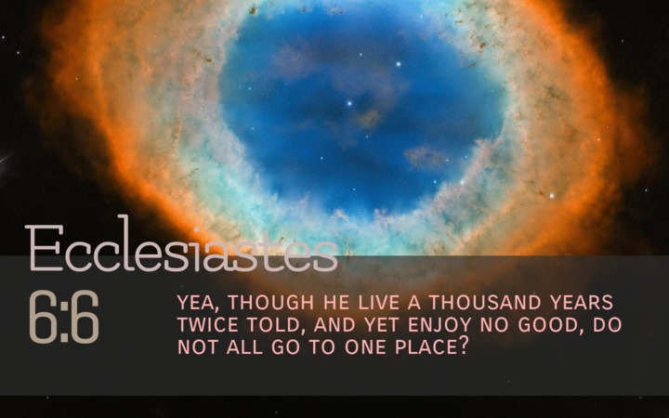

Slide 51


Slide 52


Slide 53


Slide 54


Slide 55
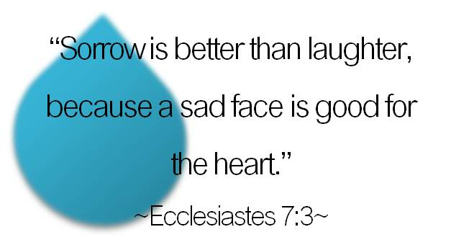

Slide 56
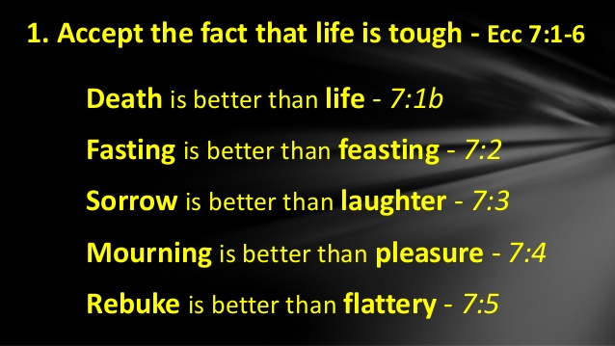

Slide 57


Slide 58
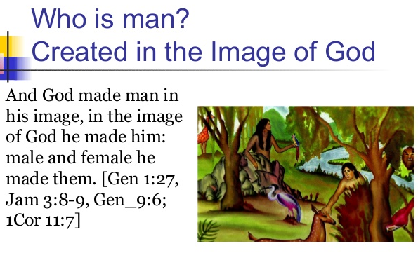

Slide 59


Slide 60
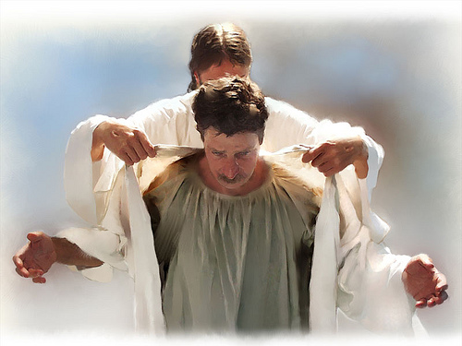

Slide 61
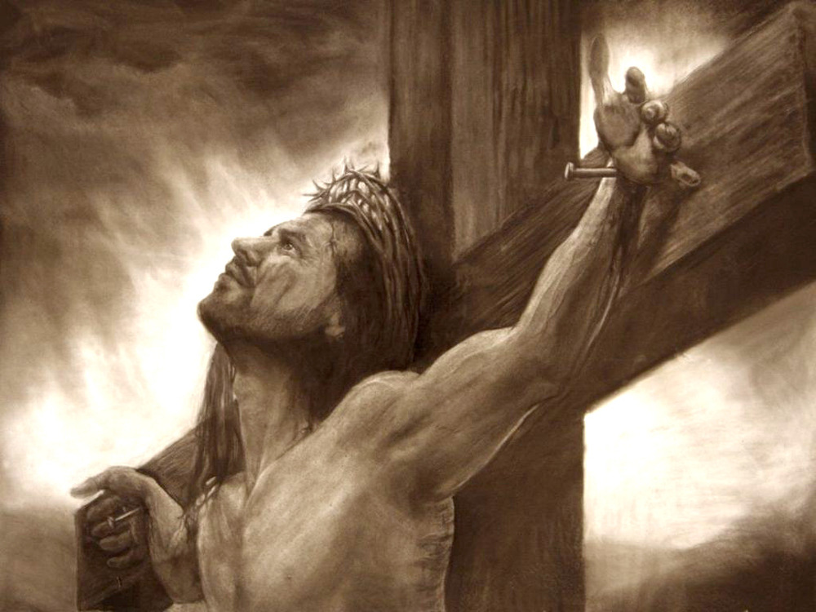

Slide 62
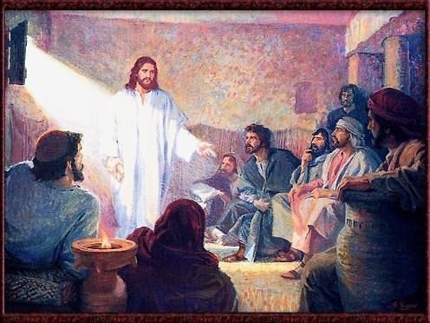

Slide 63
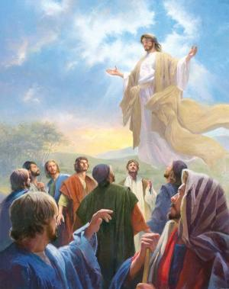

Slide 64
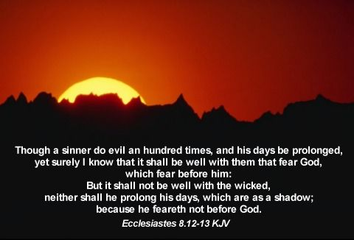

Slide 65
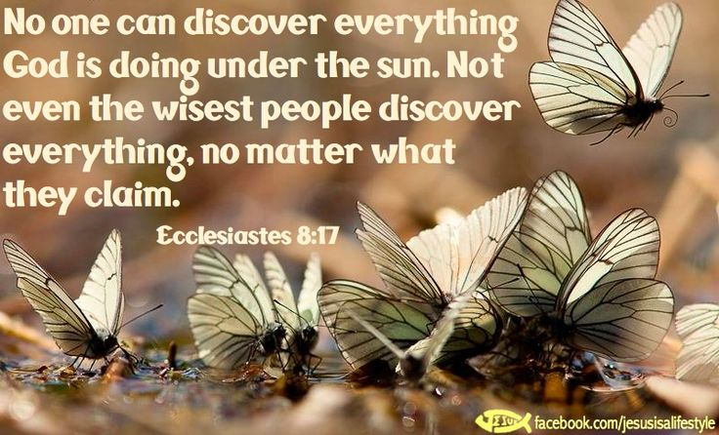

Slide 66
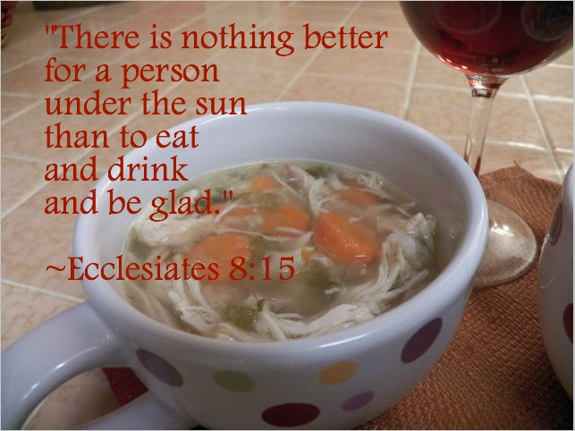

Slide 67
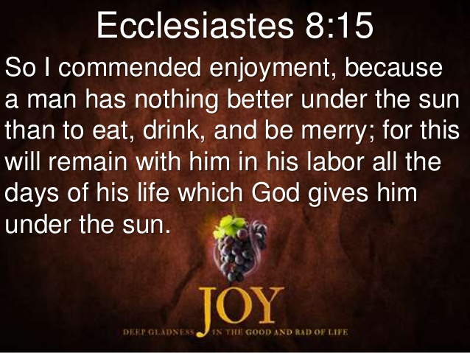

Slide 68
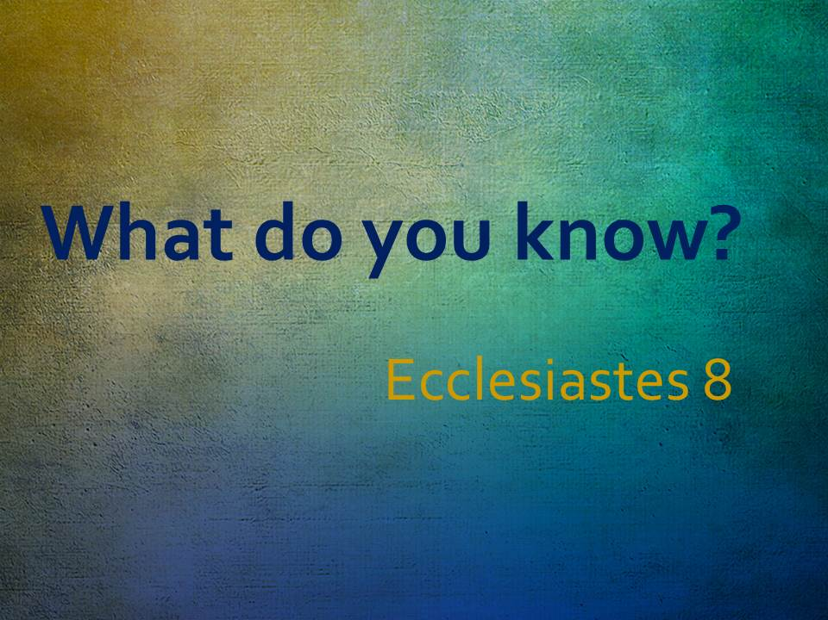

Slide 69


Slide 70
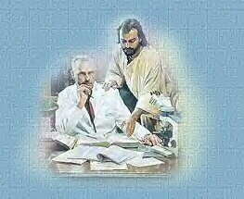

Slide 71
