Slide 1
A BIBLE STUDY OF THE BOOK OF ECCLESIASTES
Theme:
Solomon and Jesus,
Both Sons of David, say:
“Fear God and keep his commandments,
For this is the whole duty of man!”
Trinity Lutheran Church
Norman, Oklahoma
Pastor David Nehrenz
Date: 10-18-15
Lesson: 7

Slide 2
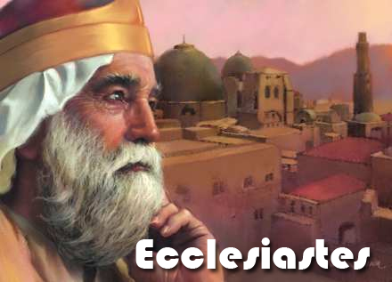

Slide 3
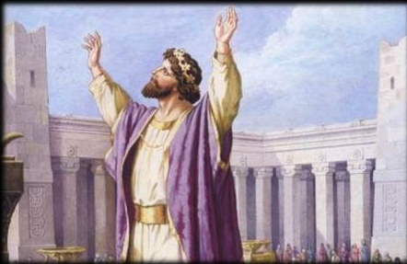

Slide 4
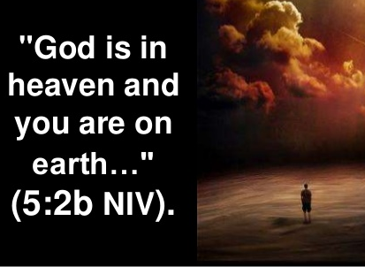

Slide 5
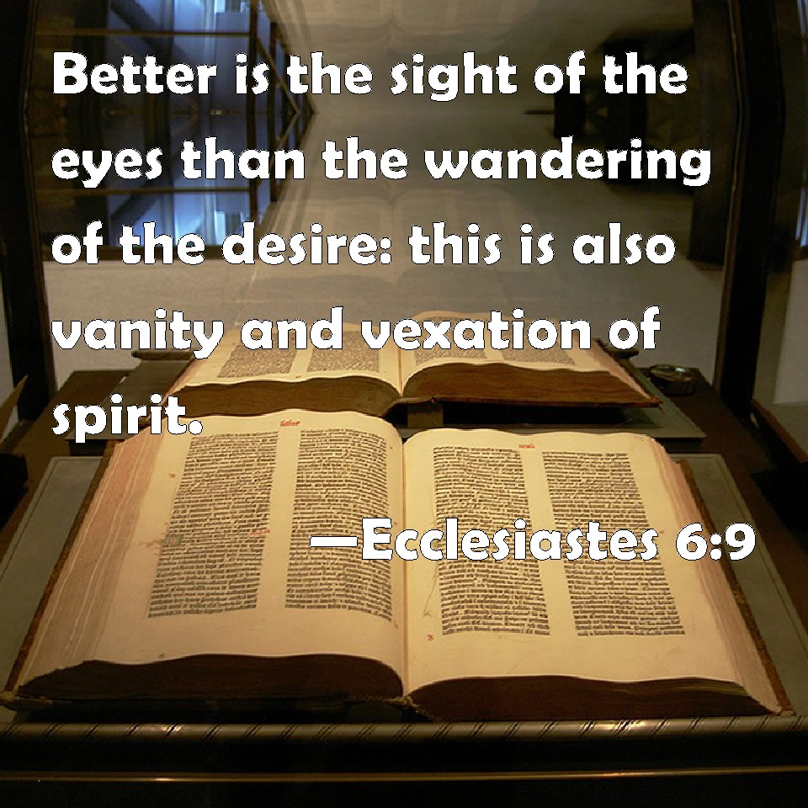

Slide 6


Slide 7
A. TEXT (Chapter 7)
(1) A good name is better than precious ointment, and the day of death than the day of birth. (2) It is better to go to the house of mourning than to go to the house of feasting, for this is the end of all mankind, and the living will lay it to heart. (3) Sorrow is better than laughter, for by sadness of face the heart is made glad. (4) The heart of the wise is in the house of mourning, but the heart of fools is in the house of mirth.
(5) It is better for a man to hear the rebuke of the wise than to hear the song of fools. (6) For as the crackling of thorns under a pot, so is the laughter of the fools; this also is vanity. (7) Surely oppression drives the wise into madness, and a bribe corrupts the heart.
(8) Better is the end of a thing than its beginning, and the patient in spirit is better than the proud in spirit.
(9) Be not quick in your spirit to become angry, for anger lodges in the bosom of fools.
(10) Say not, "Why were the former days better than these?" For it is not from wisdom that you ask this. (11) Wisdom is good with an inheritance, an advantage to those who see the sun. (12) For the protection of wisdom is like the protection of money, and the advantage of knowledge is that wisdom preserves the life of him who has it.

Slide 8
(13) Consider the work of God: who can make straight what he has made crooked? (14) In the day of prosperity be joyful, and in the day of adversity consider: God has made the one as well as the other, so that man may not find out anything that will be after him.
(15) In my vain life I have seen everything. There is a righteous man who perishes in his righteousness, and there is a wicked man who prolongs his life in his evildoing. (16) Be not overly righteous, and do not make yourself too wise. Why should you destroy yourself? (17) Be not overly wicked, neither be a fool. Why should you die before your time? (18) It is good that you should take hold of this, and from that withhold not your hand, for the one who fears God shall come out from both of them.
(19) Wisdom gives strength to the wise man more than ten rulers who are in a city.
(20) Surely there is not a righteous man on earth who does good and never sins.

Slide 9
(21) Do not take to heart all the things that people say, lest you hear your servant cursing you. (22) Your heart knows that many times you have yourself cursed others.
(23) All this I have tested by wisdom. I said, "I will be wise," but it was far from me. (24) That which has been is far off, and deep, very deep; who can find it out?
(25) I turned my heart to know and to search out and to seek wisdom and the scheme of things, and to know the wickedness of folly and the foolishness that is madness. (26) And I find something more bitter than death: the woman whose heart is snares and nets, and whose hands are fetters. He who pleases God escapes her, but the sinner is taken by her.
(27) Behold, this is what I found, says the Preacher, while adding one thing to another to find the scheme of things-- (28) which my soul has sought repeatedly, but I have not found. One man among a thousand I found, but a woman among all these I have not found.
(29) See, this alone I found, that God made man upright, but they have sought out many schemes.

Slide 10
B. STUDY NOTES:
1. The day of our death is better than the day of our birth since we enter into eternal life in heaven
(2 Cor 5:1-10; Php 1:21-23)
2. Taking bribes only brings corruption (Mt 28:11-15; Lk 22:4-6)
3. Anger from man brings all kinds of destruction (Pr 16:32; 17:15; 1 Cor 13:4,5)
4. Wisdom preserves our life in many ways (Pr 3:13-18; 13:14)
5. God brings both good times and bad times (Gen 50:20; Rom 8:28,29)
6. Being righteous in Christ does not mean that one will escape tragedy, early death or ruin.
The THEOLOGY OF THE CROSS vs. The THEOLOGY OF GLORY
7. To avoid the extremes of legalism and libertinism and lead a balanced life is the path of wisdom.
8. No one is righteous upon earth (2 Chr 6:36; Rom 3:10-20), that is why we need Jesus – The Righteous One.

Slide 11
9. We cannot discover wisdom on our own, it is far off and can only come from God
(Job 28:12-28; Is 55:8,9; Rom 11:33; 1 Cor 2:9-16)
10. A sinful immoral woman is a trap for a foolish man, leading to adultery and idolatry.
(Pr 7:6-27; Col 2:8; Jas 3:15)
11. Only God can make us upright and righteous (Gen 3:1-6; Rom 5:12)
12. A good name is precious (Pr 22:1)
13. God made Jacob crooked and not straight and he had to live with the consequences for the rest of his life
(Gen 32:22-32)
14. Solomon chastises women for lacking wisdom yet he was the fool who chased after them (1 Ki 11:1-4)
Since he had hundreds of foreign wives who seduced him into polytheism and idol worship he truly did not find godly wisdom from among them, but he should have known better!

Slide 12
Luther’s Works on Eccl. 7:8
“That is, perseverance crowns the work; wait for the end. It is not how you begin that matters, but how you follow through. It is much better to have reached the end than to have attempted the beginning. Do not praise anyone before the Last Day. Not he who has begun, but “he who endures to the end will be saved” (Matt. 10:22).
What I am saying about matters of religion may also be said about all other matters, in accordance with the common saying: “The beginning is hot, the middle is warm, the end is obnoxious,” so that it lies completely in ashes. We Germans are especially subject to criticism on account of this vice, that we are lustful for new things. We begin many things, but we do not continue or persist in anything. This affects us above all in the area of doctrine, where every day we embrace new ones.
But this is the fickleness of the human heart. Therefore one must think not about the beginning but about the end. See to it, then, that you persevere. You will suffer slander on account of your wisdom; you will experience ingratitude; people will forget your acts of kindness; they will disparage your best advice and will return evil for good. If one’s spirit has been unsure, this will cause it to quit. But you, continue bravely and persevere, because God will eventually grant you the fruit of your work.”
Luther, M. (1999). Luther’s works, vol. 15: Ecclesiastes, Song of Solomon, Last Words of David, 2 Samuel 23:1-7. (J. J. Pelikan, H. C. Oswald, & H. T. Lehmann, Eds.) (Vol. 15, p. 116). Saint Louis: Concordia Publishing House.

Slide 13
C. LIFE APPLICATION
1. Why is a good name better than precious ointment, and the day of death better than the day of birth?
2. How is it better for a man to hear the rebuke of the wise than to hear the song of fools?
3. When have you seen that it is wise to not be quick in your spirit to become angry?
4. Where do we observe that in the day of prosperity we can be joyful, but in the day of adversity we consider: God has made the one as well as the other?
5. Do not take to heart all the things that people say, lest you hear your servant cursing you. Your heart knows that many times you have yourself cursed others. What is the point being made here?
6. God only can make a man upright. Who is the agent of this in our lives as Christians?

Slide 14
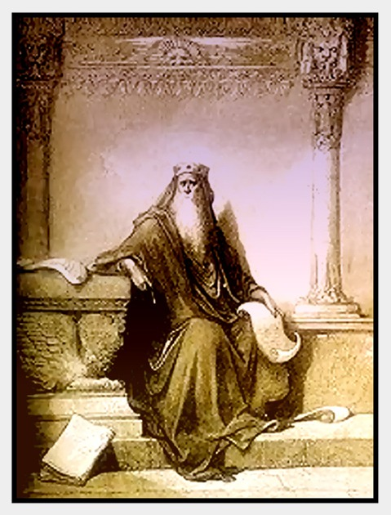

Slide 15
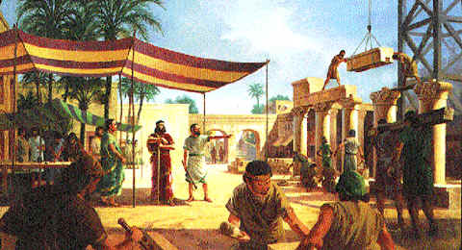

Slide 16
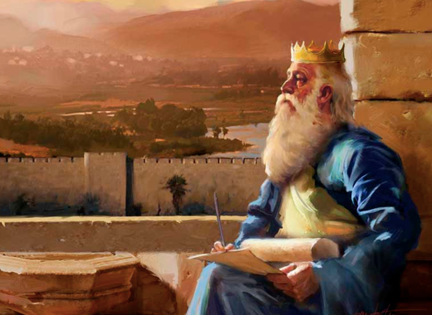

Slide 17
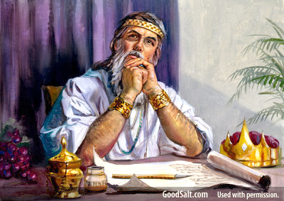

Slide 18
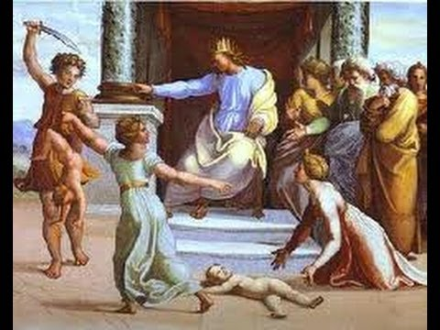

Slide 19
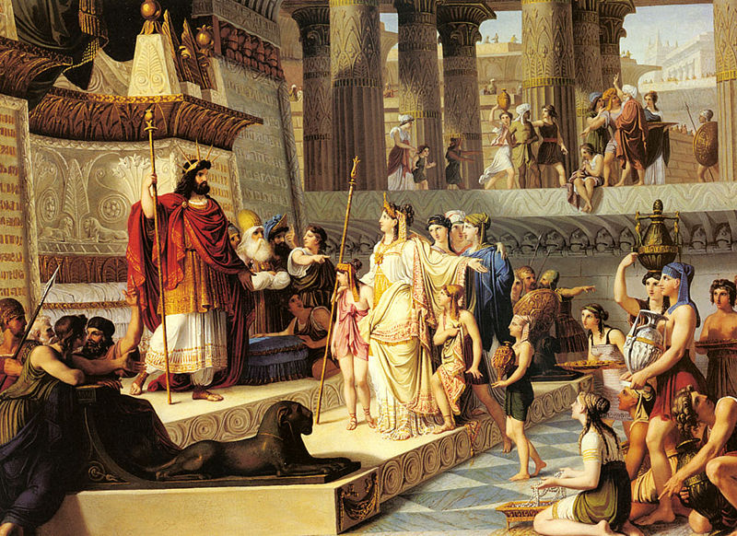

Slide 20
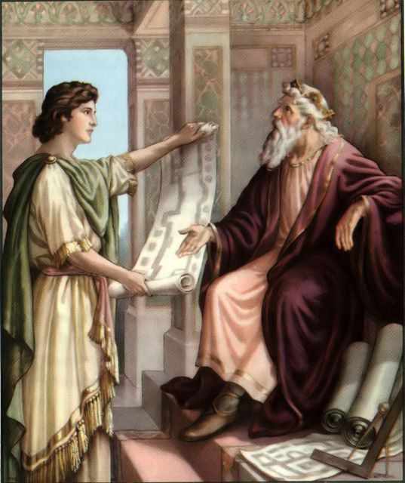

Slide 21
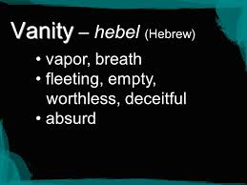

Slide 22
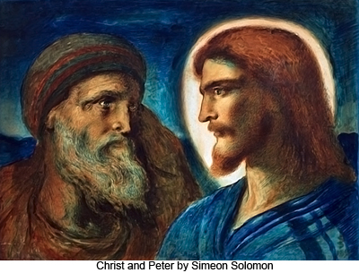

Slide 23
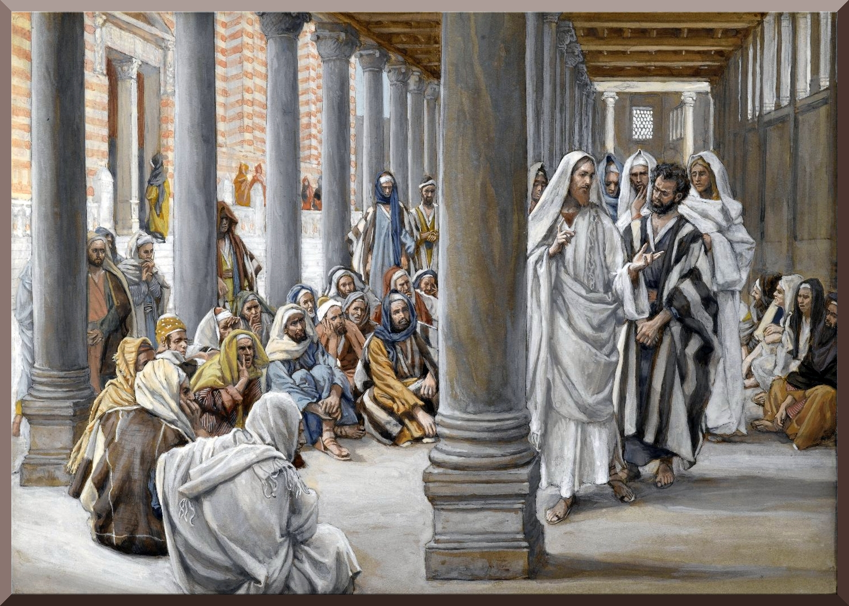

Slide 24
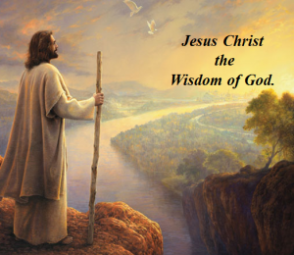

Slide 25
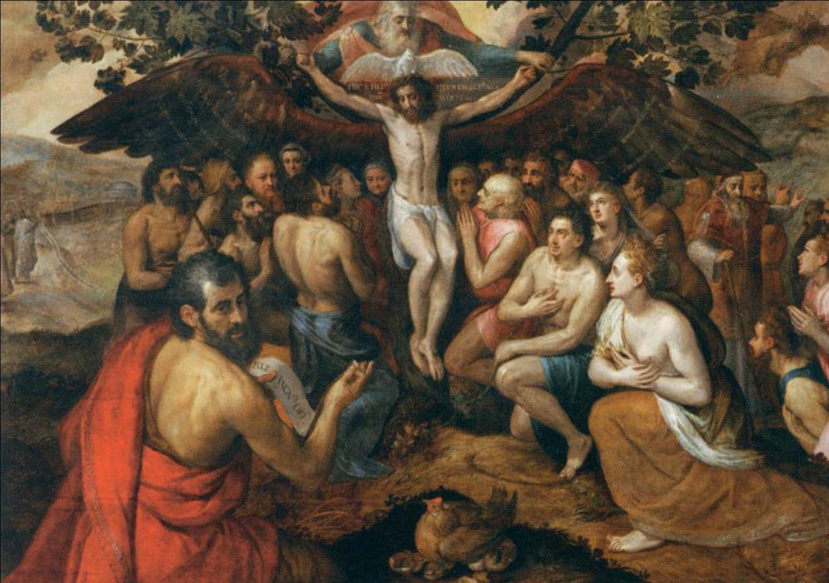

Slide 26
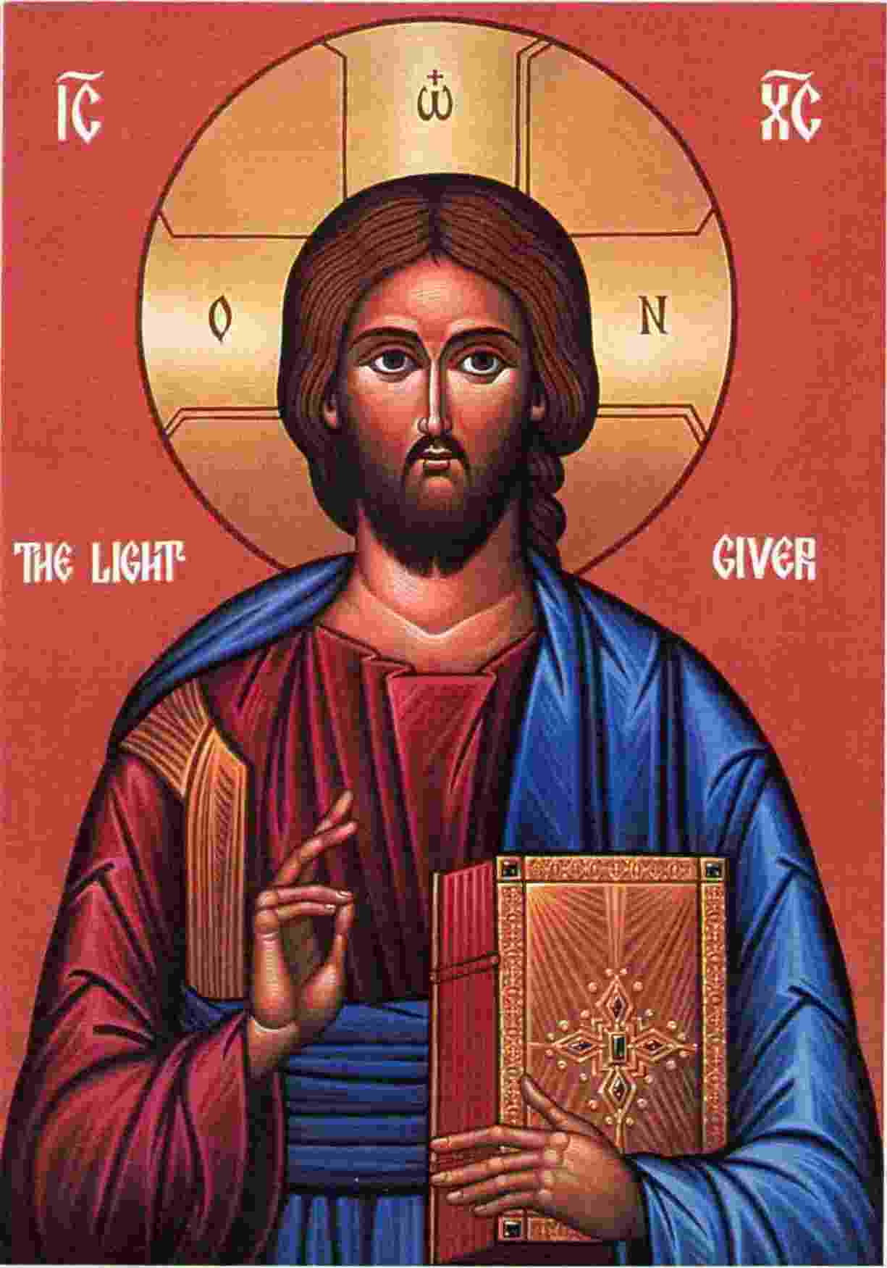

Slide 27
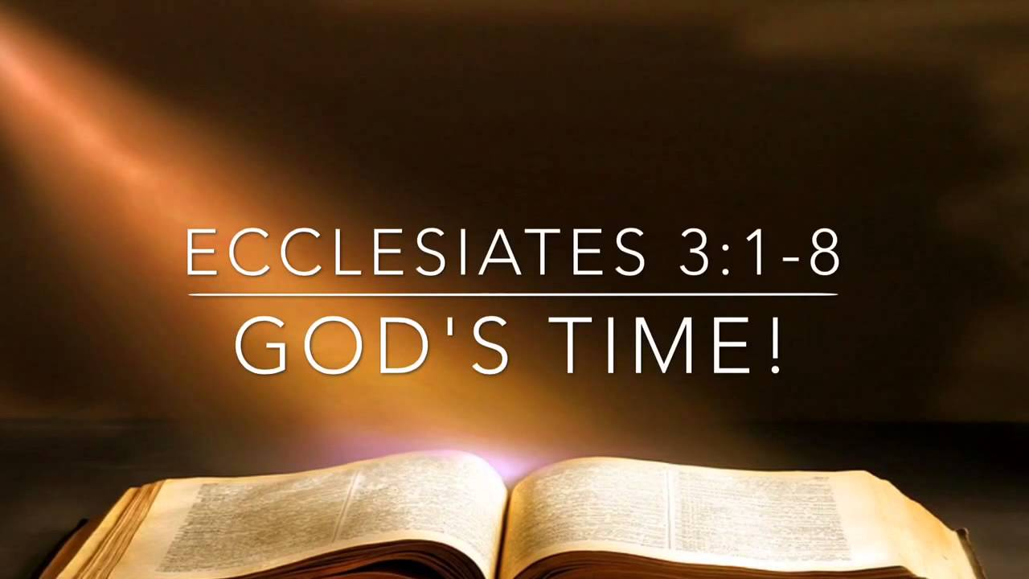

Slide 28
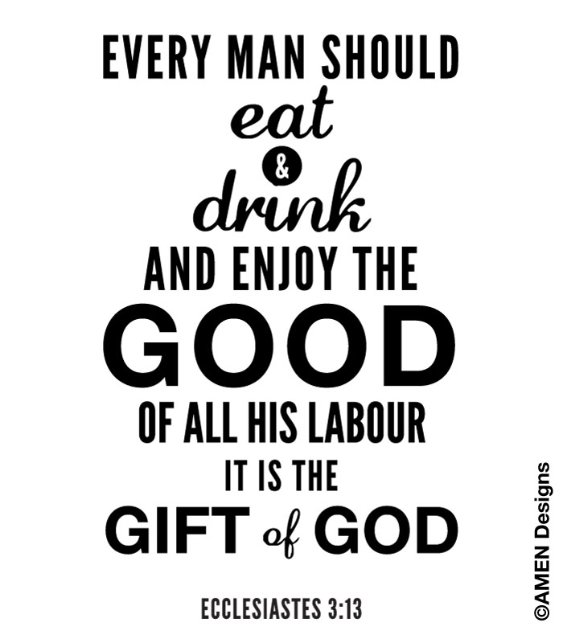

Slide 29


Slide 30
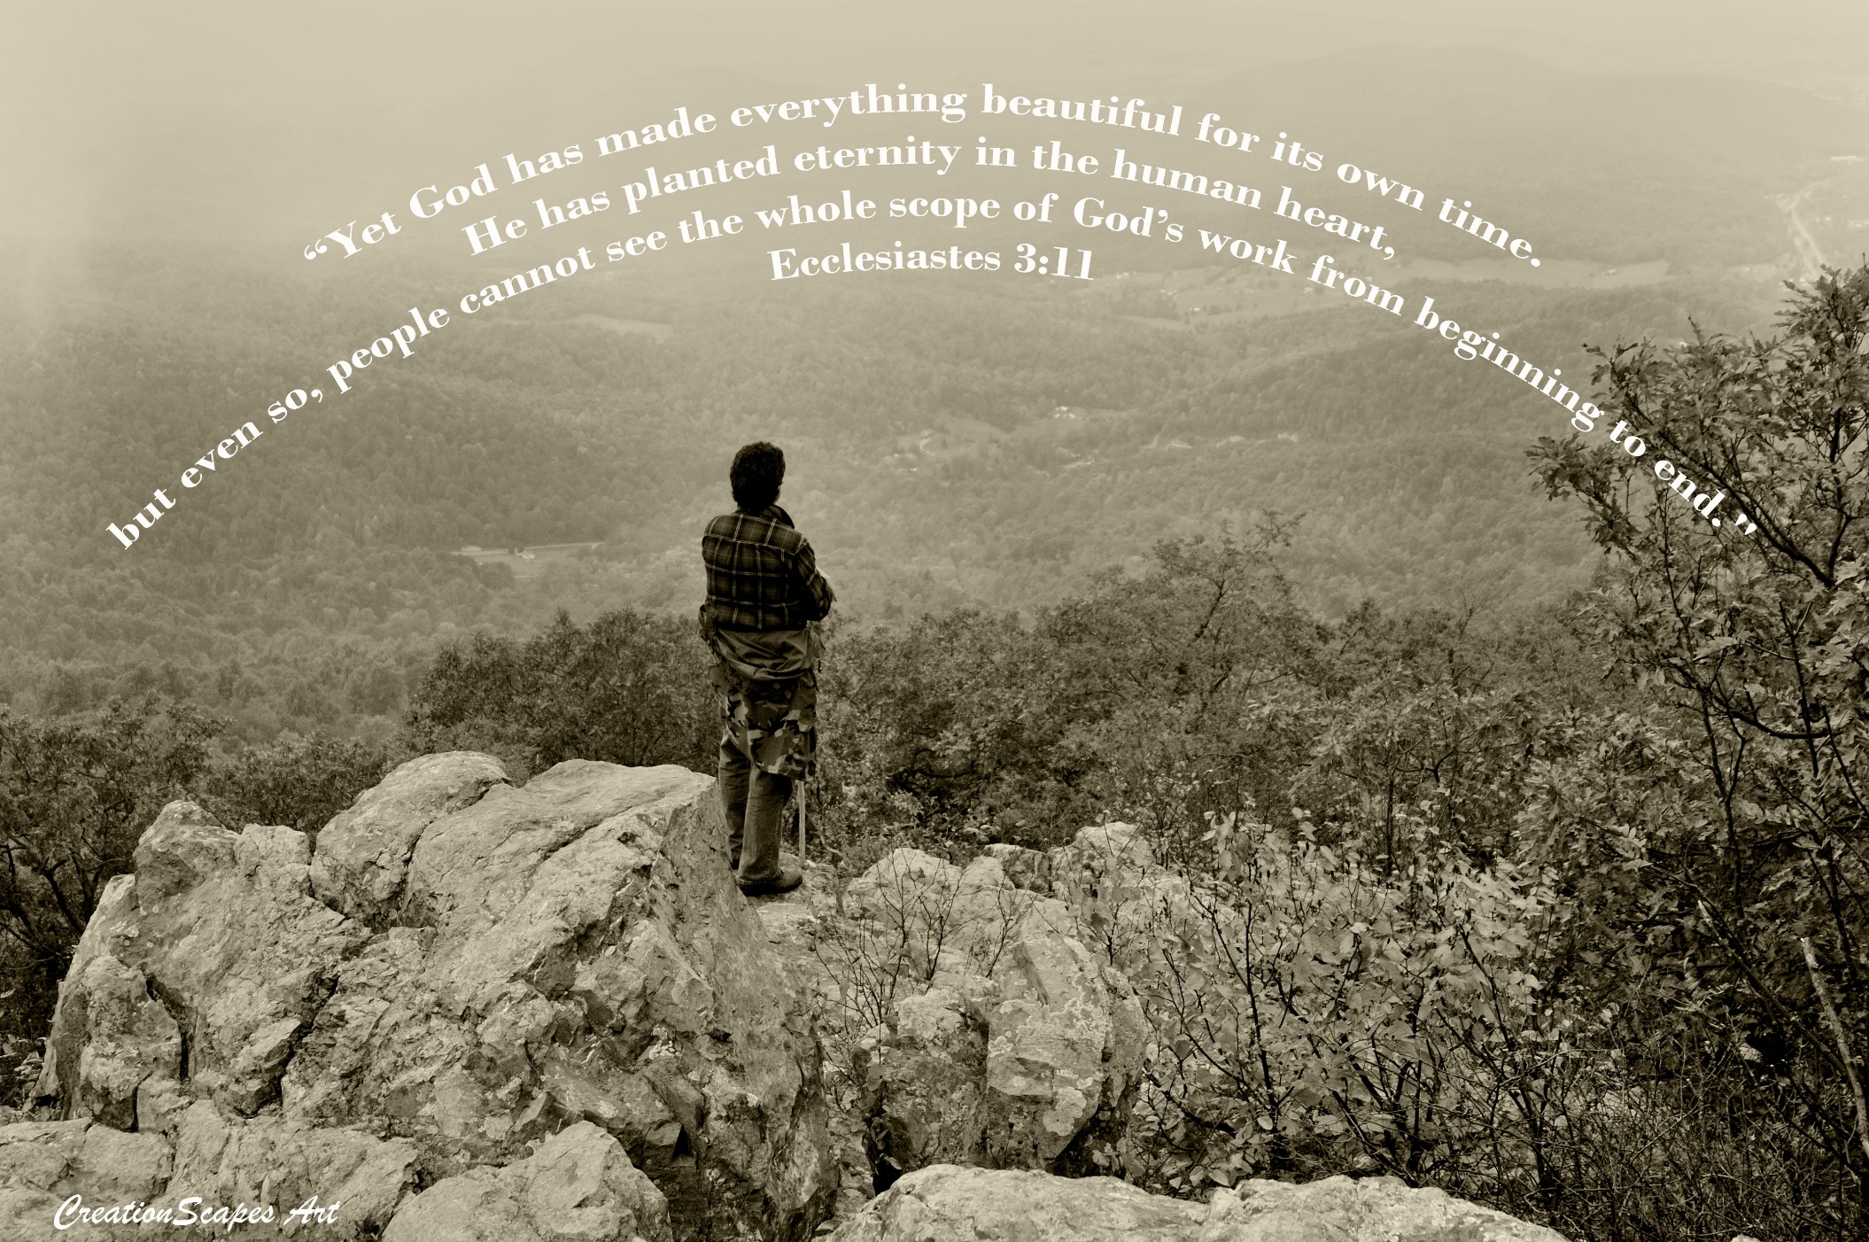

Slide 31
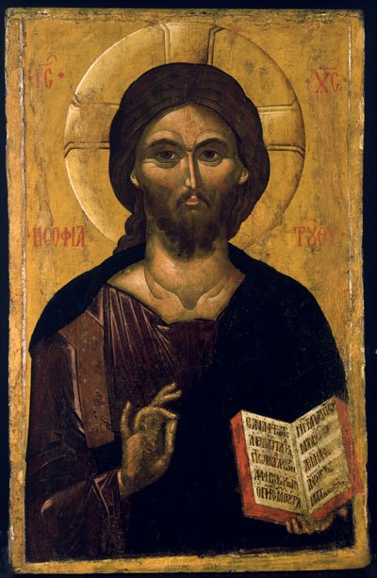

Slide 32
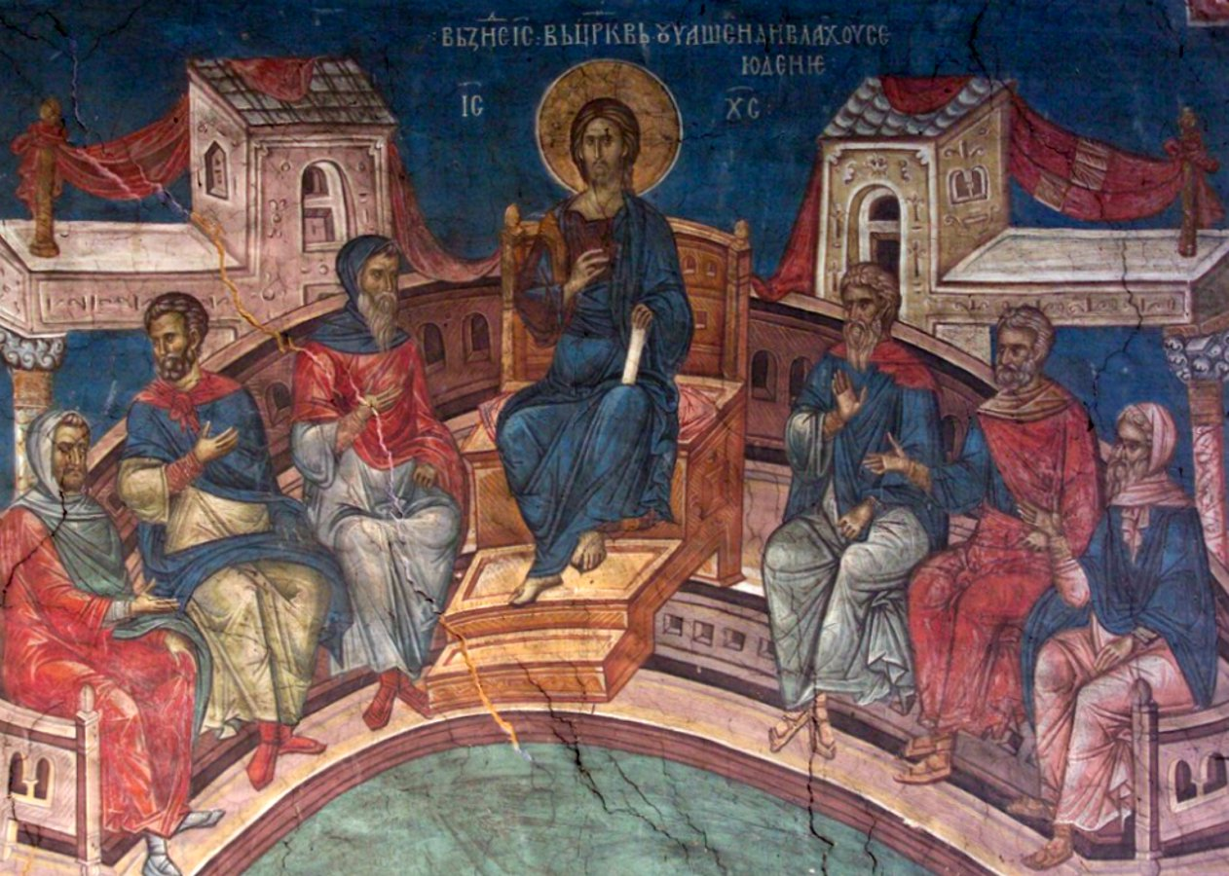

Slide 33


Slide 34


Slide 35
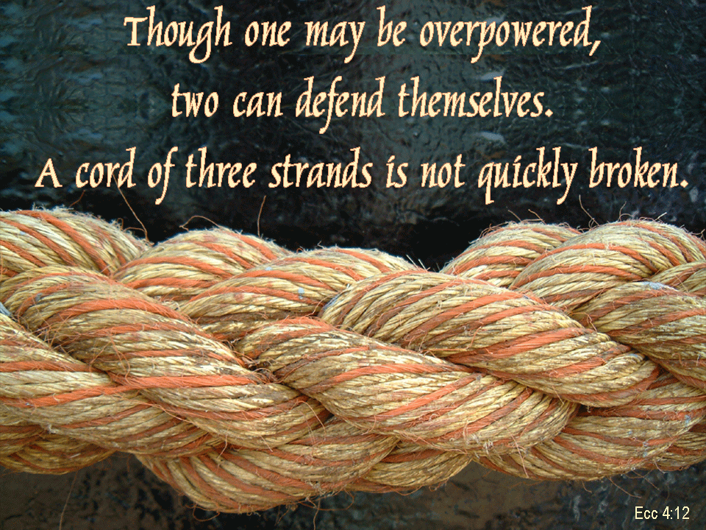

Slide 36
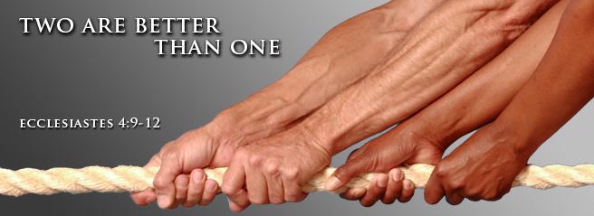

Slide 37
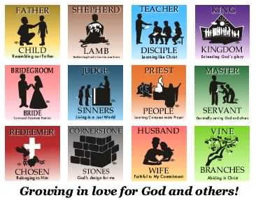

Slide 38

"Better is a handful of quietness than two hands full of toil and a striving after wind." ~ Ecclesiastes 4:6

Slide 39
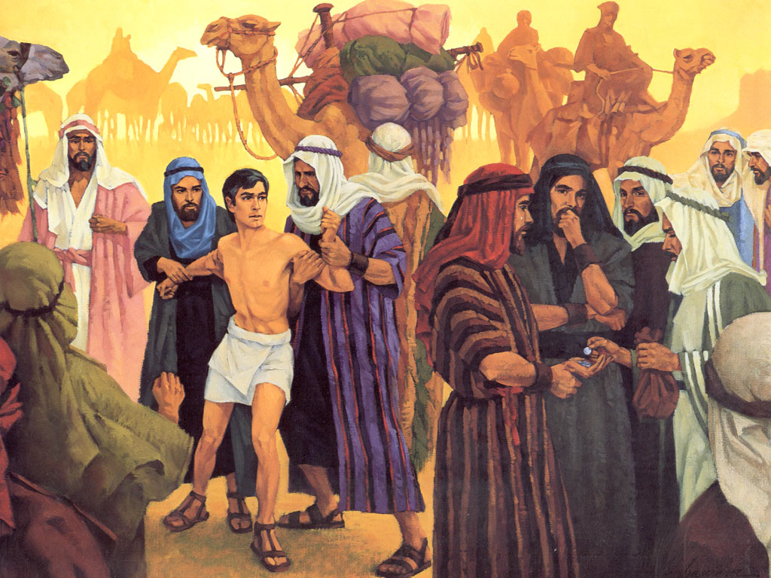

Slide 40
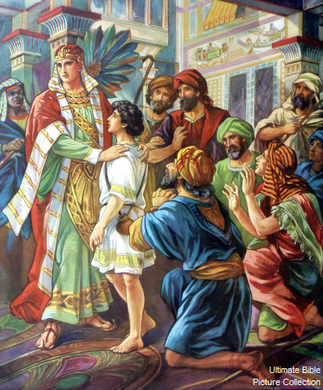

Slide 41


Slide 42
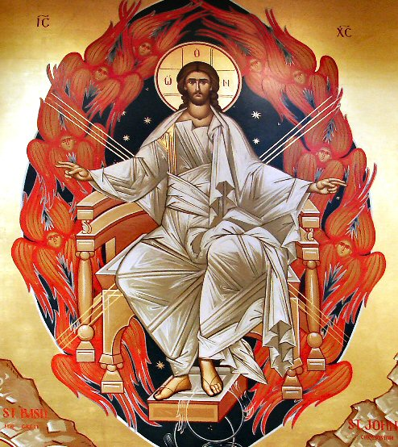

Slide 43
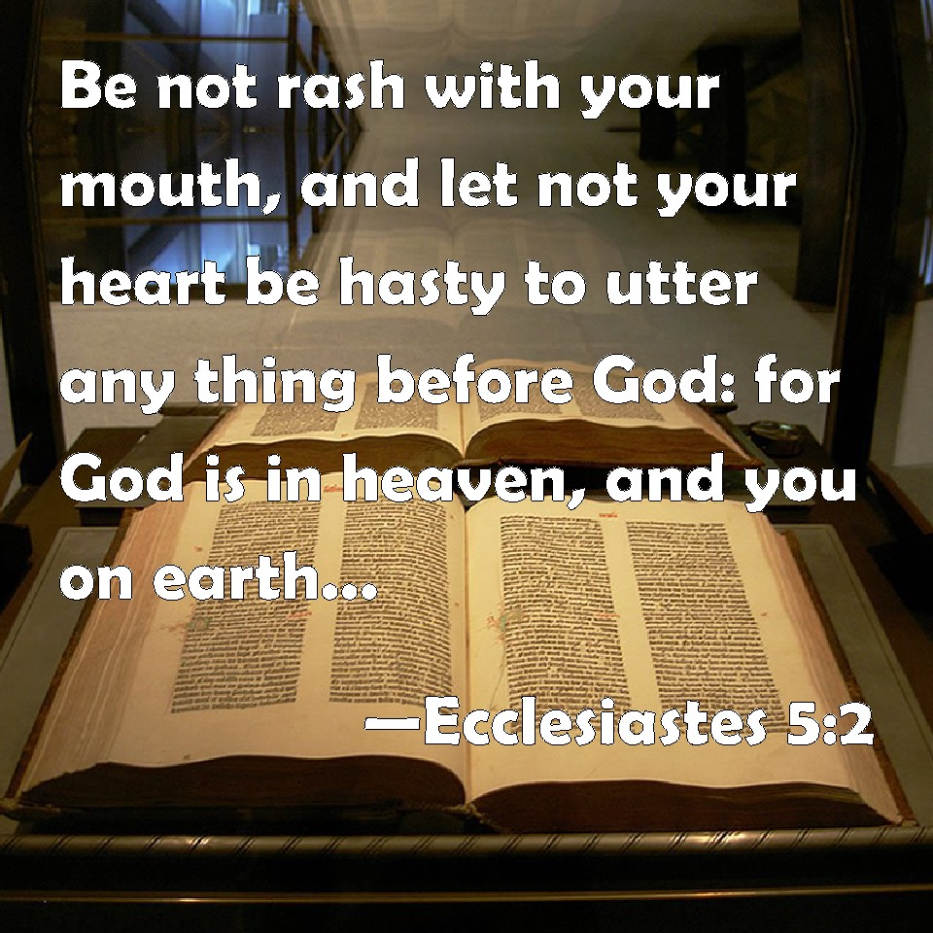

Slide 44
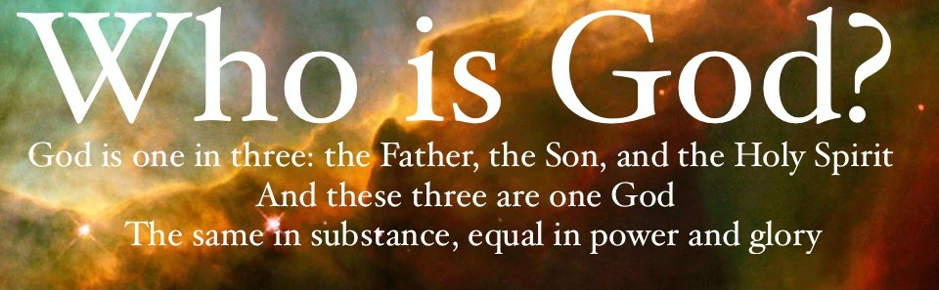

Slide 45


Slide 46
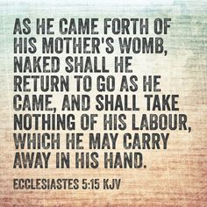

Slide 47


Slide 48
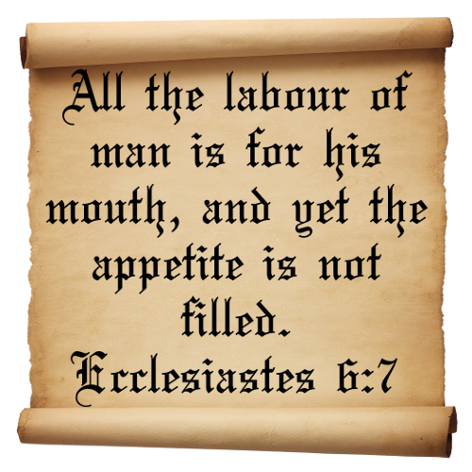

Slide 49
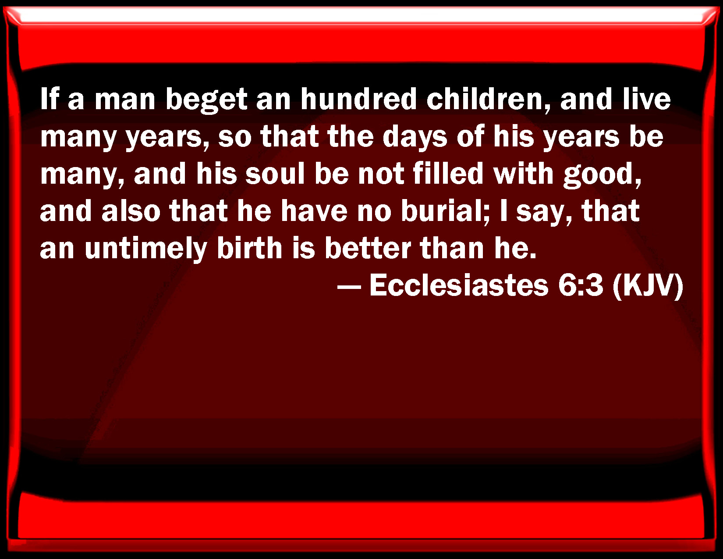

Slide 50


Slide 51


Slide 52


Slide 53
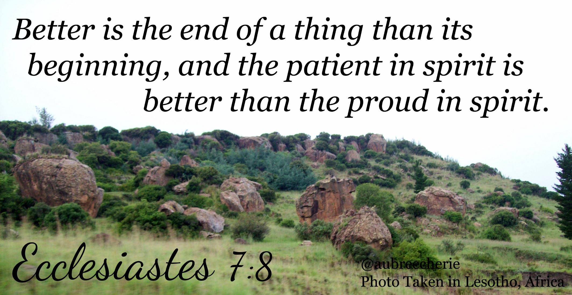

Slide 54


Slide 55
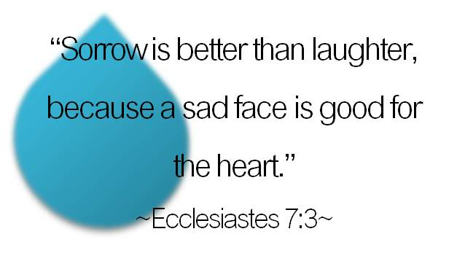

Slide 56
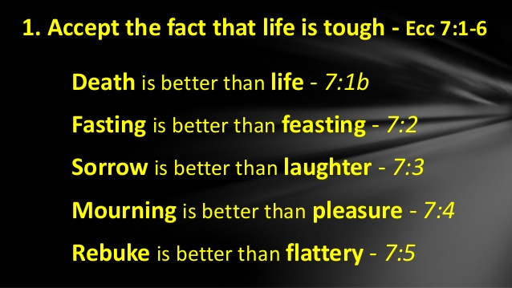

Slide 57
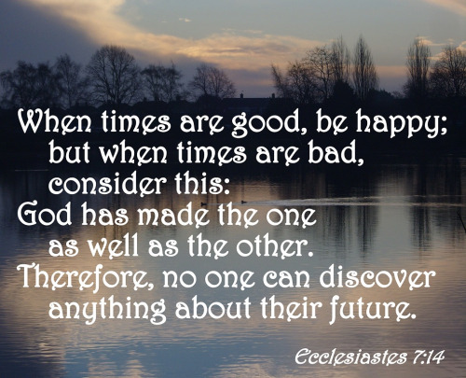

Slide 58
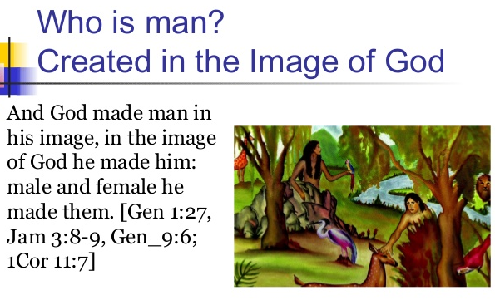

Slide 59


Slide 60
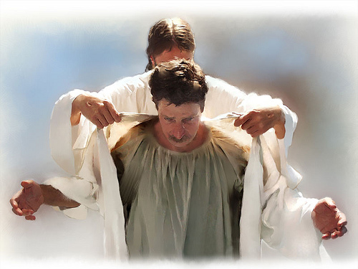

Slide 61
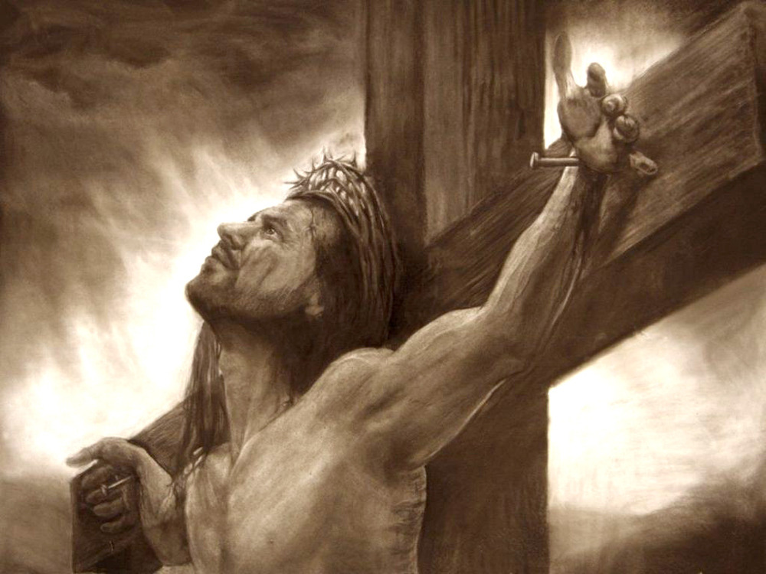

Slide 62
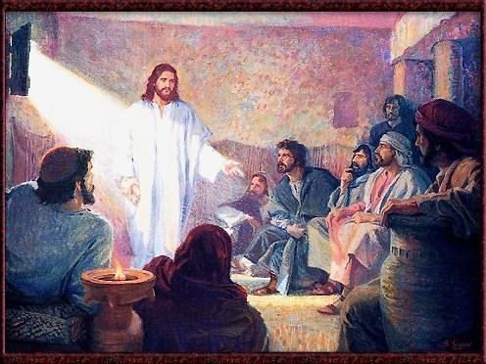

Slide 63
