Slide 1
A BIBLE STUDY OF THE BOOK OF ECCLESIASTES
Theme:
Solomon and Jesus,
Both Sons of David, say:
“Fear God and keep his commandments,
For this is the whole duty of man!”
Trinity Lutheran Church
Norman, Oklahoma
Pastor David Nehrenz
Date: 10-4-15
Lesson: 5

Slide 2
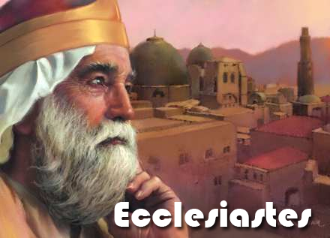

Slide 3
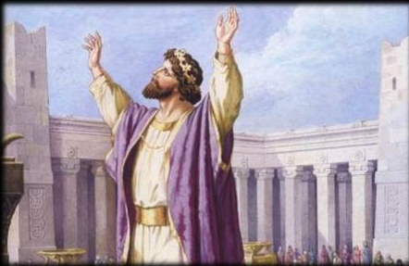

Slide 4
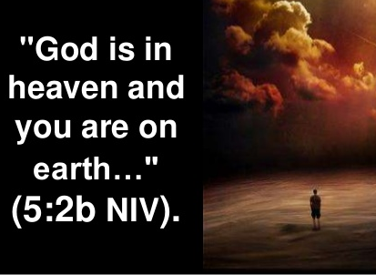

Slide 5
TEXT (Chapter 5)
(1) Guard your steps when you go to the house of God. To draw near to listen is better than to offer the sacrifice of fools, for they do not know that they are doing evil. (2) Be not rash with your mouth, nor let your heart be hasty to utter a word before God, for God is in heaven and you are on earth. Therefore let your words be few. (3) For a dream comes with much business, and a fool's voice with many words.
(4) When you vow a vow to God, do not delay paying it, for he has no pleasure in fools. Pay what you vow. (5) It is better that you should not vow than that you should vow and not pay. (6) Let not your mouth lead you into sin, and do not say before the messenger that it was a mistake. Why should God be angry at your voice and destroy the work of your hands? (7) For when dreams increase and words grow many, there is vanity; but God is the one you must fear.

Slide 6
(8) If you see in a province the oppression of the poor and the violation of justice and righteousness, do not be amazed at the matter, for the high official is watched by a higher, and there are yet higher ones over them. (9) But this is gain for a land in every way: a king committed to cultivated fields.
(10) He who loves money will not be satisfied with money, nor he who loves wealth with his income; this also is vanity. (11) When goods increase, they increase who eat them, and what advantage has their owner but to see them with his eyes? (12) Sweet is the sleep of a laborer, whether he eats little or much, but the full stomach of the rich will not let him sleep.

Slide 7
(13) There is a grievous evil that I have seen under the sun: riches were kept by their owner to his hurt, (14) and those riches were lost in a bad venture. And he is father of a son, but he has nothing in his hand. (15) As he came from his mother's womb he shall go again, naked as he came, and shall take nothing for his toil that he may carry away in his hand. (16) This also is a grievous evil: just as he came, so shall he go, and what gain is there to him who toils for the wind? (17) Moreover, all his days he eats in darkness in much vexation and sickness and anger.
(18) Behold, what I have seen to be good and fitting is to eat and drink and find enjoyment in all the toil with which one toils under the sun the few days of his life that God has given him, for this is his lot.
(19) Everyone also to whom God has given wealth and possessions and power to enjoy them, and to accept his lot and rejoice in his toil--this is the gift of God. (20) For he will not much remember the days of his life because God keeps him occupied with joy in his heart.

Slide 8
STUDY NOTES:
1. Rash vows are often made within superficial religions. To guard your steps, listen before you speak
(1 Sam 15:22). The fool always has dreams of grandeur which are just pipe dreams.
2. True vows are a serious matter when made before God
(Nu 21:1-3; 30:2; Dt 6:13; 23:21-23; 1 Sam 1:11,24-28; Ps 116:14; Mt 5:33-37; 15:8,9; Heb 6:16)
When a fool speaks, he is like one who refuses to listen and learn from others (Prov 1:20-27; 10:8-10)
3. The temple messenger was the one who heard people’s vows (Lev 10:11; Mal 2:7)
4. Every high person has a higher person over them, so do not be surprised what you might see, because we know what is in the hearts of sinful men, since we are one of them! (Job 24:22-24; John 2:24-25)

Slide 9
5. Kings as administrators profit from the produce of the fields (Amos 7:1)
6. Riches and wealth do not bring true contentment
(Mt 6:19-21, 24-34; 1 Tim 6:7-10)
7. The more we have, the more we have to worry about and greater wealth brings greater anxiety and sleeplessness.
8. We cannot take any earthly possessions with us when we die
(Job 1:21; Ps 49:17; Lk 12:13-21)
9. Life and everything in it is a gift of God (Ps 145:15,16; Job 14:5)

Slide 10
Luther’s Works AE 15:74-75 “The reading of this book has the same effect on senseless people that the preaching of the Gospel has on wicked people. For when the latter hear the righteousness of faith and Christian liberty being preached and the righteousness of works being denied, they soon draw the inference: “Then let us not do any works. In fact, let us sin! For faith is sufficient.”
On the other hand, if works and the fruits of faith are preached, they soon attribute justification to these and look for salvation from that source. Thus it is that the Word of God is always followed by these two effects, presumption and despair, so that it is extremely difficult to stick to the royal road. This little book has the same effects. For when senseless people hear this doctrine, that we should have such a quiet and peaceful heart that we commit everything to God, they draw this inference: “If everything is in the hand of God, we shall not do any works.”
In the same way others sin in the opposite direction by being excessively solicitous and wanting to measure and control everything in every way. But one should travel on the royal road. Let us work hard and do whatever we can in accordance with the Word of God; let us not, however, measure the work on the basis of our efforts, but commit every effort and plan and outcome to the wisdom of God.
Therefore Solomon seems to me to be anticipating an objection here and addressing a salutary exhortation to those who are not traveling on the middle road but are either too negligent of their work or too concerned about it. He advises them to let themselves be governed by the Word of God and meanwhile to work diligently.”

Slide 11
Paul Simon’s song “Slip Sliding Away”
Slip slidin’ away, Slip slidin’ away, You know the nearer your destination,
The more you’re slip slidin’ away
1. I know a man, He came from my hometown, He wore his passion for his woman Like a thorny crown, He said, “Delores, I live in fear, My love for you’s so overpowering I’m afraid that I will disappear”
Slip slidin’ away Slip slidin’ away, You know the nearer your destination
The more you’re slip slidin’ away
2. And, I know a woman Became a wife, These are the very words she uses to describe her life, She said, “A good day Ain’t got no rain” She said, “A bad day’s when I lie in bed And think of things that might have been”
Slip slidin’ away Slip slidin’ away, You know the nearer your destination
The more you’re slip slidin’ away
3. And I know a father Who had a son, He longed to tell him all the reasons For the things he’d done He came a long way Just to explain, He kissed his boy as he lay sleeping Then he turned around and headed home again
Slip slidin’ away Slip slidin’ away You know the nearer your destination
The more you’re slip slidin’ away
4. God only knows God makes his plan, The information’s unavailable To the mortal man We’re working our jobs, Collect our pay, Believe we’re gliding down the highway When in fact we’re slip slidin’ away
Slip slidin’ away Slip slidin’ away You know the nearer your destination
The more you’re slip slidin’ away
.

Slide 12
LIFE APPLICATION
1. He who loves money will not be satisfied with money, nor he who loves wealth with his income.
Why is this true?
2. As he came from his mother's womb he shall go again, naked as he came, and shall take nothing for his toil that he may carry away in his hand. What are the various ways to respond to this reality?
3. I have seen to be good and fitting is to eat and drink and find enjoyment in all the toil with which one toils under the sun the few days of his life that God has given him. How can we do this?

Slide 13
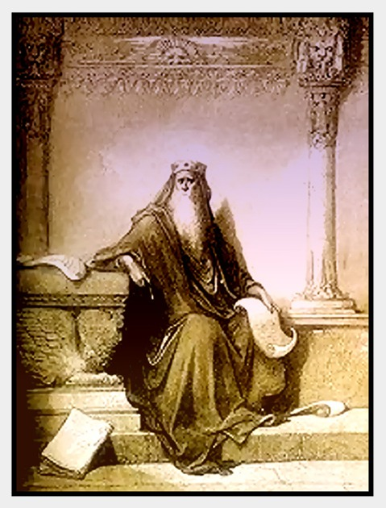

Slide 14
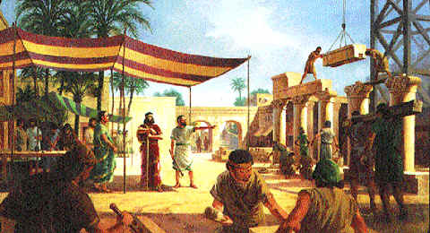

Slide 15
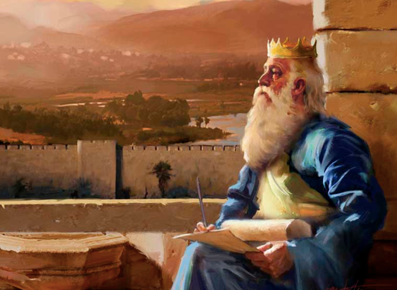

Slide 16
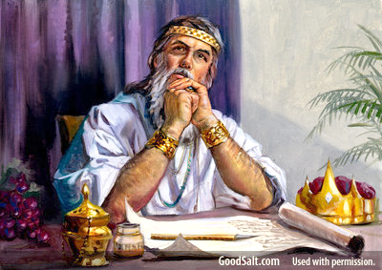

Slide 17
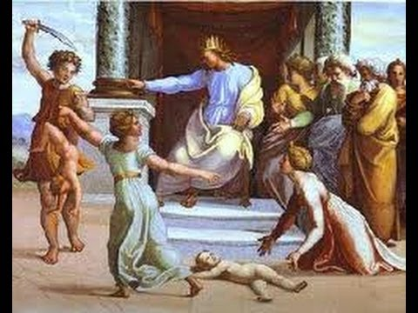

Slide 18
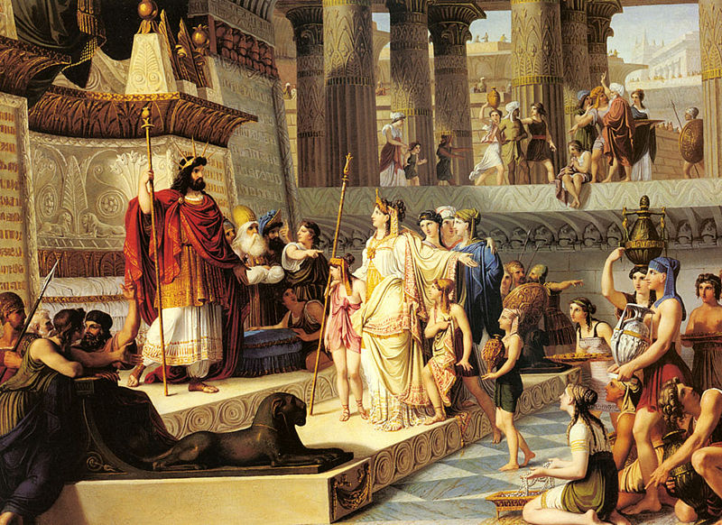

Slide 19
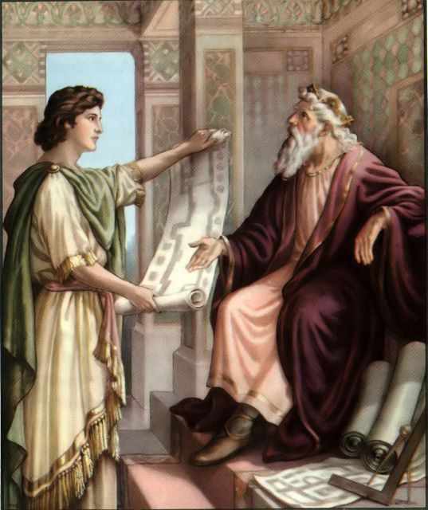

Slide 20
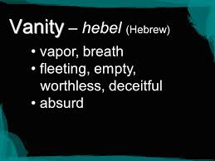

Slide 21
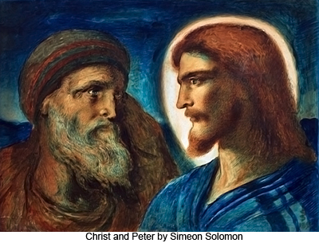

Slide 22
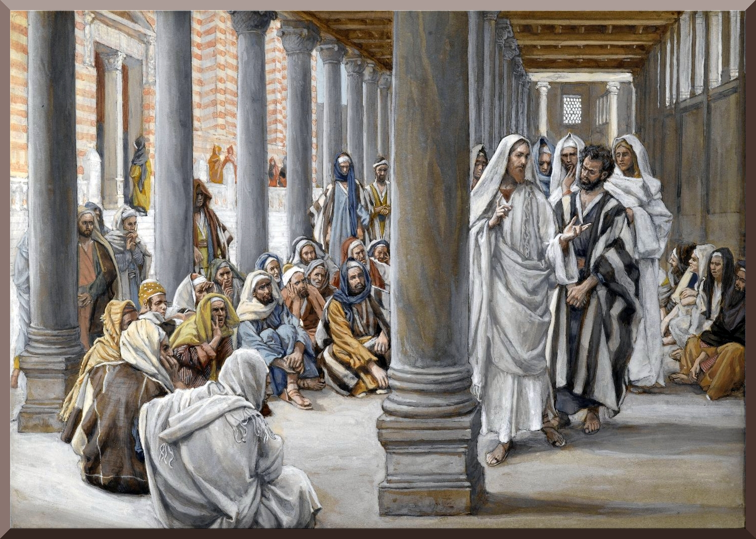

Slide 23
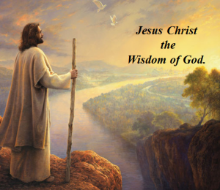

Slide 24
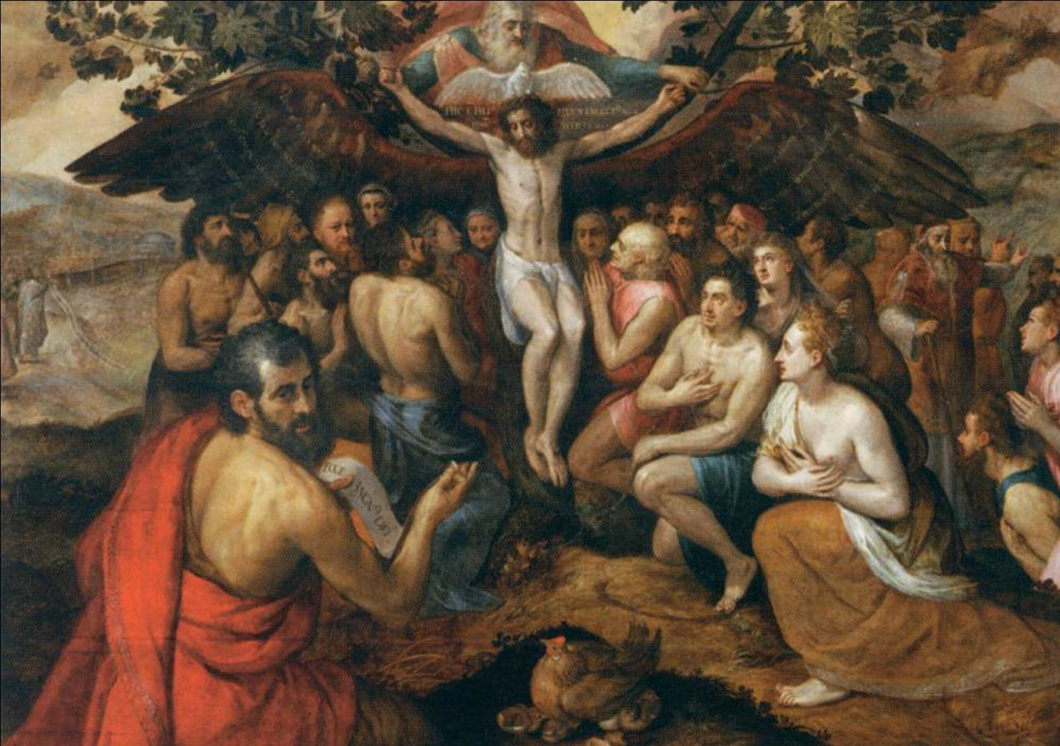

Slide 25
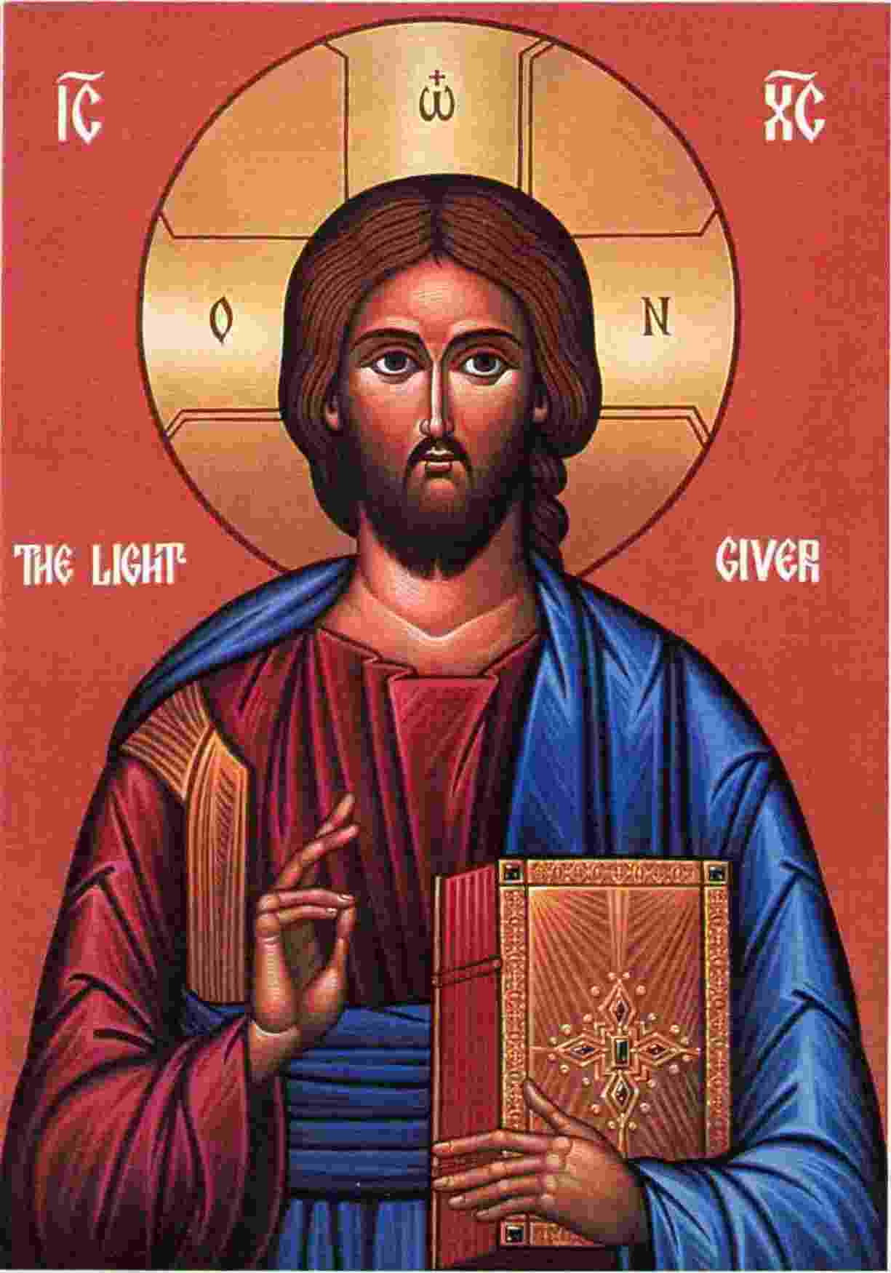

Slide 26


Slide 27
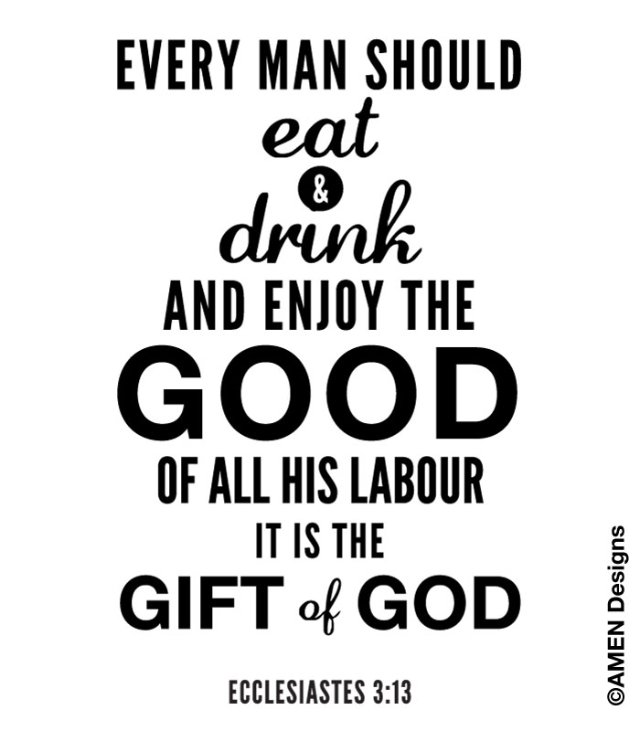

Slide 28


Slide 29
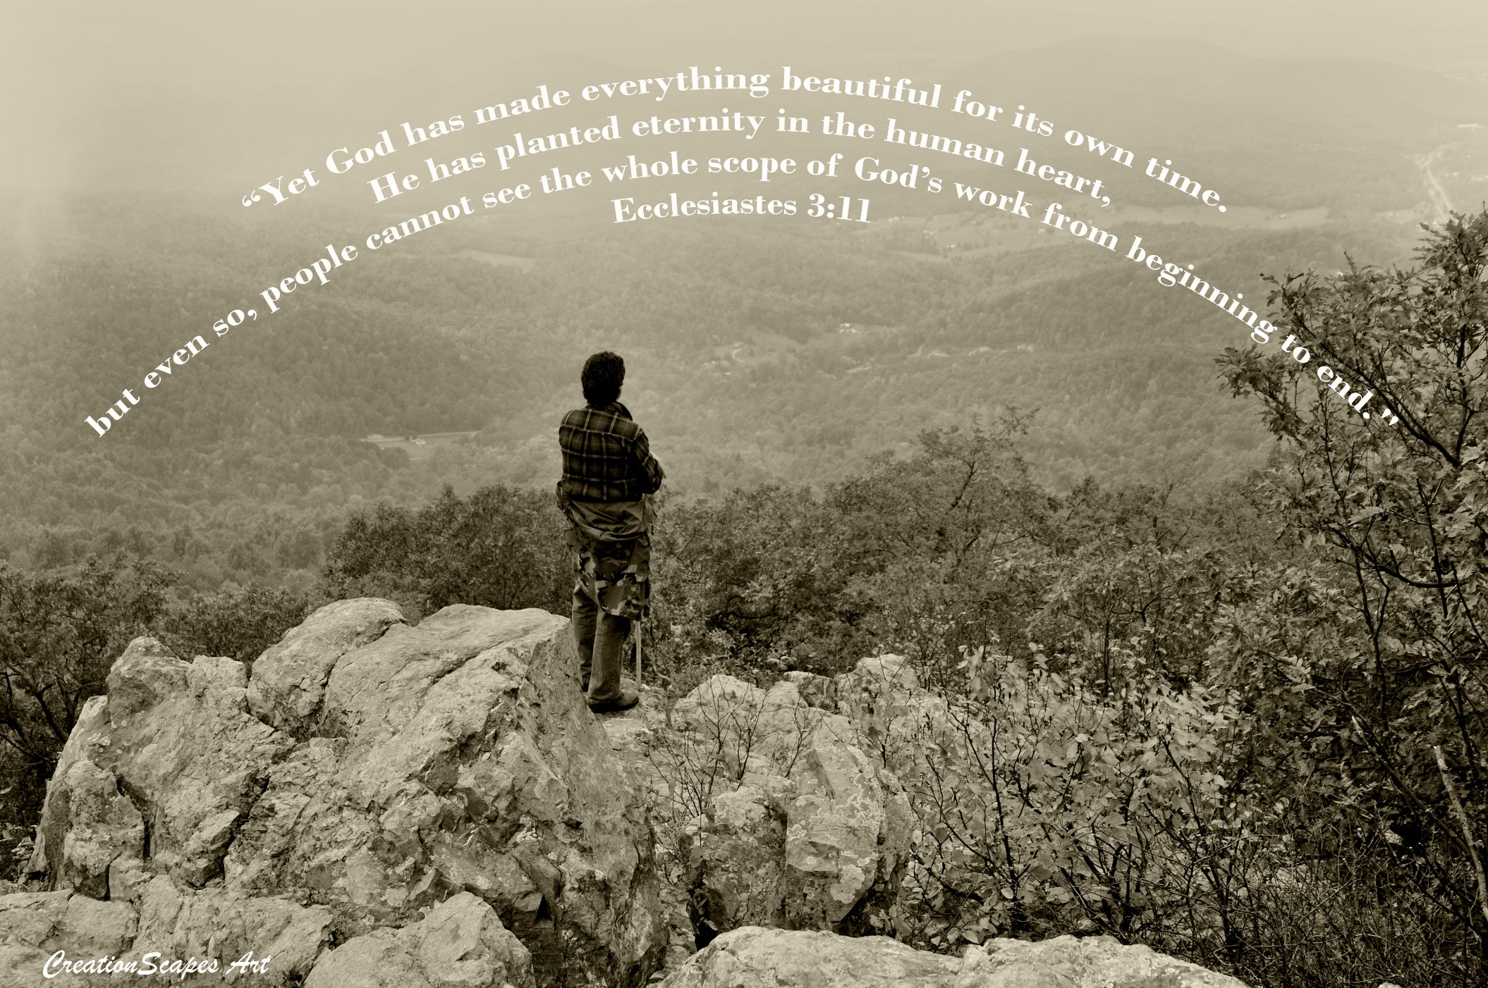

Slide 30
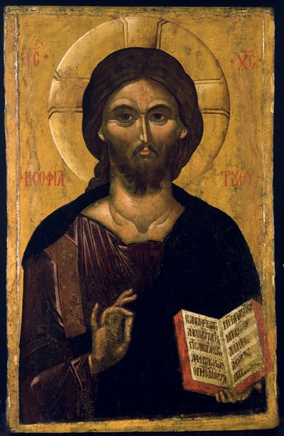

Slide 31
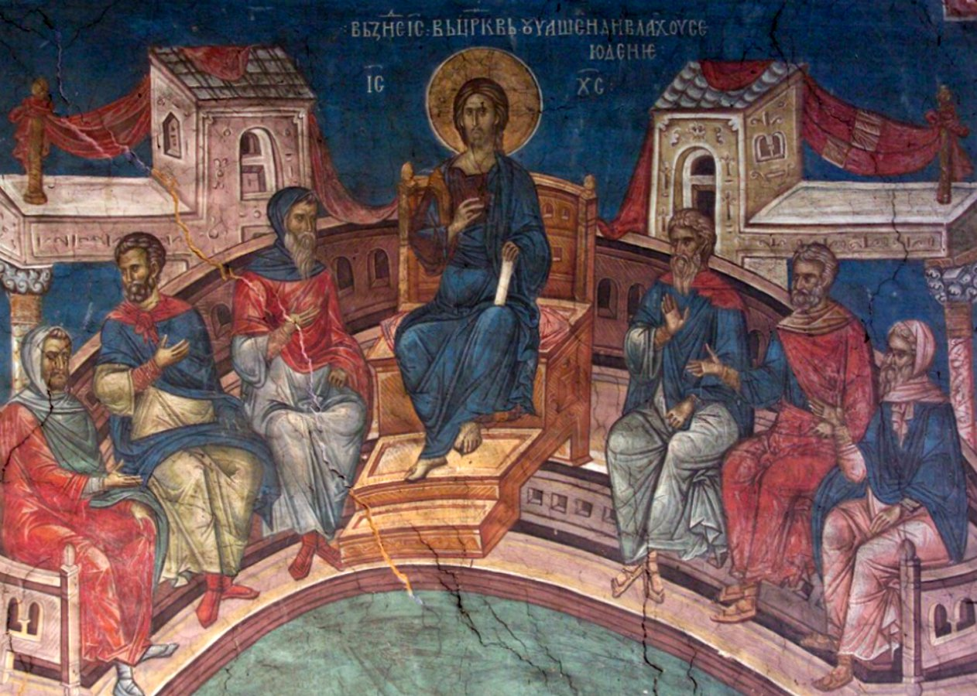

Slide 32


Slide 33
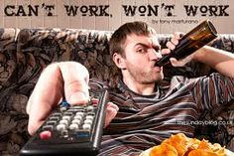

Slide 34
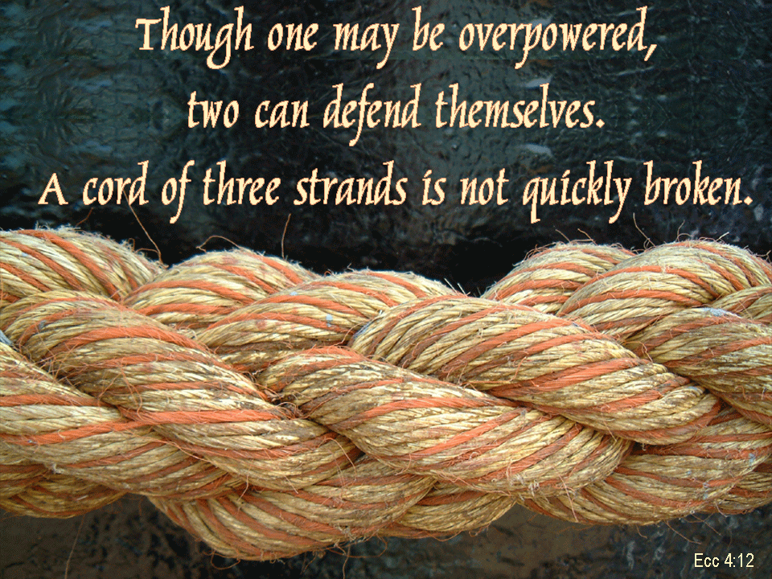

Slide 35


Slide 36


Slide 37

"Better is a handful of quietness than two hands full of toil and a striving after wind." ~ Ecclesiastes 4:6

Slide 38
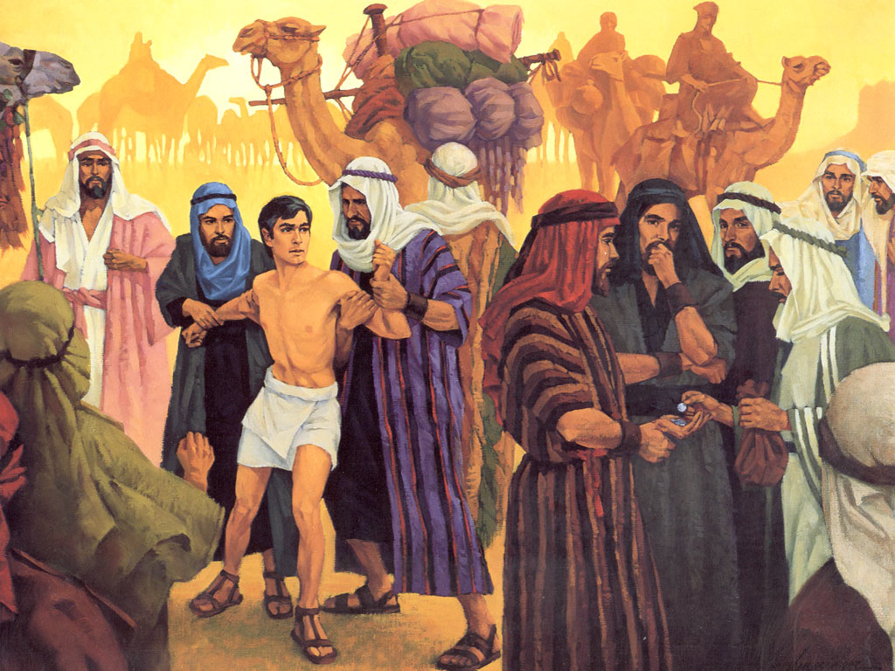

Slide 39
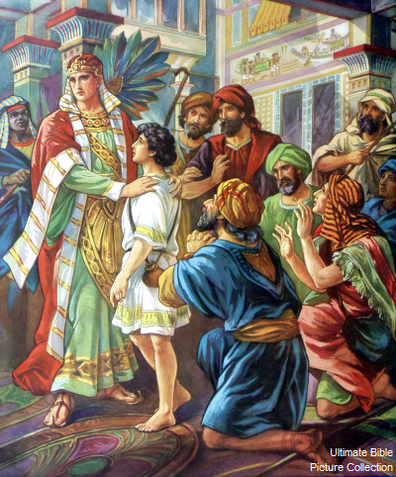

Slide 40


Slide 41
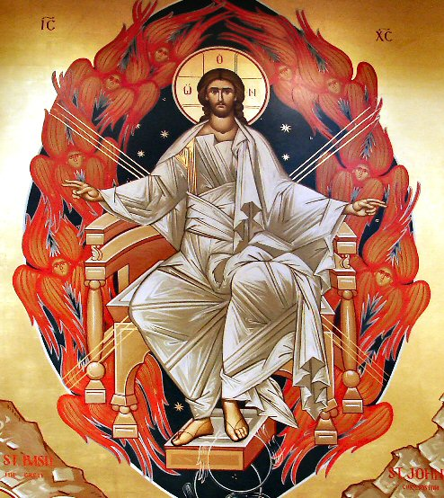

Slide 42
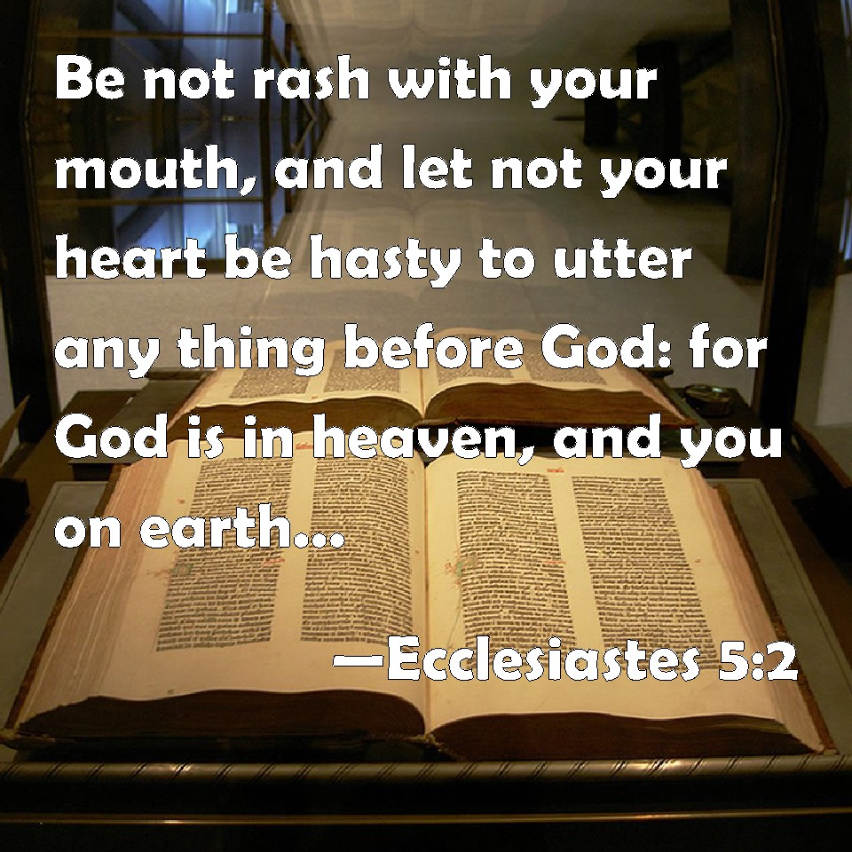

Slide 43


Slide 44


Slide 45
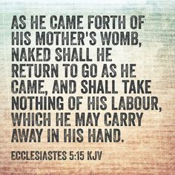

Slide 46


Slide 47
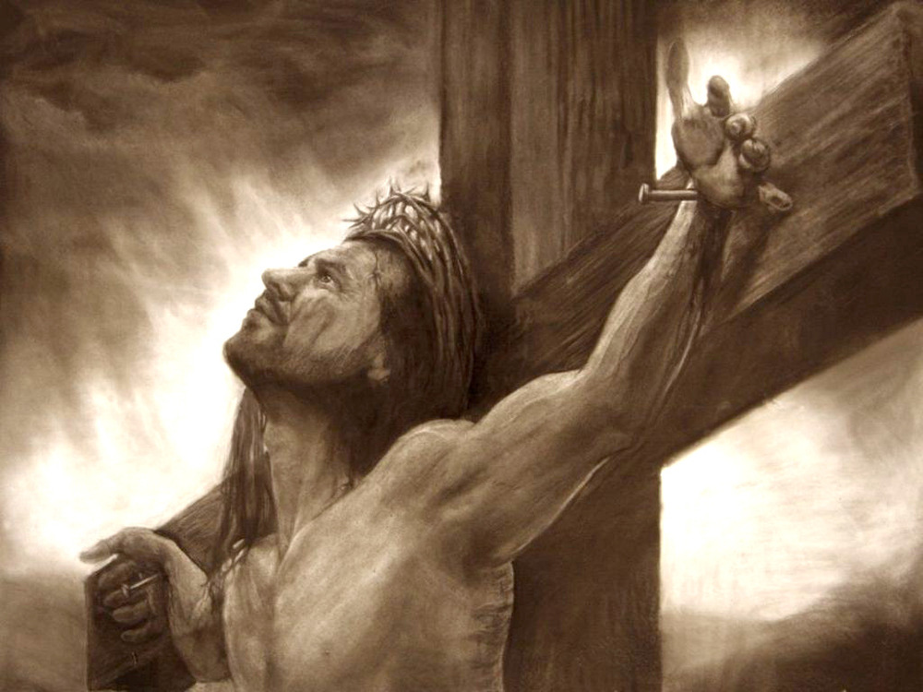

Slide 48
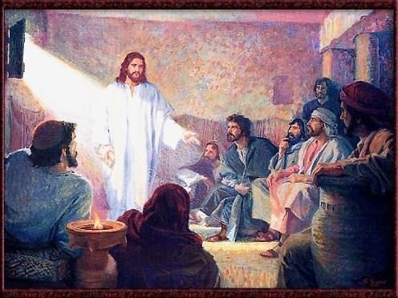

Slide 49
