Slide 1
A BIBLE STUDY OF THE BOOK OF ECCLESIASTES
Theme:
Solomon and Jesus,
Both Sons of David, say:
“Fear God and keep his commandments,
For this is the whole duty of man!”
Trinity Lutheran Church
Norman, Oklahoma
Pastor David Nehrenz
Date: 12-13-15
Lesson: 12b

Slide 2
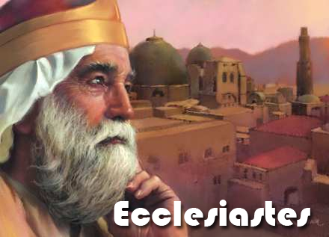

Slide 3
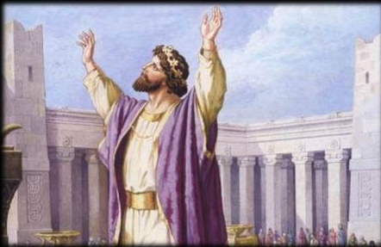

Slide 4
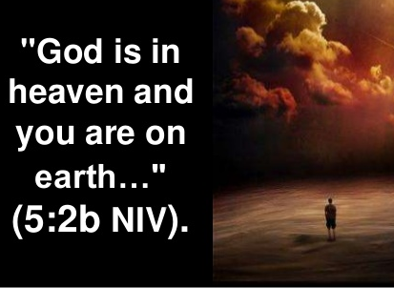

Slide 5
TEXT (Chapter 12)
(1) Remember also your Creator in the days of your youth, before the evil days come and the years draw near of which you will say, "I have no pleasure in them";
(2) before the sun and the light and the moon and the stars are darkened and the clouds return after the rain, (3) in the day when the keepers of the house tremble, and the strong men are bent, and the grinders cease because they are few, and those who look through the windows are dimmed,
(4) and the doors on the street are shut--when the sound of the grinding is low, and one rises up at the sound of a bird, and all the daughters of song are brought low—
(5) they are afraid also of what is high, and terrors are in the way; the almond tree blossoms, the grasshopper drags itself along, and desire fails, because man is going to his eternal home, and the mourners go about the streets—
(6) before the silver cord is snapped, or the golden bowl is broken, or the pitcher is shattered at the fountain, or the wheel broken at the cistern, (7) and the dust returns to the earth as it was, and the spirit returns to God who gave it.

Slide 6
(8) Vanity of vanities, says the Preacher; all is vanity. (9) Besides being wise, the Preacher also taught the people knowledge, weighing and studying and arranging many proverbs with great care. (10) The Preacher sought to find words of delight, and uprightly he wrote words of truth.
(11) The words of the wise are like goads, and like nails firmly fixed are the collected sayings; they are given by One Shepherd.
(12) My son, beware of anything beyond these. Of making many books there is no end, and much study is a weariness of the flesh.
(13) The end of the matter; all has been heard: Fear God and keep his commandments, for this is the whole duty of man. (14) For God will bring every deed into judgment, with every secret thing, whether good or evil.

Slide 7
STUDY NOTES:
1. To remember your Creator in the days of your youth is essential, since it shapes the whole rest of your life
(v. 1)
(Rom 1:25; Col 3:10; 1Pet 4:19; 1 Tim 4:12; Titus 2:1-8; 1 Jn 2:13,14)
2. The allegory for aging here in (vv. 1b – 8) pictures the human body and spirit as it is worn out from a long life so that the eyes, ears, teeth, limbs and whole body moves slower and becomes feeble. Even sleep can be easily disturbed. The hair becomes white like the pale blossoms of the almond tree, and the body moves slowly like a grasshopper in cold weather. Life becomes fragile and when a silver chain has one link break, the golden hanging lamp and bowl will come crashing to the ground. This the life under the curse
(Gen. 3).
3. Man goes to his eternal home when he dies (v. 5)
(John 14:1-6,23; 2 Cor 5:1-7)

Slide 8
4. “The dust returns to the earth as it was, and the spirit returns to God who gave it” (v. 7)
We are created with a body and a soul. When we die, the body is buried and returns to dust and the soul goes to be with Christ in heaven. When Christ returns on the Last Day, the body is raised and reunited with the soul to dwell in Paradise forever.
(Gen 2:7; 3:19; Ps 103:14; 104:29; Lk 23:43; 1 Cor 15:42-58; Phil 1:21-26)
5. In the midst of the vanity of life in a world without God, the wise have wisdom and knowledge to be studied carefully (vv. 8-10) so they can find delight in the words of truth (Rom 7:16-25)
6. “The words of the wise are like goads, and like nails firmly fixed are the collected sayings; they are given by One Shepherd” (v. 11)
(Ps 23:1; 28:9; Is 40:11; Ezek 34:15; Mt 7:14; Jn 10:11-16; Heb 13:20,21;
1 Pet 2:25; Rev 7:17)

Slide 9
7. “My son, beware of anything beyond these. Of making many books there is no end, and much study is a weariness of the flesh.” (v. 12) We have the written Word of God. There are millions of books written throughout all history and trying to read them all will wear you out. Spend most of your time reading and re-reading the Bible and you will know the wisdom from on high, come down from God Almighty.
8. The end of the matter; all has been heard:
Fear God and keep his commandments, for this is the whole of man.” (v. 13)
This is where true fulfillment is to be found, to revere and stand in awe of God and his Word
(Ps. 111; Prov 1:7; 9:10; Job 28:28; 2 Cor 5:6-11; 7:1; 1 Pet 2:17; Rev 14:7; 19:5-9)
9. “For God will bring every deed into judgment, with every secret thing, whether good or evil.” (v. 14) (Mt 12:36; Ac 17:31; Rom 2:16; 14:10-12; 1 Cor 3:12-15; 4:5; 2 Cor 5:9-10; Heb 4:12,13)

Slide 10
Luther’s Works on ch. 12
“Let us hear the conclusion of the whole matter: Fear God and keep His commandments. That is, this is the summary of it all: Fear and worship God and keep Him in view; thus you will observe everything that I have set forth in this book. For unless someone fears God, he will not be able to observe any of these things. He has cited examples of men who lived wisely and excellently, without fear, but who, when evil times came, were nevertheless not used to it and brought affliction upon themselves.
But those who fear God are able to despise and make fun of every evil and adversity when it comes, and to give thanks if it does not come. For this is the duty of all men. That is, this applies to all men and is useful to them all. In other ways of life it is gain that is sought for, but in this one it is godliness.”

Slide 11
LIFE APPLICATION:
1. “Remember also your Creator in the days of your youth”
Why is this vitally important for young people to know NOW before they get old?
2. “Man is going to his eternal home, and the mourners go about the streets”
How is this played out each and every time someone dies and then people go to his/her funeral?
3. “The dust returns to the earth as it was, and the spirit returns to God who gave it”
What does this teach us about the corruption of this world and also the immortality of the soul?
4. “Fear God and keep his commandments, for this is the whole duty of man”
Who enables us to know God and his commandments so that we can keep them?
5. “For God will bring every deed into judgment, with every secret thing, whether good or evil.”
When a person knows and realizes this, it will affect every moment of one’s life. Give examples.

Slide 12
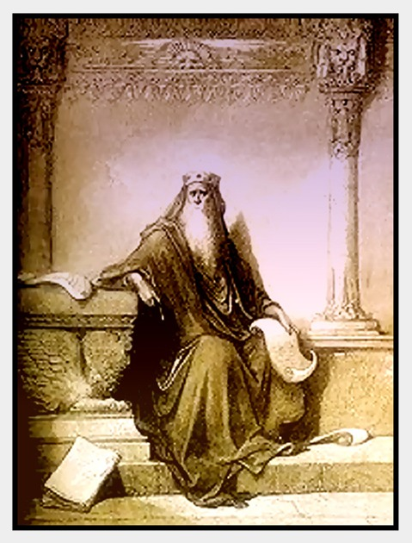

Slide 13
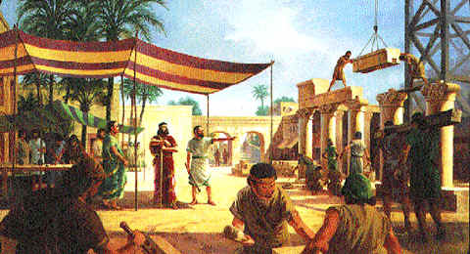

Slide 14
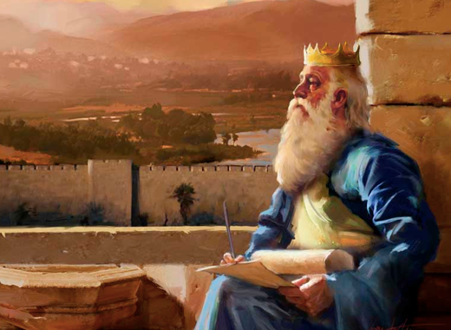

Slide 15
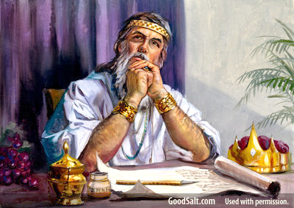

Slide 16
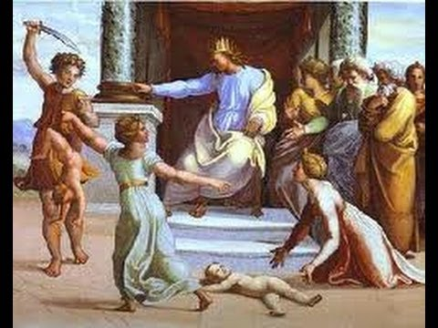

Slide 17
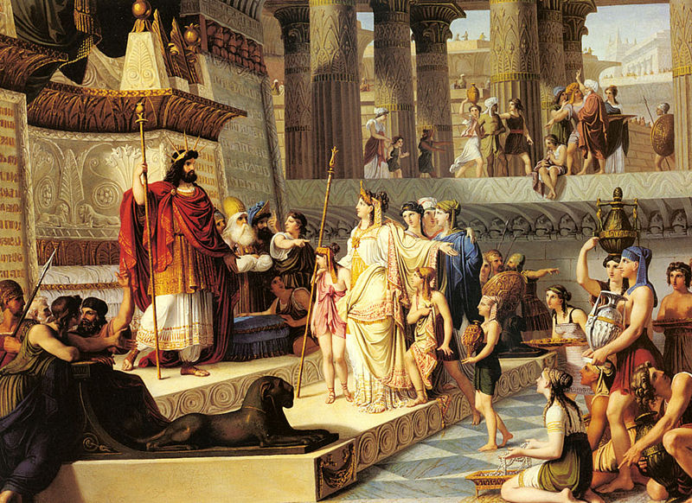

Slide 18
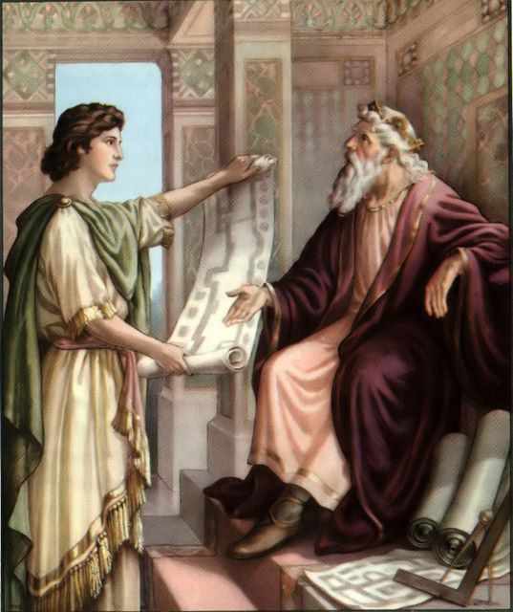

Slide 19
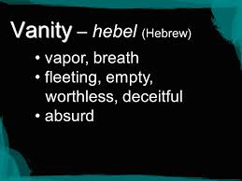

Slide 20
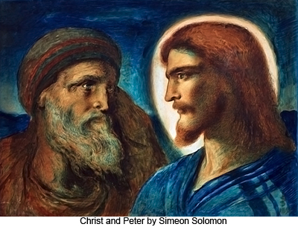

Slide 21
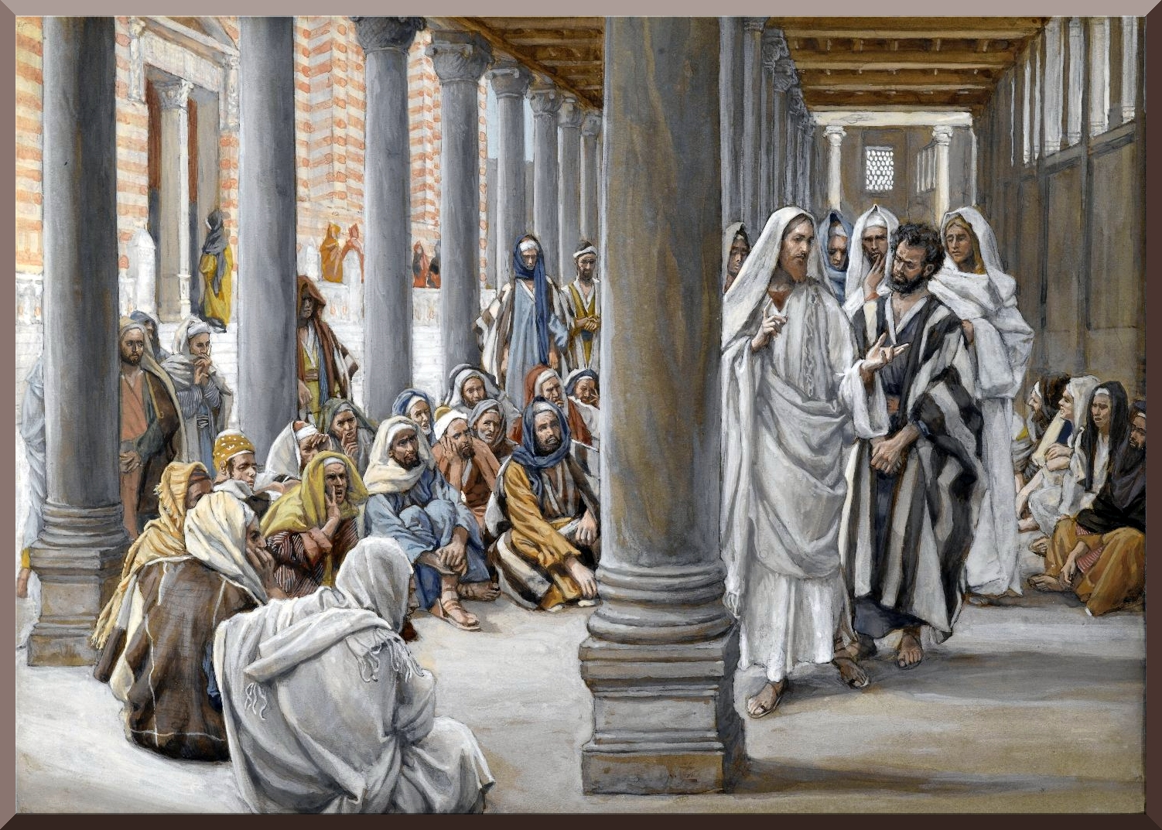

Slide 22
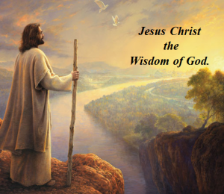

Slide 23
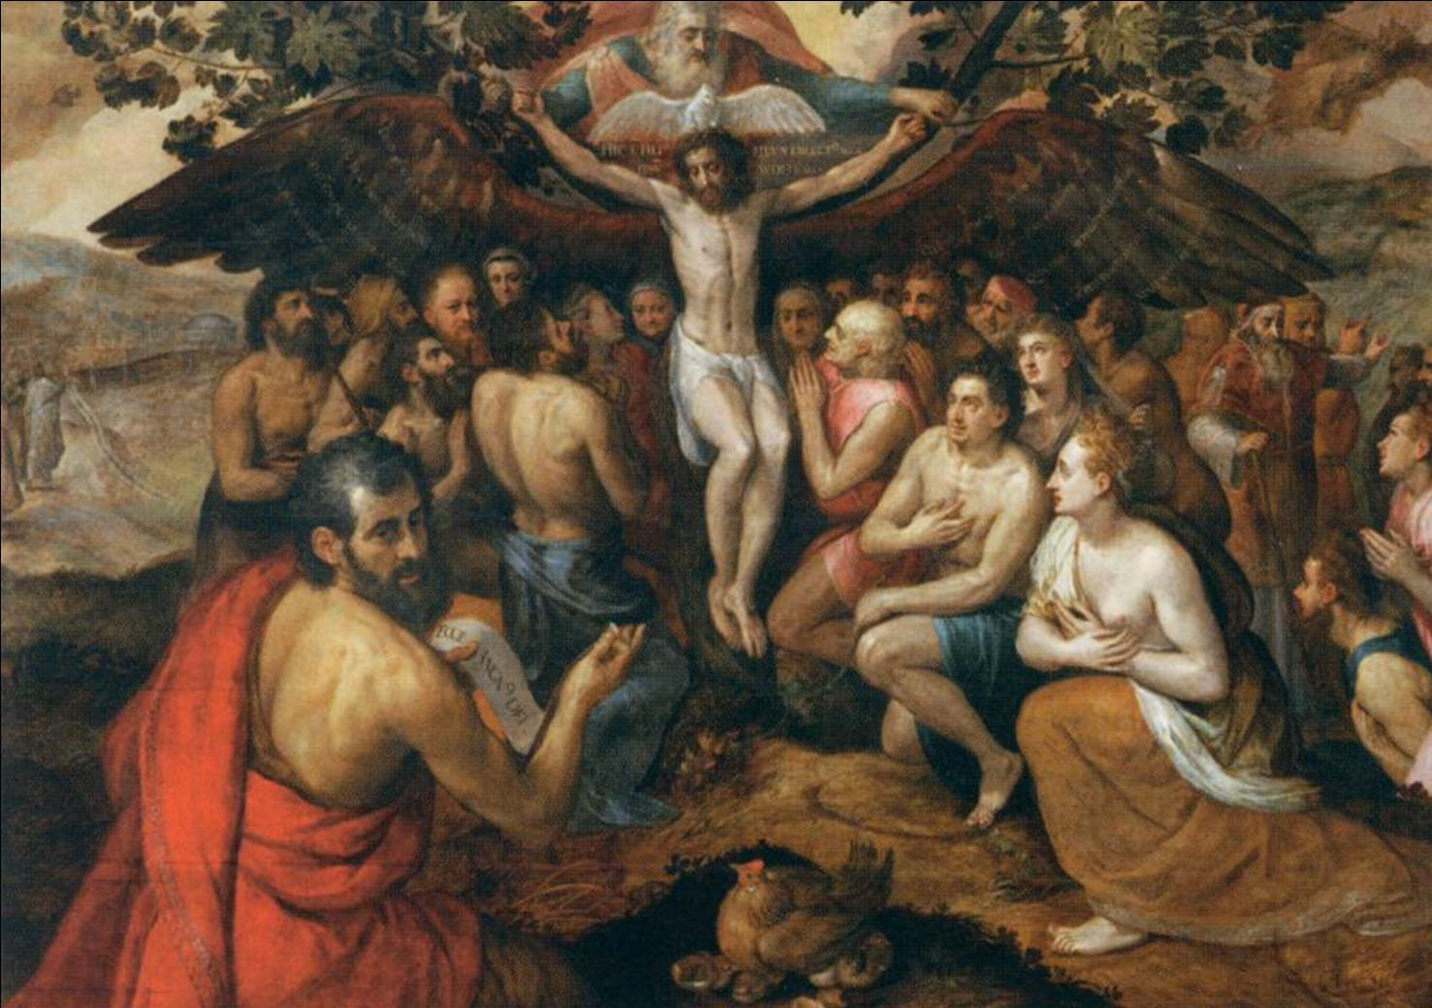

Slide 24
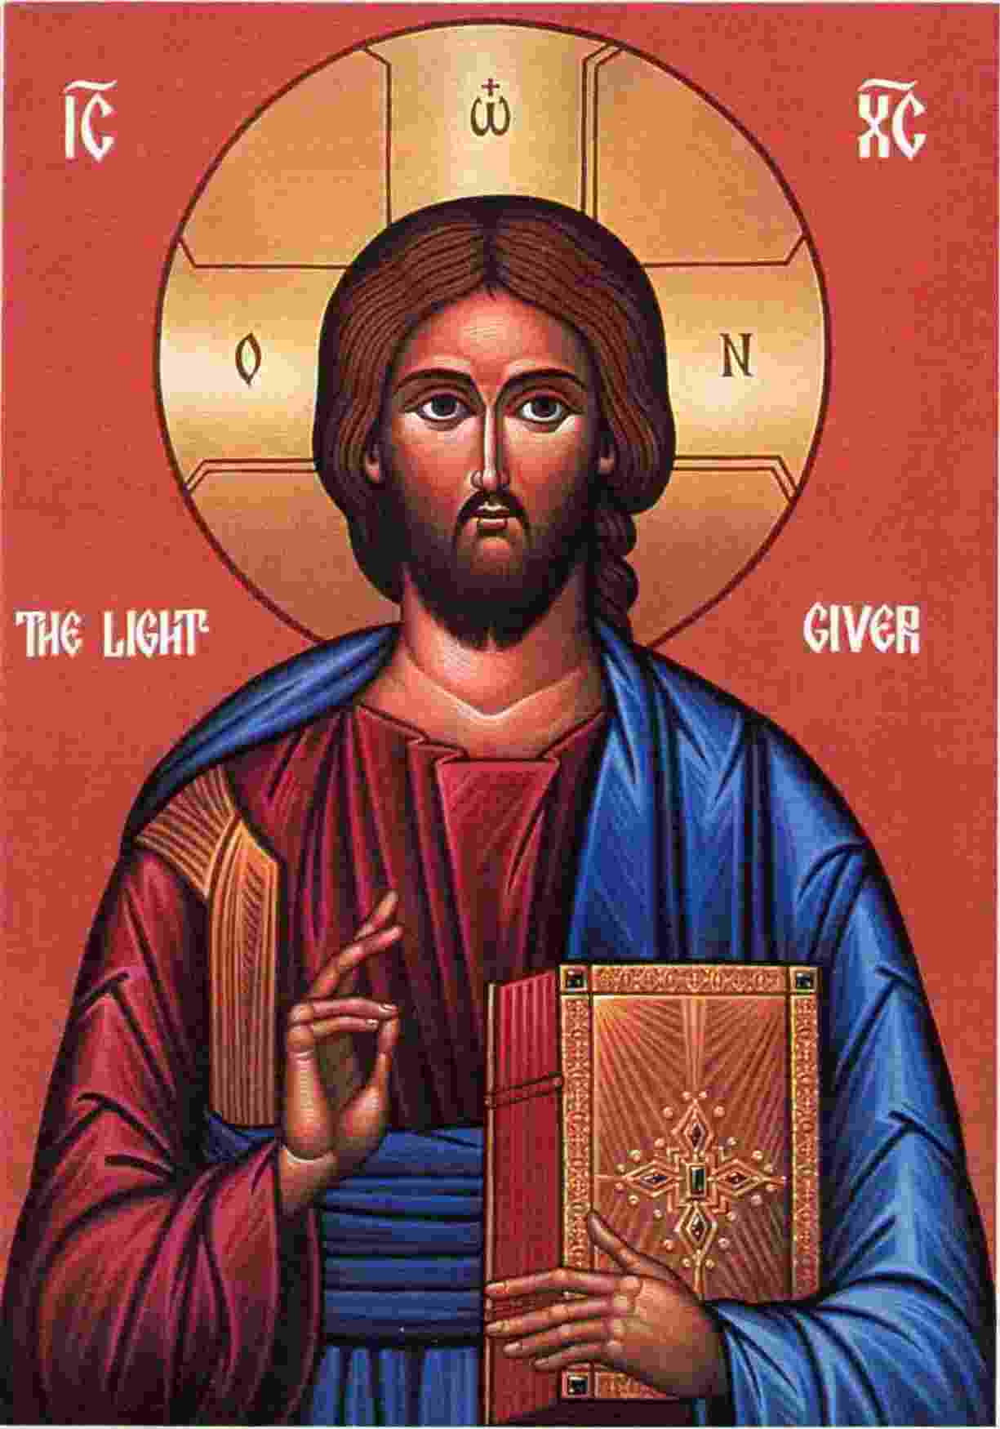

Slide 25


Slide 26


Slide 27


Slide 28
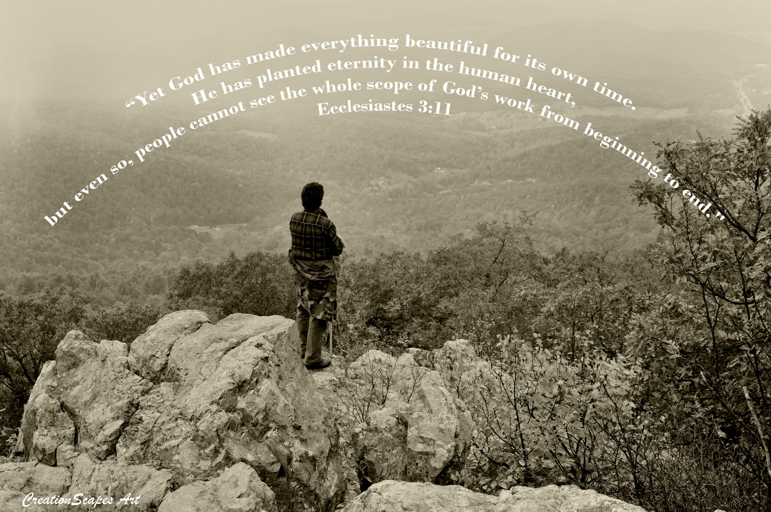

Slide 29
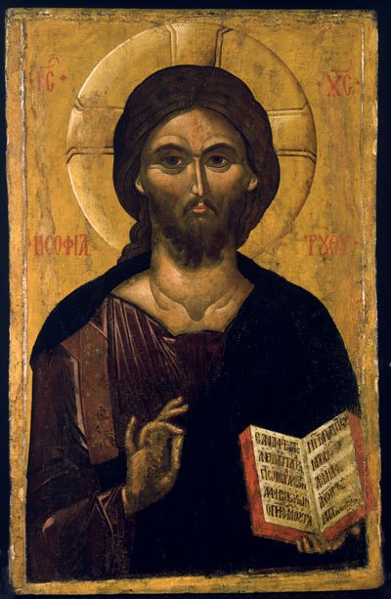

Slide 30
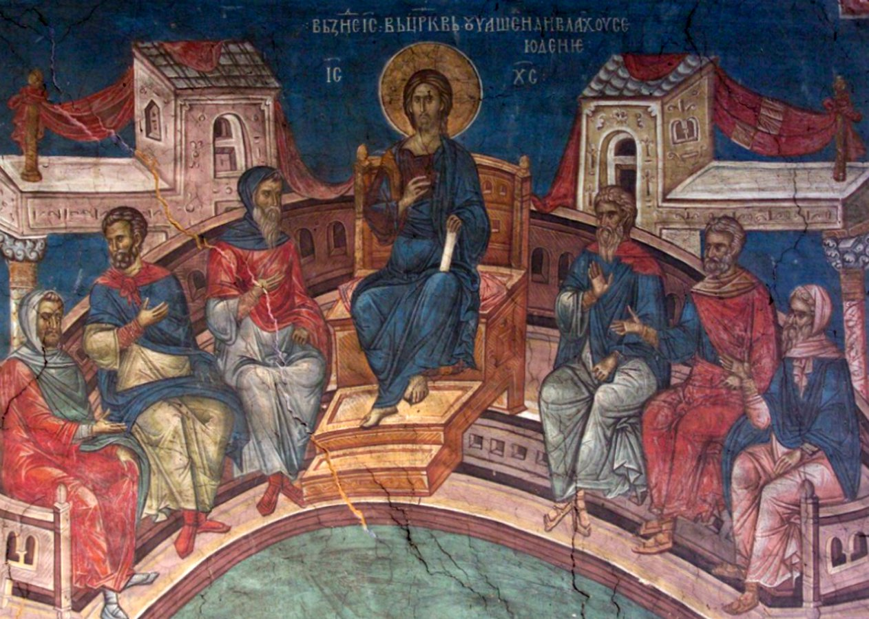

Slide 31
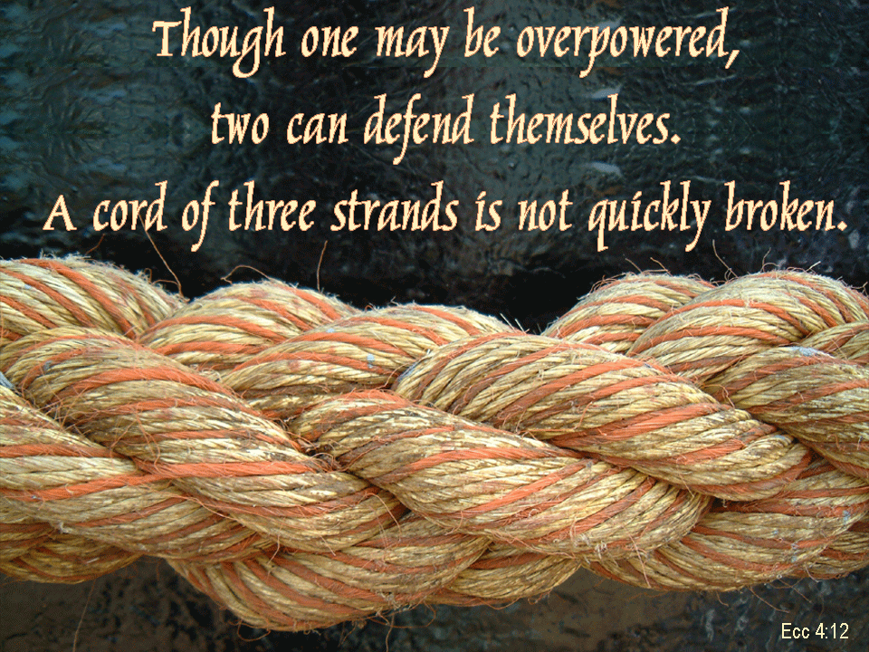

Slide 32


Slide 33

"Better is a handful of quietness than two hands full of toil and a striving after wind." ~ Ecclesiastes 4:6

Slide 34
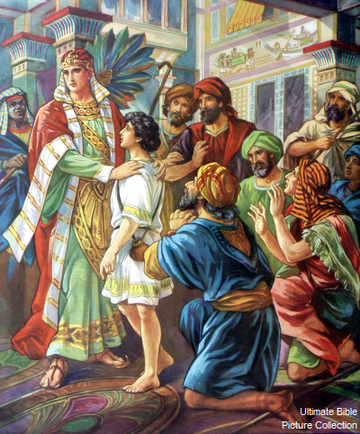

Slide 35
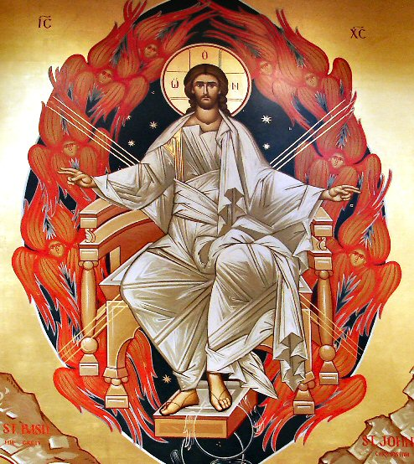

Slide 36
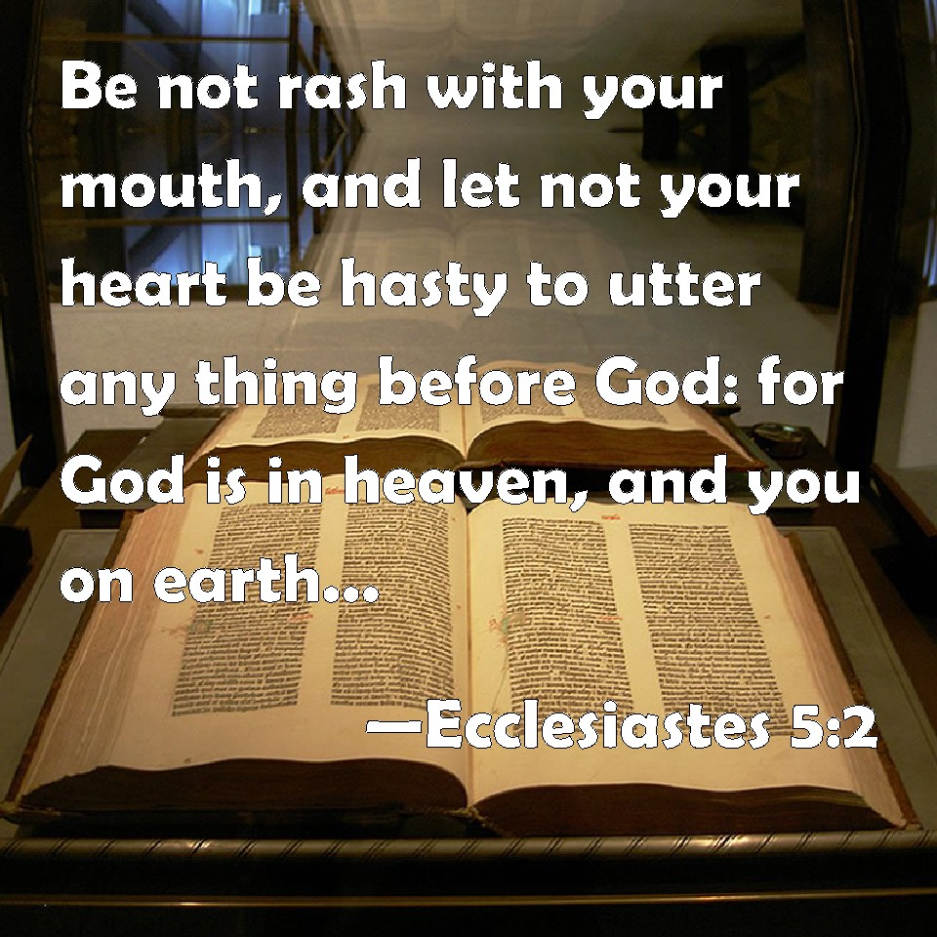

Slide 37


Slide 38


Slide 39
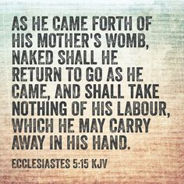

Slide 40


Slide 41
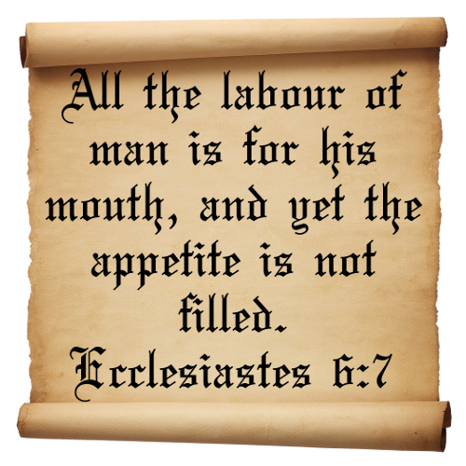

Slide 42


Slide 43


Slide 44


Slide 45


Slide 46
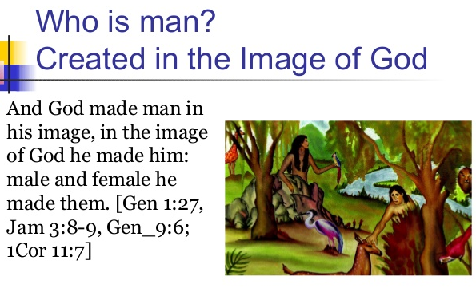

Slide 47


Slide 48
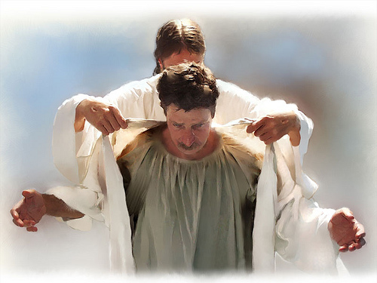

Slide 49
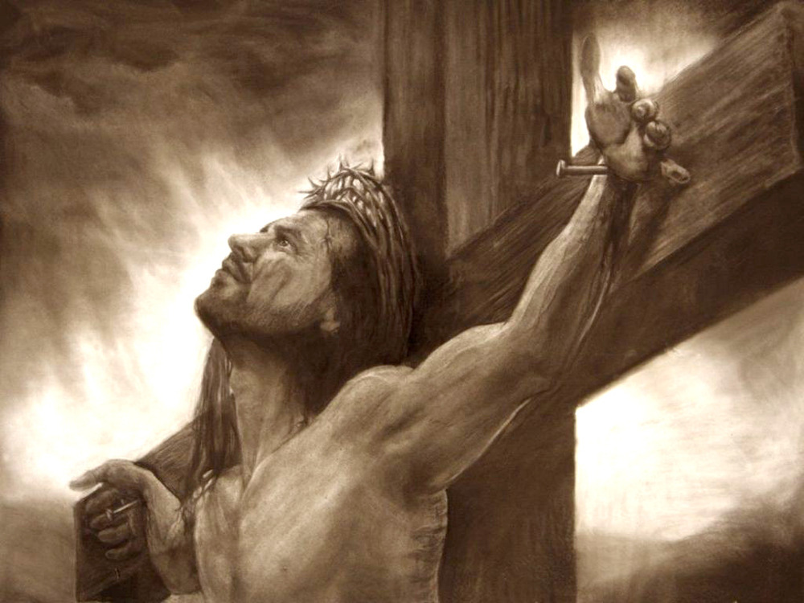

Slide 50
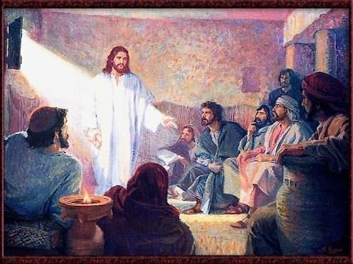

Slide 51
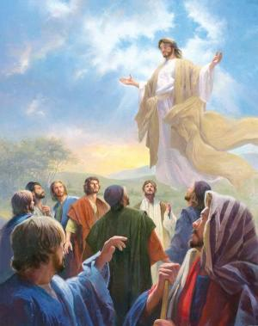

Slide 52
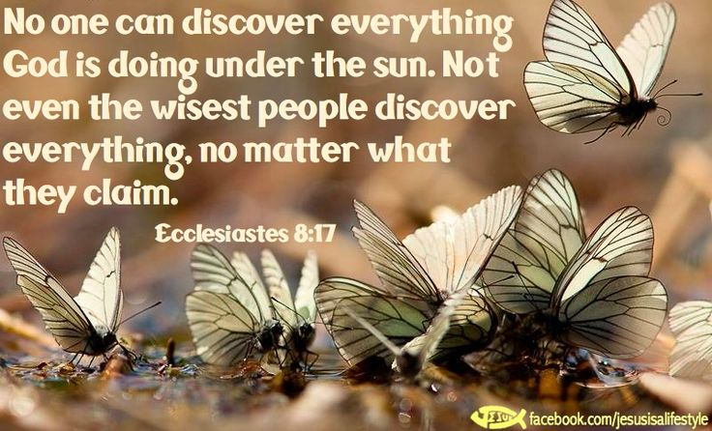

Slide 53
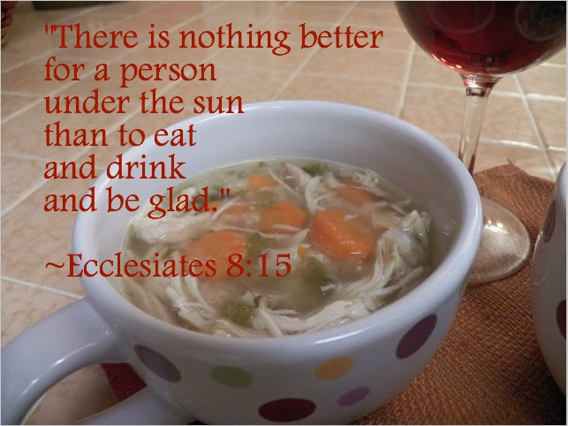

Slide 54
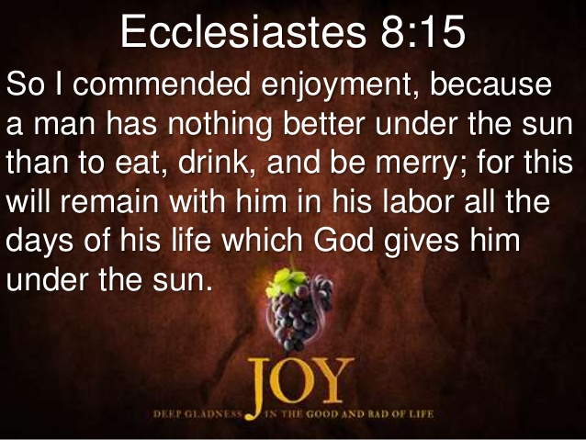

Slide 55


Slide 56
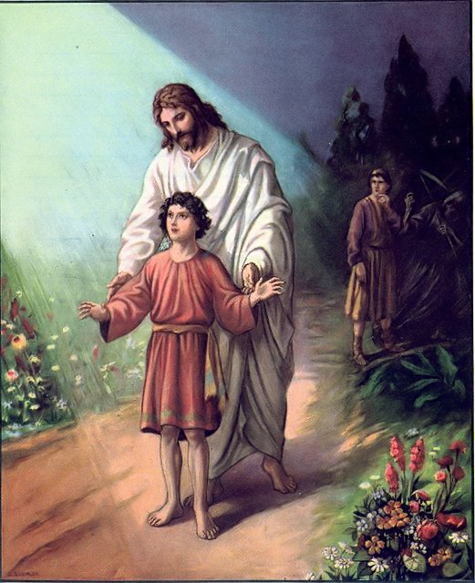

Slide 57


Slide 58
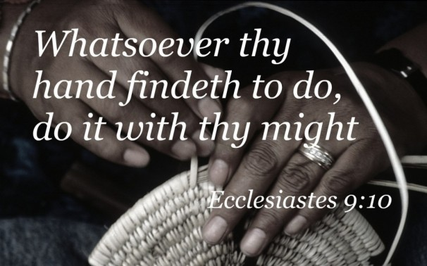

Slide 59
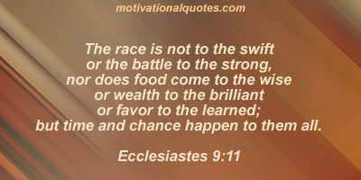

Slide 60


Slide 61
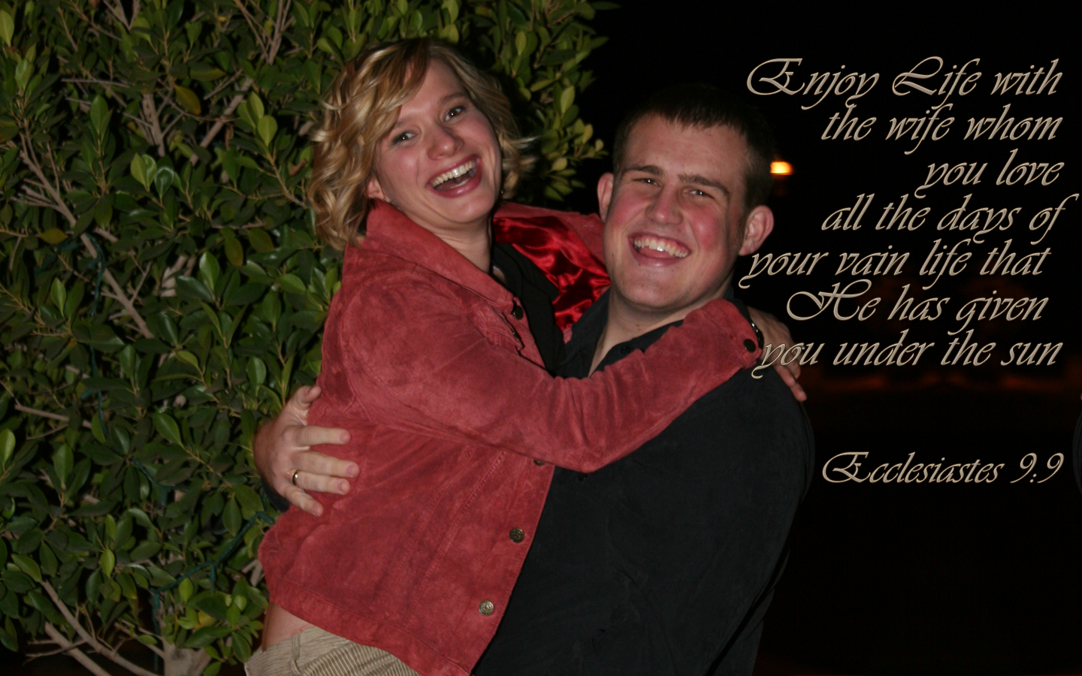

Slide 62


Slide 63


Slide 64
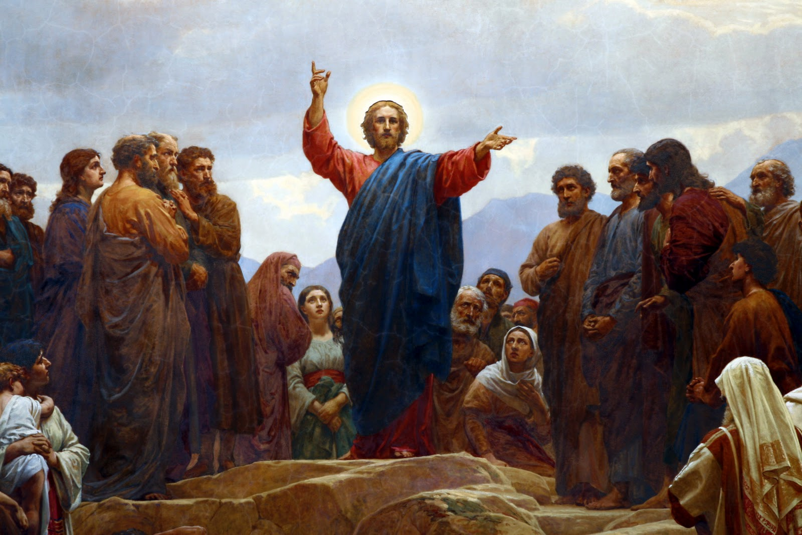

Slide 65
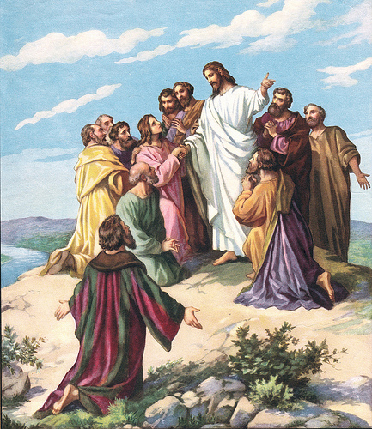

Slide 66
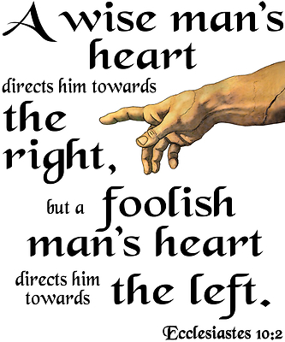

Slide 67


Slide 68


Slide 69
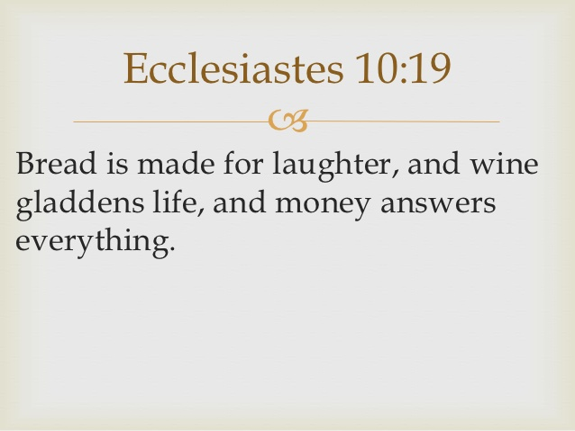

Slide 70


Slide 71


Slide 72
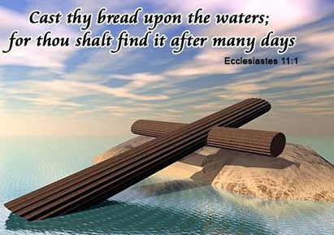

Slide 73
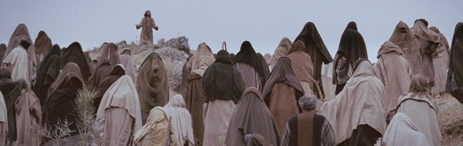

Slide 74
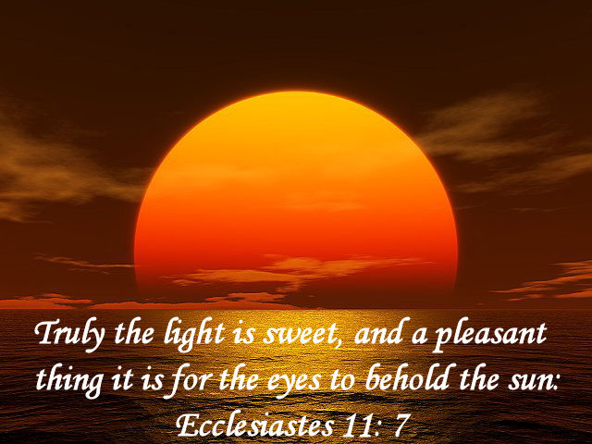

Slide 75


Slide 76
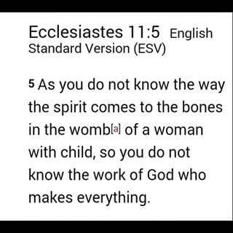

Slide 77
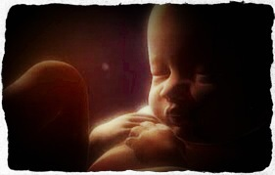

Slide 78
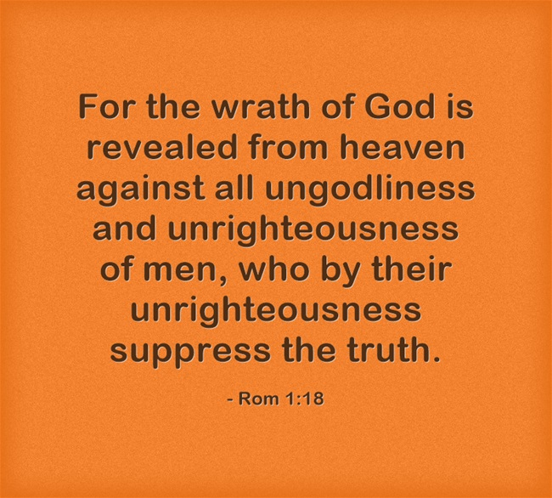

Slide 79
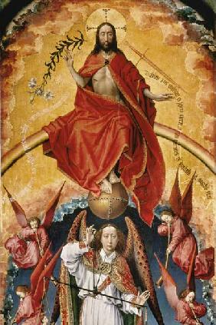

Slide 80
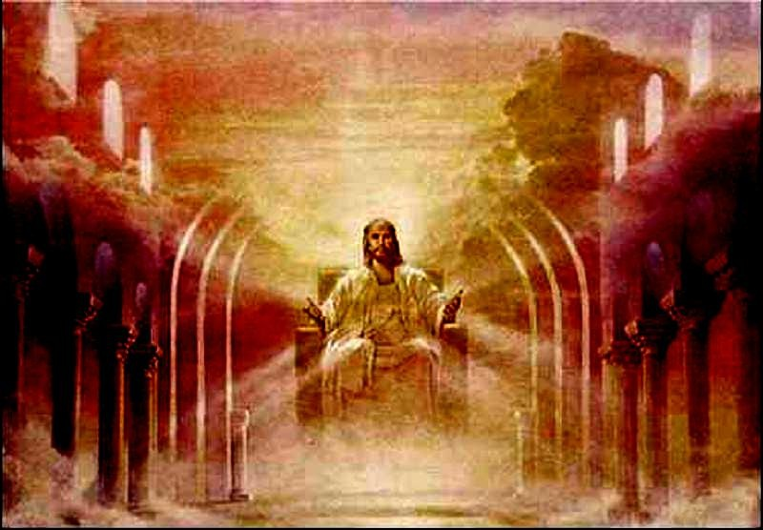

Slide 81
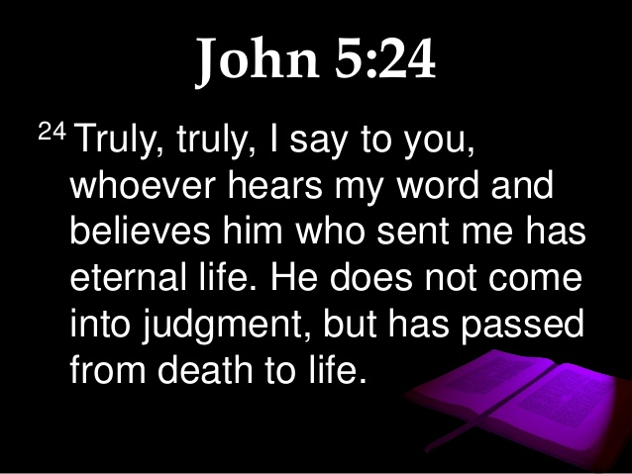

Slide 82


Slide 83


Slide 84


Slide 85


Slide 86


Slide 87


Slide 88


Slide 89


Slide 90


Slide 91


Slide 92


Slide 93


Slide 94


