Slide 1

“God’s Treasured Possession!”
-The Book of Deuteronomy-
Old Israel and New Israel =
The Church
Lesson 9 for us:
“O Lord GOD, destroy not your people
and your heritage,
whom you have redeemed through your greatness”
Date: 12-11-16
Study: #9
Text: Chapter 9:1-29

Slide 2
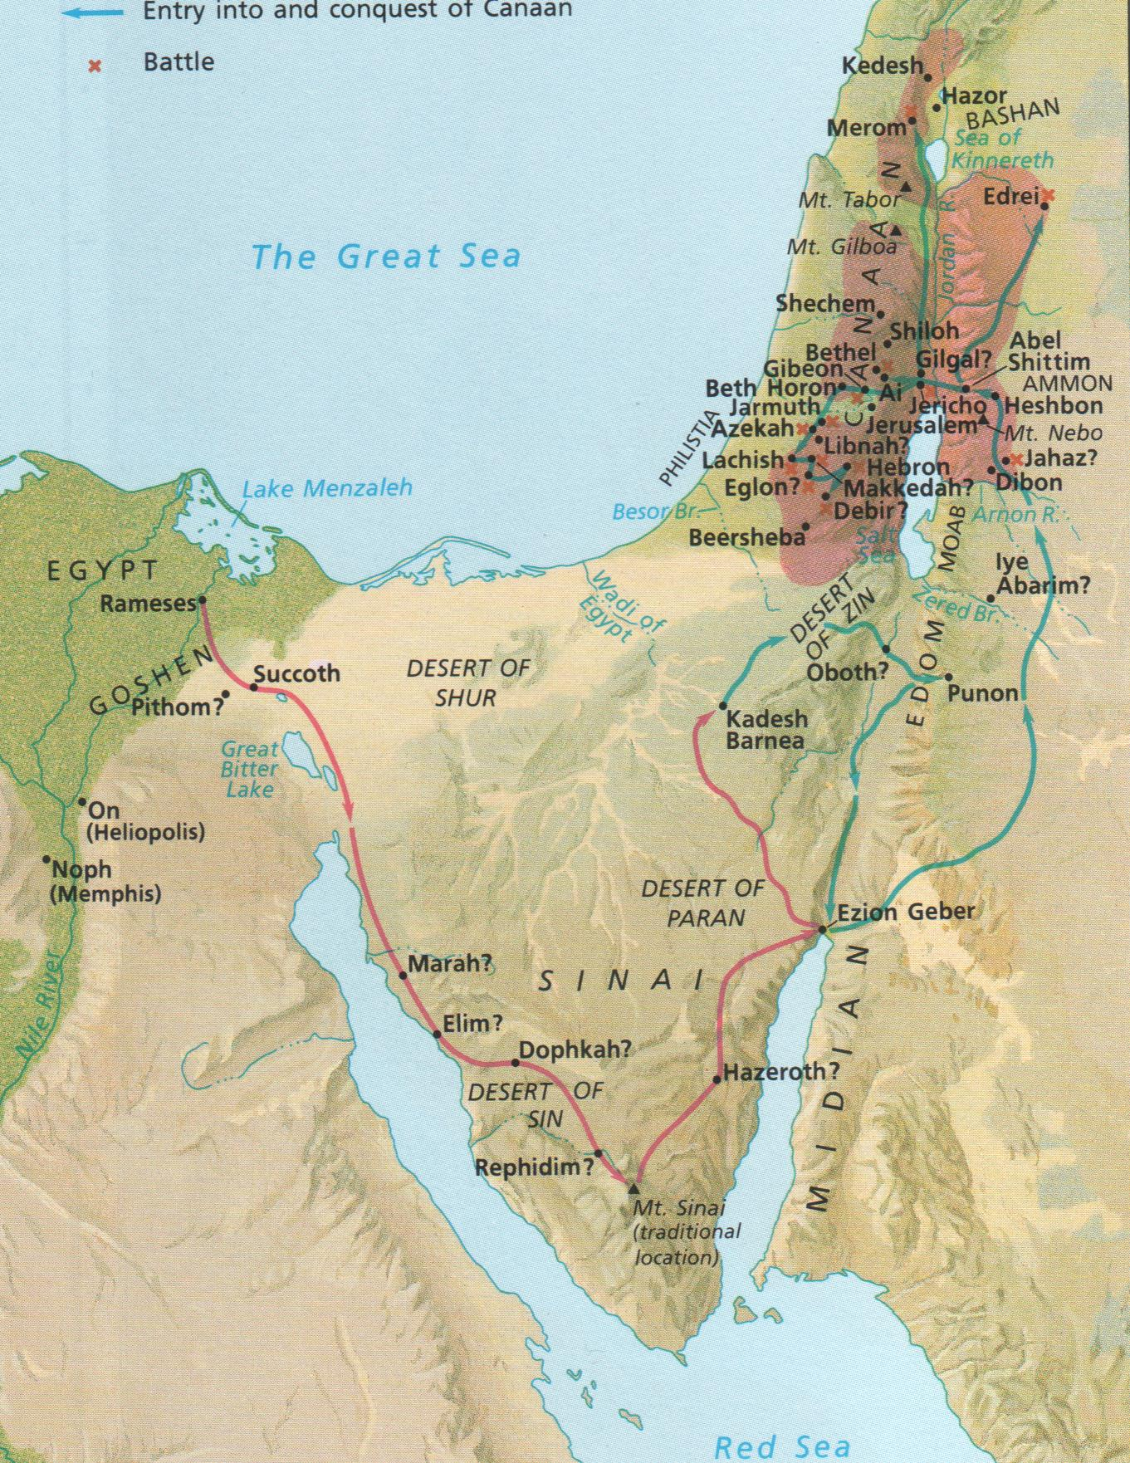

Slide 3
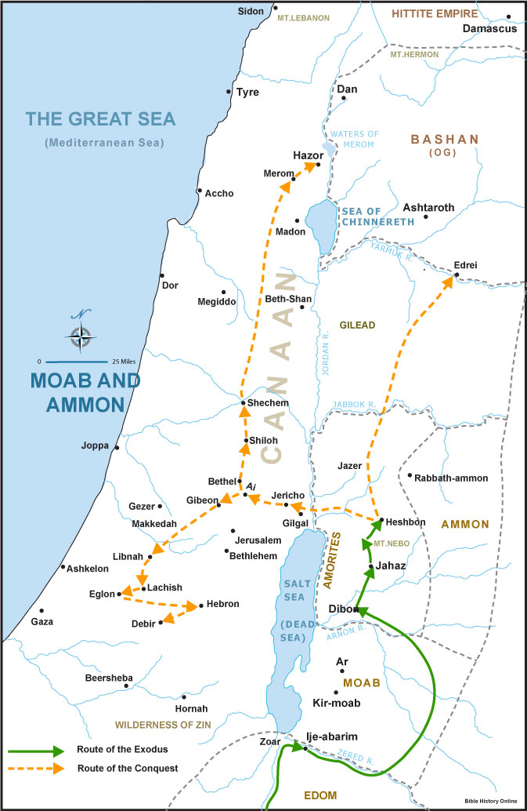

Slide 4
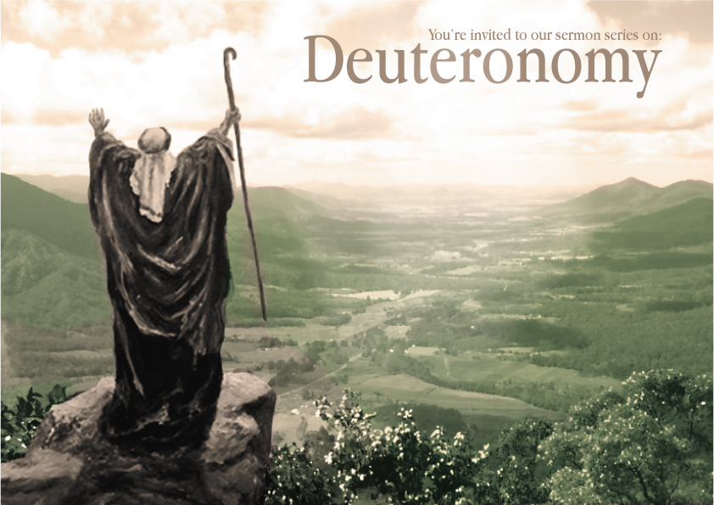

Slide 5
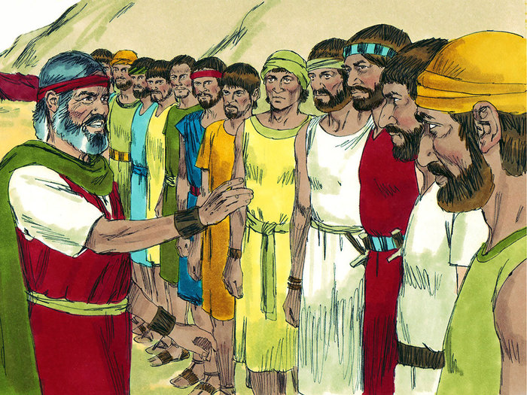

Slide 6
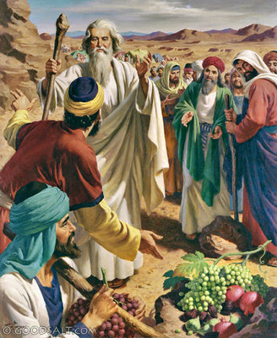

Slide 7
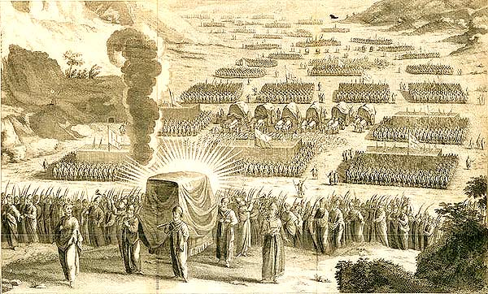

Slide 8
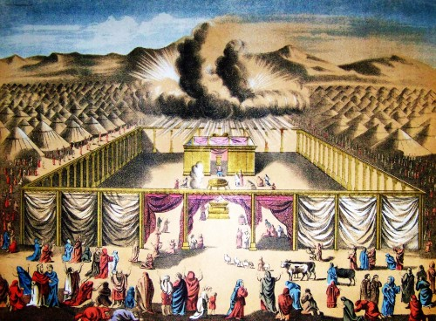

Slide 9
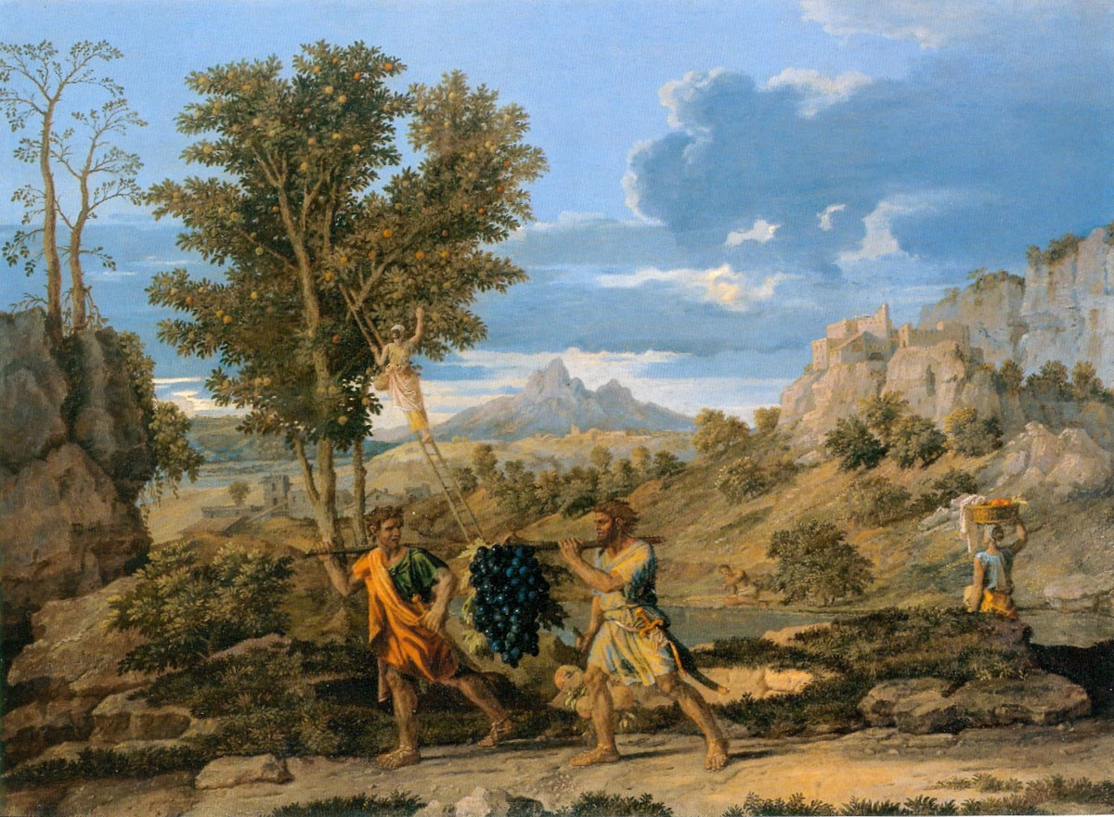

Slide 10
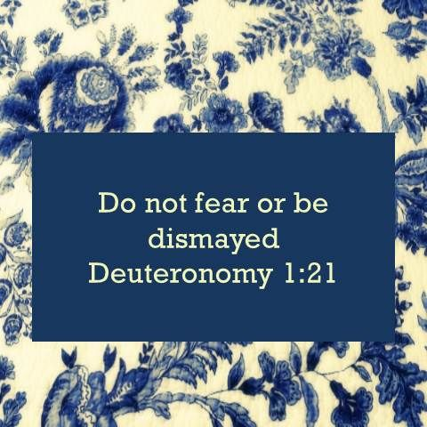

Slide 11
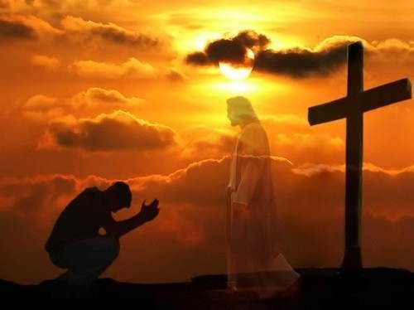

Slide 12
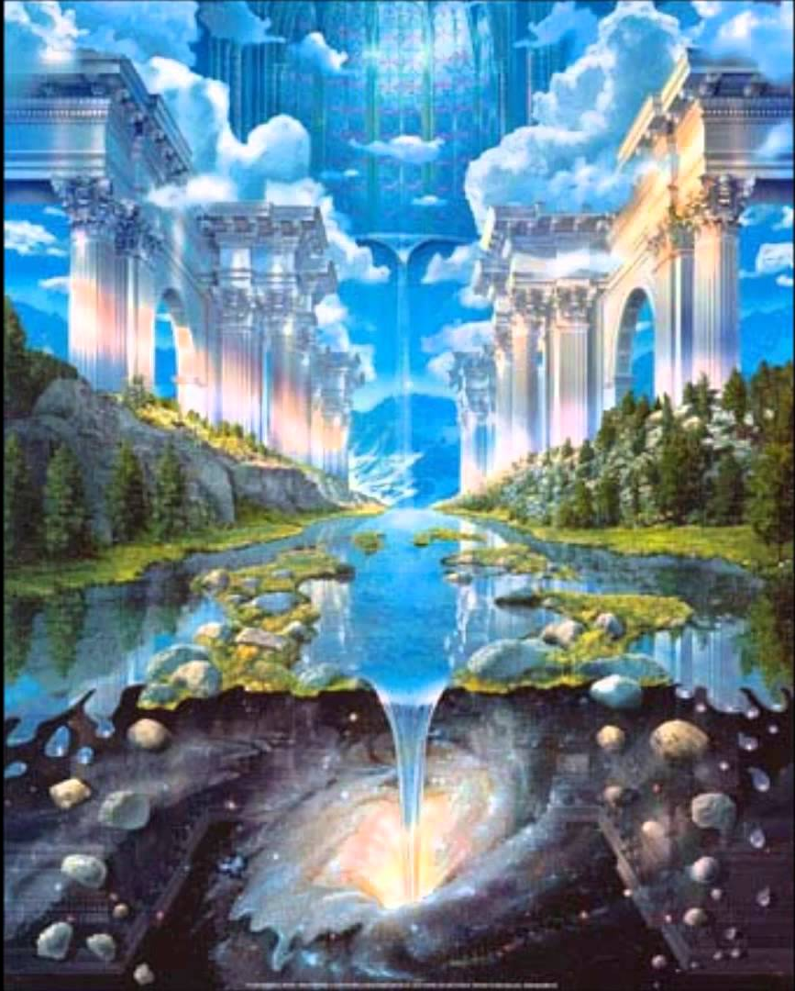

Slide 13
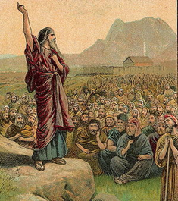

Slide 14
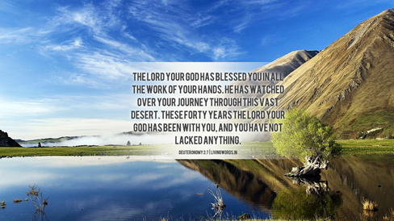

Slide 15
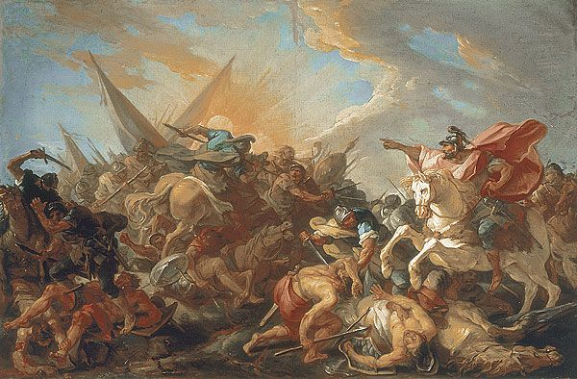

Slide 16
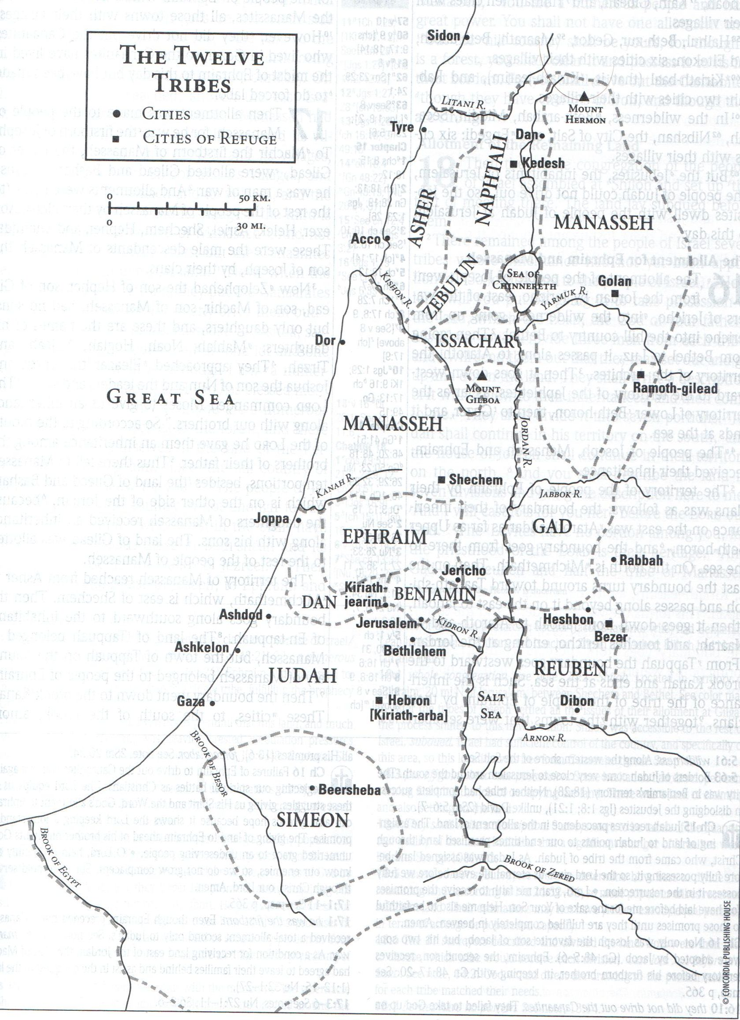

Slide 17
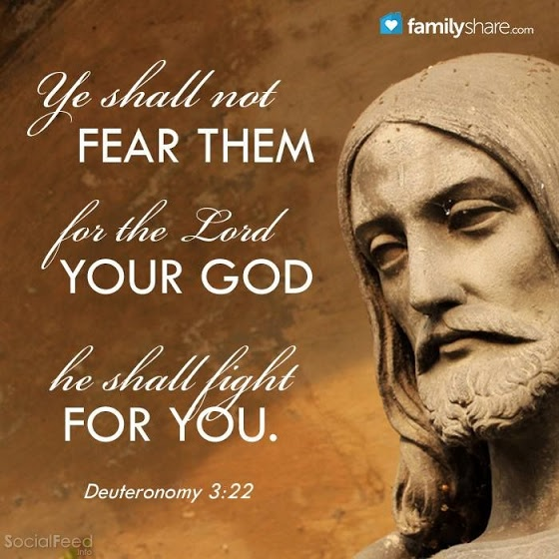

Slide 18
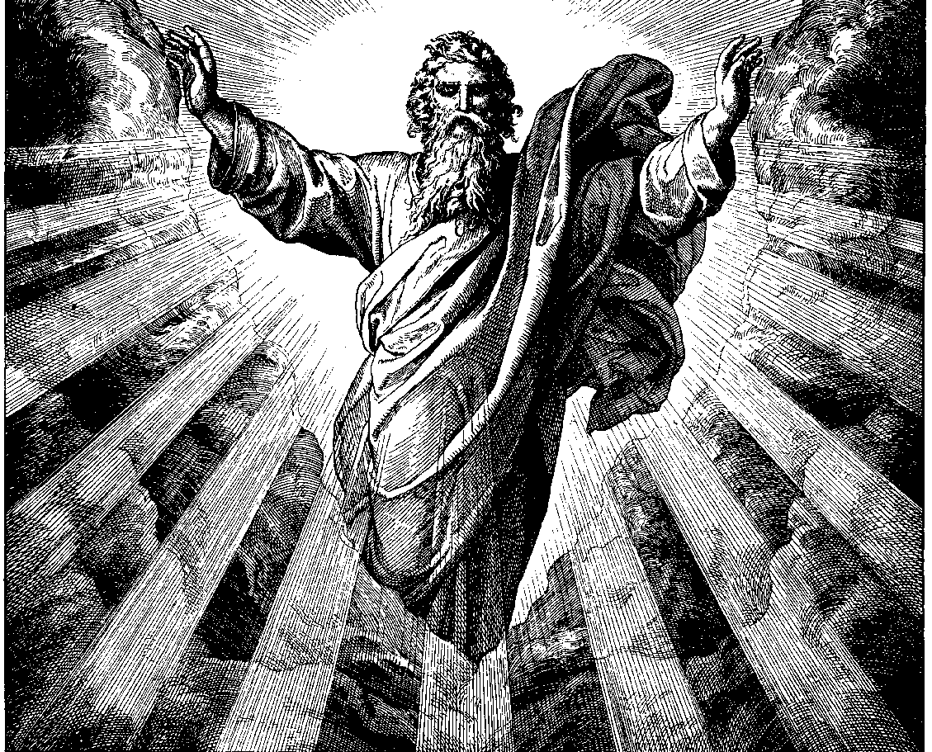

Slide 19
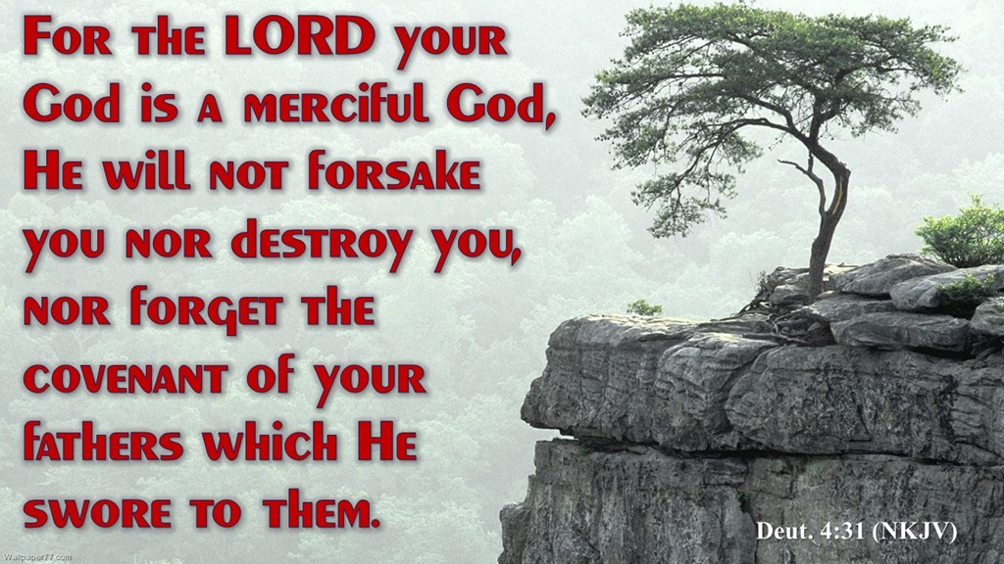

Slide 20
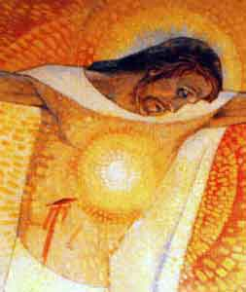

Slide 21
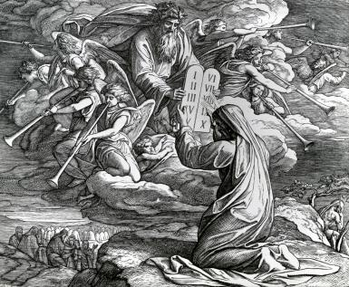

Slide 22
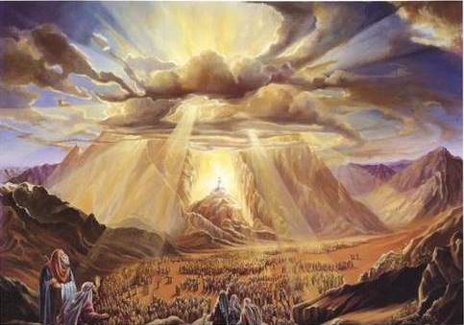

Slide 23
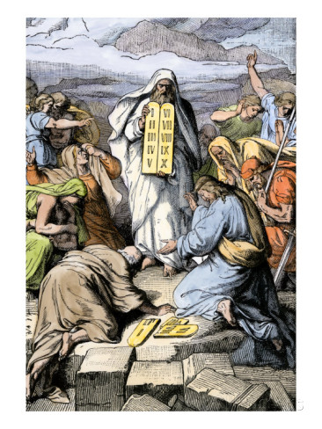

Slide 24
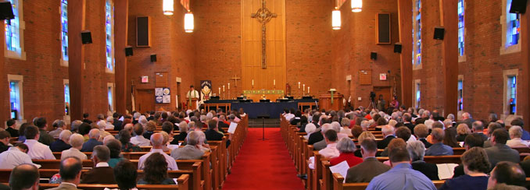

Slide 25
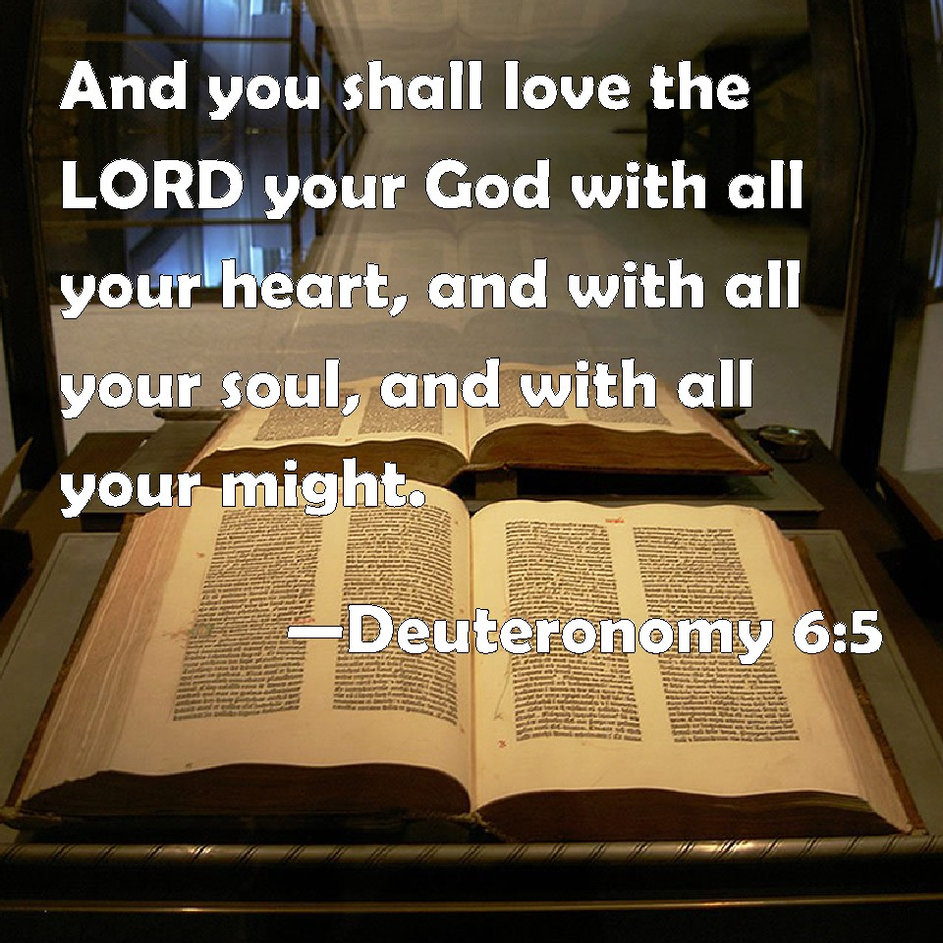

Slide 26
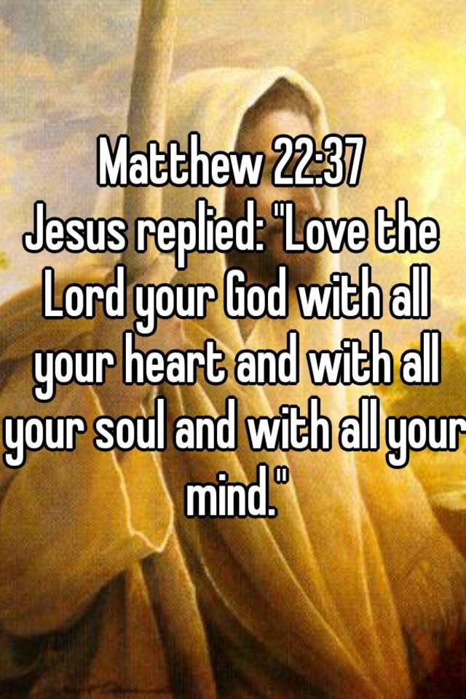

Slide 27
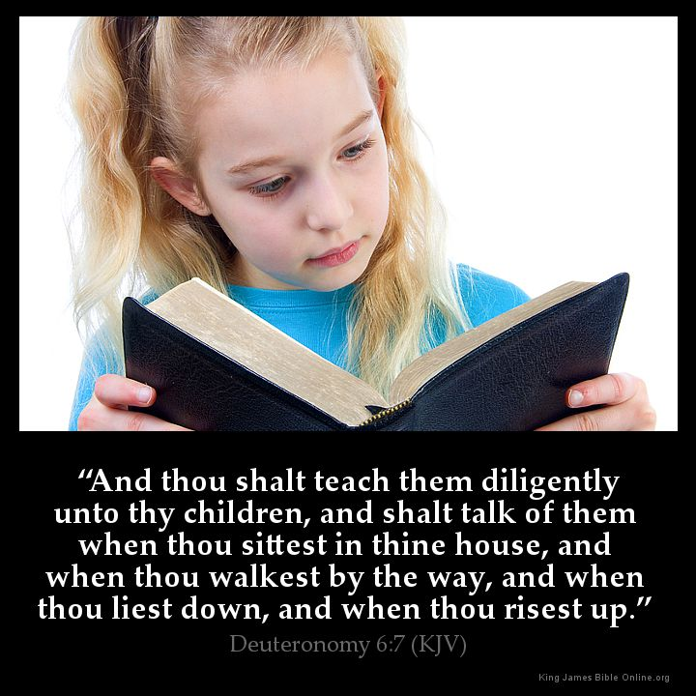

Slide 28
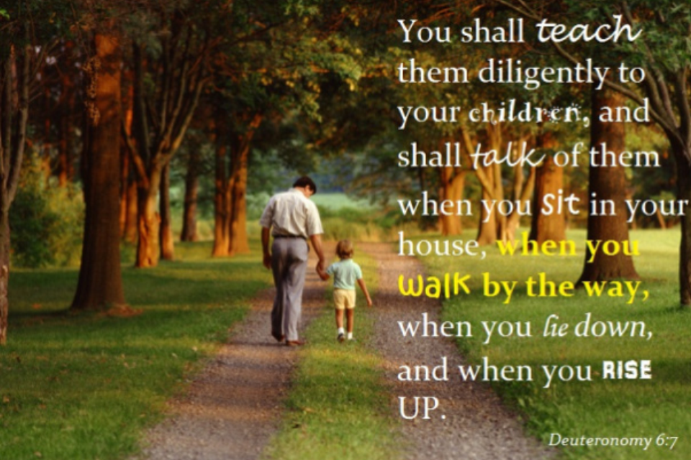

Slide 29
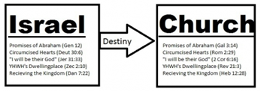

Slide 30
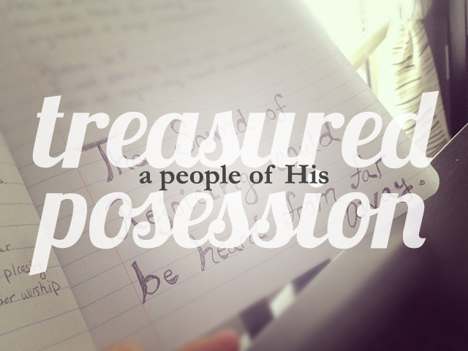

Slide 31
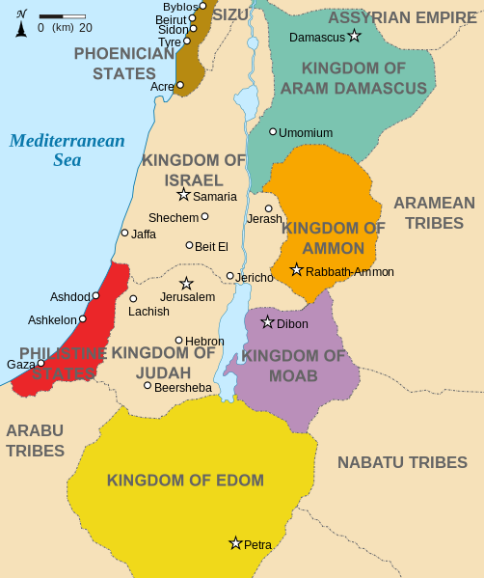

Slide 32
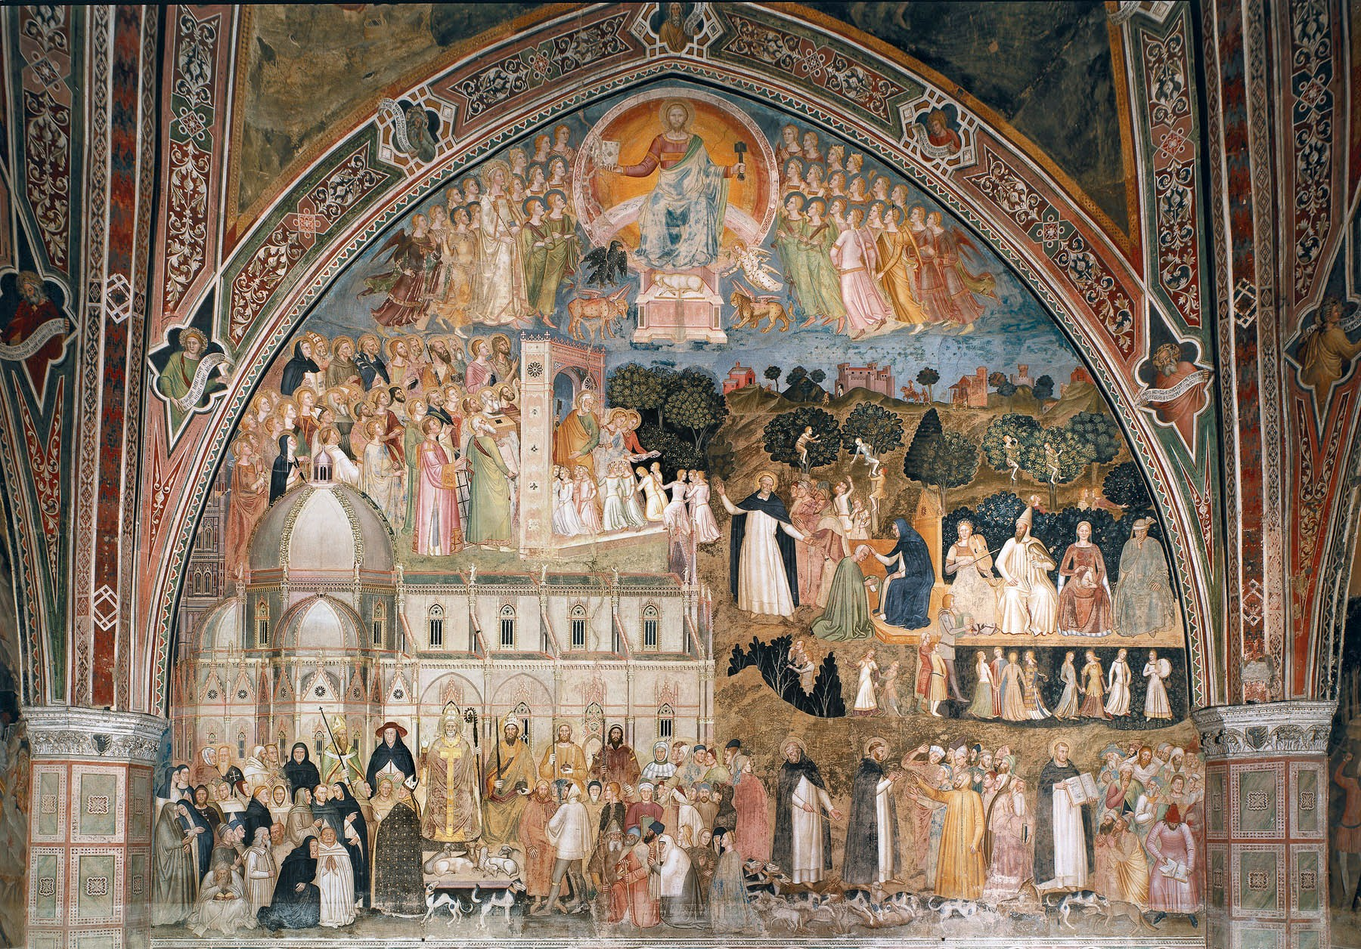

Slide 33
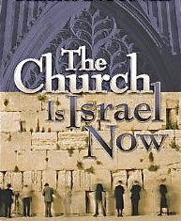

Slide 34
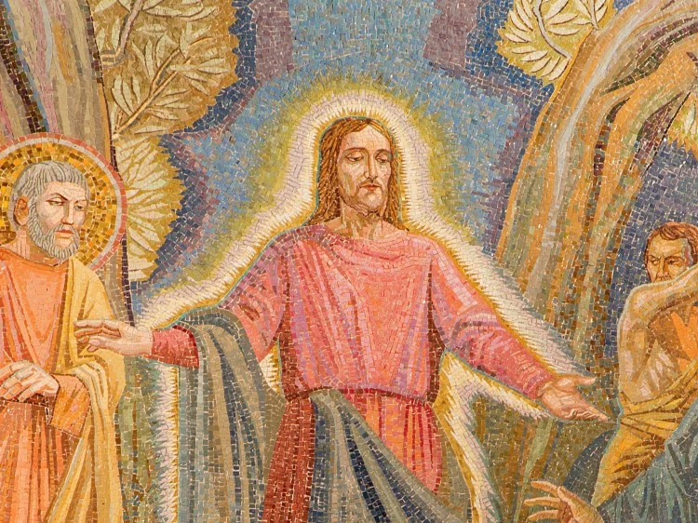

Slide 35
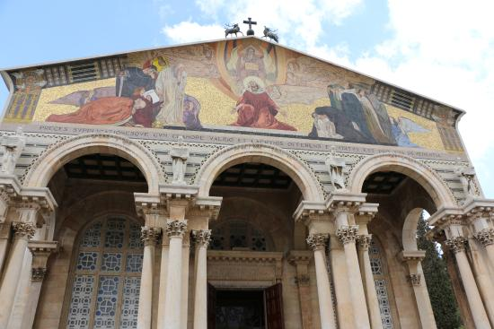

Slide 36
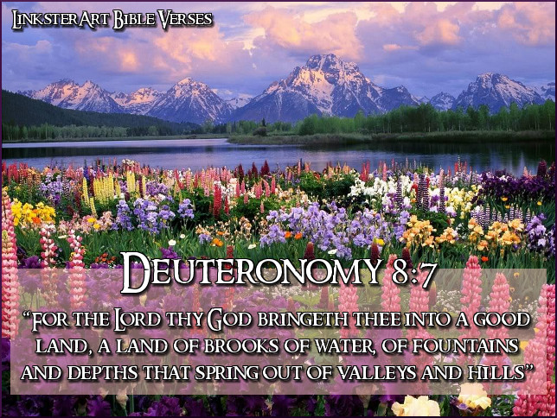

Slide 37
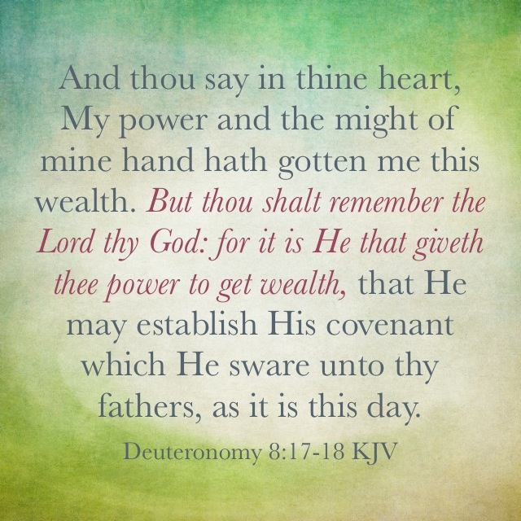

Slide 38
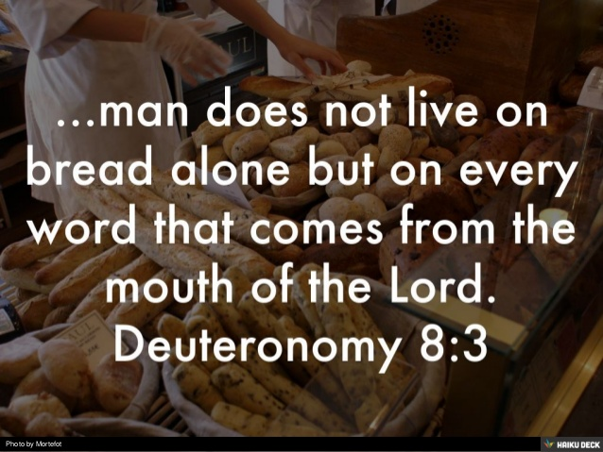

Slide 39
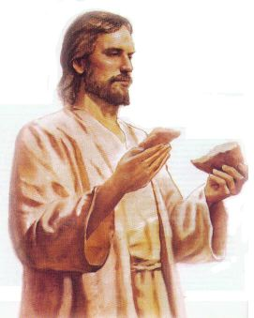

Slide 40
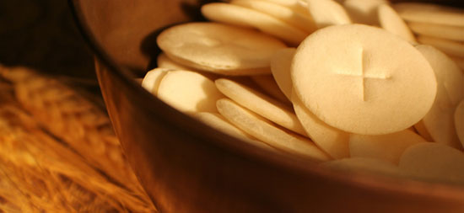

Slide 41
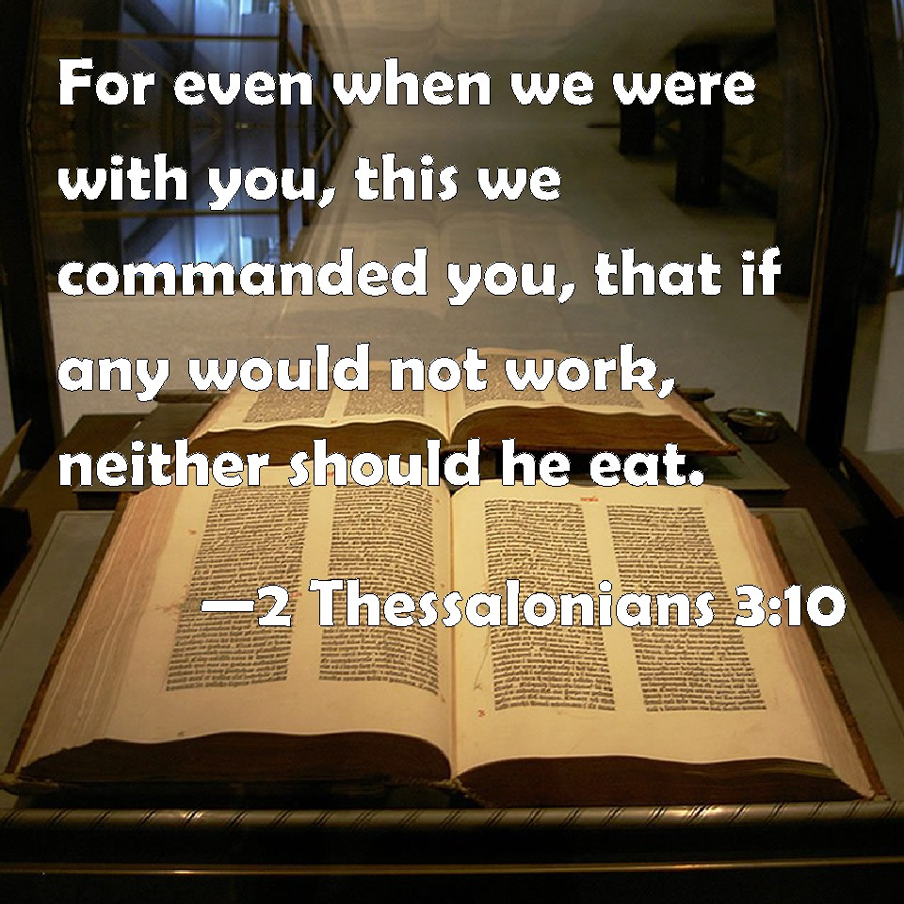

Slide 42
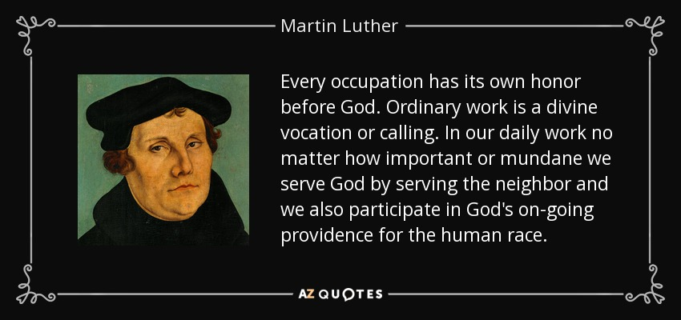

Slide 43


Slide 44
Date: 12-11-16 Study: #9 Text: Chapter 9
(1) "Hear, O Israel: you are to cross over the Jordan today, to go in to dispossess nations greater and mightier than yourselves, cities great and fortified up to heaven, (2) a people great and tall, the sons of the Anakim, whom you know, and of whom you have heard it said, 'Who can stand before the sons of Anak?' (3) Know therefore today that he who goes over before you as a consuming fire is the Lord your God. He will destroy them and subdue them before you. So you shall drive them out and make them perish quickly, as the Lord has promised you.

Slide 45
(4) "Do not say in your heart, after the Lord your God has thrust them out before you, 'It is because of my righteousness that the Lord has brought me in to possess this land,' whereas it is because of the wickedness of these nations that the Lord is driving them out before you. (5) Not because of your righteousness or the uprightness of your heart are you going in to possess their land, but because of the wickedness of these nations the Lord your God is driving them out from before you, and that he may confirm the word that the Lord swore to your fathers, to Abraham, to Isaac, and to Jacob.
(6) "Know, therefore, that the Lord your God is not giving you this good land to possess because of your righteousness, for you are a stubborn people. (7) Remember and do not forget how you provoked the Lord your God to wrath in the wilderness. From the day you came out of the land of Egypt until you came to this place, you have been rebellious against the Lord. (8) Even at Horeb you provoked the Lord to wrath, and the Lord was so angry with you that he was ready to destroy you. (9) When I went up the mountain to receive the tablets of stone, the tablets of the covenant that the Lord made with you, I remained on the mountain forty days and forty nights. I neither ate bread nor drank water.

Slide 46
(10) And the Lord gave me the two tablets of stone written with the finger of God, and on them were all the words that the Lord had spoken with you on the mountain out of the midst of the fire on the day of the assembly. (11) And at the end of forty days and forty nights the Lord gave me the two tablets of stone, the tablets of the covenant.
(12) Then the Lord said to me, 'Arise, go down quickly from here, for your people whom you have brought from Egypt have acted corruptly. They have turned aside quickly out of the way that I commanded them; they have made themselves a metal image.' (13) "Furthermore, the Lord said to me, 'I have seen this people, and behold, it is a stubborn people. (14) Let me alone, that I may destroy them and blot out their name from under heaven. And I will make of you a nation mightier and greater than they.'
(15) So I turned and came down from the mountain, and the mountain was burning with fire. And the two tablets of the covenant were in my two hands. (16) And I looked, and behold, you had sinned against the Lord your God. You had made yourselves a golden calf. You had turned aside quickly from the way that the Lord had commanded you.

Slide 47
(17) So I took hold of the two tablets and threw them out of my two hands and broke them before your eyes. (18) Then I lay prostrate before the Lord as before, forty days and forty nights. I neither ate bread nor drank water, because of all the sin that you had committed, in doing what was evil in the sight of the Lord to provoke him to anger. (19) For I was afraid of the anger and hot displeasure that the Lord bore against you, so that he was ready to destroy you. But the Lord listened to me that time also. (20) And the Lord was so angry with Aaron that he was ready to destroy him. And I prayed for Aaron also at the same time. (21) Then I took the sinful thing, the calf that you had made, and burned it with fire and crushed it, grinding it very small, until it was as fine as dust. And I threw the dust of it into the brook that ran down from the mountain.

Slide 48
(22) "At Taberah also, and at Massah and at Kibroth-hattaavah you provoked the Lord to wrath. (23) And when the Lord sent you from Kadesh-barnea, saying, 'Go up and take possession of the land that I have given you,' then you rebelled against the commandment of the Lord your God and did not believe him or obey his voice. (24) You have been rebellious against the Lord from the day that I knew you.
(25) "So I lay prostrate before the Lord for these forty days and forty nights, because the Lord had said he would destroy you. (26) And I prayed to the Lord, 'O Lord GOD, destroy not your people and your heritage, whom you have redeemed through your greatness, whom you have brought out of Egypt with a mighty hand. (27) Remember your servants, Abraham, Isaac, and Jacob. Do not regard the stubbornness of this people, or their wickedness or their sin, (28) lest the land from which you brought us say, "Because the Lord was not able to bring them into the land that he promised them, and because he hated them, he has brought them out to put them to death in the wilderness." (29) For they are your people and your heritage, whom you brought out by your great power and by your outstretched arm.'

Slide 49
Study Notes:
1. The wickedness of the nations is why God will drive them out (Gen 15:16)
It was only because of God’s grace, not because of their righteousness, that God would go before
them to destroy their enemies
(Eph 2:5; Titus 3:5)
2. Israel is a stubborn people (Ex 32:9)
3. The tablets of stone with the 10 Commandments written with the finger of God
(Ex 8:19; 20:1; 31:18; 34:28)

Slide 50
4. The corruption of the people while Moses was up on the mountain (Ex 31:18 – 32:20)
5. Moses was their intercessor who lay prostrate for 40 days. He was a type of Christ who is our Intercessor.
(1 Sam 7:5-9; Jer 15:1; Mt 4:2; Lk 4:1,2; John ch. 17)
6. They made the Lord angry at other times as well (v. 22) (Ex 17:7; Aaron- Ex 32:21; Nu 11:3,34)

Slide 51
7. To overlook their sin was an act of grace and mercy
(v. 27) (Ac 17:30)
8. God is a devouring fire
(v. 3) (Ex 19:16; Lev 10:2;
Mt 3:10-12; 13:40-42; 25:41; Lk 12:49; Jn 15:6;
1 Cor 3:13-15; 2 Th 1:7,8;
Heb 10:27; 12:21,29;
1 Pet 1:7; 2 Pet 3:7-12; Jude 1:23;
Rev 8:5-8; 19:20; 20:14,15; 21:8)

Slide 52
Life Application:
1. The fire of God’s wrath is poured out against all unbelief and wickedness.
This is pure Law.
Why must it still be proclaimed to modern man?
2. “O Lord GOD, destroy not your people and your heritage, whom you have redeemed through your greatness.”
We are redeemed by the blood of the Lamb of God,
Jesus Christ.
This is pure Gospel.
Why must this also still be proclaimed to modern man?

Slide 53
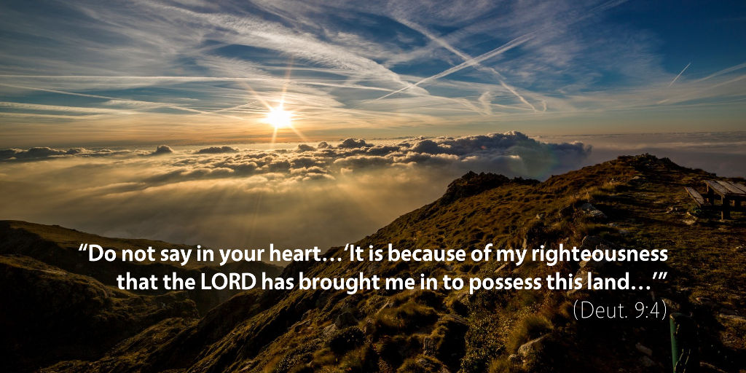

Slide 54
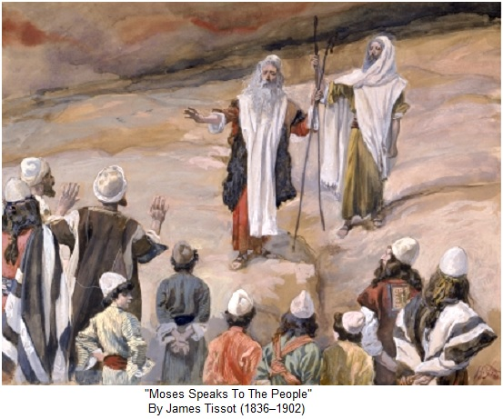

Slide 55
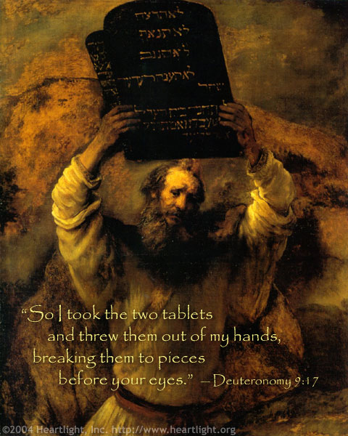

Slide 56
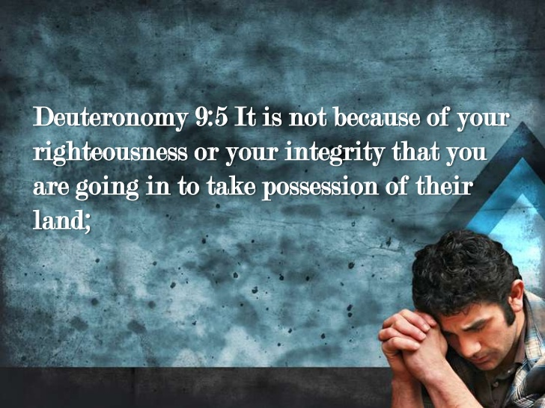

Slide 57
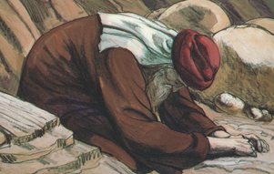

Slide 58
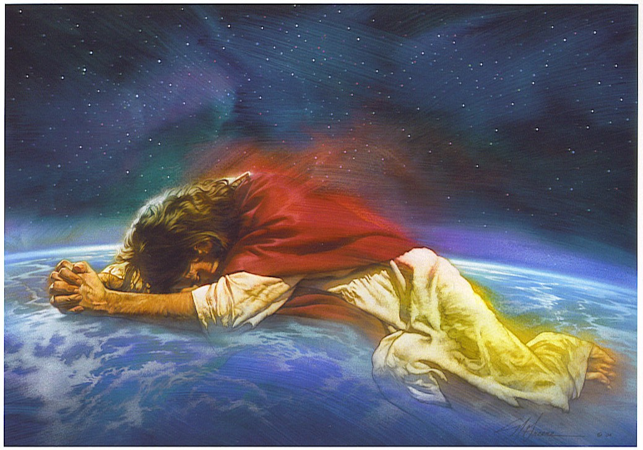

Slide 59
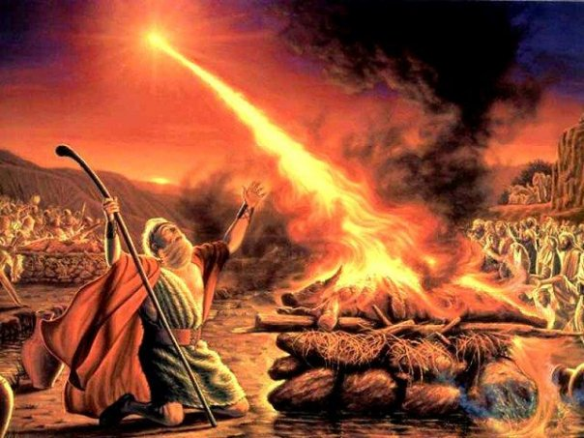

Slide 60
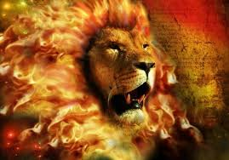

Slide 61
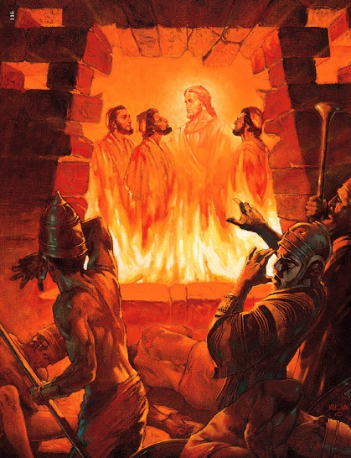

Slide 62


Slide 63


