Slide 1
Trinity Lutheran Church Norman, Oklahoma – www.tlcnorman.org The Book of Galatians Theme: “The True Gospel You Have Received” Date: 5-8-22 Lesson: 10 - Chapter 2:3-6

Slide 3
TEXT AND STUDY
(3) But even Titus, who was with me, was not forced to be circumcised, though he was a Greek. (4) Yet because of false brothers secretly brought in--who slipped in to spy out our freedom that we have in Christ Jesus, so that they might bring us into slavery-- (5) to them we did not yield in submission even for a moment, so that the truth of the gospel might be preserved for you. (6) And from those who seemed to be influential (what they were makes no difference to me; God shows no partiality) --those, I say, who seemed influential added nothing to me.
(Lev 19:15; Dt 10:17; 16:19; 1 Sam 16:7; 2 Sam 10:3; 1 Chr 19:3,7; Lk 20:21; Ac 1:16; 5:36; 10:34,35; 11:2-18; 15:1-5,24; 16:3;
Rom 6:18-22; 8:2,15; 1 Cor 3:7; 9:24; 15:11;
2 Cor 2:13; 11:5,20, 26; 12:11;
Jas 2:1; 2 Pet 2:1; Jude 1:4; Rev 2:23)

Slide 4
Luther’s Commentary. Vol. 26
“God shows no partiality”.
“Paul cites this passage from Moses, who says this very thing, not once but many times: “You shall do no injustice in judgment; you shall not be partial to the poor or defer to the great” (Lev. 19:15). And this is a γνώμη or principle of theology: “God shows no partiality.” With this statement he silences the false teachers. It is as though he were saying: “You pit against me those who are reputed to be something, but God does not care about such things. He is not swayed by the office of an apostle, a bishop, or a prince. He does not look at the honor or the authority of men.” …
Thus you will find throughout the Scriptures that God often rejected the very men who, according to external appearances, were the best and the saintliest…we have the innate fault that we show great respect for the position of men and pay more attention to it than to the Word. God, however, wants us to cling and be attached only to the Word itself…
It is not given to the secular and unregenerate man to see this, but only to the spiritual man. He alone can distinguish the position from the Word, the divine mask from God Himself and the work of God. Until now we have dealt only with the veiled God, for in this life we cannot deal with God face to face. Now the whole creation is a face or mask of God. But here we need the wisdom that distinguishes God from His mask. The world does not have this wisdom. Therefore it cannot distinguish God from His mask…

Slide 5
I am saying this to keep anyone from supposing that Paul simply condemns these external masks or social positions. He does not say that there should not be such social position, but that God shows no partiality to certain positions. There must be masks or social positions; for God has given them, and they are His creatures. The point is that we are not to worship and adore them…
Thus the magistrate, the emperor, the king, the prince, the consul, the teacher, the preacher, the pupil, the father, the mother, the children, the master, the servant—all these are social positions or external masks. God wants us to respect and acknowledge them as His creatures, which are a necessity for this life. But He does not want us to attribute divinity to them, that is, to fear and respect them in such a way that we trust them and forget Him…
These and similar examples, with which Scripture is filled, warn us not to put our trust in the social position and not to suppose that when we have the position, we have everything…Thus God has given all His creatures that they may serve us and we may use them, not that we may serve and worship them. Therefore let us make use of bread, wine, clothing, possessions, gold, etc.; but let us not trust or glory in them. For we are to glory and trust in God alone; He alone is to be loved, feared, and honored.

Slide 6
Paul uses the term “position” of a man here to designate apostleship, the office of the apostles, who performed many great miracles, taught and converted many to faith, and knew Christ personally. In other words, this term “position” covers the whole outward conduct of the apostles, which was holy, as well as their authority, which was great. Nevertheless, Paul says, God does not show partiality to these things—not that He has no regard for them at all, but that where justification is involved, He has no regard for them. We must pay careful attention to this distinction, that about theological issues we must speak in a way that is vastly different from the way we speak about social issues.
Where social issues are involved, as I have said, God wants us to honor and respect these “positions” as His masks or instruments through which He preserves and governs the world. But when the issue is one involving religion, conscience, the fear of God, faith, and the worship of God, then we must not fear or trust any social position or look to it for consolation and rescue, either physical or spiritual. This is why God wants no partiality “in judgment,” for judgment is something divine…
Accordingly, there is a strong emphasis on the word “God.” Where religion and the Word of God are the issue, there must be no partiality. But apart from religion, apart from God, there must be προσωπολημψία and partiality; for otherwise confusion would result, and all respect and order would disappear. In this world God wants the observance of order, respect, and a distinction among social positions.

Slide 7
Otherwise the child or the pupil or the subject or the servant would say: “I am just as much a Christian as my father or teacher or prince or master! So why should I respect him?” Therefore God wants the difference of social position to be observed among us—not in the sight of God, where the distinction ceases. There is neither Greek nor Jew, but they are all one in Christ (Gal. 3:28).
… For the issue here is not the distinction among social positions; it is something far more important. It is a divine matter involving God and His Word, the question whether this Word is to have priority over the office of an apostle or vice versa. To this question Paul answers: “To preserve the truth of the Gospel and to keep the Word of God and the righteousness of faith pure and undefiled, let apostleship go! An angel from heaven or Peter or Paul—let them all perish!”

Slide 8
LIFE APPLICATION
God shows no partiality in spiritual matters,
but there are differences between social estates in the life of mankind on earth.
Explain this distinction.
What does Luther mean when he talks about “the masks of God?”

Slide 10
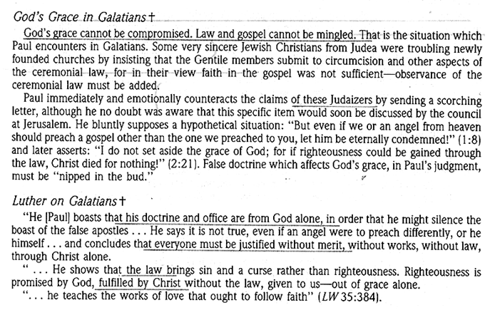

Slide 11
