Slide 1
Trinity Lutheran Church Norman, Oklahoma – www.tlcnorman.org The Book of Galatians Theme: “The True Gospel You Have Received” Date: 2-27-22 Lesson: 1 - Chapter 1:1-5

Slide 3
TEXT AND STUDY (1) Paul, an apostle--not from men nor through man, but through Jesus Christ and God the Father, who raised him from the dead— (Acts 1:22; 2:24, 32; 9:1,15; 17:18; 20:24; Rom 1:4; 1 Cor 1:1; 15:8,20; Php 3:4-14; 1 Pet 1:3) (2) and all the brothers who are with me, To the churches of Galatia: (Acts 13:14 – 14:23; 16:6; Php 4:20,21; 2 Tim 4:10; 1 Pet 1:1)

Slide 4
(3) Grace to you and peace from God our Father and the Lord Jesus Christ,
(John 14:27; 20:19; Rom 1:7; Eph 1:2)
(4) who gave himself for our sins to deliver us from the present evil age, according to the will of our God and Father,
(Mt 1:21; 20:28; Jn 1:29; 1 Cor 1:20; 15:3; 2 Cor 4:4; Eph 2:2; 6:12; 1 Pet 2:24)
(5) to whom be the glory forever and ever. Amen.
(Rom 9:5; 11:36; 16:27; Eph 3:21; 1 Tim 1:17)

Slide 5
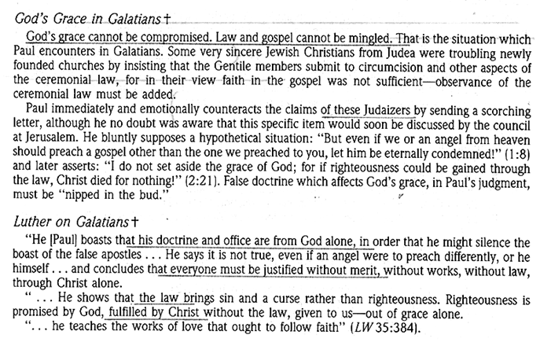

Slide 6
